Slide 1
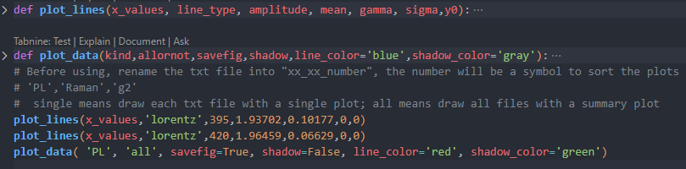
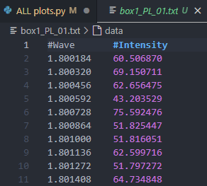
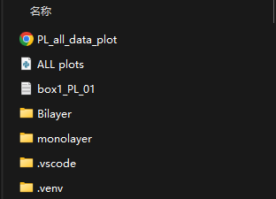
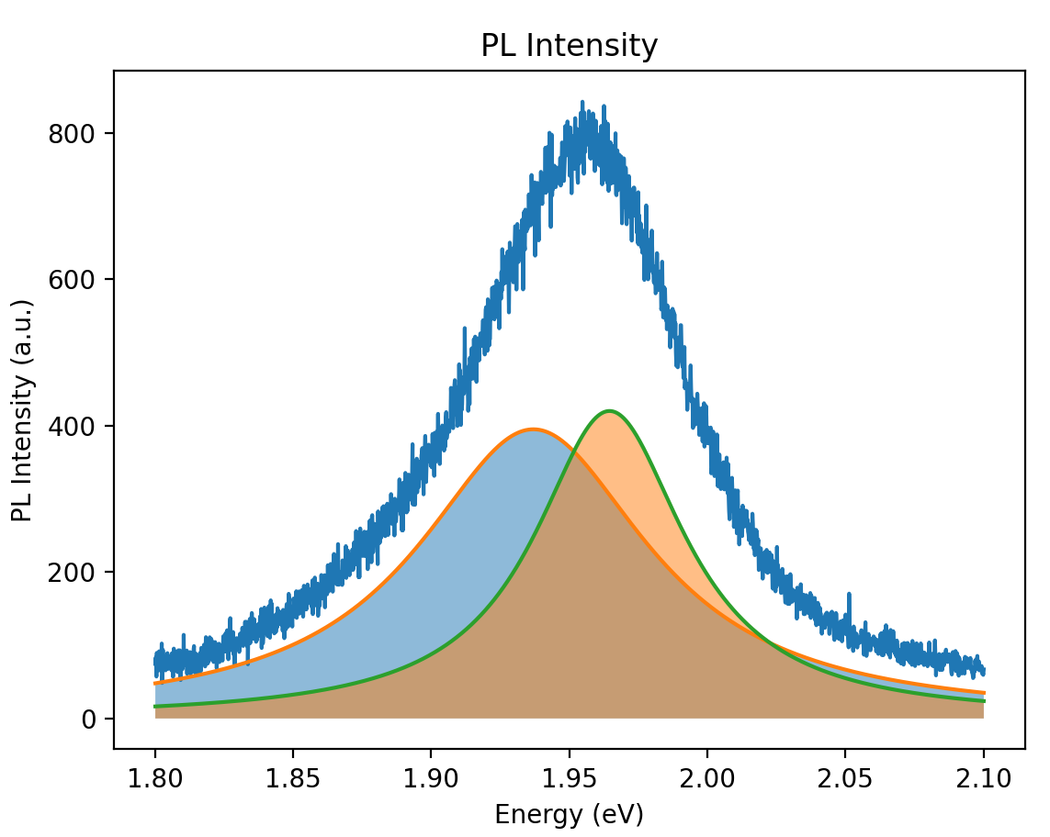
Easy to plot
Rename, Choose and Plot

Slide 2
Monolayer WSe2

Slide 3
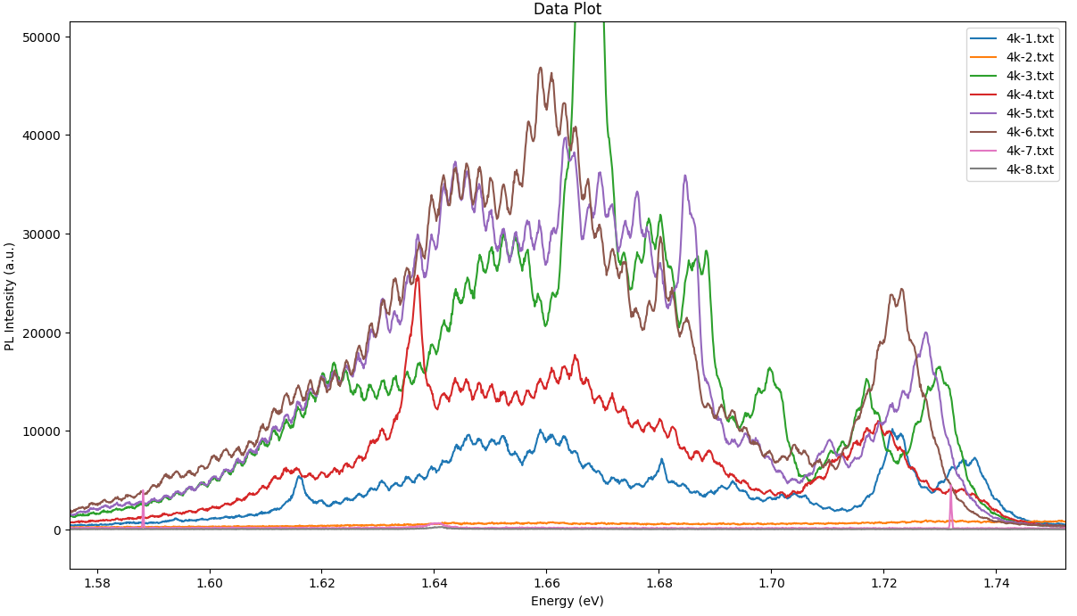
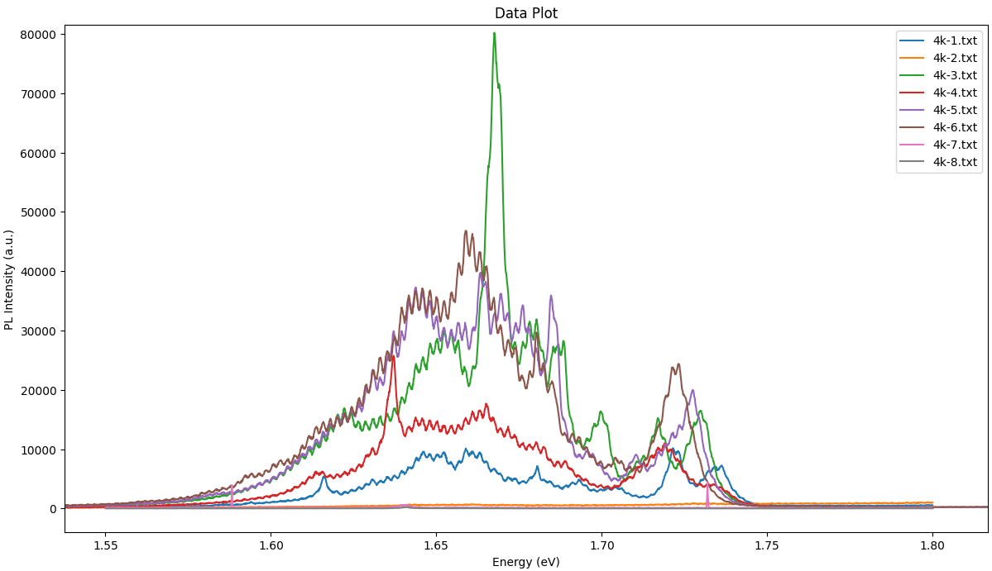
WSe2 Monolayer PL

Slide 4
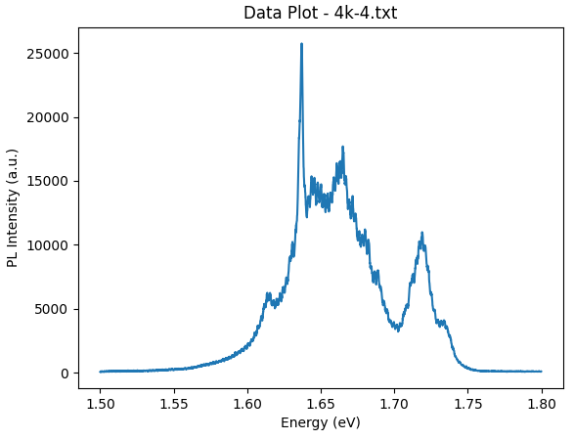
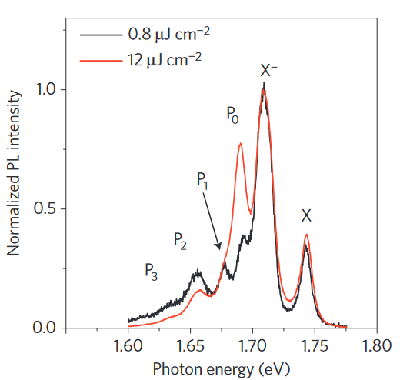
1.7-1.75eV peaks: radiative recombination of neutral excitons (1.73)/negative trions (1.71)
1.65-1.70eV peaks: defect-related localized state transition (1.66) biexciton emission (1.68)
1.63eV main peak: defect-related localized state transition
1.61eV peak: recombination of A exciton (lowest-energy exciton transition)
DOI: 10.1038/NPHYS3324 DOI: 10.1038/srep22414
Notes:
photo-excited electron-hole pairs are trapped in potential wells(created by lattice defects or residual impurities)
localized states may form within the bandgap with an emission energy below the exciton and trion emission energies

Slide 5
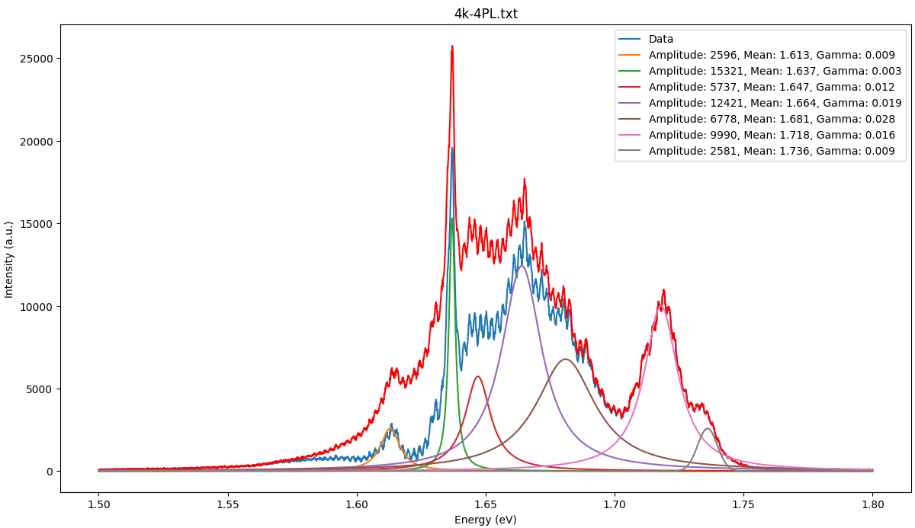

Slide 6
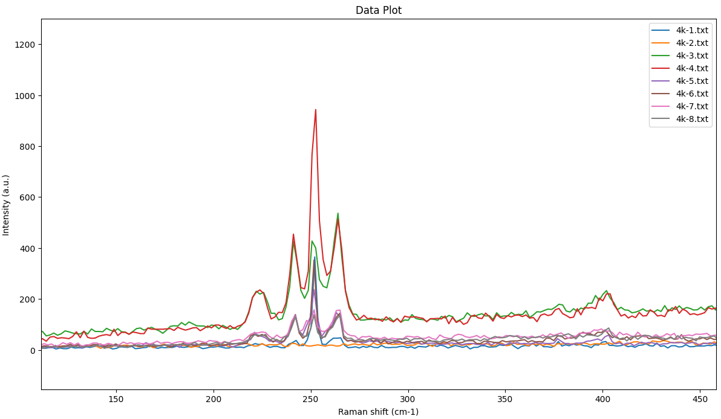
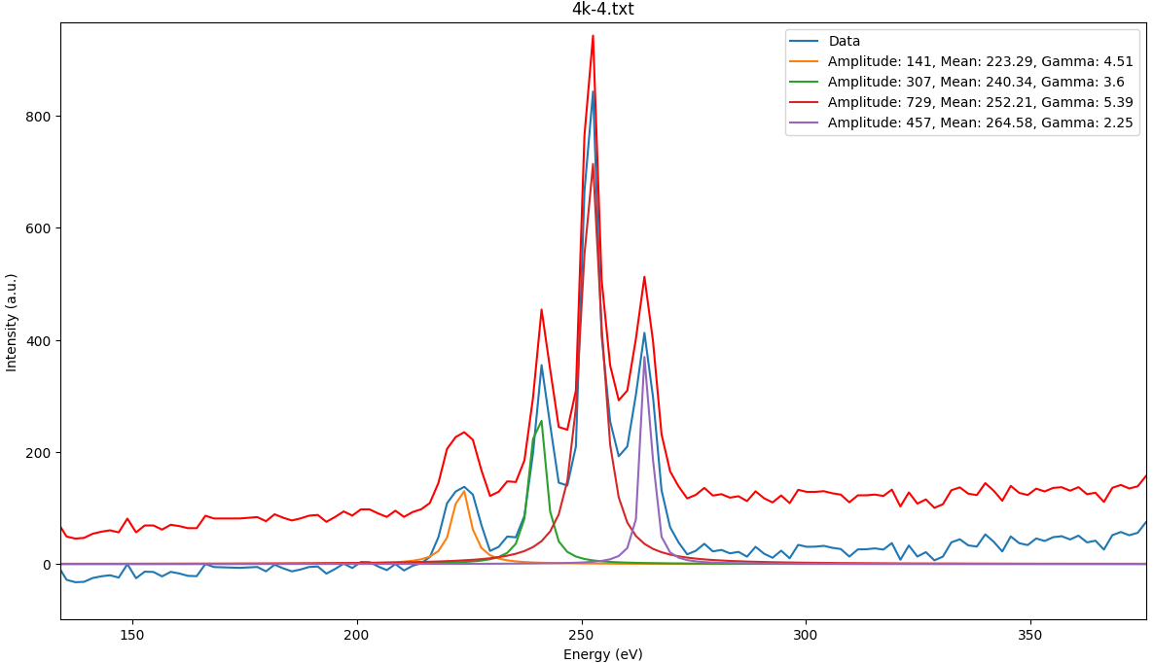
Monolayer Raman
223.3${cm}^{−1}$:${ E}^{′−}$ 240.3${cm}^{−1}$: $A^{′}$ 252.2${cm}^{−1}$:${ E}^{′+}$ 264.6${cm}^{−1}$: 2LA
Notes:
A′ is an out-of-plane phonon mode in which the top and bottom chalcogen atoms vibrate in opposing directions,
while E′ is in-plane mode where the metal atoms vibrate out-of-phase with the chalcogen atoms.
The 2LA mode results from a double resonance process involving two phonons from the LA branch.
The displacement eigenvector of the E′+ mode is 正交 to the direction of strain, while it is parallel for the E′−mode

Slide 7
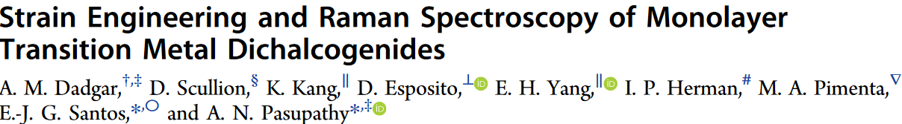
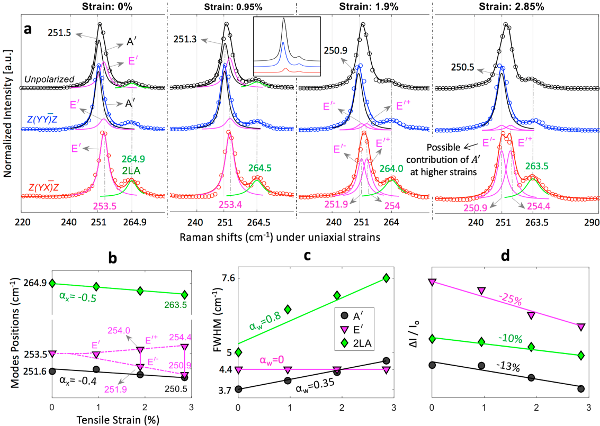
Chem. Mater. 2018, 30, 5148−5155

Slide 8
Re-doped WS2

Slide 9
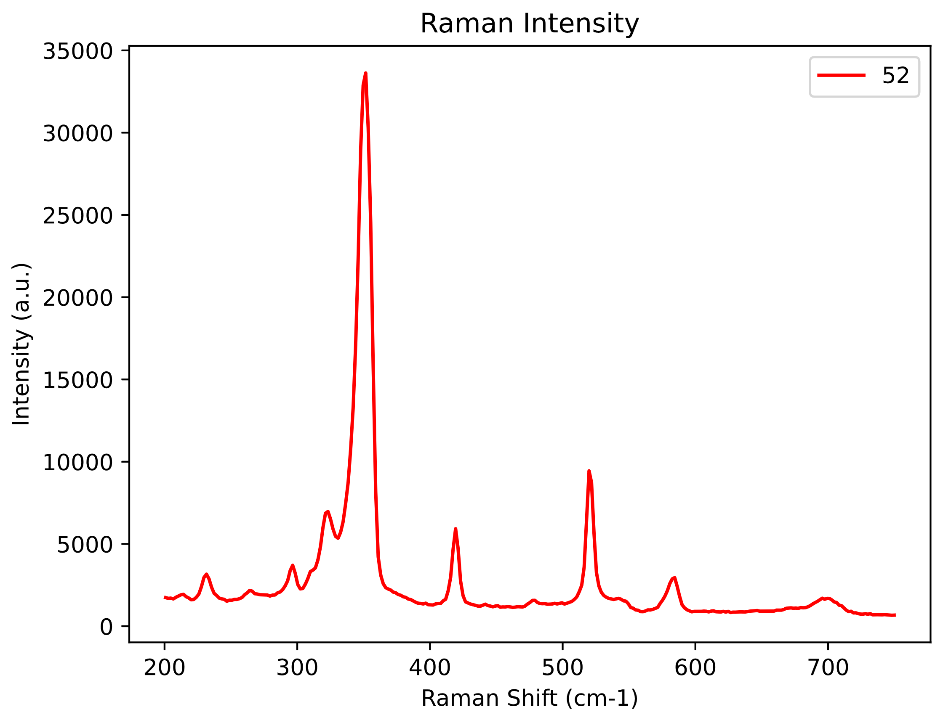
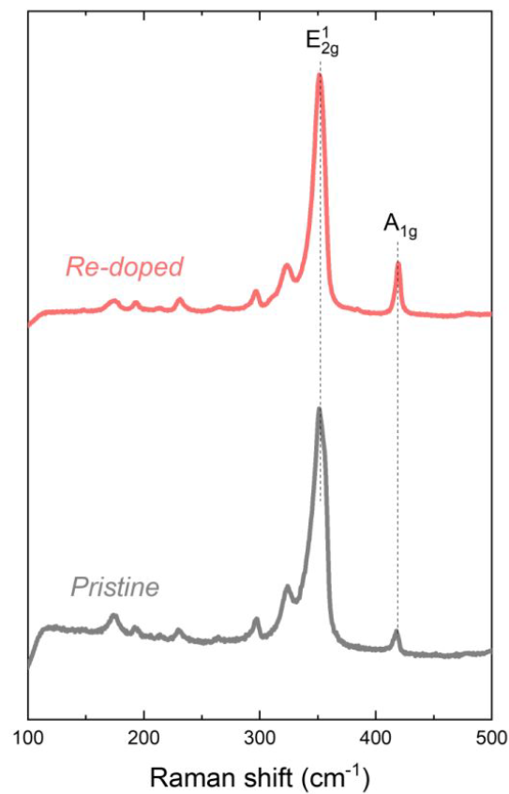
Re-WS2 Raman
Nano Lett. 2021, 21, 5293−5300

Slide 10
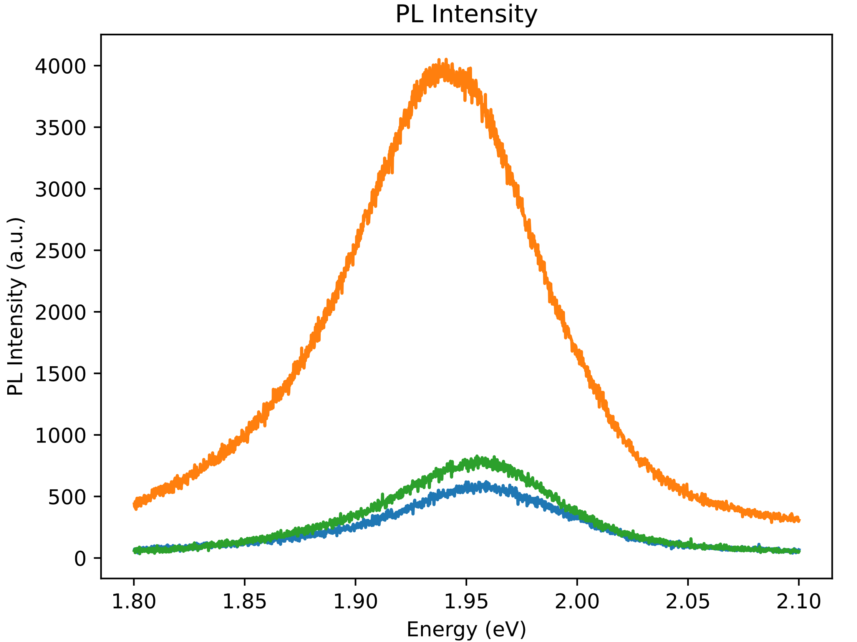
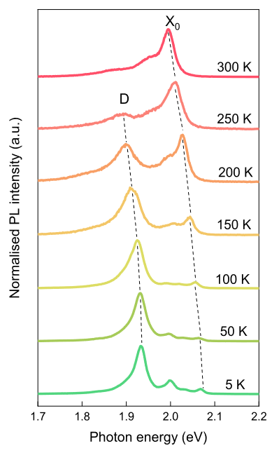
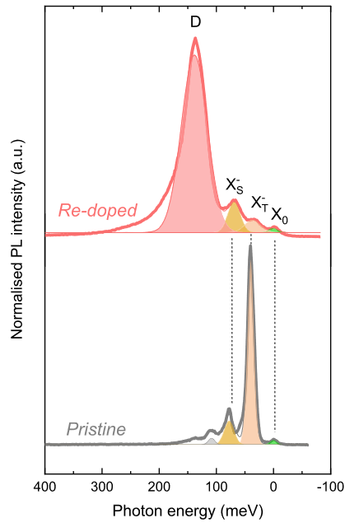
Re-WS2 PL (RT)
Notes:
Many MoS2/ Our is RT, they are 77K

Slide 11
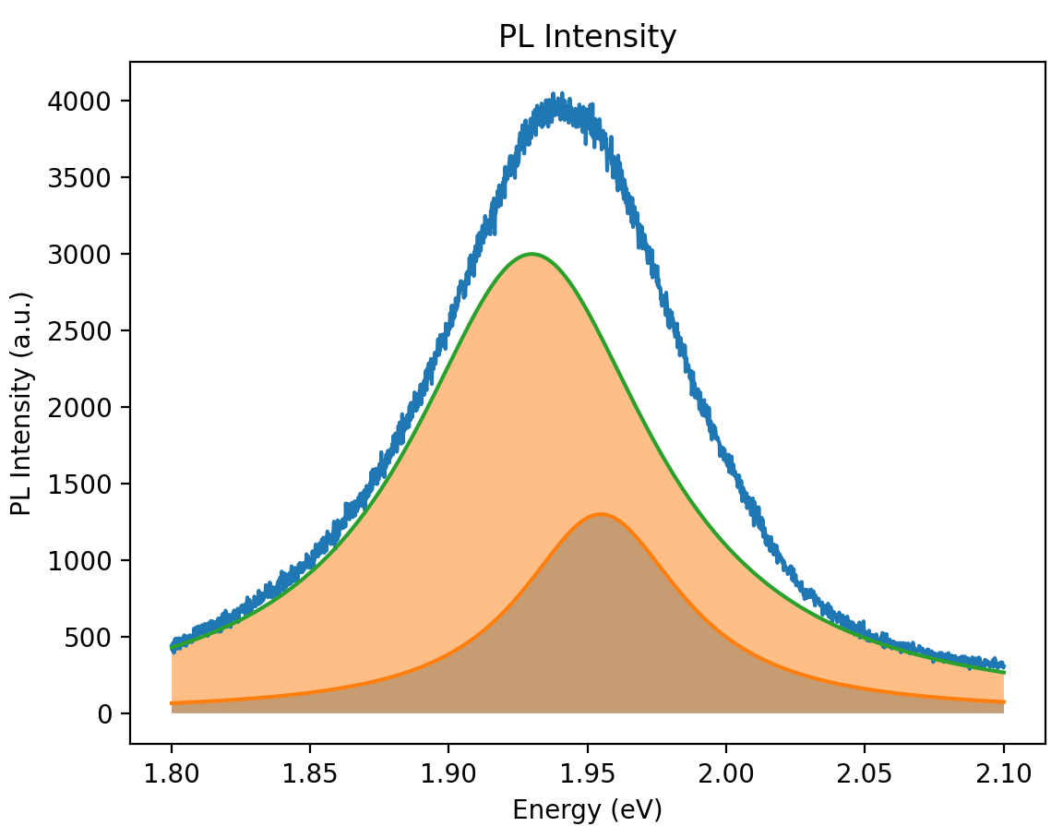
Re-WS2 PL fit (Spot1, Laser power 20mW, 0.5%, RT)
1.930eV: Linewidth: 106meV
1.958eV: Linewidth: 71meV

Slide 12
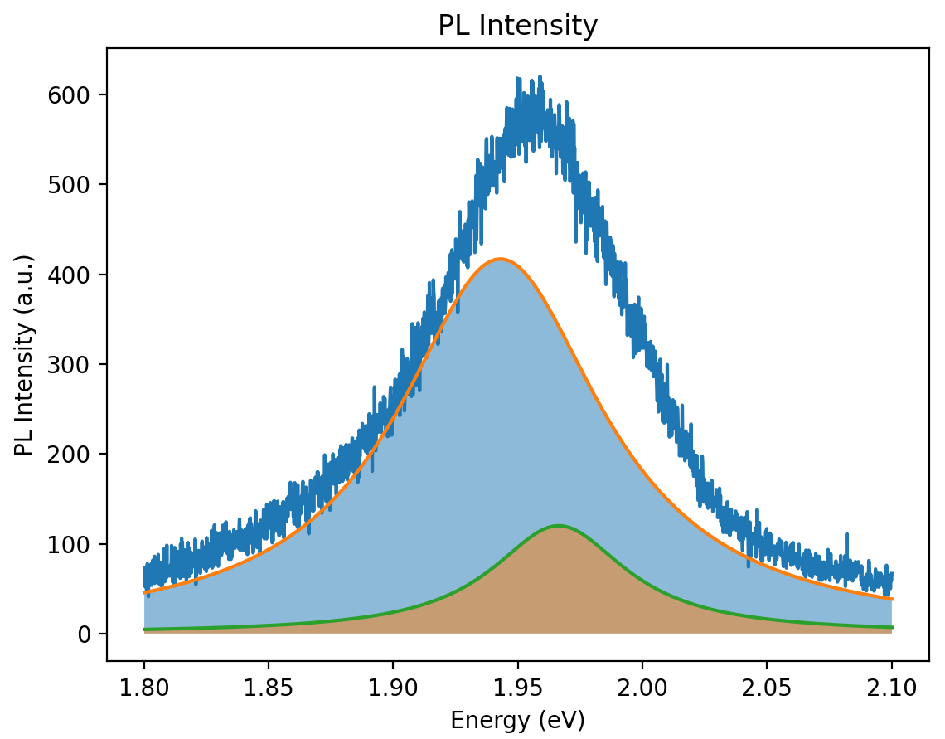
Re-WS2 PL fit (Spot1, Laser power 20mW, 0.1%, RT)
1.943eV: Linewidth: 103meV
1.966eV: Linewidth: 66meV

Slide 13
Re-WS2 PL fit (Spot2, Laser power 20mW, 0.1%, RT)
1.941eV: Linewidth: 102meV
1.965eV: Linewidth: 66meV

Slide 14
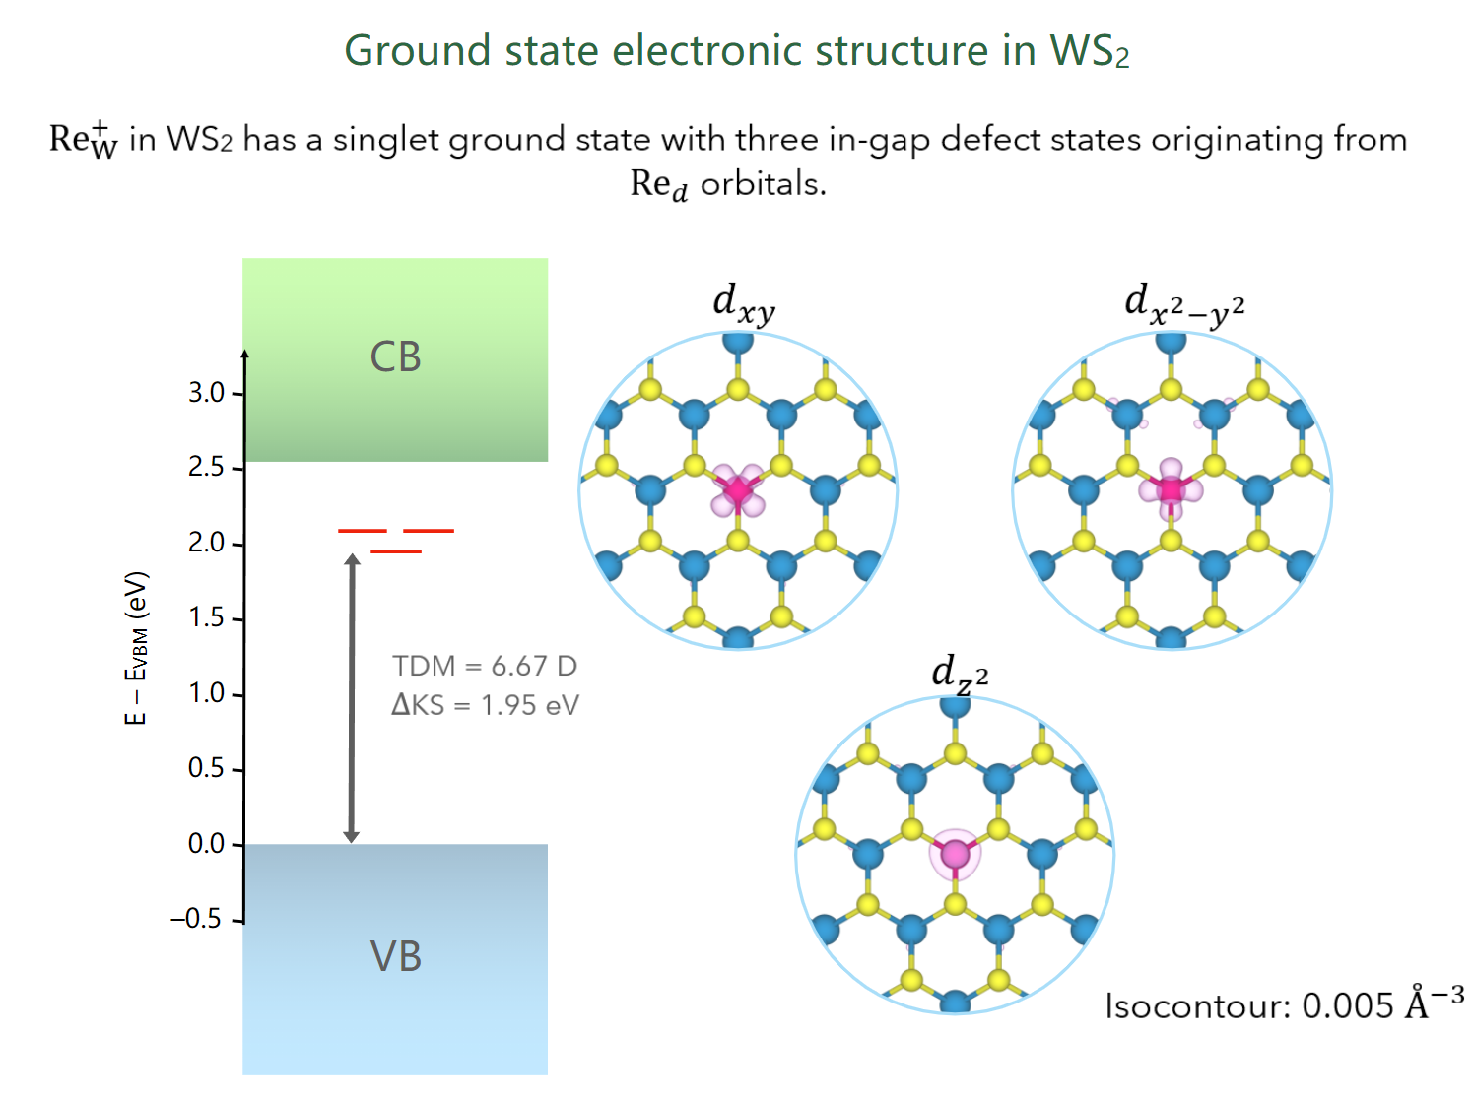
Calculation

Slide 15
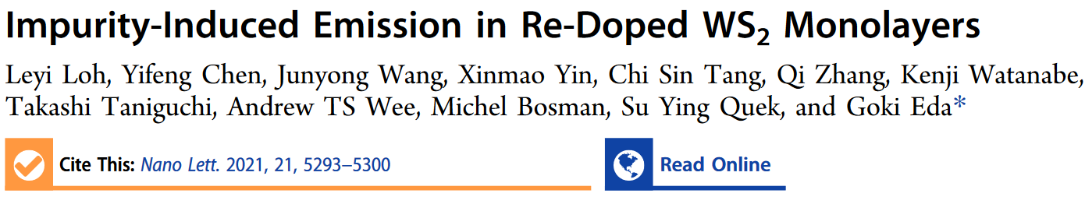
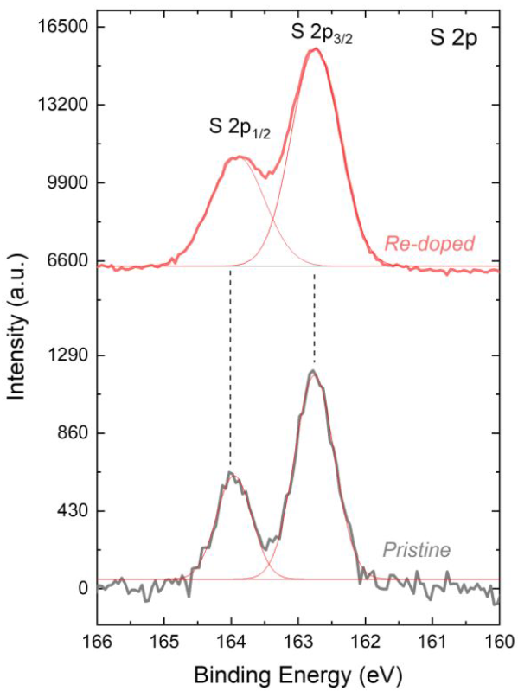
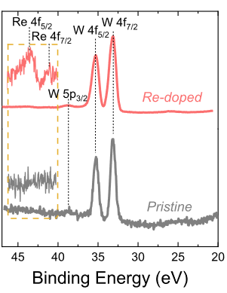
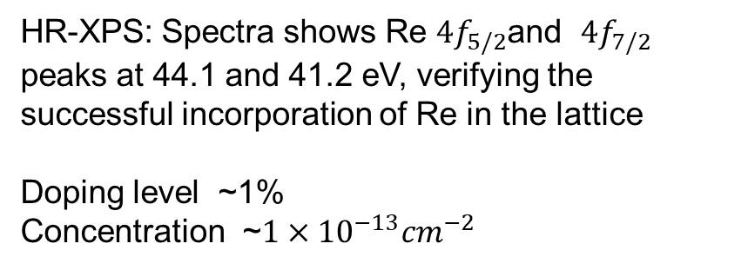
HR-XPS: Spectra shows Re $4f_{5/2}$and $4f_{7/2}$ peaks at 44.1 and 41.2 eV, verifying the successful incorporation of Re in the lattice
Doping level ~1%
Concentration ~${1×10}^{−13}{cm}^{−2}$
Notes:
Re impurities give rise to a strong subgap emission peak that remains dominant below 200 K

Slide 16
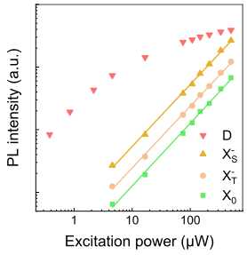
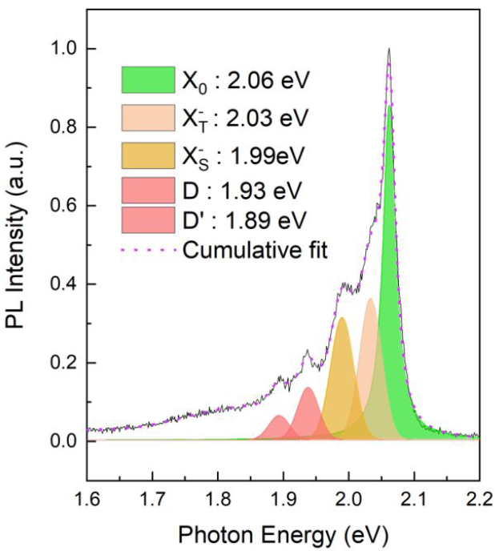
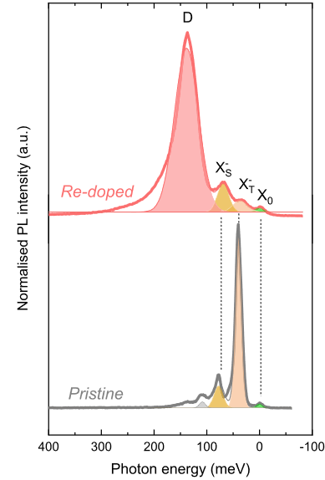
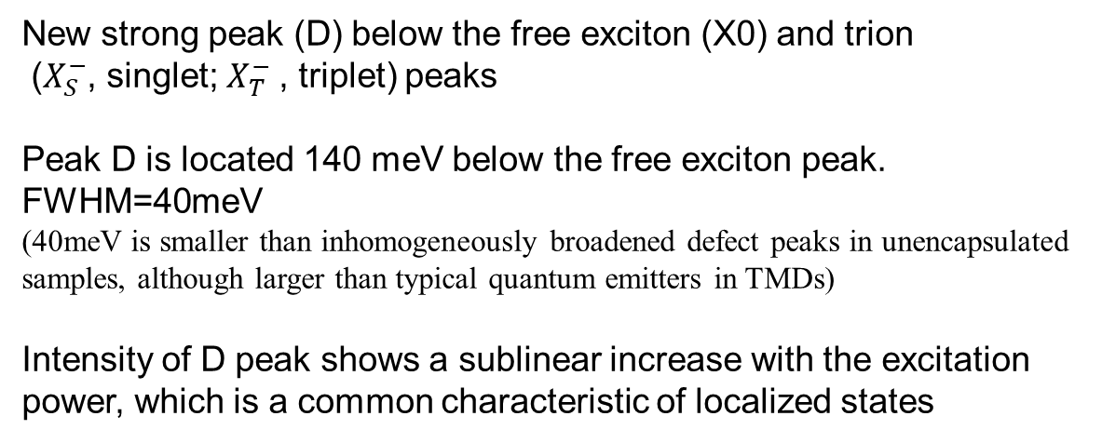
Monolayer PL (4K)
New strong peak (D) below the free exciton (X0) and trion
($X_{S}^{−}$, singlet; $X_{T}^{−}$, triplet) peaks
Peak D is located 140 meV below the free exciton peak.
FWHM=40meV
(40meV is smaller than inhomogeneously broadened defect peaks in unencapsulated samples, although larger than typical quantum emitters in TMDs)
Intensity of D peak shows a sublinear increase with the excitation power, which is a common characteristic of localized states
Notes:
Figure2 shows the Re:WS2 at a lower nominal doping level

Slide 17
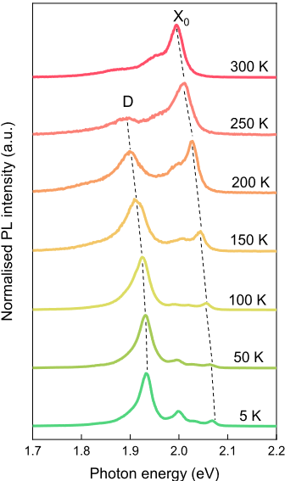
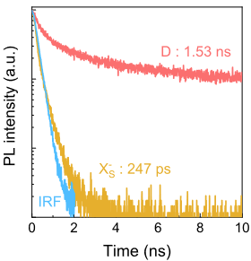
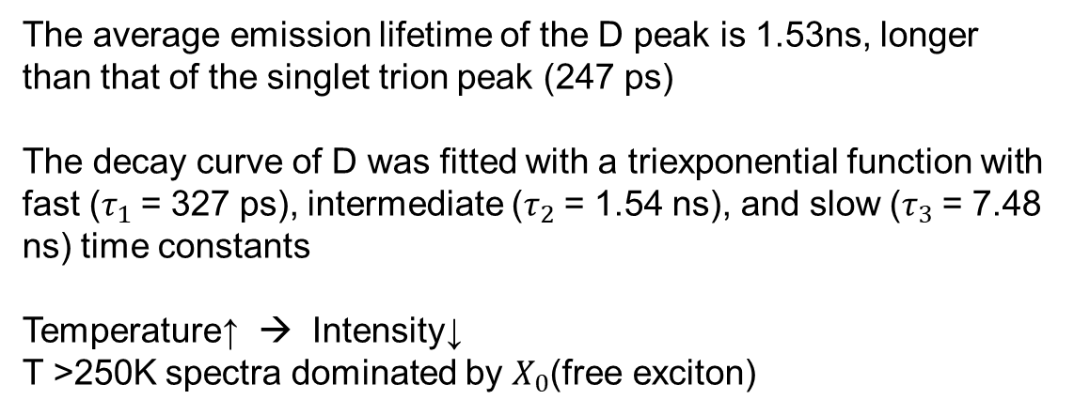
TR-PL & Temperature-dependent
The average emission lifetime of the D peak is 1.53ns, longer than that of the singlet trion peak (247 ps)
The decay curve of D was fitted with a triexponential function with fast ($τ_{1}$= 327 ps), intermediate ($τ_{2}$= 1.54 ns), and slow ($τ_{3}$= 7.48 ns) time constants
Temperature↑ → Intensity↓
T >250K spectra dominated by $X_{0}$(free exciton)
Notes:
The long lifetime of the D peak is another characteristic of localized state emission, as was previously reported for intrinsic vacancy defects.(TRPL 77K)
Trion is mono fit
Thermal stability of the D emission is relatively high compared to that of previously reported localized emitters,
which are often observable only below ∼150 K

Slide 18
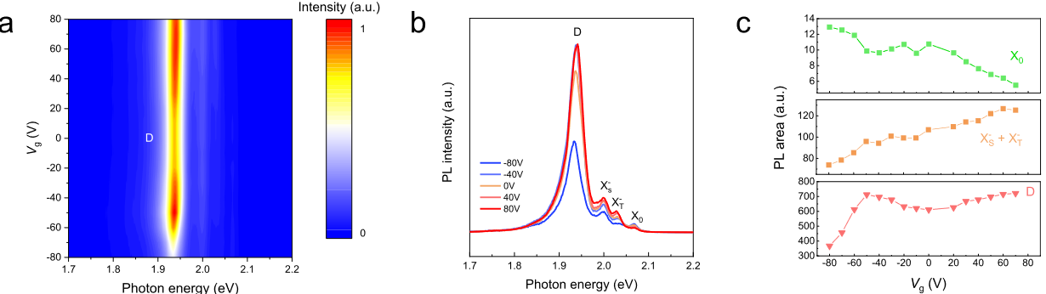
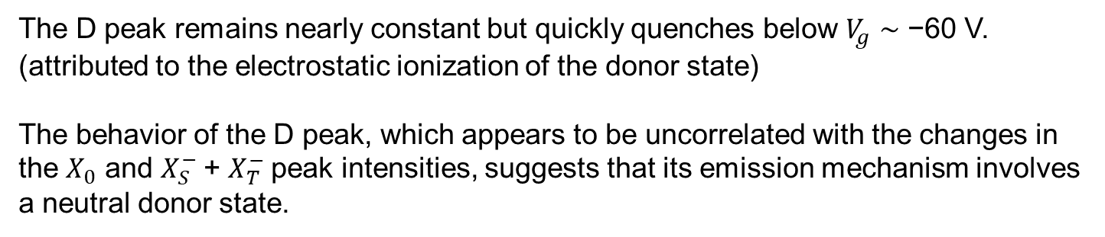
Gate-dependent emission spectrum
The D peak remains nearly constant but quickly quenches below $V_{g}$ ∼ −60 V. (attributed to the electrostatic ionization of the donor state)
The behavior of the D peak, which appears to be uncorrelated with the changes in the $X_{0}$ and $X_{S}^{−}$+ $X_{T}^{−}$peak intensities, suggests that its emission mechanism involves a neutral donor state.
Notes:
Free-exciton and negative trion peaks show an expected gate-dependence, where the former decreases in intensity and the latter increases in intensity with increasing gate bias.

Slide 19
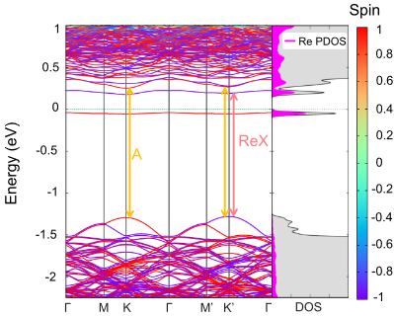
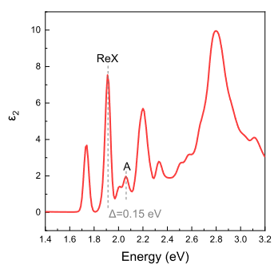
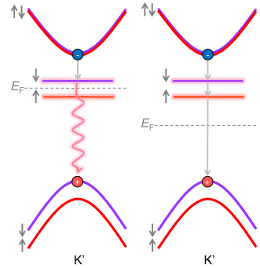
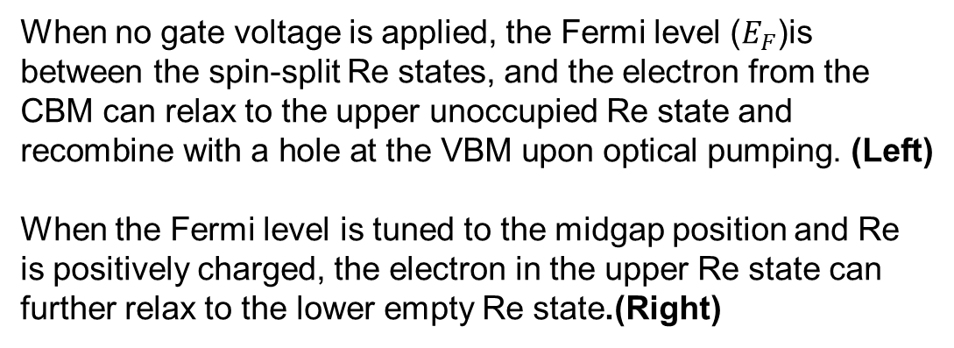
First Principles Calculations
Re defect-related exciton (ReX) peaks ∼0.15 − 0.32 eV below A
These ReX peaks involve transitions from VBM to the unoccupied defect band in the neighborhood of K′, while the A peak stems from transitions at both the K and K′ points
The occupied Re band is located 300 meV below the CBM, indicating a high activation energy for the ionization of the Re donor
When no gate voltage is applied, the Fermi level ($E_{F}$)is between the spin-split Re states, and the electron from the CBM can relax to the upper unoccupied Re state and recombine with a hole at the VBM upon optical pumping. (Left)
When the Fermi level is tuned to the midgap position and Re is positively charged, the electron in the upper Re state can further relax to the lower empty Re state.(Right)
Notes:
One unoccupied spin-down defect band about 100 meV below the conduction band minimum (CBM) and another occupied spin-up defect band right below the Fermi level. The free exciton peak at 2.06 eV
The transition between the lower Re state and the VBM is dipole-forbidden.

Slide 20
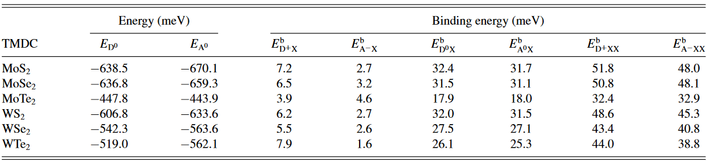
Their unsolved questions
High energy difference(140meV)
Simulations predicted a 30 meV red-shift of such excitons from the A exciton peak due to weak dipole−dipole interactions
Relatively high thermal stability(250K)
An alternative explanation is a transition that involved ionized donor-bound excitons. And these bound excitons should have an explicit gate-voltage dependence for PL intensity, which was not observed in their samples.
PhysRevB.96.075431(2017)
Notes:
Neutral-donor-bound excitons can also be modeled as a localized state consisting of a ground exciton bound to a neutral donor by a dipole−dipole interaction.

Slide 21
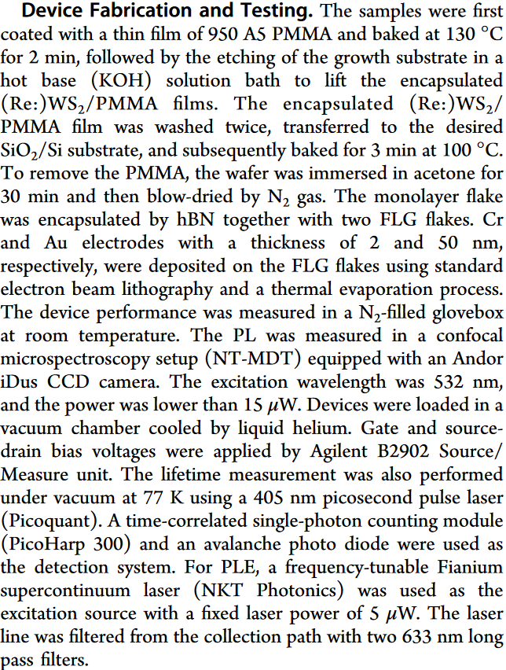
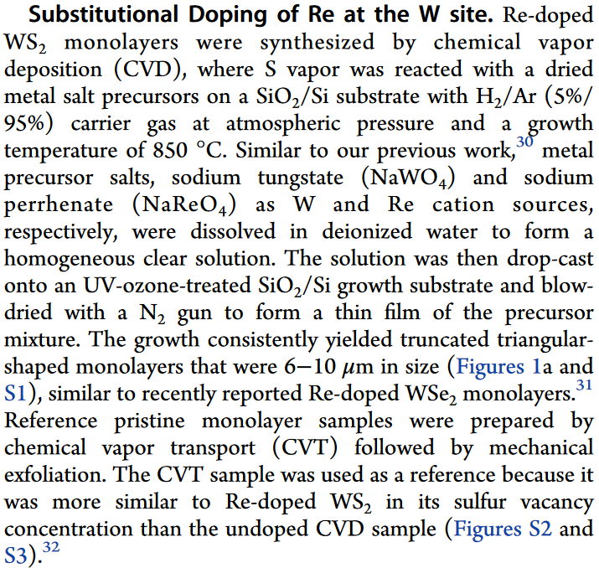
Methods

