Slide 1
Package Diagram
Software Engineering and Design – Gruppe Weiss

Slide 2
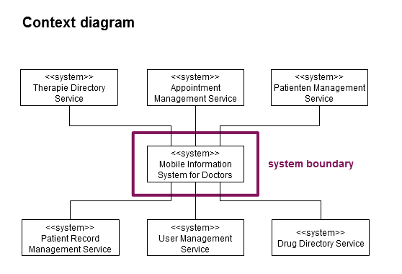
System Environment

Slide 3
Package Diagram

