Slide 1
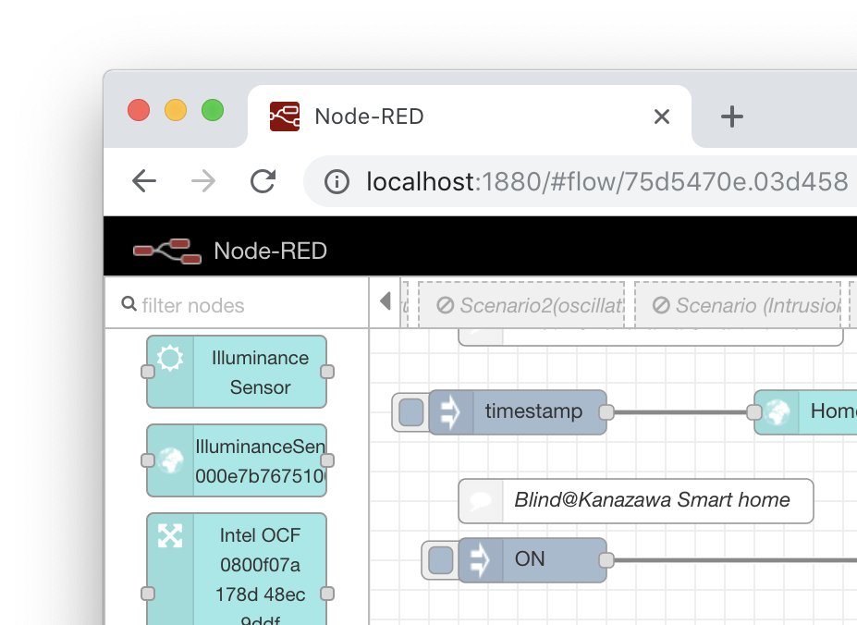
Rapid IoT Application Development using the Web of Things
Our “Node Generator” simplifies IoT application development
by generating Node module of Node-RED from a Thing Description
Node-RED is widely used in IoT application development field, because of its intuitive programming user interface.
By generating a Node, developer can handle a Thing as a Node of Node-RED Flow Editor.
To interact a Thing, simply send a message, and receive a response from Thing as a message
WoT Thing Description
Node
Generator
General Metadata
Interaction Affordances
Data Schemas
Public Security Configuration
Protocol Binding(s)

