Slide 1
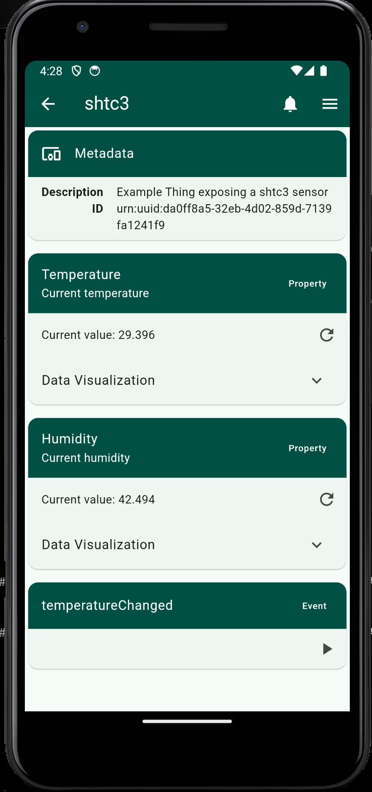
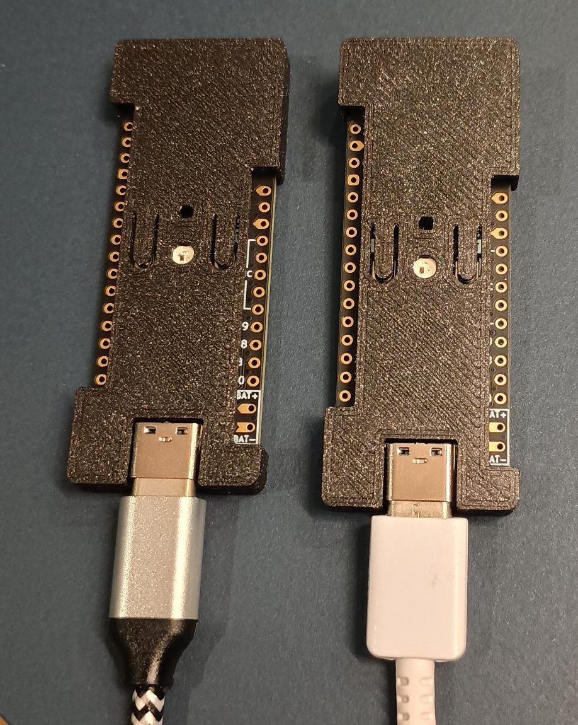


Interoperable Open Source Implementations
Background/Motivation:
Flexibility to deploy WoT applications and consumers on a large range of devices
Also support devices that are more resource constrained
What can be seen:
Thingweb Flutter App
Mobile App
Supports HTTP, CoAP, MQTT
Several discovery mechanisms
Powered by dart_wot
ESP32c3 Microcontrollers
Bare-metal (esp-hal)
Temperature sensor
RGB LED
Button
HTTP and server-side events
Powered by wot-rust (no_std)
Flutter App
Microcontrollers

