Slide 1


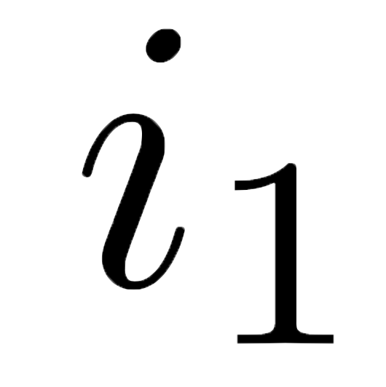
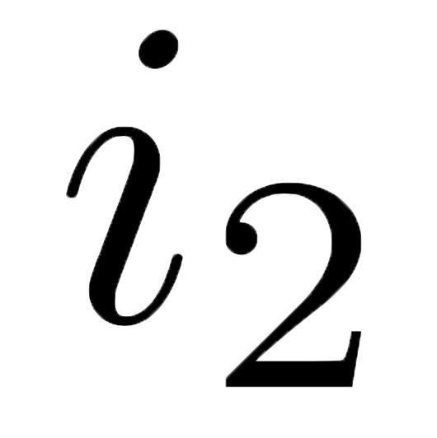



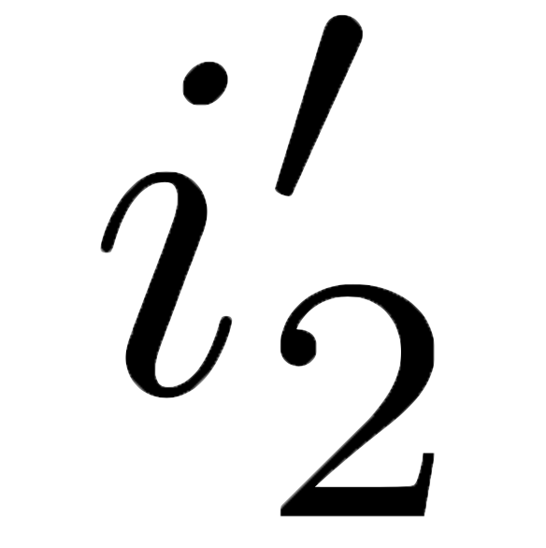
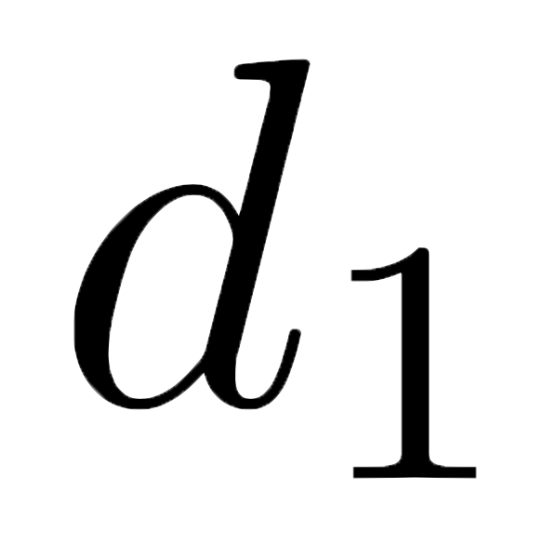
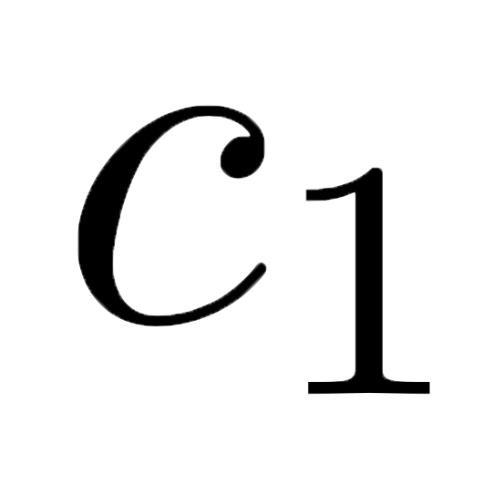
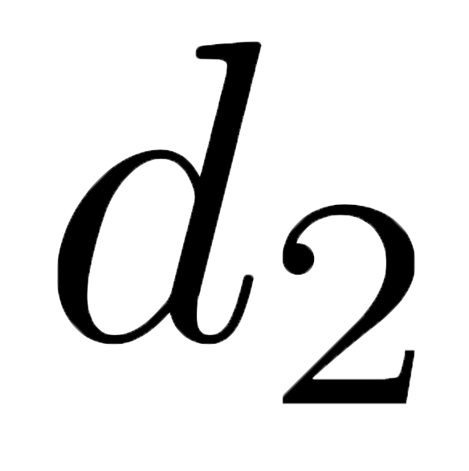

[1, 2]
1
[[[1, 2], [3]], [[4]]]
[[1, 2], [3]]
[1, 2]
1
get
get
get
get
update
update
put
put
put
put
[100, 2]
100
[[[100, 2], [3]], [[4]]]
[[100, 2], [3]]
[100, 2]
100
[[[1, 2], [3]], [[4]]]
[ , [[4]]]
[[[100, 2], [3]], [[4]]]
put
put
get
[[1, 2], [3]]
[ , [3]]
[[100, 2], [3]]
put
put
get
[1, 2]
put
[100, 2]
get
update
100
1

