Slide 1
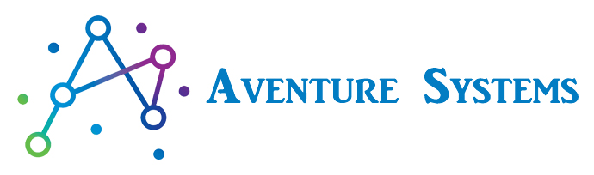
https://www.aventuresys.com/

Slide 2
Environments - RMS
Dev
APIs
Pipeline
Terraform
DevOps
QA/ Non Pro
Manual
Scripts
Backend
Frontend
SonarQube
QA testbench
Black/ white box
Performance
Security
Capacity planning
UAT (User Acceptance Test)
SIT
Pipeline
Manual
Automation
Regression
Black/ white box
As RMS, we have decided to use 3 lower environments, 1 prod setup in an active-active mode.
Non/Pre Prod box
QA box
Production

Slide 3
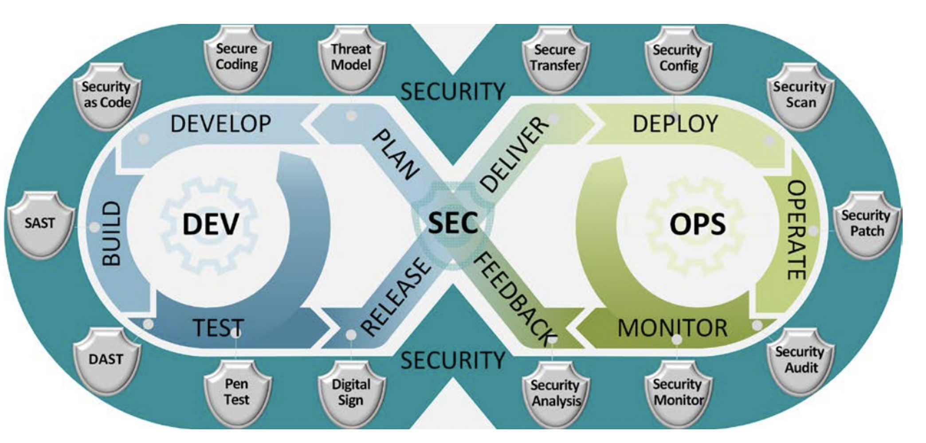

Slide 4
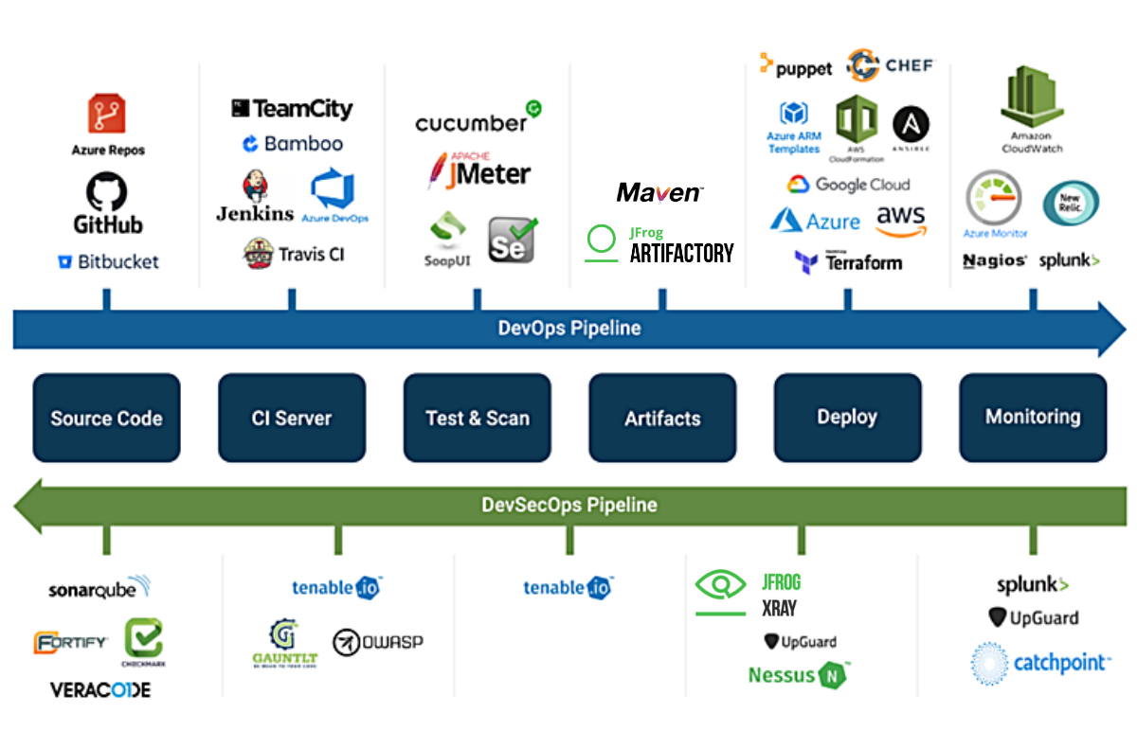

Slide 5
Category | Tools/ techs
Development – (Java based) Backend – Java Front end – Angular | Eclipse, Rest APIs and JUnit Visual code, Jasmine and Karma
DBs | MySQL/ mongoDB, SQL Express
QA | Selenium with Java, SoAP UI, Cucumber, Jmeter
Sec | SonarQube, Pentest*
DevOps | Terraform, AWS components
Hosting | Kubernetes, clusters (if required)
API Manager | AWS APIM

