Slide 1
BABLUS (Online Saloon Booking)
Book your best looks

Slide 2
Introduction
Bablus is an application that helps users to find the Salon and beauty parlors around by searching pin code, address, or location.
The application allows users to find the best service centers in various locations based on the reviews and ratings.
The primary objective of the platform includes booking a service or an appointment.

Slide 3
Objectives
To help find the Salons and Beauty parlours nearby
Easily choose the best centre/shop based on information, reviews, and ratings
Users can directly book appointments for their needs without hassling which helps save time
It helps local businesses to increase more leads and sales that generate excellent opportunities as well as income

Slide 4
Scope
Transforming the traditional businesses to online
Reducing the waiting time for salon services

Slide 5
Software Used
Programming languages: Dart, JavaScript.
Libraries and frameworks: Flutter, Nodejs, Express.js, etc.
Applications: Visual Studio Code, Android Studio, Chrome, Postman.
Database: MongoDB

Slide 6
Diagrams
DFD Symbols
CFD
Admin DFD
Shop DFD
User DFD
ER Diagram

Slide 7
User interface
Open Online
Open Offline

Slide 8
Limitations
Requires internet connectivity to use the application
Shop owner should be active in the application

Slide 9
Future scope
Google map integration for calculating distance and direction
Payment Gateway Integration using RazorPay
Quick chat option between the user and shop
End

Slide 10
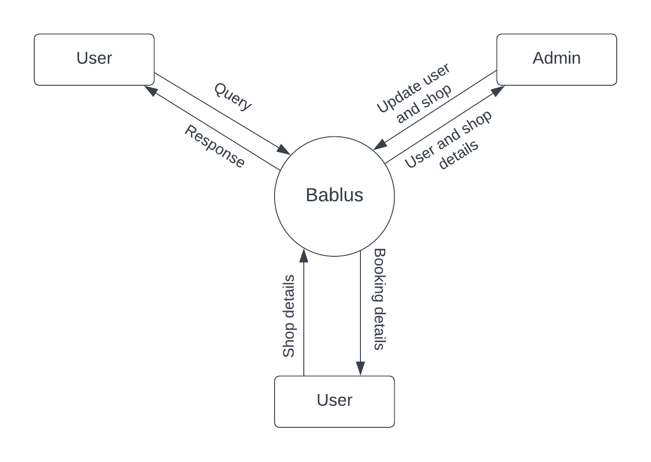
CFD ( level 0)
Back

Slide 11
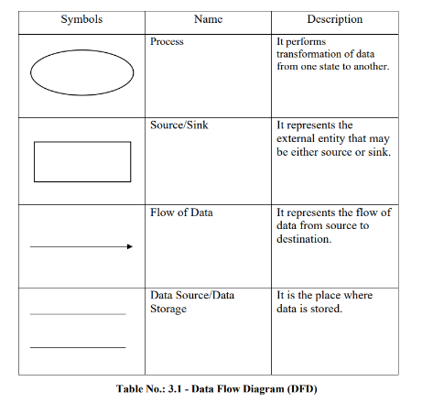
DFD Symbols
Back

Slide 12
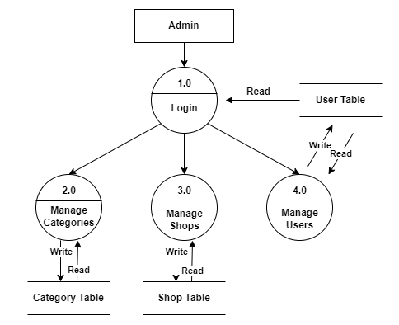
DFD Admin ( level 1)
Level 2
Back

Slide 13
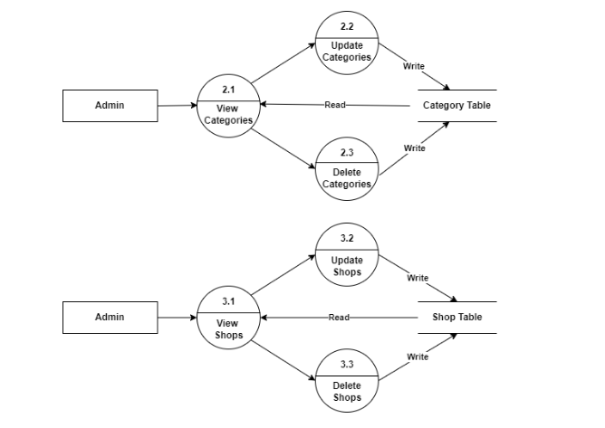
DFD Admin ( level 2)
Level 2
Back

Slide 14
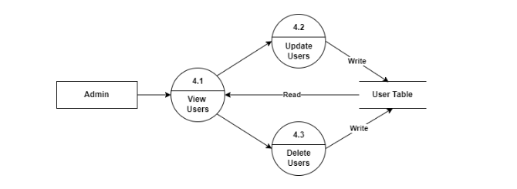
DFD Admin ( level 2) continued
Back

Slide 15
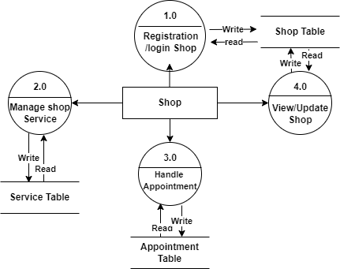
DFD Shop (Level 1)
Level 2
Back

Slide 16
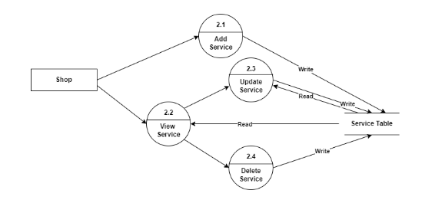
DFD Shop (Level 2)
Level 2
Back

Slide 17
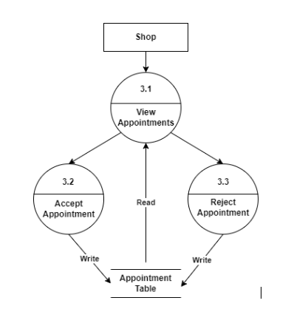
DFD Shop (Level 2)
Back

Slide 18
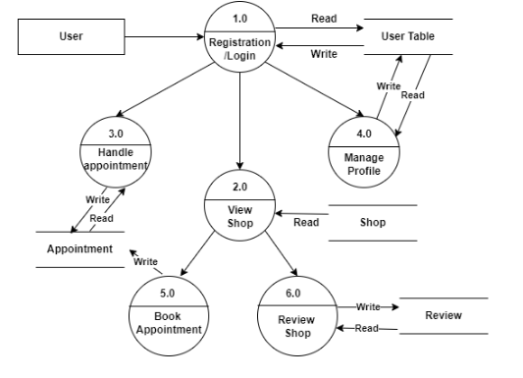
DFD User (Level 1)
Level 2
Back

Slide 19
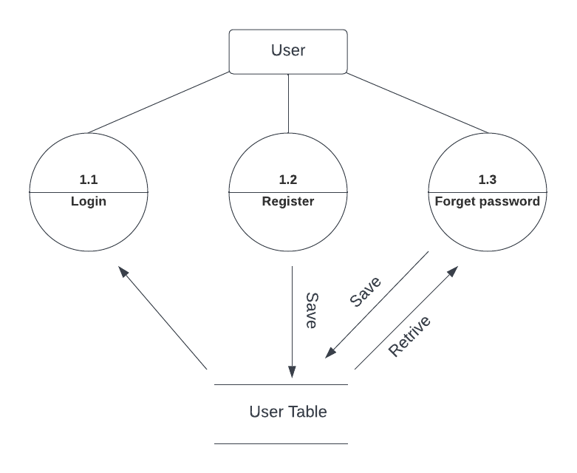
DFD User (Level 2)
Back

Slide 20
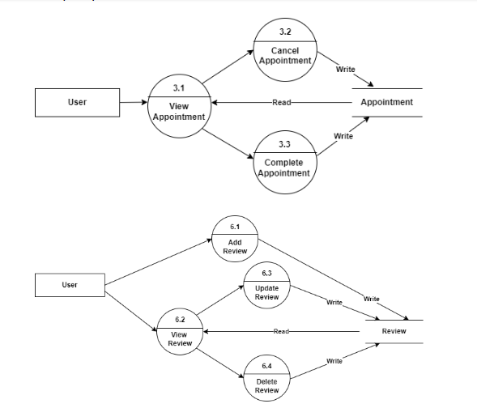
DFD User (Level 2) continued
Back

Slide 21
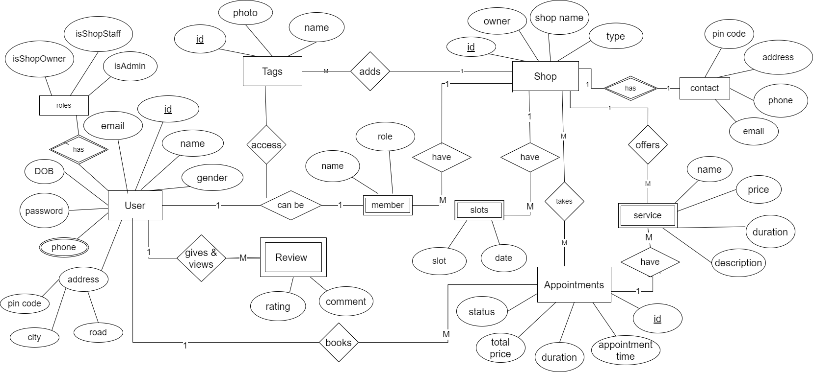
Entity Relationship Diagram
Back

Slide 22
Thank You
There is no space like 127.0.0.1
Expertis in dream of Metaverse
Bablus By Expertis

