Slide 1
What is synopsis?
Brief summary of your project

Slide 2
Format
Title
Introduction and objectives
Project category(Database/Web Application/Networking/Multimedia)
Tools/Platform, h/w and s/w
Analysis(DFD,ER diagram)
Complete structure- modules and descriptions
Data structures
Type of the project - Industry defined/client defined/ user defined
Limitations
Future Scope

Slide 3
Data Flow Diagrams

Slide 4
Data Flow Diagram
A data flow diagram (DFD) maps out the flow of information for any process or system.
It uses defined symbols like rectangles, circles and arrows, short text​ .

Slide 5
Different DFD Notations:
Yourdon and/or De Marco
Gane & Sarson
SSADM(Structured System Analysis and Design Methodology)
Unified Modeling Language

Slide 6
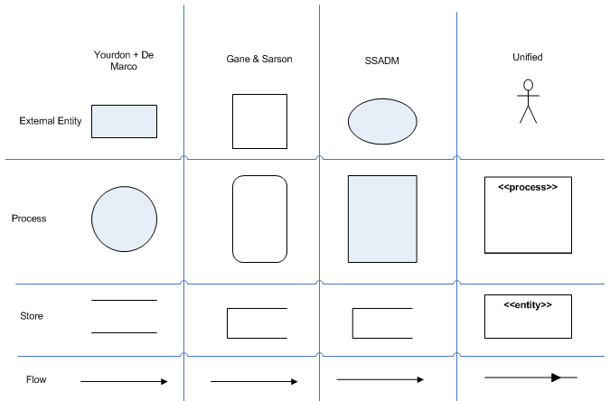

Slide 7
Example
Inter college Event Management System

Slide 8
Inter College Event management System
Identify the entities
Student
College
Admin
List out the functions(process) for each entity
Register/Login
View Event
Register for the event
Payment
Feedback
List out the data stores
Student info
College info
Event info
Payment info

Slide 9
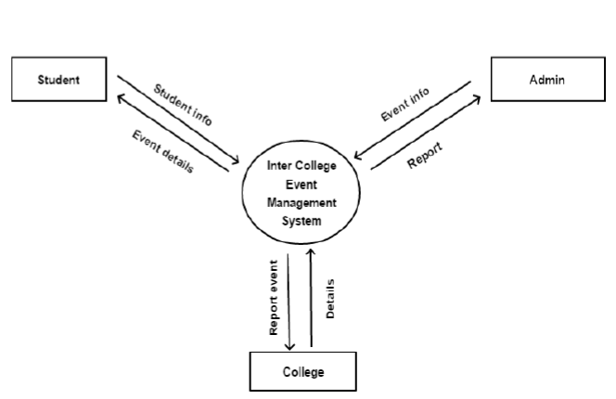
CFD(Level 0)

Slide 10
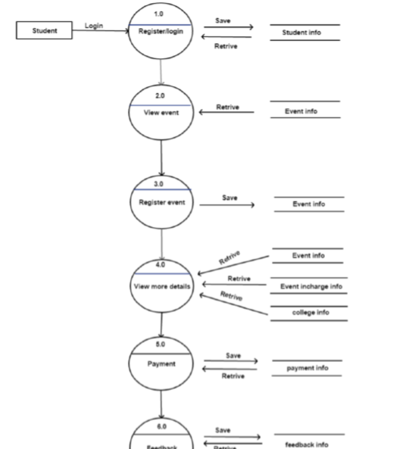
Level 1(Student)

Slide 11
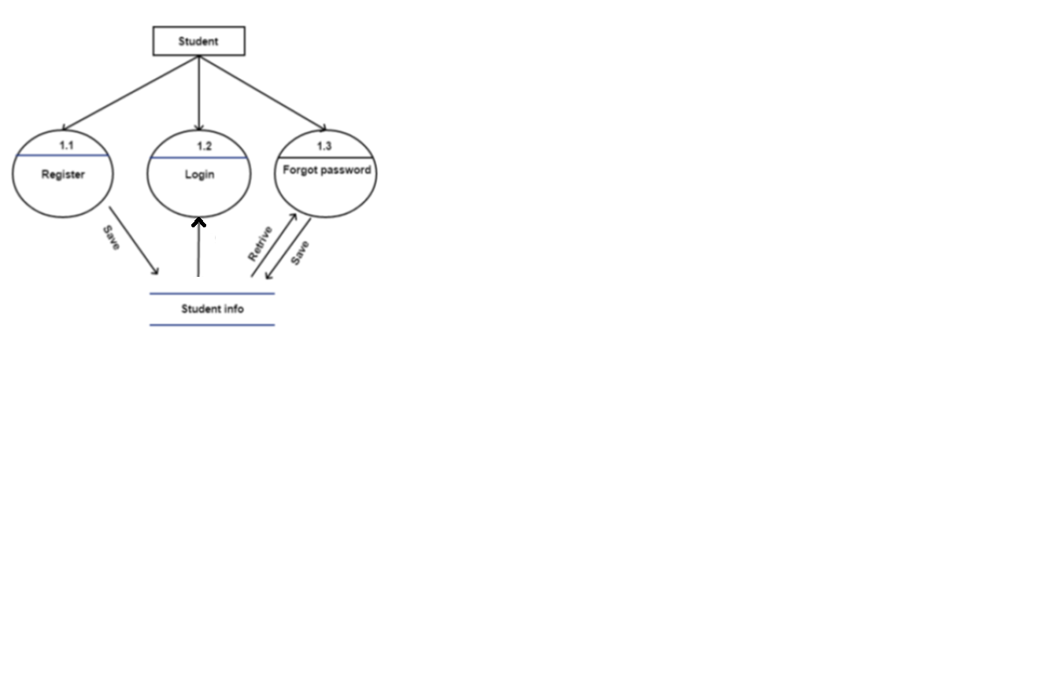
Level 2 (Student)

