Slide 1



Contents
The data Analysis team studied the situation of both companies from weaknesses and strengths.
Blackwell Electronics
Electronidex
Statistical investigations
Statistical investigations
Conclusion
Conclusion
Conclusions and Recommendations

Slide 2




Blackwell Electronics Sales Volume and Profitability Prediction
Product Types
PC
Laptops
Netbook Smartphone
Volume
643 pcs
434 pcs
1277 pcs
1525 pcs
Revenue
110,000 $
71,000 $
48,000 $
24,000 $
44%
17%
28%
11%
110,000 $
643 pcs
71,000 $
434 pcs
We used SVM algorithm to predict the sales volumes of the items indicated, which gave us the following metrics
RMSE
256.74
R-Squared
0.90
MAE
114.26
19%
39%
9%
33%
48,000 $
1525 pcs
24,000 $
1525 pcs

Slide 3
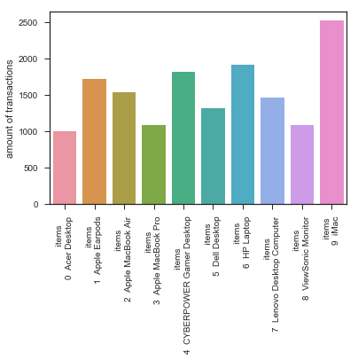
Electronidex
What are they selling?

Slide 4
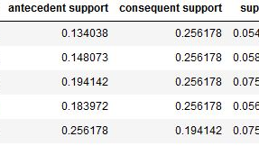
Electronidex
Market Basket Analysis
(Dell Desktop) → | (iMac) | 39% & 5.4%
(Dell Desktop, ViewSonic Monitor) → | (HP Laptop) 57% & 1.5%

Slide 5
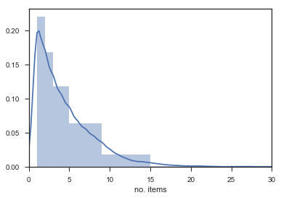
Electronidex
Items per transaction

Slide 6
Electronidex
Customer Base
At least 57% business customers, probably more
Based on assumption: At least two monitors / and or notebooks
Average no. Of Items per transaction: 4.4
Gamer products -> Gamer

Slide 7
Electronidex
Buy or sell? Ask mom…
Obtain more data / information: customer related -> customer base
Onliner Retailer market data & prospect & organizational/cost structure
&
Do we need a stronger online business?
Do we have to diversify brands?
OR
why are we not doing it by ourselves?

