Slide 1

Voice Based Email System For Blinds
by
Marthadu Harshad Ali
Roll No. 204G1A3214
Sheik Sameer Ahammad
Roll No. 204G1A3249
Muthyala Rupalakshmi
Roll No. 204G1A3243
Uppara Meghana
Roll No. 204G1A3230
Under the guidance of
Dr. C. Sasikala _{M. Tech., Ph.D.}
Associate Professor
Department of Computer Science and Engineering (Data Science)
Srinivasa Ramanujan Institute of Technology
(Affiliated to JNTUA & Approved by AICTE) (Accredited by NAAC with ‘A’ Grade & Accredited by NBA (EEE, ECE & CSE)
Rotarypuram Village, B K Samudram Mandal, Ananthapuramu – 515701.
2023 - 2024

Slide 2

Contents
Abstract
Problem statement
Objectives of Project
Literature survey for first objective
Literature survey for second objective
Proposed Work -(Methods to be followed for proposed system)
References
GitHub Link
Queries

Slide 3
Abstract
Internet is one of the basic luxury for daily living. Every person is using the facts and information on internet. On the other hand, blind people face difficulty in accessing the text resources. The advancement in computer based accessible systems has opened up many avenues for the visually impaired across a wide majority of the globe. Audio feedback based virtual environment like, the screen readers have helped blind people to access internet applications immensely. Our Proposed system, the voicemail system architecture that can be used by a blind person to access e-mails. In this project, the use of speech to text and text to speech techniques. Also this system can be used by any normal person who is not able to read. The system is completely based on interactive voice response which will make it efficient.

Slide 4
Problem Statement
Blind people cannot read the information and cannot view the mouse cursor to give commands to the computer. They cannot access their mail and cannot send mail as they cannot visualize what is already present on the screen they cannot make out where to click to perform the required operations.
Therefore, the computer becomes an impractical thing for blind people and information retrieval a tedious job. For a visually challenged person using a computer for the first time is not that convenient as it is for a normal user even though it is user-friendly.

Slide 5
Objectives of Project
The application will be a python-based application for visually challenged persons using IVR- Interactive voice response, thus sanctioning everyone to control their mail accounts using their voice only and to be able to read, send and perform all the other useful tasks.
The main objective of the project is to completely eliminate the keyboard and respond through voice only.

Slide 6
Literature Survey for first objective
T. Shabana et al.., proposed an email system that will help even a naïve visually impaired person to use the services for communication the system will not let the user make use of keyboard instead will work only on mouse operation and speech conversion to text.

Slide 7
Literature survey for second objective
Isha Salve et al.., used three types of technologies to create the application namely STT(speech-to- text) where the speech is converted to text , TTS(text-to- speech) to convert the text to speech, and thirdly IVR(interactive voice response) which describes the interaction between the user and the technology.

Slide 8
Existing System
Simple e-mail systems are available in which only voice recognition and text-to-speech are accessible by remembering the keyboard shortcuts to access.
The existing voice-based e-mail system has made use of IVR, Speech to text converter, Mouse click event and Screen reader.
There will be a small icon of mic on who’s clicking the user had to speak and his/her speech will be converted to text format, which the blind people would see and read.
There are various search engine which take request in the form of text from user and retrieve the relevant documents from server and responds by displaying it in the form of text which is not possible for visually challenged people.

Slide 9
Continue…
User have to use mouse connected to the computer and should perform.
In existing system, they have chosen Web UI as the interface for system which is not easy for the impaired people to us.

Slide 10
Proposed System
Because using this technology involves visual perception, it is extremely difficult for visually impaired persons to use it.
This is because in order to access the internet you would need to know what is written on the screen, which is not possible by blind person.
In this proposed system it mainly concentrates on different types of technologies Speech-to-Text (STT) this module collects the speech given by the user and converts to Text, Text-to-Speech (TTS) this converts the response give to system to Speech.
Doesn’t need any mouse click events to send and receive emails.
Purely based on the voice commands given by the user.

Slide 11
Reference
[1]. T.Shabana, A.Anam, A.Rafiya and K.Aisha, “Voice Based Email System For Blinds”,” International Journal of Advanced Research in Computer and Communication Engineering, vol. 04, issue 01, Jan. 2015.
[2]. Isha Salve, Nabila Qureshi, Nuzhat Anjum, Sayed Sana Zafar and Kamlesh Kelwade, “Voice Based E-mail for Visually Challenged”,” International Journal of Engineering and Technology, vol. 07, issue 03, Mar. 2020.

Slide 12
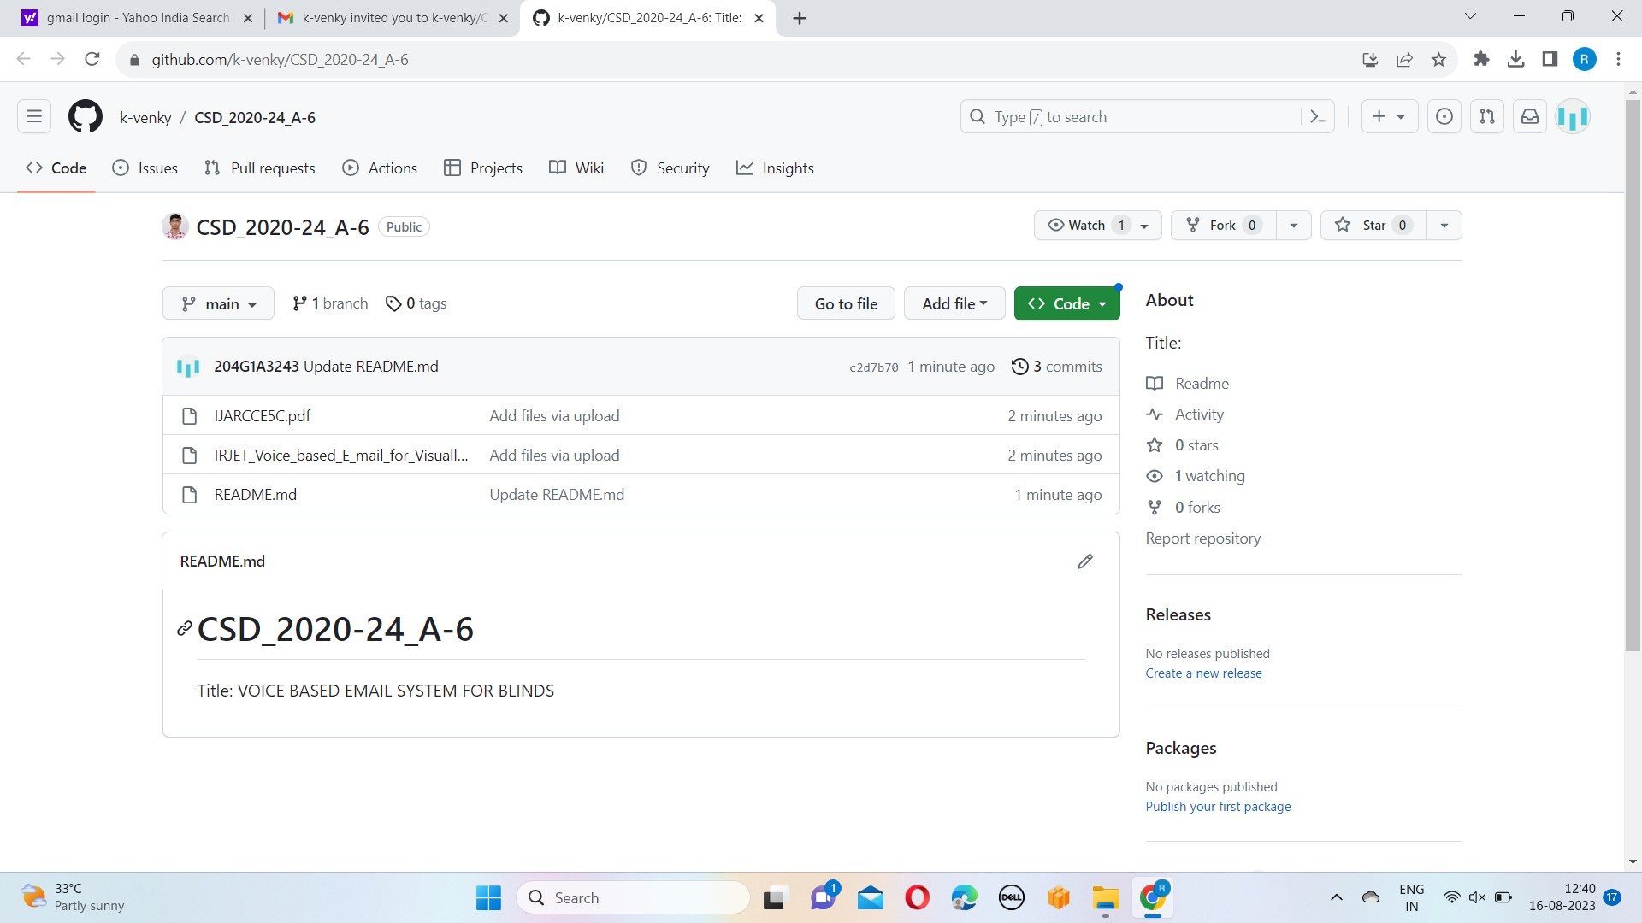
Git Hub Dashboards of each student

Slide 13
Any Queries?

Slide 14
Thank You!!!

