Slide 1
Fusion Heat Transport
PDE Benchmark
Numerical Solver Comparison with ML-Based Selection
for 1D Radial Heat Equation in Fusion Plasmas
∂T/∂t = (1/r) ∂/∂r (r χ(|∂T/∂r|) ∂T/∂r)
χ(|T'|) = (|T'| − 0.5)^α + 0.1 (|T'| > 0.5)

Slide 2
Project Overview
▶ 1D radial heat equation with nonlinear diffusivity χ(|T'|)
▶ Models anomalous heat transport in fusion plasma devices
▶ Three numerical solvers: Implicit FDM, Spectral, PINN
▶ Automated benchmarking with L2/L∞ error metrics
▶ ML-based solver selector (decision tree) predicts best solver
▶ Incremental learning: model improves with each benchmark run
▶ Pure Python — numpy + scipy only (no sklearn dependency)

Slide 3
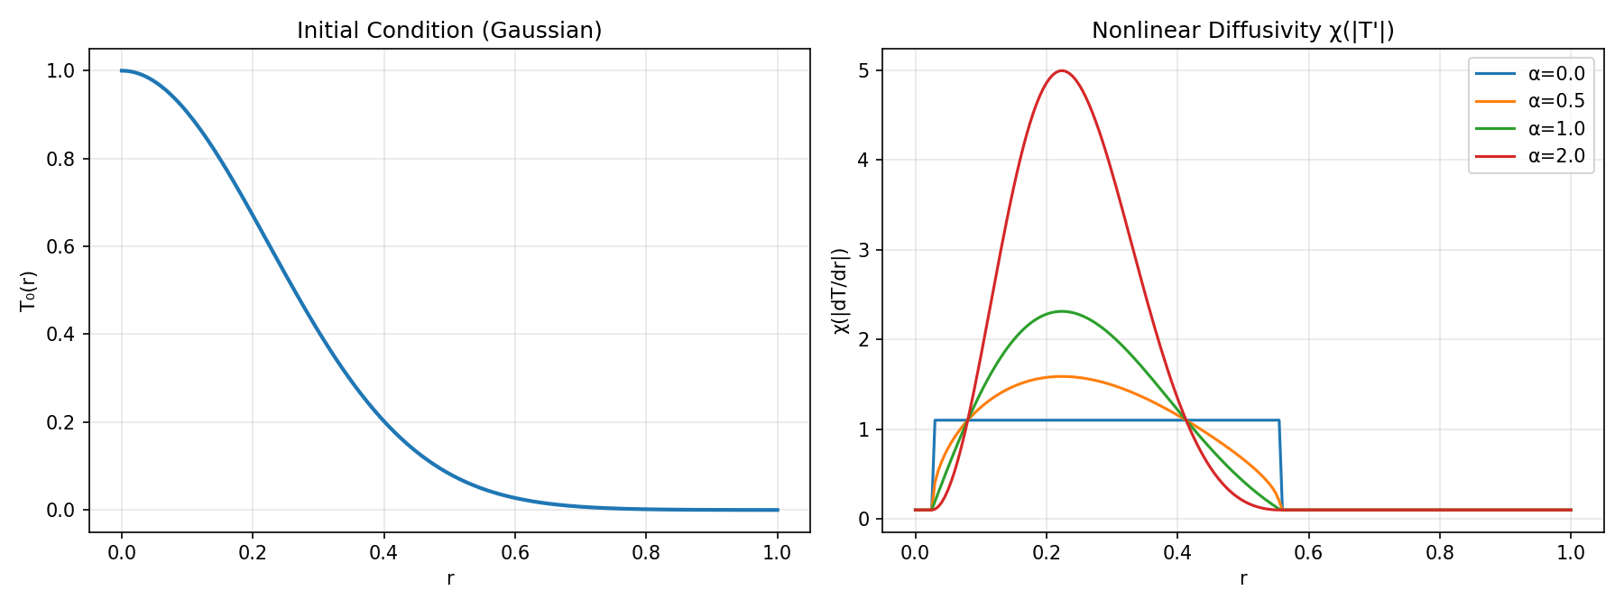
The PDE: Radial Heat Equation
∂T/∂t = (1/r) ∂/∂r (r χ ∂T/∂r)
χ(|T'|) = (|T'| − 0.5)^α + 0.1 if |T'| > 0.5
χ(|T'|) = 0.1 if |T'| ≤ 0.5
Boundary conditions:
r = 0: ∂T/∂r = 0 (symmetry)
r = 1: T = 0 (fixed wall)
Singularity at r = 0:
L'Hôpital → 2χ ∂²T/∂r²

Slide 4
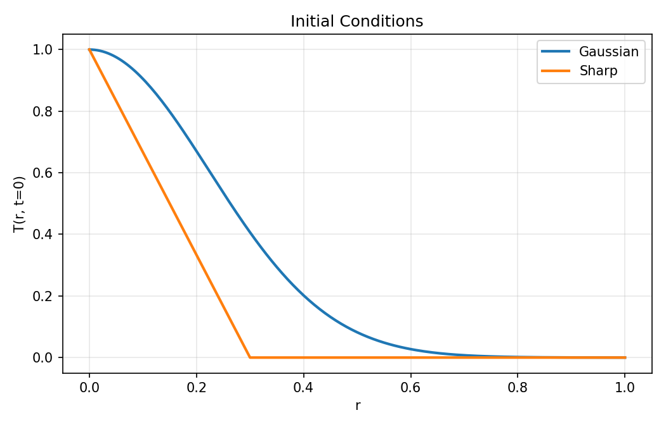
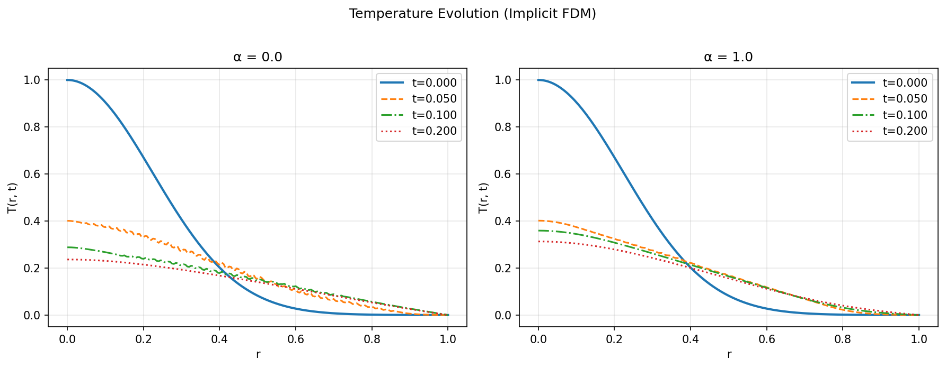
Initial Conditions & Time Evolution
Gaussian: smooth, T₀ = exp(-10r²)
Sharp: step-like, localized peak
α = 0: standard linear diffusion
α > 0: enhanced diffusion at steep gradients

Slide 5
Numerical Solvers
Solver
Method
Key Features
implicit_fdm
Crank-Nicolson FDM
2nd order, scipy banded solver, L'Hôpital at r=0
spectral_cosine
Cosine Expansion
cos((k+0.5)πr) basis, semi-implicit stepping
pinn_stub
Physics-Informed NN
MLP with PDE loss (requires PyTorch)
Reference Solution
Same Implicit FDM with 4× spatial and temporal refinement
~16× more accurate (2nd order → (1/4)² error reduction)
Works for any α — no analytical solution needed

Slide 6
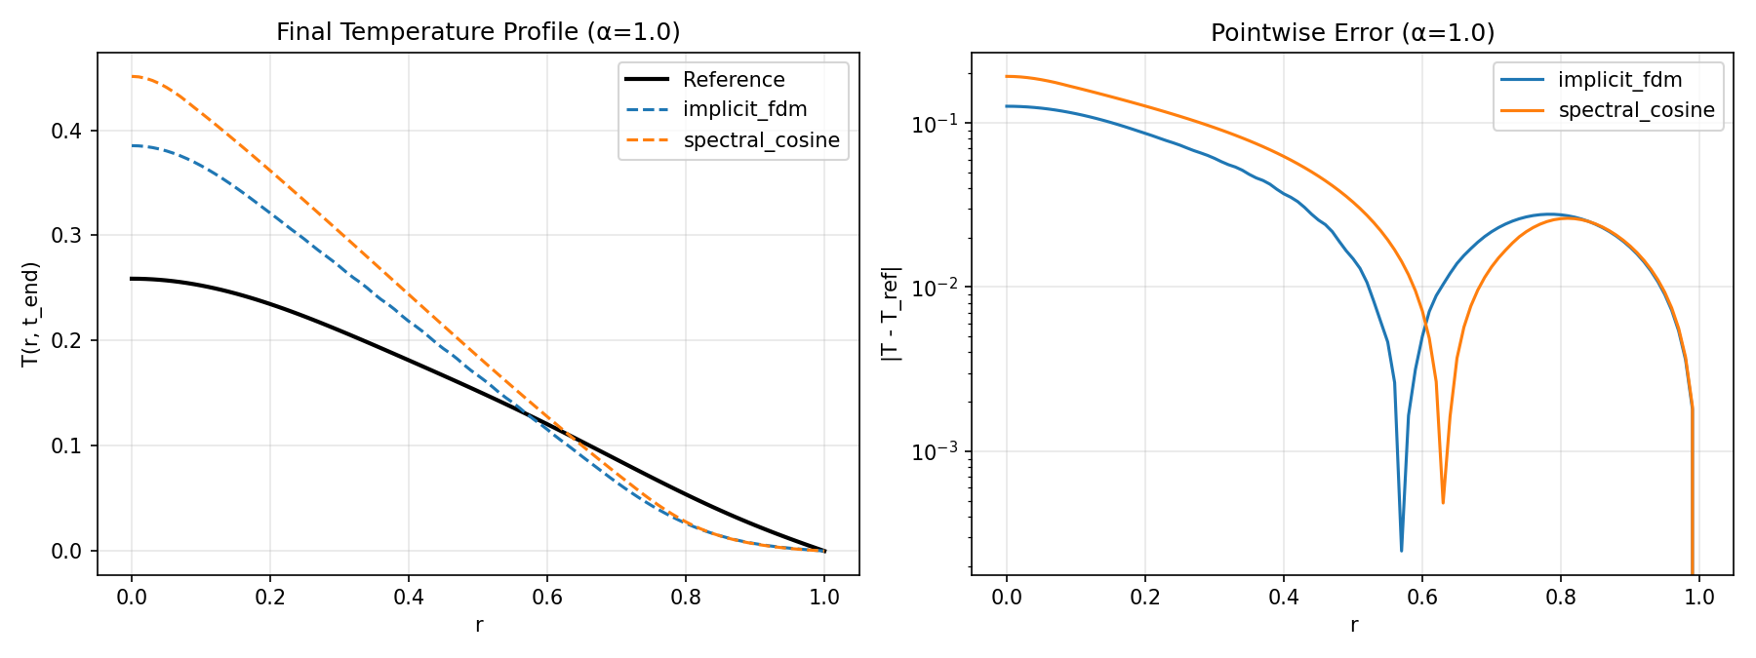
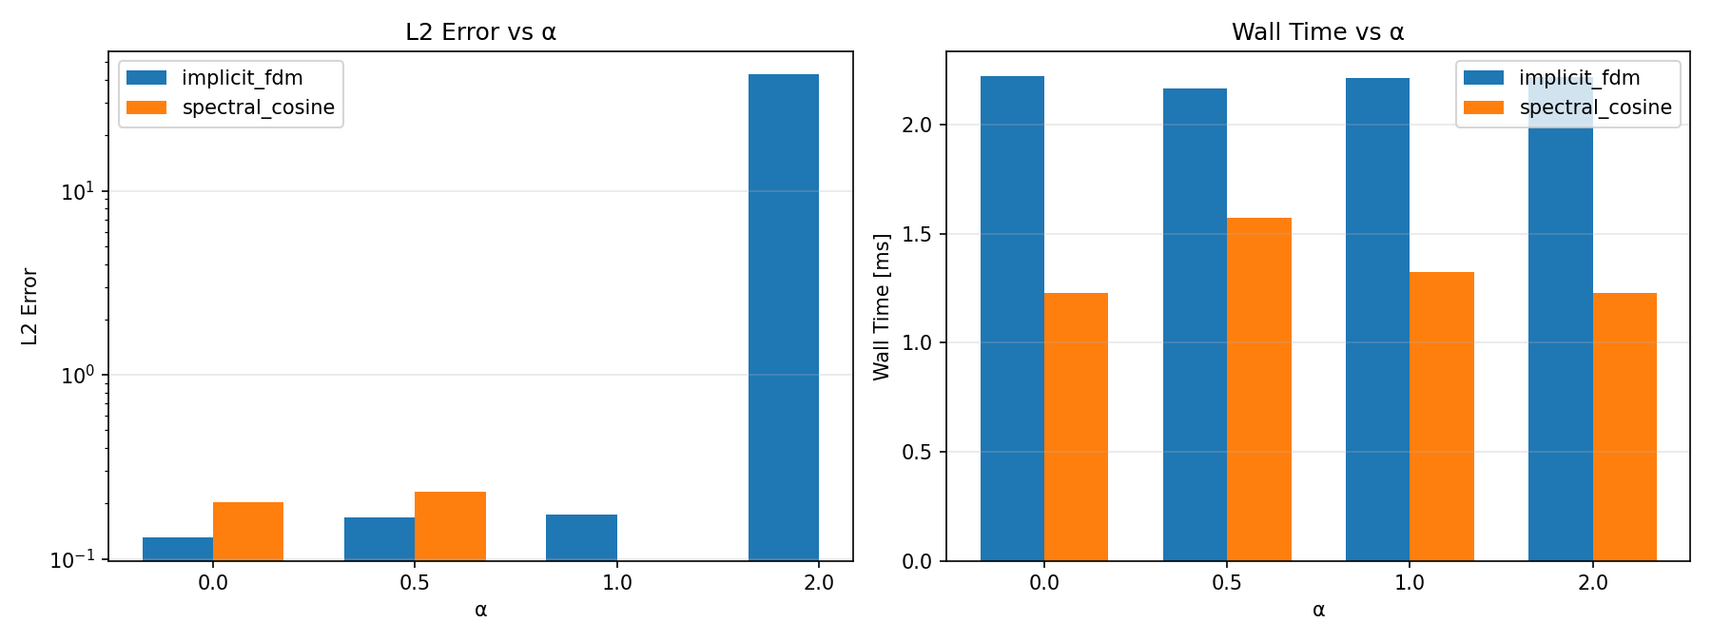
Benchmark Results

Slide 7
Solver Selection Policy
score = L2_error + λ × wall_time
Post-hoc Selection (default)
ML Prediction (new)
Run ALL solvers
Compute errors vs reference
Pick lowest score
λ = 0.1 (accuracy-focused)
Extract 14 features from T₀
Decision tree predicts best solver
Run ONLY predicted solver
No sklearn — numpy-only tree

Slide 8
ML Feature Engineering (14 Features)
Problem Parameters (6)
• α, nr, dt, t_end
• init_gaussian, init_sharp (one-hot)
Physical Features from T₀ (5)
• max_abs_gradient, energy_content
• max_chi, max_laplacian, T_center
Derived Features (3)
• gradient_sharpness = max_grad / T_center
• chi_ratio = max_chi / min_chi
• problem_stiffness = α × max_grad
All features extracted BEFORE solving → enables prediction without computation

Slide 9
ML Workflow
Step 1
Step 2
Step 3
Generate Data
Train Model
Predict & Run
Parameter sweep
~432 instances
8 α × 2 init × 3 nr
× 3 dt × 3 t_end
▶
CART decision tree
Gini impurity
max_depth = 5
numpy-only
▶
Extract features
Predict best solver
Run only that one
# Step 1: Generate training data
python -m app.run_benchmark --generate-data
# Step 2: Train model
python -m policy.train # or: make train
# Step 3: Use ML selector
python -m app.run_benchmark --use-ml-selector --alpha 1.5

Slide 10
Incremental Learning with --update
▶ Each benchmark run can improve the ML model
▶ --update flag: run benchmark → append results to CSV → retrain
▶ Model accumulates experience over time
▶ No need to regenerate full training set
# Run benchmark and update model
python -m app.run_benchmark --alpha 0.3 --init sharp --update
# Accumulate more data
python -m app.run_benchmark --alpha 1.2 --nr 71 --update
# Use improved model
python -m app.run_benchmark --use-ml-selector --alpha 0.3
Benchmark → Label best → Append CSV → Retrain tree → Updated model

Slide 11
Project Architecture
app/
CLI entrypoint, benchmark runner
solvers/
FDM (Crank-Nicolson), Spectral (cosine), PINN (stub)
features/
Gradient, Laplacian, chi, energy, ML feature extraction
metrics/
L2 and L∞ error computation
policy/
Post-hoc selection + ML decision tree + training
reports/
CSV and Markdown output generation
tests/
22 unit tests (pytest)
docs/
Manual, tutorial with figures
Dependencies: numpy, scipy | Optional: torch (PINN)
CI: GitHub Actions (Python 3.10 / 3.11 / 3.12)

Slide 12
CLI Reference
make test
Run all 22 tests
make benchmark
Run benchmark (default α)
make train
Generate data + train ML model
--alpha 0.5 1.0
Custom α values
--init sharp
Sharp initial condition
--nr 101 --dt 0.0005
Higher resolution
--generate-data
Create training CSV (~432 samples)
--use-ml-selector
Predict best solver, run only that
--update
Append results + retrain model
--model-path PATH
Custom model file path

Slide 13
Development Process (1/3): Foundation
Steps 1-2
Scaffold & Features
pyproject.toml, Makefile, feature extraction (gradient, laplacian, chi, energy)
Steps 3-6
Three Solvers
Implicit FDM (Crank-Nicolson), Spectral (cosine basis), PINN stub
Steps 7-10
Metrics & Policy
L2/L∞ error, solver selection (score = error + λ×time), CSV/Markdown reports
Steps 11-12
Documentation & Run
README, CLAUDE.md, first benchmark run → implicit_fdm wins for all α
Key Design Decisions
• r=0 singularity: L'Hôpital rule → (1/r)∂(rχ∂T/∂r) → 2χ∂²T/∂r²
• Reference solution: same FDM at 4× refinement (no analytical solution needed)
• Modular SolverBase ABC → easy to add new solvers
• Minimal dependencies: numpy-only core

Slide 14
Development Process (2/3): Optimization
Step 13
Detailed Manual
docs/MANUAL.md — reference solution process, error definitions, PDE formulation
Step 14
Claude Code Skills
5 slash commands (/run-benchmark, /add-solver, etc.) + auto syntax-check hook
Step 15
English Translation
All docs and skill files translated from Japanese to English
Step 16
Vectorization
FDM ~2.6× speedup, Spectral ~23× speedup via matrix ops
Step 17
scipy.linalg.solve_banded
Replaced Python-loop Thomas algorithm with LAPACK → additional ~2.5× speedup
Performance Gains
Implicit FDM total speedup: ~6.5× | Spectral total speedup: ~23×
• Vectorized tridiagonal construction + precomputed geometric factors
• Matrix-vector transforms replacing per-mode loops in spectral solver
• LAPACK dgbsv (Fortran) replacing Python-loop Thomas algorithm

Slide 15
Development Process (3/3): ML & Docs
Step 18
ML Solver Selector
14 features, numpy-only decision tree, --generate-data / --use-ml-selector
+update
Incremental Learning
--update flag: append results to CSV + retrain → model improves over time
Docs
Tutorial & Figures
6-part tutorial, 5 auto-generated figures (generate_figures.py)
CI
GitHub Actions
Test matrix: Python 3.10 / 3.11 / 3.12 on every push and PR
Fix
Python 3.12 Compat
build-backend: setuptools.backends._legacy → setuptools.build_meta
Slides
Presentation
python-pptx auto-generated slides with embedded benchmark figures
Key Innovation: ML Selector
• No sklearn — CART tree with Gini impurity in pure numpy (~100 LOC)
• Features designed for pre-solve prediction (problem params + T₀ properties)
• Incremental learning closes the loop: use → observe → improve
• All artifacts reproducible: python docs/generate_figures.py, python docs/generate_slides.py

Slide 16
Summary
✅ Complete PDE benchmark suite for fusion heat transport
✅ Three solvers with automated error evaluation
✅ ML solver selector: numpy-only decision tree (14 features)
✅ Incremental learning via --update flag
✅ Comprehensive documentation: manual, tutorial, figures
✅ CI/CD with GitHub Actions (Python 3.10-3.12)
Future Directions
• Full PINN implementation with PyTorch
• Additional solvers (explicit FDM, FEM, etc.)
• 2D extension for toroidal geometry
• Ensemble model or gradient boosting for selector

