Slide 1
Solver Selection Analysis
Feature-Cost Function Relationship
Analysis of which solver wins under which conditions
based on 432 parameter combinations
score = L2_error + 0.1 × wall_time

Slide 2
Cost Function Definition
score = L2_error + λ × wall_time
▶ L2_error: Weighted L2 norm vs reference solution
L2 = √(∫(T - T_ref)² r dr / ∫ T_ref² r dr)
▶ wall_time: Actual computation time [seconds]
▶ λ = 0.1 (default): Accuracy-focused selection
λ = 0 → pure accuracy, λ = 1 → speed-focused
▶ Reference: Same Implicit FDM with 4× refinement
The solver with the LOWEST score wins

Slide 3
12 Features for Solver Prediction
Problem Params (4)
Physical Features (5)
Derived Features (3)
α (alpha)
nr (grid points)
dt (time step)
t_end (sim time)
max_abs_gradient
energy_content
max_chi
max_laplacian
T_center
gradient_sharpness
chi_ratio
problem_stiffness
Key Derived Feature:
problem_stiffness = α × max_abs_gradient
Captures interaction between nonlinearity and gradient steepness
For T₀ = 1 - r²:
max_abs_gradient ≈ 2.0 (at r=1)
max_chi = (α)(1.5)α + 0.1 (since |T'| = 2r > 0.5 for r > 0.25)

Slide 4
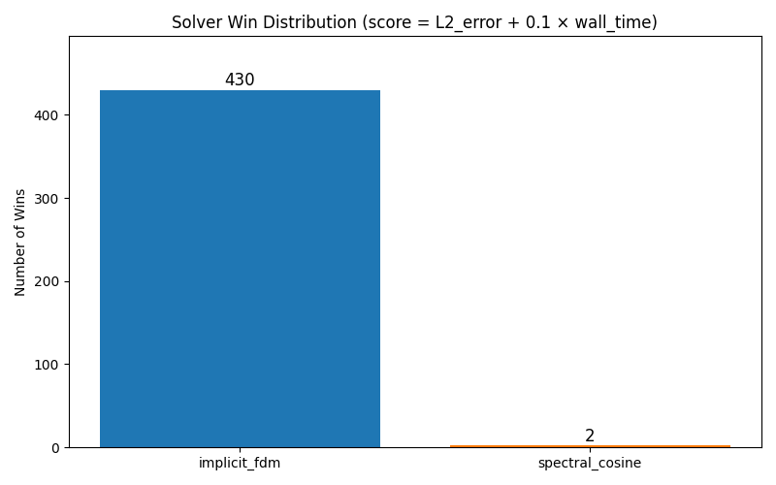
Analysis Result: Solver Win Distribution
Key Findings
implicit_fdm: 99.5%
(430 / 432 cases)
spectral_cosine: 0.5%
(2 / 432 cases)
pinn_stub: 0%
(NaN errors)
Conclusion: Implicit FDM dominates due to unconditional stability
of Crank-Nicolson scheme with the threshold-based χ formula.

Slide 5
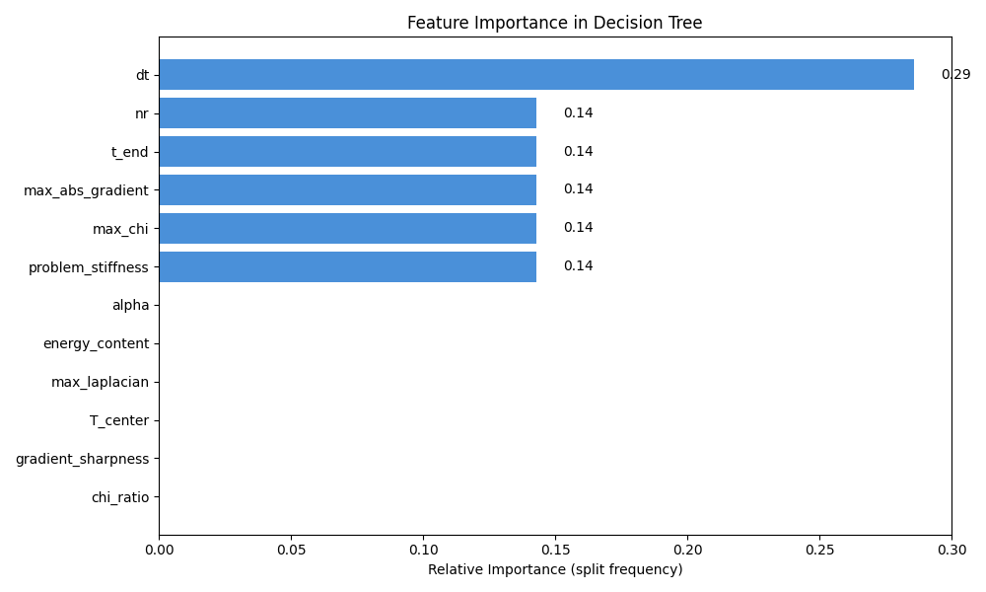
Feature Importance in Decision Tree
Top 5 Features
1. dt (0.29)
2. nr (0.14)
3. t_end (0.14)
4. max_abs_gradient (0.14)
5. max_chi (0.14)
Interpretation: Time step (dt) is the most critical feature.
The spectral solver requires finer time steps for stability.

Slide 6
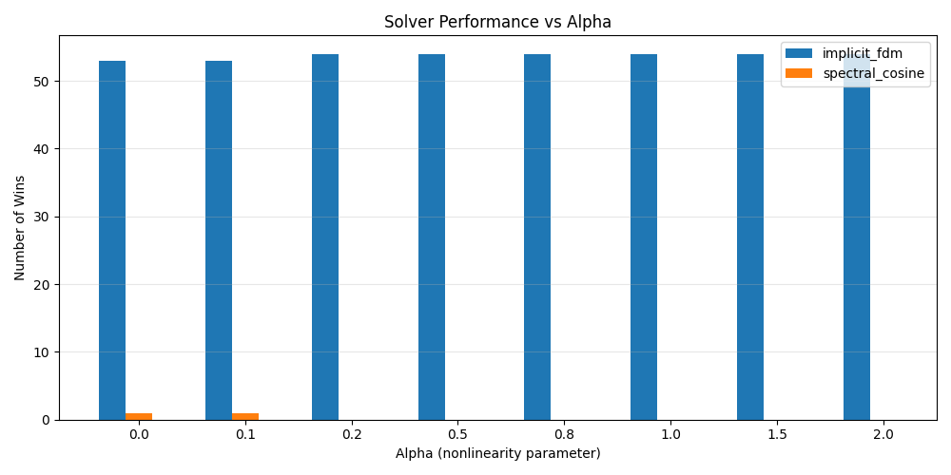
Solver Performance vs Alpha
▶ Spectral solver only wins at α = 0.0 and α = 0.1
▶ For α ≥ 0.2, implicit FDM wins 100% of cases
▶ Higher α → stronger nonlinearity → spectral instability
▶ The threshold χ formula causes numerical issues in spectral method

Slide 7
When Does Spectral Solver Win?
Spectral wins in only 2 out of 432 cases:
Case 1: α=0.0, nr=71, dt=0.001, t_end=0.05
Case 2: α=0.1, nr=31, dt=0.002, t_end=0.1
Common characteristics:
• Very low alpha (α ≤ 0.1) → near-linear diffusion
• problem_stiffness < 0.27 → weak nonlinearity
• chi_ratio ≈ 11 → minimal diffusivity variation
Decision Rule from Tree:
IF problem_stiffness <= 0.33 AND max_abs_gradient <= 2.71:
THEN spectral_cosine MAY win
ELSE:
THEN implicit_fdm wins

Slide 8
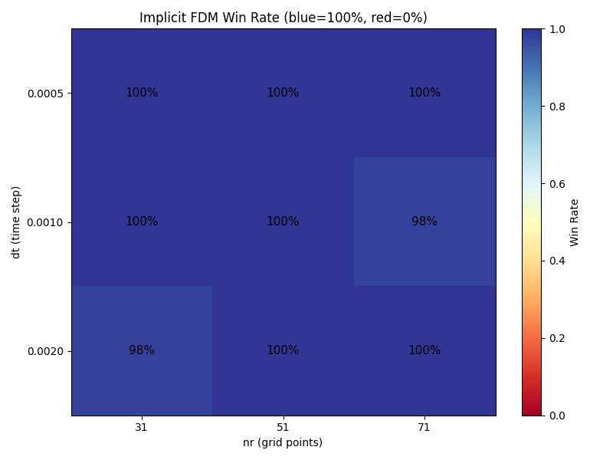
FDM Win Rate by dt and nr
Observation:
100% FDM wins
across all
dt-nr combinations
(Blue = FDM wins)

Slide 9
Why Does Implicit FDM Dominate?
1. Numerical Stability
2. Spectral Solver Issues
Crank-Nicolson is unconditionally stable
Handles stiff nonlinear χ correctly
L'Hôpital rule at r=0 is clean
Operator splitting is semi-explicit
Threshold χ causes Gibbs-like issues
Unstable for α > 0.1
3. Cost Function Favors Accuracy
λ = 0.1 means error matters 10× more than time
FDM is slightly slower but much more accurate
Spectral's NaN/Inf errors → automatic disqualification
4. Initial Condition T₀ = 1 - r²
max|dT/dr| = 2 at r=1 → always above threshold 0.5
Nonlinear regime is active for all cases

Slide 10
Recommendations
For Users:
✅ Use implicit_fdm as the default solver
✅ Consider spectral only for α < 0.1 (near-linear regime)
✅ ML selector is not needed for current IC (T₀ = 1 - r²)
For Development:
⚠ Improve spectral solver stability for threshold χ
⚠ Consider implicit treatment of nonlinear term in spectral
⚠ Add more IC types to create diverse training data
⚠ Implement full PINN to provide a third viable option
The ML selector will become useful when solvers have
more balanced performance across parameter space.

Slide 11
Summary
▶ Analyzed 432 parameter combinations (8α × 3nr × 3dt × 3t_end)
▶ Cost function: score = L2_error + 0.1 × wall_time
▶ Implicit FDM wins 99.5% of cases due to:
• Unconditional stability of Crank-Nicolson
• Robust handling of threshold-based χ
▶ Spectral solver only competitive at α ≤ 0.1
▶ Most important feature: dt (time step)
▶ Decision rule: IF problem_stiffness > 0.33 THEN use FDM

Slide 12
Analysis Tools Created
New Script: docs/analyze_solver_selection.py
▶ Generates/loads training data (432 samples)
▶ Computes solver win distribution
▶ Analyzes feature statistics by winning solver
▶ Trains decision tree and extracts feature importance
▶ Extracts human-readable decision rules
▶ Generates 6 visualization figures
Generated Figures:
solver_distribution.png
feature_importance.png
alpha_analysis.png
dt_nr_heatmap.png
cost_breakdown.png
alpha_vs_stiffness.png
# Run analysis
python docs/analyze_solver_selection.py

