Slide 1
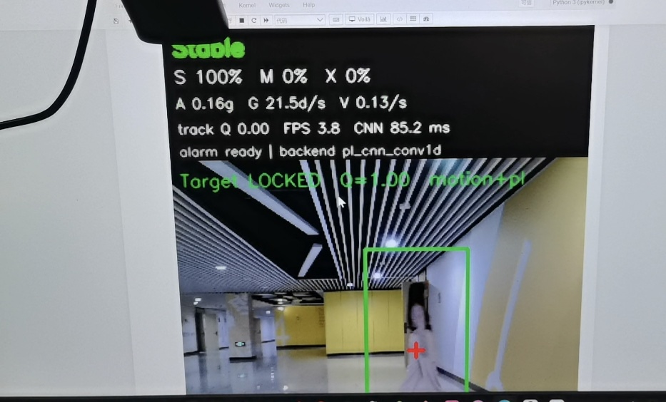
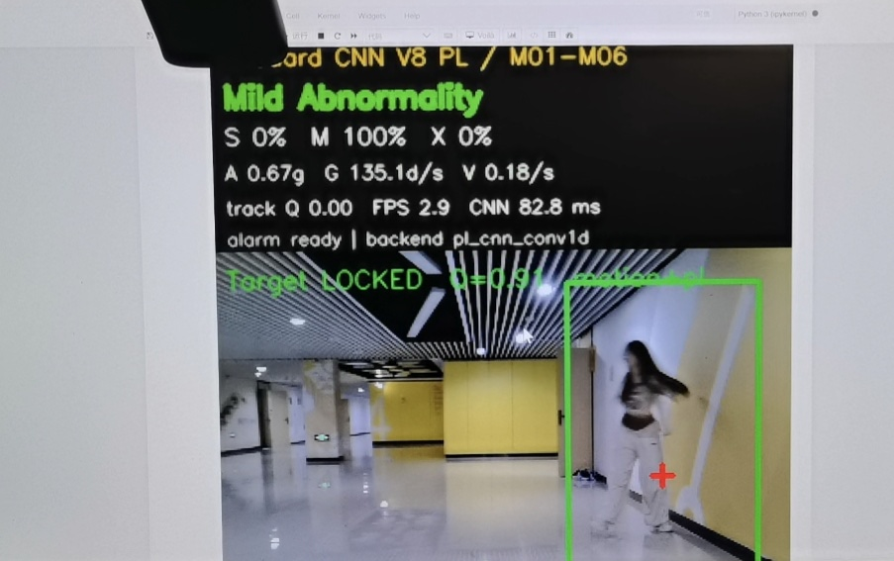
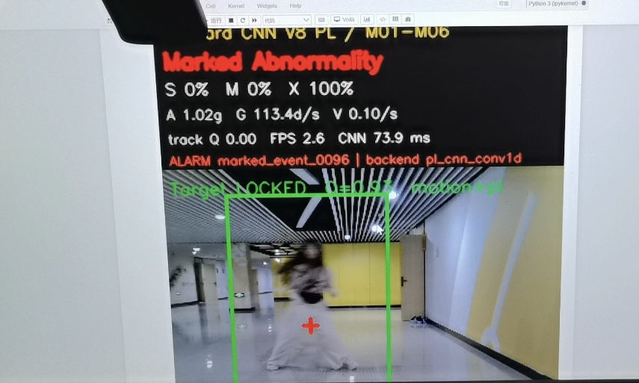
PYNQ-Z2 / 双模态感知 / FPGA协同计算
FitGuard 双模态步态评估终端
面向步态观察与风险提示的实时感知原型
AMD
Zynq-7000
项目概述
系统框图与关键创新
测试结果
PROJECT OVERVIEW
SYSTEM ARCHITECTURE
MEASURED RESULTS
让步态观察从“看见动作”走向“多源判断”
USB 摄像头
PL 视觉预处理
双分支轻量 CNN
94.39%
窗口准确率
人体图像
PS 目标跟踪
6 层 Conv1D
时间对齐
腰部 MPU6050 采集加速度与角速度；USB 摄像头追踪人体运动。两路数据经 ESP32 与 PYNQ-Z2 汇聚，在统一时间窗内完成分类。
2.56 s 滑动窗口
94.37%
Macro-F1
腰部 MPU6050
ESP32 无线链路
融合判别与校验
加速度 / 角速度
IMU 数据传输
PS 端 Softmax / 去抖
33.22 ms
PL 后端平均时延
模型卷积计算部署于 PL；PS 负责采集、归一化、融合、状态输出与事件记录。
设计关注
板端状态验证
连续运行记录中三类状态均有输出
同一部署模型输入消融
同步质量｜目标连续性｜端侧时延｜异常可追溯
IMU + 视觉 94.39% IMU 输入 92.65% 视觉输入 40.91%
融合
94.39%
用途边界
IMU
92.65%
工程原型用于步态观察与风险提示，不用于临床诊断。
稳定
轻微异常
明显异常
视觉
40.91%
口径：同一部署模型，将未参与分支替换为训练均值；非独立训练的单模态模型对比。
验证补充：737 次分类输出｜串口接收率 99.881%｜18/18 定点黄金样例通过

Slide 2
PYNQ-Z2 / DUAL-MODAL SENSING / FPGA
FitGuard Dual-Modal Gait Assessment Terminal
A real-time sensing and edge-inference prototype
AMD
Zynq-7000
PROJECT OVERVIEW
SYSTEM ARCHITECTURE
MEASURED RESULTS
WHY FITGUARD?
KEY ENGINEERING IDEAS
CURRENT TEST CONDITIONS
From visible movement to multi-sensor assessment
USB camera
PL vision pre-process
Lightweight dual-branch CNN
94.39%
Window accuracy
Human-motion frames
PS target tracking
6 Conv1D layers
Time alignment
A waist-worn MPU6050 captures acceleration and angular velocity. A USB camera tracks body motion. ESP32 streams IMU data to PYNQ-Z2, where both streams are aligned and classified in fixed windows.
2.56 s windows
94.37%
Macro-F1
Waist MPU6050
ESP32 wireless link
Fusion & validation
Acceleration / angular rate
IMU data stream
PS Softmax / debouncing
33.22 ms
PL backend avg. latency
CNN convolution runs in PL. PS manages acquisition, normalization, fusion, state output and event logging.
ON-BOARD STATE EXAMPLES
All three classes appeared during runtime logging
INPUT ABLATION · SAME DEPLOYED MODEL
DESIGN FOCUS
IMU + vision 94.39% IMU input 92.65% Vision input 40.91%
Time alignment · track continuity · edge latency · traceable events
Fusion
94.39%
SCOPE
IMU
92.65%
An engineering prototype for gait observation and risk cues. Not for clinical diagnosis.
STABLE
MILD ABNORMALITY
MARKED ABNORMALITY
Vision
40.91%
Method: replace the omitted branch with its training mean. This is not a comparison of separately trained single-modal models.
Runtime checks: 737 classifications · 99.881% serial receive rate · 18/18 fixed-point golden samples passed

