Slide 1
Tokamak
DAVID WRIGHT K00223366

Slide 2
A website to educate schoolchildren.
Eye catching story to promote science.
Aim of the site was to explain a few facts.
And to use illustrations to do it.

Slide 3
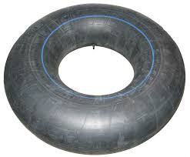
A torus is a hollow doughnut, like this tube.

Slide 4
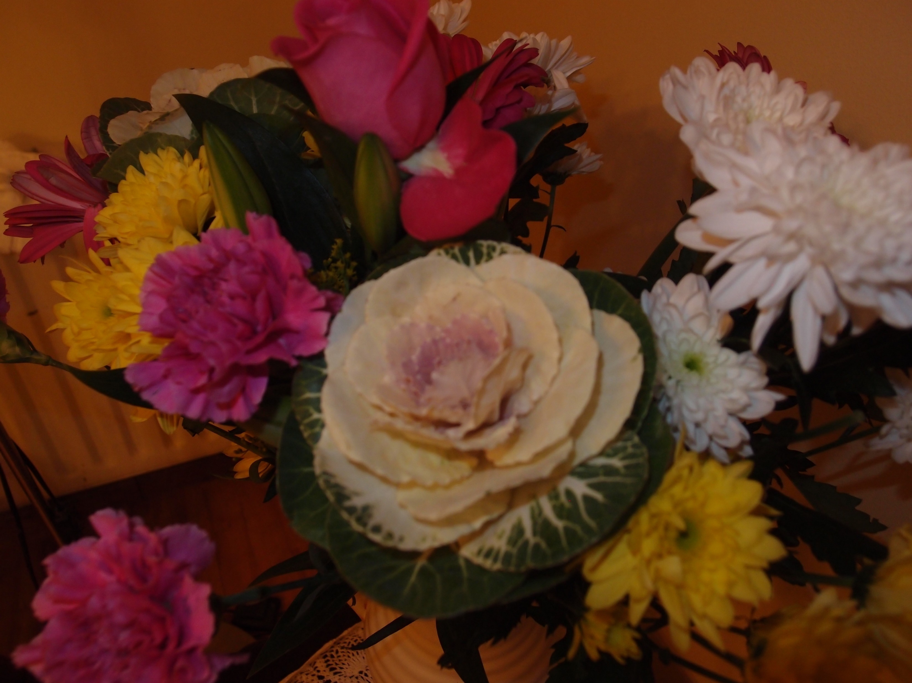
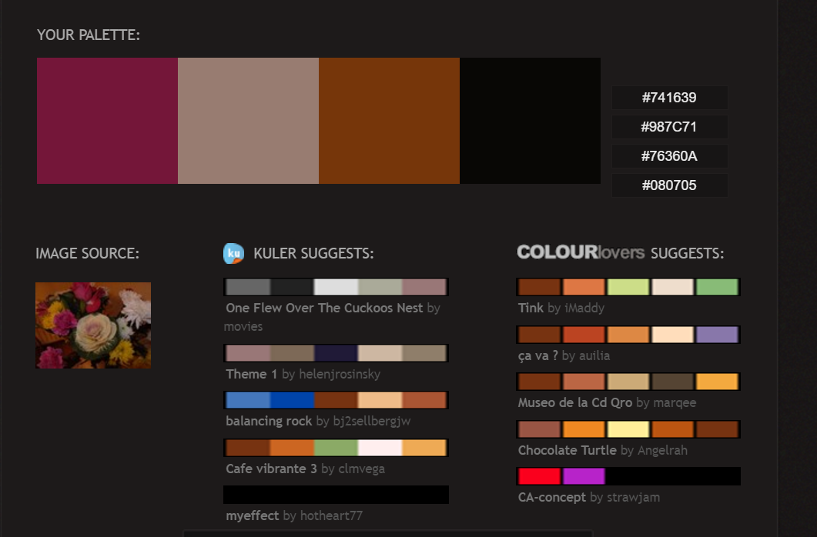
Moodboards

Slide 5

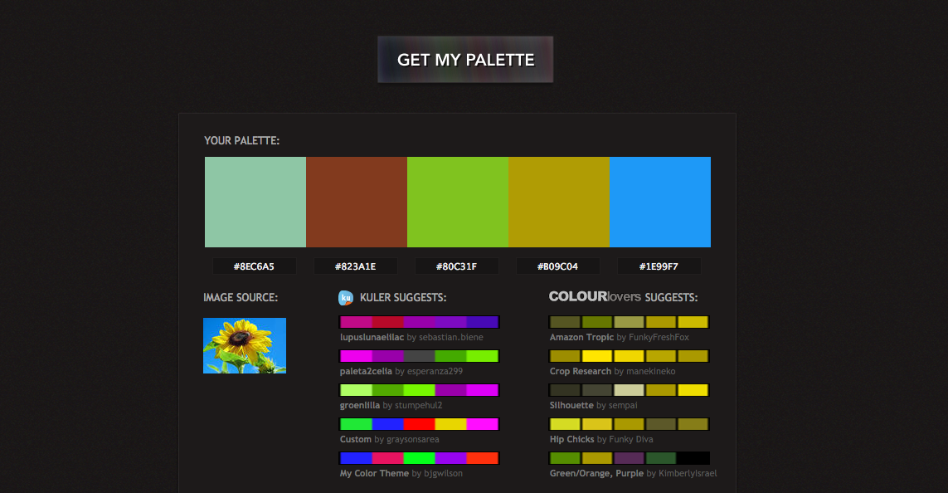
More Moodboard

Slide 6
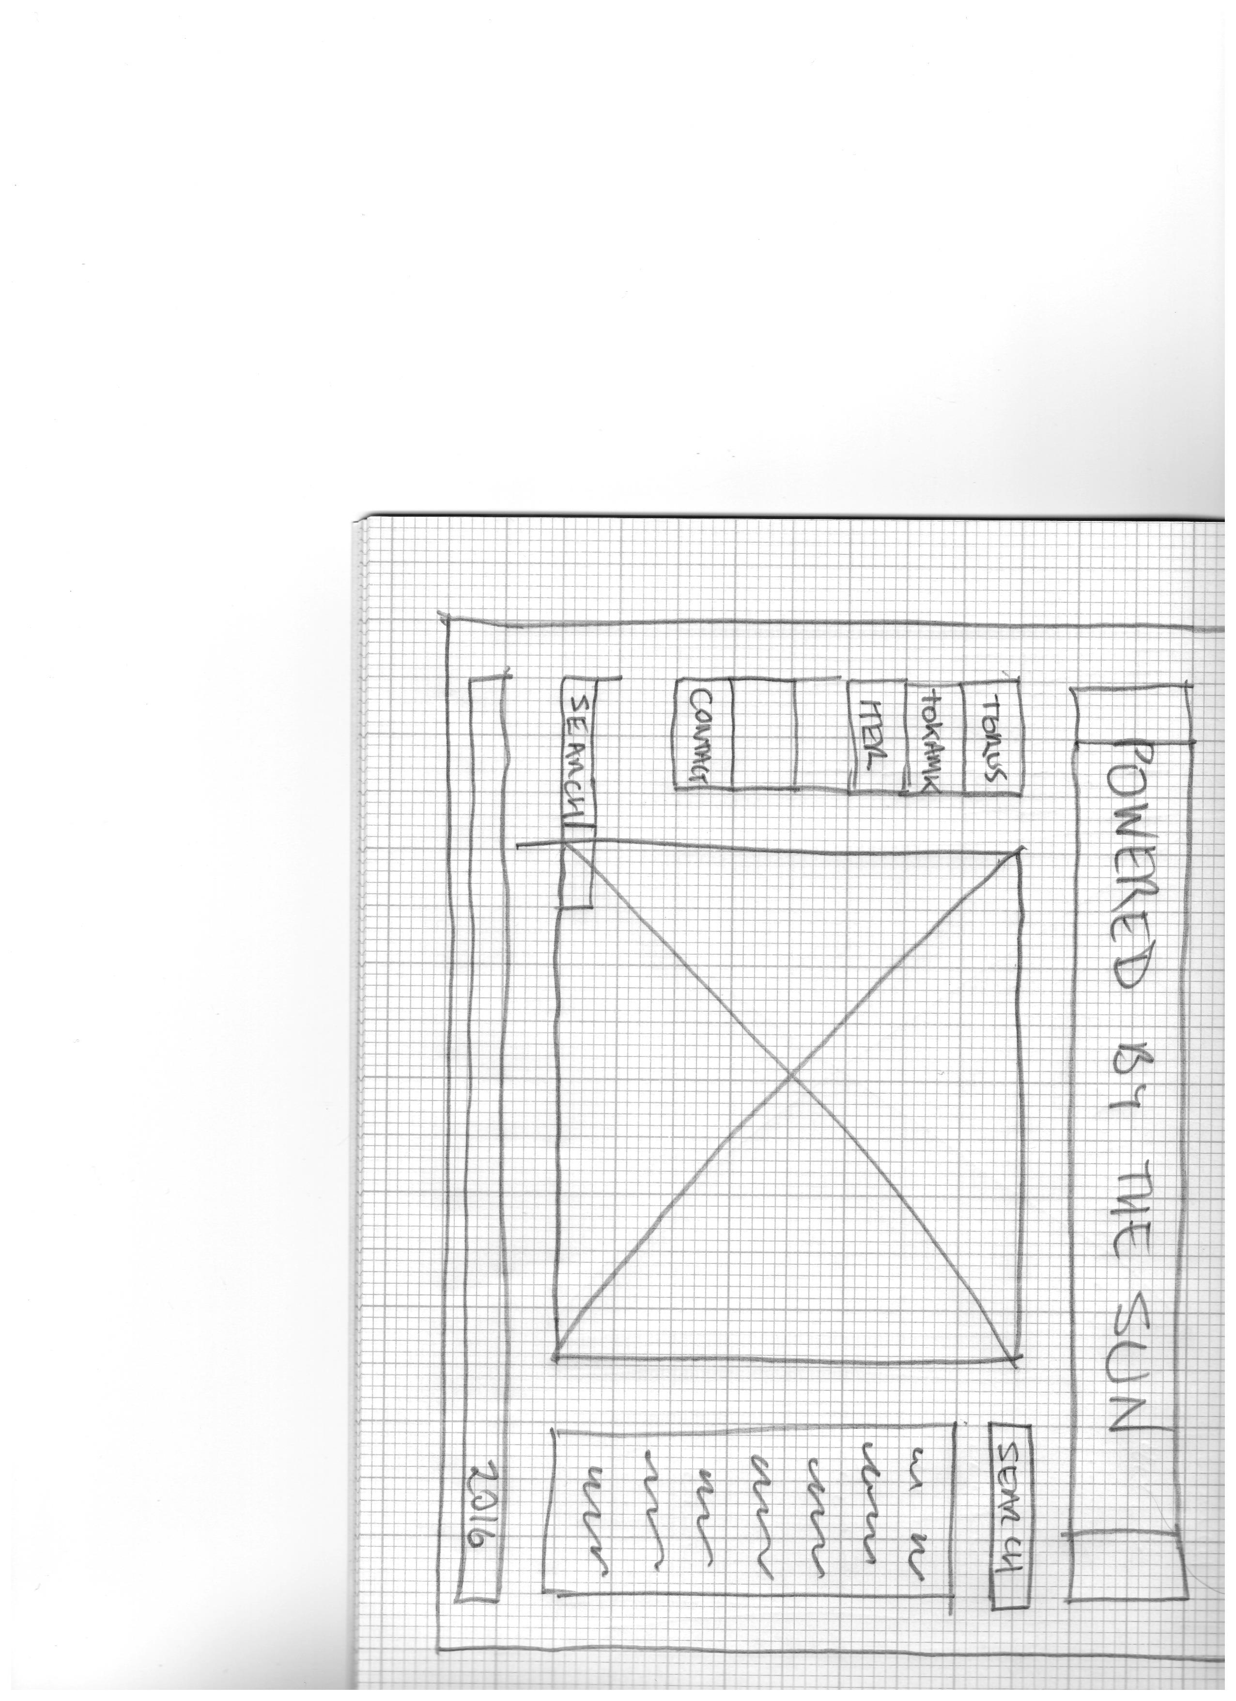
Wireframe mockup

Slide 7
https://k00223366.github.io/WebDevelopment/index.html
https://www.theguardian.com/environment/2016/dec/02/after-60-years-is-nuclear-fusion-finally-poised-to-deliver

