Slide 1
An Spideog Álainn
Jillian Ryan
K00233554

Slide 2
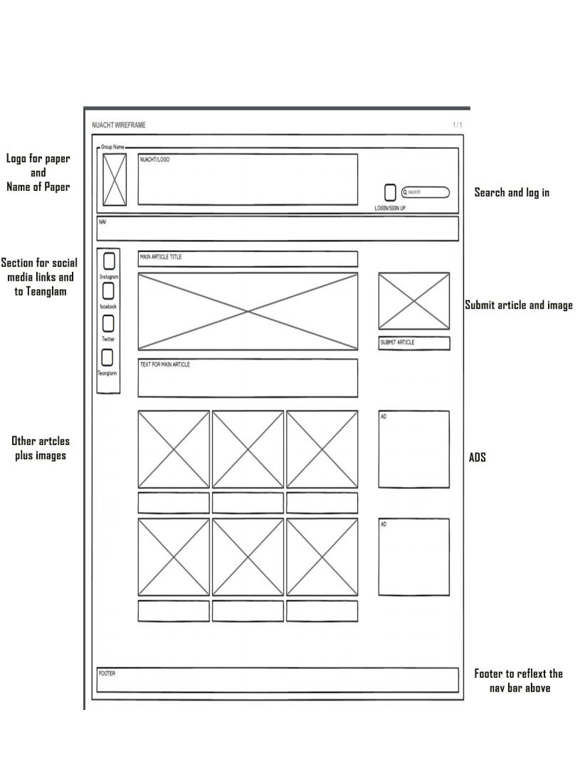
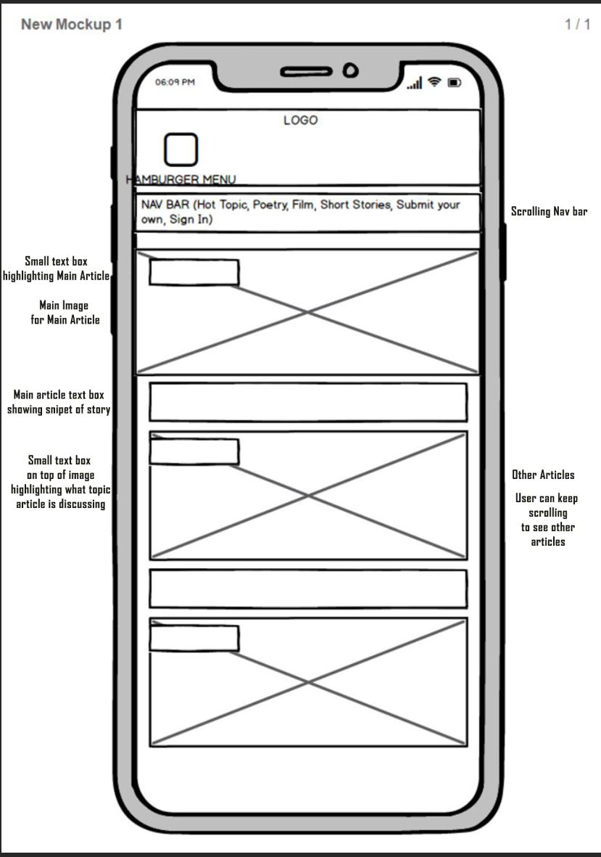
What I hoped to create!!

Slide 3
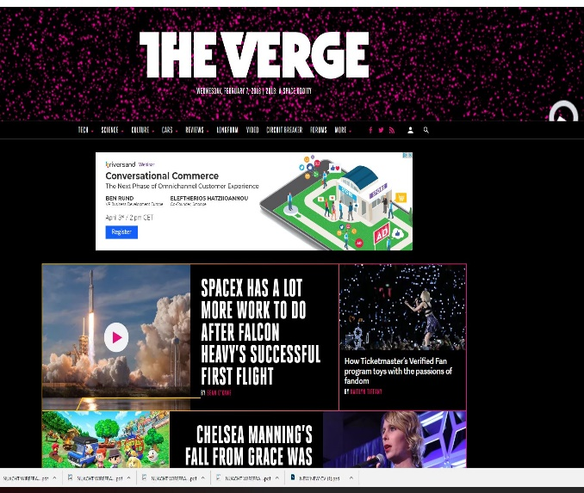
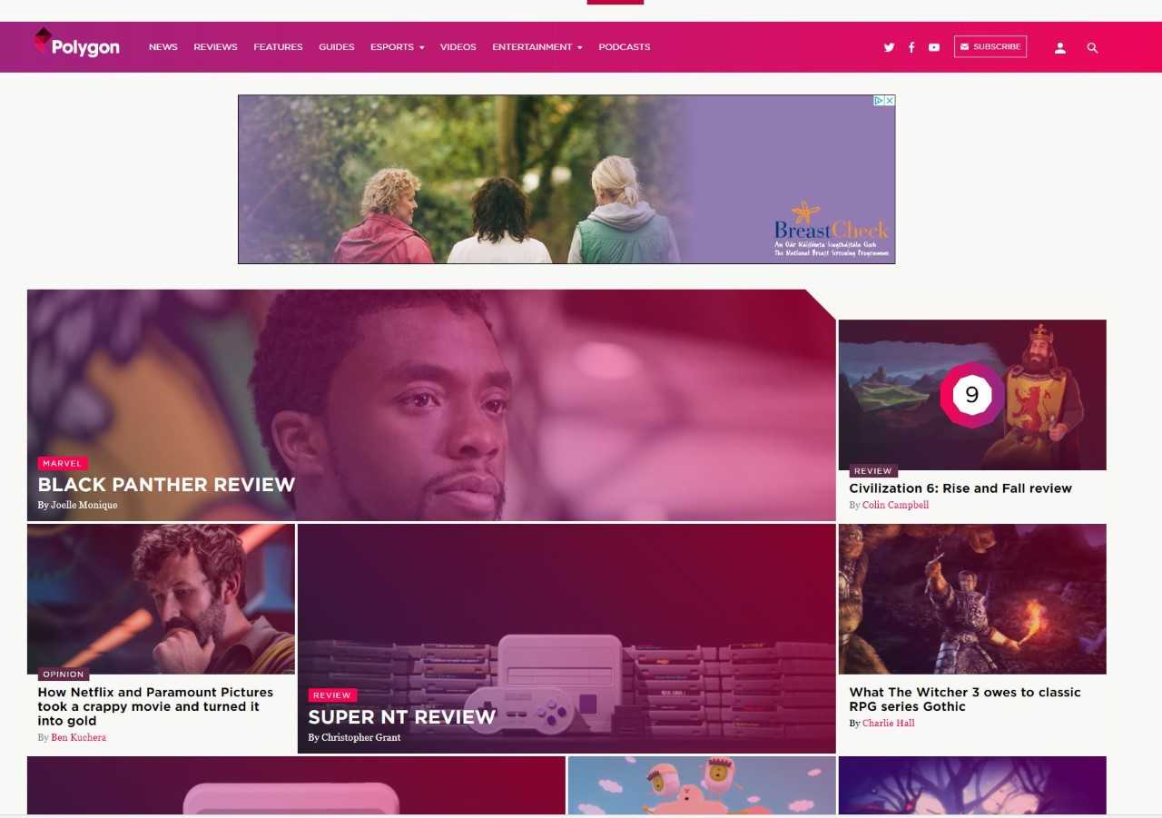
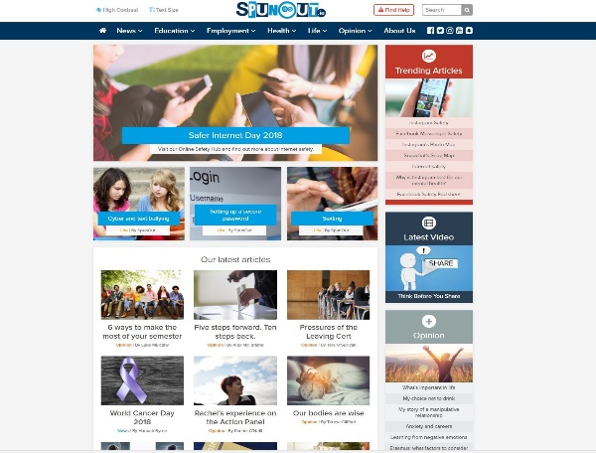
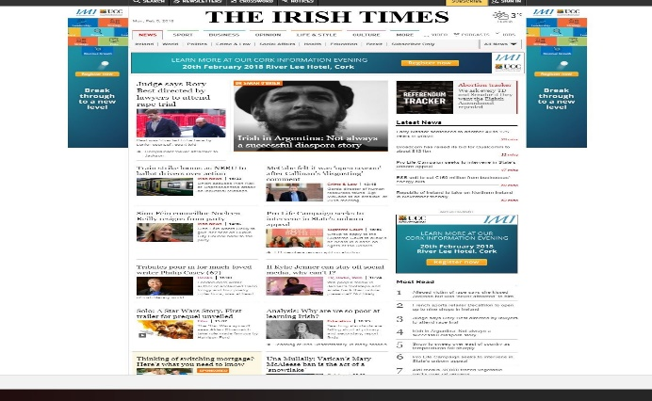


Moodboard!!
Did not want it to look like an ‘Irish’ website.

Slide 4
Obstacles and what I learned:
Started backwards – content first and then structure was a very bad idea.
Had issues laying out the page due to typing up all stories first (next time just copy and paste content).
Found CSS grids and Flex Box quite confusing and watching loads of videos confused things even further.
W3 Schools – copied and pasted code from W3 schools, unsure of actual meaning of code.
Concentrate less on content next time.
Image grid - instructions from w3 schools helped a lot
Happy with colour – although too much negative space.
Issues getting other article pages to align centre
Ended up putting ads to the bottom of page – better layout in the end

Slide 5
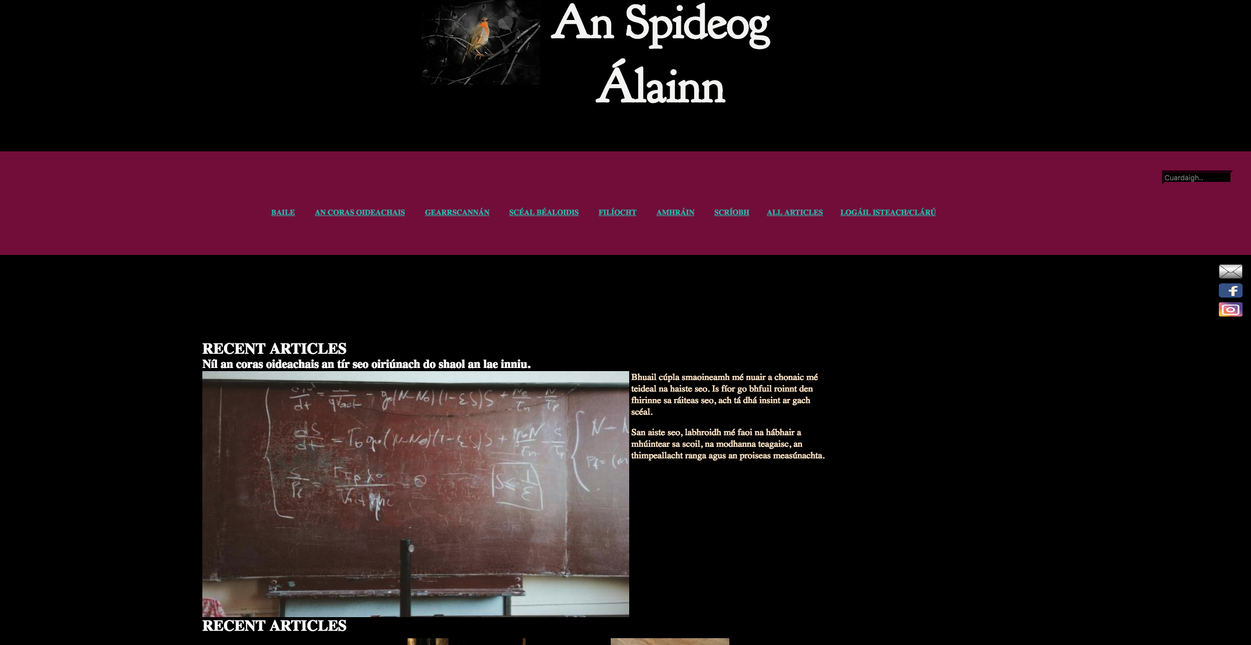
End Result:

