Slide 1



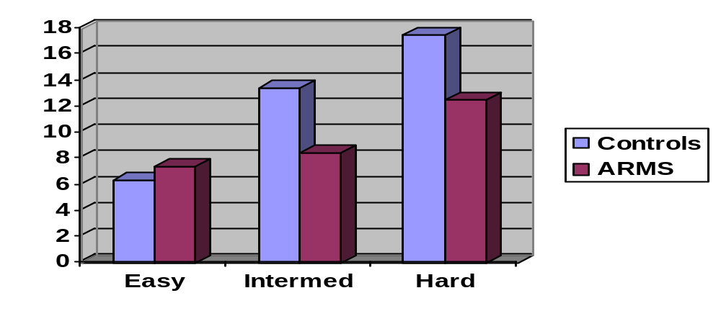

People with an At Risk Mental State Jump to Conclusions
Matthew R. Broome^{1,} Louise C. Johns¹, Isabel Valli¹, James B. Woolley¹, Paul Tabraham¹, Caroline Brett¹, Lucia R. Valmaggia¹⁻², Emmanuelle Peters, Philippa Garety³, PK McGuire¹
¹ Section of Neuroimaging / OASIS, Institute of Psychiatry, King’s College London, UK
² Department of Psychiatry and Neuropsychology, Maastricht University, NL
3 Department of Psychology, Institute of Psychiatry, King’s College London, UK
Background
Cognitive models propose that the faulty appraisal of anomalous experiences is a critical factor in developing psychosis, particularly delusions. One aspect of appraisal, reasoning, can be studied using the ‘Beads’ paradigm, in which the subject is shown a series of different coloured beads and is required to guess which of two jars they have been drawn from. Patients with psychotic disorders require fewer beads to be drawn before they are sure of their source than controls, yet are not any less accurate. This ‘jumping to conclusions’ (JTC) response style has been interpreted as reflecting a data gathering reasoning bias.
Results
Sample
Beads Task
There was no significant difference in performance of the ARMS subjects in comparison to the control group on the classical (or ‘easy’) version of the Beads task: the mean number of beads viewed by ARMS subjects before they responded was 7.4 compared to 6.4 for controls. However, on both of the harder versions of the task (60:40 and 44:28:28) the ARMS group drew fewer beads than controls before responding. For the intermediate version of the task the mean number of beads viewed by ARMS subjects before they responded was 8.5, but for controls was 13.4 (p < 0.001). On the hard version of the task, ARMS viewed 12.5 beads and controls 17.5 (p = 0.012). See figure below.
Draws to decision by
Task difficulty & group
Correlations with Beads task performance
PDI scores: For both groups on both the intermediate and hard conditions of the beads task there was an inverse relationship between the number of beads viewed before the response and scores on the PDI and each of its’ subscales. These were statistically significant for the total PDI score and all three PDI subscales on intermediate (60:40) version of the task and evident as trends for the hard version. The strongest and most significant correlation was with scores on the conviction subscale of the PDI. There were no significant correlations between performance on the easy (85:15) version and any of the PDI measures.
Intolerance of Uncertainty: In both groups the number of beads viewed was inversely related to the Intolerance of Uncertainty score, with a significant correlation on the intermediate version and a trend on the hard version of the task
Working Memory: In controls the number of beads drawn in all versions of the task was directly correlated with the number of errors on the bead span task, although this only reached significance on the intermediate version. Conversely, in the ARMS group there was a negative correlation between beads viewed and errors on the bead span task. Again this was only significant on the intermediate version of the task.
People with an ARMS display a jumping to conclusions reasoning style which is associated with impaired working memory and intolerance of uncertainty. This may underlie their tendency to develop abnormal beliefs and their vulnerability to psychosis. The JTC bias, as well as being a trait vulnerability, may have a state component and one would expect such a bias to increase as ARMS subjects made the transition to psychosis. Conversely, those in whom the ARMS remitted may demonstrate an attenuation of the JTC bias. This could be tested in a longitudinal study of subjects with an ARMS. The effect of memory impairment was divergent in the two groups: in controls, there was an increased conservatism in those with poorer ability to recall sequences of beads, the opposite to what was evident in the ARMS group. This suggest that controls with poor working memory compensated by seeking more information, or did not find being uncertain how to respond as aversive as the at risk subjects.
 | Controls N=23 | ARMS N=35
IQ (NART) | 110.9 (7.3) | 102.3 (10.6)
IQ (Quick) | 104.7 (13.4) | 100.1 (9.8)
Age | 24.9 (3.0) | 24.2 (4.3)
Aims and Hypotheses
We tested the hypothesis that subjects with an ARMS would be more likely to JTC than controls. Secondary predictions were that the tendency to JTC would be associated with impaired working memory and an intolerance of uncertainty, and would predict the severity of abnormal beliefs.
Methods
Sample
Individuals with an At-Risk Mental State (ARMS; n=35), were recruited from Outreach and Support in South London (OASIS) (Broome, Woolley, Johns, et al, 2005). Healthy volunteers (n=23) were recruited via advertisements in the local media. The groups were matched on socio-demographic variables. Subjects were excluded if there was a history of neurological disorder or if they met DSM-IV criteria for a substance misuse or dependence disorder.
Psychopathology was assessed using the Comprehensive Assessment of At Risk Mental State (CAARMS; (Yung, Phillips, Yuen, et al, 2003)), the Peters’ Delusions Inventory (PDI; (Peters, Joseph & Garety, 1999), the Positive and Negative Symptom Scale (PANSS; (Kay, Fiszbein & Opler, 1987)) and the delusion subscale of the Scale for the Assessment of Positive Symptoms (Andreason, 1984).
Reasoning Task
The tendency for participants to ‘jump to conclusions’ was examined using a modified version of the ‘beads’ reasoning task. In the Beads task, subjects are shown two jars of coloured beads, informed of the relative proportions of beads in each, then told that they will be shown a series of beads drawn from one of the jars. Subjects are then asked to judge which jar is the source of the beads. Subjects are asked to be ‘as certain as possible’. The modified version involved 3 conditions: (i) 2 jars with bead ratios of 85:15, (ii) 2 jars with 60:40 and (iii) 3 jars with 44:28:28. Real jars of beads in the appropriate ratios and colours were shown to the subjects when the task was being explained beforehand.
Working memory
The ability to hold information about bead colour on line was assessed using an adaptation of the digit span task that used a string of different coloured beads (between 5 and 9; as in the Beads task) rather than numbers. Subjects were presented with 5 different length strings of coloured beads, 2 trials of each, using a laptop.
Tolerance of Uncertainty
Tolerance of uncertainty was evaluated using the Freeston Intolerance of Uncertainty scale (Freeston, Rheaume, Letarte, et al, 1994). This questionnaire is a 27-item Likert scale and was designed to generate a single summary score. Intolerance of uncertainty is conceptualized as a manifestation of basic dysfunctional (trait) schema that may in turn guide information processing and appraisal. It can generate and maintain anxiety in ambiguous situations both through facilitating the perception of difficulties where none exist, and where difficulties do exist, lead to inefficient responses to them.
IQ
Premorbid and current intellectual function was estimated using the National Adult Reading Test (NART) and the Quick test.
Conclusion
Key References
Broome, M. R., Woolley, J. B., Johns, L. C., et al (2005) Outreach and support in South London (OASIS): implementation of a clinical service for prodromal psychosis and the at risk mental state. European Psychiatry, 20, 372-378.
Broome, M. R., Woolley, J. B., Tabraham, P., et al (2005) What causes the onset of psychosis? Schizophr Res, 79, 23-34.
Freeman, D., Garety, P. A., Kuipers, E., et al (2002) A cognitive model of persecutory delusions. British Journal of Clinical Psychology, 41, 331-347.
Garety, P., Kuipers, E., Fowler, D., et al (2001) A cognitive model of the positive symptoms of psychosis. Psychological Medicine, 31, 189-195.
Van Dael, F., Versmissen, D., Janssen, I., et al (2006) Data Gathering: Biased in Psychosis? Schizophr Bull, 32, 341-351.
Acknowledgements
The staff, service users and referrers of the OASIS team.

