Slide 1
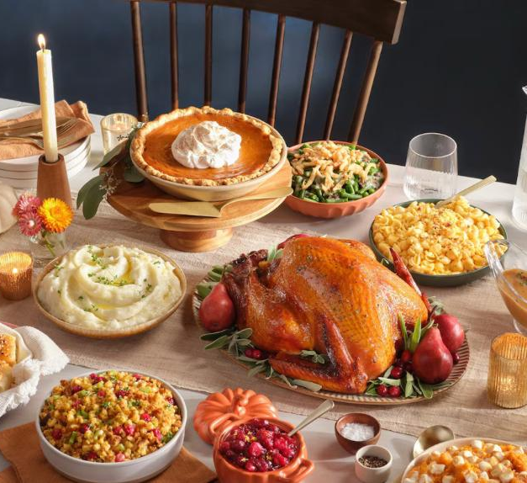

JOIN US FOR THANKSGIVING ALL DAY THURSDAY 27 / 11/ 2025
Full thanksgiving plate incl. desert
Adults: €18
Kids: €12
NOW OPEN 7 DAYS A WEEK FROM 10AM – 8PM

