Slide 1
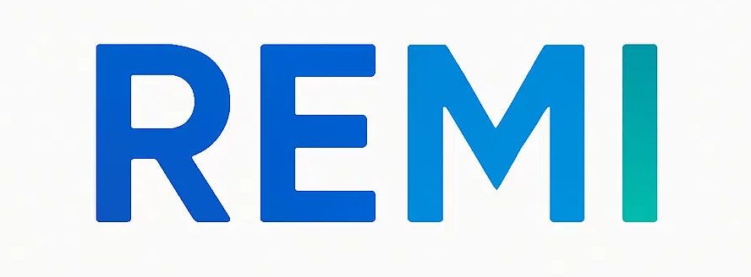
REMI
Personalized nutrition that adapts to real life.
Strategic discussion with Fagron Genomics · September 2026
Turns personalized nutrition into everyday action.
2026

Slide 2
REMI / WHY REMI EXISTS
Change is hard.
≈ 1 in 3
Knowing what to change is not the same as knowing how to change.
avoid or may avoid medical
information about their health
Medical information avoidance meta-analysis, 2025.
YOU DISCOVER YOU ARE
What does that actually change
in my breakfast, lunch or dinner?
APOE2.
The practical question starts after the insight.
Knowing what to change is not enough.
People need help applying it every day.
REMI
Make change easier.
Step by step. In real life.
What if easier change made us want to know ourselves better?
FIRST CLINICAL PARTNER
FunMedDev
Functional Medicine Clinic · Liège · ≈30 patients tested with our first MVP
Ongoing collaboration to test REMI MVPs. Shared observation: patients understood recommendations, but struggled to apply them in daily life.
Sources: Offer et al., 2025, systematic review and meta-analysis; REMI / FunMedDev internal product-learning collaboration, 2026.
02

Slide 3
REMI / PRODUCT MODEL
REMI turns personalized nutrition into everyday action.
By connecting practitioner expertise, biological insights and real-life behaviour.
Biology
Health context
Practitioner expertise
Personality &
preferences
Lifestyle & real-life
behaviour
REMI
PERSONALIZATION ENGINE
PRACTITIONER COPILOT
PATIENT COMPANION
Understand → Structure → Draft protocol
Personalize → Monitor → Adapt
Understand → Learn → Eat → Improve
Follow → Adapt
Personalized support between consultations.
REMI suggests. The practitioner decides.
Source: REMI product vision and roadmap, 2026.
02

Slide 4
REMI / REAL-LIFE PERSONALIZATION
Personalization starts with the meal already on the table.
“
I’m eating pasta tonight.
”
Improve what you are actually
going to eat.
ONE MEAL. TWO PERSONALIZED PATHS.
PROFILE A
PROFILE B
Add fibre
Change fat source
Adjust portion
Modify side
Recipes are an output — not the product identity.
Genetics · Practitioner guidance · Health context · Symptoms · Preferences · Personality · Habits · Real-life behaviour
Source: REMI product vision; FunMedDev MVP learning, 2026.
03

Slide 5
REMI / WHY NOW
Personalized nutrition is growing.
Everyday application is still the opportunity.
$3.7B
→
$12.6B
14.65%
91%
Europe personalized nutrition
market estimate · 2025 → 2034
Projected annual growth
2026–2034
Comfort with personalized
nutrition apps
Industry estimate, not a REMI forecast.
European category signal.
Survey signal, not adoption.
Personalized insights are growing. Everyday application is still the opportunity.
Sources: Market Data Forecast, Europe Personalized Nutrition Market, 2026; NutraIngredients, 2025, citing Euromonitor Voice of the Consumer: Health & Nutrition Survey (Feb 2025; n=21,061 total).
04

Slide 6
REMI / ROADMAP
Build patient intelligence. Expand personalization. Scale the care loop.
A REMI-owned platform roadmap — designed to learn first, then scale.
2026
2027
2027 / 28
EUROPE
PATIENT
INTELLIGENCE
PRACTITIONER COPILOT
+ BIOLOGICAL DATA
SPECIALIST NETWORK
+ REMOTE CARE
PERSONALIZED
NUTRITION
Real-life personalization
Education · daily guidance
Feedback · FunMedDev V2
Protocol drafting · monitoring
Education · genetics
Biomarkers · multiple sources
Trained practitioners
Online consultations
Personalized care pathways
Replicate the
care loop
market by market
Belgium is the starting point. Europe is the ambition.
Source: REMI product roadmap, 2026. 2027+ stages are strategic build ambitions.
05

Slide 7



REMI / THE TEAM
One vision. Three complementary capabilities.
Product / Market / Technology — built around the same care loop.
MORGANE PAQUET
ARNAUD RUELLE
JAMIE NISBET
PRODUCT / PATIENT EXPERIENCE
BUSINESS / PARTNERSHIPS
TECHNOLOGY / ARCHITECTURE
Nutrition · practitioner research
Patient insight · product vision
Real-life personalization
Strategy · partnerships
Commercial development
Scale · European opportunity
Product engineering · integrations
Data layers · modularity
Scalability · platform architecture
ONE VISION · THREE COMPLEMENTARY CAPABILITIES
Source: REMI founding team and internal company information, 2026.
06

Slide 8
REMI / OPEN DISCUSSION
Where do our ambitions overlap?
FAGRON GENOMICS
REMI
Genetic testing
Genetic expertise
Scientific knowledge
Practitioner education
International footprint
Personalized nutrition platform
Practitioner Copilot
Protocol support
Patient education
Daily personalization
Longitudinal follow-up
Future practitioner network
×
Publicly described capabilities
REMI-owned platform ambition
Where could these capabilities create the most value together?
Testing · Education · Practitioners · Patient journey · Data · Europe
Fagron capabilities: public information from Fagron Genomics website and 2025 annual-report materials. REMI capabilities: internal product vision.
07

Slide 9
BACKUP / DISCUSSION IF RELEVANT
One possible path from biological insight to daily action.
A hypothesis to explore if post-test experience, follow-up or activation are priorities.
Test
+ insight
Practitioner
interpretation
Personalized
protocol
REMI
education
Feedback
+ adaptation
Biological
information
Context and
judgement
Clear next
steps
Daily action in
real life
Longitudinal
follow-up
Hypothesis for discussion — not a final partnership model.
Conceptual discussion slide based on REMI product vision and publicly described Fagron Genomics result pathway.
B1

Slide 10
BACKUP / DISCUSSION IF RELEVANT
From scientific knowledge to everyday practitioner capability.
A strategic possibility to explore if practitioner education and adoption are priorities.
FAGRON EXPERTISE
REMI
+
Scientific knowledge
Genetic insight · clinical cases
Training content
Practitioner workflow
Protocol-building tools
Community · patient follow-up
PRACTITIONERS BETTER EQUIPPED TO USE NUTRIGENETICS
LEARN
→
APPLY
→
FOLLOW
Nutrigenetics · Polymorphisms · NutriGen interpretation · Limits · Protocol building · Patient communication
Potential area to explore — not a decided practitioner program.
Public basis: Fagron Genomics webinars and NutriGen materials. REMI elements: internal product and community vision.
B2

Slide 11
BACKUP / DISCUSSION IF RELEVANT
A potential practitioner–patient growth flywheel.
How scientific value, activation and adoption could reinforce a stronger ecosystem.
FAGRON
PRACTITIONERS
REMI
PATIENTS
OUTCOME
OUTCOME
Scientific
education + testing
More
capability
Workflow +
daily activation
More personalized
journeys
More value
from the test
More adoption
& ecosystem
VALUE FOR FAGRON
VALUE FOR REMI
More test value · usage · practitioner / patient adoption
Practitioner adoption · engagement · stronger care loop
Hypothesis for discussion — not a committed growth strategy.
Conceptual discussion slide based on REMI platform vision and publicly described Fagron Genomics education capabilities.
B3

Slide 12
BACKUP / DISCUSSION IF RELEVANT
Belgium proves the care loop. Europe can reproduce it.
A market-by-market expansion hypothesis — not an announced launch plan.
NETHERLANDS
FRANCE
Adjacent · digital readiness
Language · ecosystem
BELGIUM
THEN ASSESS
Prove the
care loop
SPAIN
GERMANY
Digital infrastructure
Scale · localization
MARKET SELECTION CRITERIA
Practitioner ecosystem · Digital readiness · Partner availability · Language · Economics
Potential markets to assess after Belgium — not announced launches.
Sources: European Commission Digital Decade Country Reports 2025 (Netherlands, France, Spain, Germany); REMI strategic market assessment.
B6

