Slide 1
Why you should care the SONy PSN was hacked
Bryan Nehl
CARFAX systems developer
twitter: @k0emt
Notes:
Intro myself
My interest/background in security

Slide 2
Why you should care the SONy PSN was hacked
What to expect today
An interactive talk – this means you!
Brief background of the SONY PSN hack
Impact on SONY
Impact on consumers
Impact on other .COMs
Impact on developers, etc.
Introduction to terminology
Developer Practices (whirl wind)
Resources
Next Steps
Bryan Nehl – twitter: @k0emt
Notes:
Deck w/my notes on github!
Intro myself
My interest/background in security
Consumer
Developer
Manager
Who is in the audience?
Neighboring security talk
Where are you in terms of knowing you need to do something with security?
Can take more time talking about ramifications or more in the tech side.

Slide 3
Sony PSN Hack
What has this meant to Sony?
Notes:
Loss of faith/trust in them.
Lots of money: lost revenue, money spent in recovery, money spent in remediation.
Hurt relationship with customers because of lack of communication.
They will likely serve as a case study for the security field for many years.
SONY PSN background
77 million users information is at stake: names, addresses, birthdates, PSN ID and passwords as well as secret answers and credit card numbers.
It took them about a week to notify users.
PSN down for PS3 and PSP owners for 23 days.
They have offered to buy credit monitoring service.
When they came back on line they had an issue with the password change web page.
They offered up a couple of free games to network members (per account).
Retaliation for SONYs campaign of prosecuting those that were hacking the PS3.
SONY communicated that the breach would cost them at least $171 million.
http://www.wired.com/gamelife/2011/04/playstation-network-hacked/
http://www.theregister.co.uk/2011/06/03/sony_pictures_hacked/
http://www.theregister.co.uk/2011/05/24/sony_playstation_breach_costs/
http://www.guardian.co.uk/technology/gamesblog/2011/apr/27/playstation-network-hack-sony
http://www.atg.wa.gov/BlogPost.aspx?id=28174

Slide 4
Sony PSN Hack
What kind of impact has this had on consumers?
Hackers?
Notes:
A loss of faith/trust in the cloud. Can point to Sony now as a justification.
Anger.
An increased awareness of security issues.
Don’t answer default style questions with the real answers.
Security assurances may be a way for them to comparison shop services.
Knowledgeable users will demand better security.
Inspiration. More script kiddies?

Slide 5
Sony PSN Hack
What might this mean to other companies?
Notes:
In 2007, retailer TJX Companies set aside $118 million to cover a database hack that exposed data for at least 45.6 million payment card accounts.
Heartland Payment Systems reserved about $105 million for lawsuits related to costs in an attack that allowed a hacker to obtain records for as many as 100 million cards.
You need to take security seriously. It will catch up with you.
Are you prepared to answer questions about security from your customers?
Do you have a Chief Security Officer? Who's responsibility is it?
Use this as an opportunity to create or re-evaluate security plans/measures/policies.
At least consider and evaluate the basics:
Who are potential attackers?
Why might they attack us? What is their motivation?
money?
social agenda? (does your company do anything controversial?)
How much will it cost them to attack us?
How much will it cost us to fend them off?
How much will it cost for us to recover from an attack?
Product differentia – SalesForce.com

Slide 6
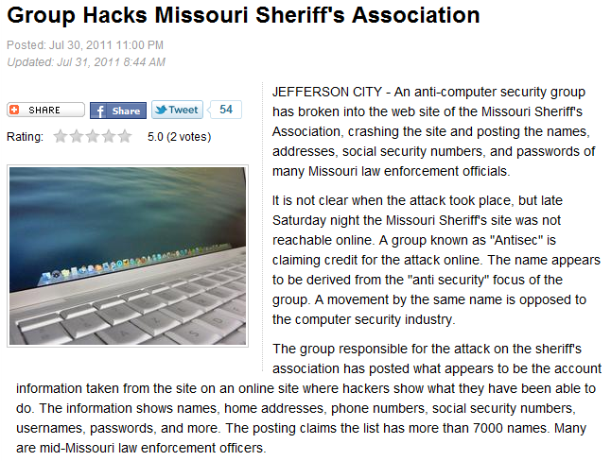
http://www.komu.com/news/group-hacks-missouri-sheriff-s-association/
Notes:
Recent example

Slide 7
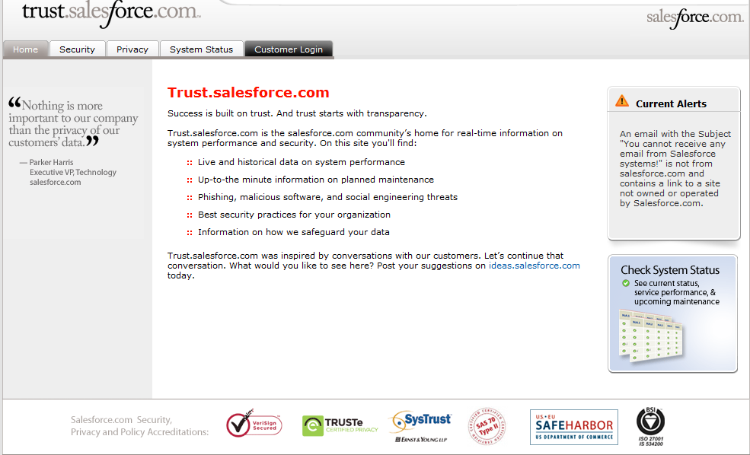
Notes:
Product differentia

Slide 8
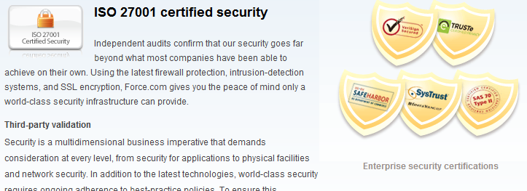
Sony PSN Hack
Notes:
Another example from salesforce.com

Slide 9
Sony PSN Hack
What can I take away from this as a CONSUMER / user?
Notes:
Strong passwords
Use secure sites when possible: FaceBook and Twitter
Ask/check what security measures the company has in place
Use a separate credit card for online purchases
Use made up answers for "school", "pet" type questions
An alternate birthday?
When doing sensitive transactions online only have that one window open.
Maybe use incognito/privacy mode.

Slide 10
Sony PSN Hack
What can I take away from this as a Developer?
Security is a FIRST CLASS concern
Notes:
Learn/know what are best practices
Security requirements will have a direct impact on application design
SQL Injection
Security and usability interact with each other.
Understand may need to change what you have done based on security breach
(example: Sony’s reset password page, email address and birthday)
Script attack your own stuff (Red teams)
Use this as an opportunity to evaluate your area of responsibility, provide information about problem areas and possible solutions to management.
SECURITY IS A FIRST CLASS CONCERN
Keeping up to date on patches
Do dev/test with non-admin roles
Code attributes (Code Access Security - CAS)
Use AD roles/accounts to restrict who can run code
http://msdn.microsoft.com/en-us/library/ff648663.aspx
Bring in experts when you don't know!
Don't reinvent the wheel. Use existing libraries.

Slide 11
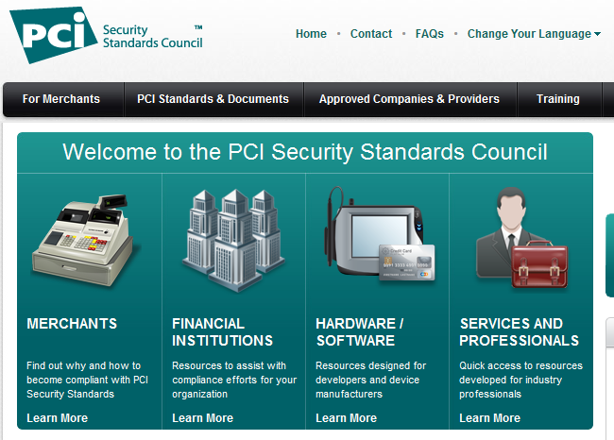
Sony PSN Hack
https://www.pcisecuritystandards.org/
Notes:
Do you handle credit card information?

Slide 12
Sony PSN Hack
What can I take away from this as a Developer?
Protect against SQL INJECTION attack
Notes:
SQL
SQL Injection attack/Parameterized SQL
http://www.codinghorror.com/blog/2005/04/give-me-parameterized-sql-or-give-me-death.html
SQL in the URL (Oklahoma)
http://thedailywtf.com/Articles/Oklahoma-Leaks-Tens-of-Thousands-of-Social-Security-Numbers,-Other-Sensitive-Data.aspx
Does the app have full access to the database once connected?
Use database roles and stored procedures to limit
Use a web service
Are you storing connection information in web.config?

Slide 13
Sony PSN Hack
Terminology
Confidentiality, Authenticity, Integrity
Identity
Seals, Certificates
MAC, Message digest, Hash function
Encryption
Data sharding and partitioning
DOS, DDOS (Distributed Denial Of Service) Attack
Zombies
Virus toolkits
Peer-to-peer and mesh network file sharing
Physical Security
Notes:
Sometimes you don’t even know the terms to initiate your search!

Slide 14
Sony PSN Hack – Dev stuff
In browser attacks or Man-in-the-Browser (MitB) attacks
http://en.wikipedia.org/wiki/Man_in_the_Browser
Spam from your email
Bank account access
Client side/server side validation
Apple VIP platinum pass code developer event story
https://www.whitehatsec.com/home/solutions/BL_jobs.html
Configuration files
Debug messages visible to users
http://msdn.microsoft.com/en-us/library/e8z01xdh(v=VS.100).aspx
Connection info visible in config file
Notes:
Hashed VIP codes into client side validation.
The source size was small enough that a brute force attack was feasible.

Slide 15
Sony PSN Hack – XSS
XSS Cross Site Scripting
https://www.infosecisland.com/blogview/11402-Cross-Site-Scripting-XSS-Some-Examples.html
https://www.owasp.org/index.php/Cross-site_Scripting_(XSS)
http://download.microsoft.com/download/E/E/7/EE7B9CF4-6A59-4832-8EDE-B018175F4610/Quick%20Security%20Reference%20-%20Cross-Site%20Scripting.docx
Notes:
Ever go to a web forum and find that there was an ad in the middle of the screen for something that is totally unrelated to the content? Seem like spam? Probably was XSS.

Slide 16
Sony PSN Hack – Passwords
Password policies
Please don't build a poor limit/policy into your app
How do you store in db?
Use existing libraries
MS login form
Third party API OpenID/OpenAuth
Notes:
The users password should never be stored in a human readable form (hash it with a salt and compare the hash of the provided password + salt to what is stored)

Slide 17
Sony PSN Hack – BUFFEROVERFLOW Attack
Is your system vulnerable?
Buffer overflow attacks
Through standard input
URL line
DATA
C# vulnerable?
C++?
Notes:
C# is not vulnerable unless you have “unsafe” code http://msdn.microsoft.com/en-us/library/f58wzh21.aspx
http://social.msdn.microsoft.com/Forums/hu-HU/csharpgeneral/thread/c5cd011f-b513-4aa2-9b0f-f24a7966b55d
C++ is vulnerable

Slide 18
Sony PSN Hack – IDS/IPS/Logging
Intrusion Detection System (IDS)
Intrusion Prevention System (IPS)
SNORT is an open source IDS/IPS tool
http://www.snort.org
Application and System Event Logging

Slide 19
Resources
Ross Anderson 1ed Security Engineering
http://www.cl.cam.ac.uk/~rja14/book.html
Handbook of Applied Cryptography
http://www.cacr.math.uwaterloo.ca/hac/
Lecture Notes on Cryptography
http://cseweb.ucsd.edu/~mihir/papers/gb.html
MS SDL Process Templates for VSTS and TFS, Risk Assessment documents
http://www.microsoft.com/security/sdl/adopt/processtemplate.aspx
OWASP -- The Open Web Application Security Project
www.owasp.org
Microsoft Security Development Lifecycle (SDL)
http://www.microsoft.com/security/sdl/default.aspx
Wireshark -- what is your app putting out on the wire?
http://www.wireshark.org/
Nmap (Port scanner) – I see you!
http://nmap.org/
Firesheep – I am you!
http://codebutler.com/firesheep

Slide 20
Next STEPS
What will you do now?
As a consumer?
As a developer?
As a Manager?
As someone in marketing?
Etc.

Slide 21
Bryan’s info
Twitter: @k0emt
Blog: soloso.blogspot.com
Github: k0emt
Notes:
This presentation is available on github

Slide 22


