Slide 1
MongoDB: A high level introduction and demonstration.
Features
Strengths
Gotchas
Demonstration
Would you like to know more?
Bryan Nehl
@k0emt

Slide 2


What is MongoDB?
Document Store
Jagged structured documents
BSON
Considered NOSQL
Web Scale
NOT

Slide 3
Structure
Databases
Collections
Documents
Fields

Slide 4
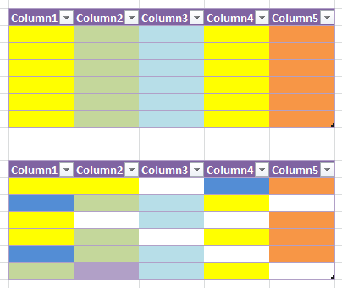
Relational / Document Structure

Slide 5
Features

Slide 6
JSON Review
json.org
{“key” : “values”}
JSON types
string, number, object, array, true, false, null
Lists
Sub-documents

Slide 7
Features
JSON/BSON (see bsonspec.org)
JavaScript shell
GridFS
File System Style backups

Slide 8
Features
Supports indexes
Features for optimizing (perf/stat/top)
Tools for monitoring (MMS)
GeoJSON
Full Text Search (default on v2.6)

Slide 9
Aggregation Framework
Often compared/contrasted with:
Map-Reduce (lightweight alternative)
SQL (where, order by, group by)
Pipe line architecture
In version 2.6:
returns a cursor
Can output to a collection
Can do disk based sorting

Slide 10
Scalable
Safety
Write safety (the w option)
Journal protection (the j option)
Replication
Sharding
Commodity PHYSICAL machines with local storage

Slide 11
Sharding
Sharding distributes a single logical database system across a cluster of machines
Shards
Store a portion of the collection – size scalability
Balance read/write load and data across machines
Enabled per database and collection
mongos
used to access the shards
Utilize config servers which have metadata
About the cluster
About where the chunks are for the shards
http://docs.mongodb.org/manual/sharding/

Slide 12
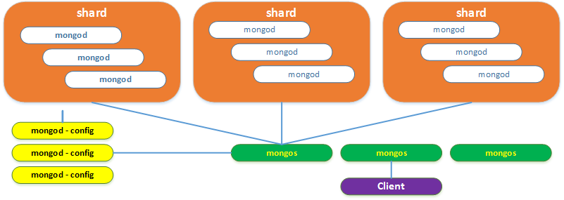
Production Sharding Environment
Notes:
Diagram

Slide 13
Security
Layered – start with your network
Authentication
Challenge – Response
LDAP, Kerberos
Certificate
Authorization
Role based access for users
http://docs.mongodb.org/manual/security/

Slide 14
Lots of Drivers
Java / Groovy / JVM
JavaScript / Node.js
Python
C / C++ / C#
Go / Erlang
Perl / PHP
Ruby / Scala
http://docs.mongodb.org/ecosystem/drivers/

Slide 15
Example Java Code
MongoClient mongoClient = new MongoClient("localhost");
DB stuffDb = mongoClient.getDB("workshop");
DBCollection exampleCol = stuffDb.getCollection("examples");
DBObject document;
document = exampleCol.findOne(new BasicDBObject("someField",5));
System.out.println(document);
DBCursor cursor = exampleCol.find();
while(cursor.hasNext()) {
document = cursor.next();
System.out.println("c doc: " + document);
}
mongoClient.close();

Slide 16
Example Python code
from pymongo import MongoClient
client = MongoClient("localhost")
db = client.workshop
col = db.examples
doc = col.find_one({"someField": 5})
print doc
for doc in col.find():
print "c doc: " + str(doc)
client.close()

Slide 17
Strengths

Slide 18
Simplicity
Installation
Download (archive or MSI)
Copy into place
Create /data/db
Start mongod
Interact with it using mongo

Slide 19
Interactive Shell
Very powerful and easy to use
Example
List databases
Create a document
Auto-creates database
Fields are not fixed across documents, in order, type or occurrence

Slide 20
Interactive Shell -- Demo
show dbs
use mydb
show dbs
show collections
db.inventory.insert({“car”:”Escape”})
db.inventory.find()
show dbs
show collections
db.inventory.insert({“car”:{“make”:”Ford”,”model”:”Escape”}})

Slide 21
Gotchas

Slide 22
Gotchas
If you misspell…
Database / collection / field
Production defaults for Windows/Linux
Remember to configure your dev box!
GUI interfaces are still immature
Joins have to be done in code
No Transactions (individual operations are atomic)
Cut-n-paste those dang fancy “quotes”

Slide 23
Gotchas
Give the shell something syntactically wrong and it’ll eat it
Isn’t as strict about deleting multiple documents as it is about updating them
Improperly repeat a field name in a query and it’ll use the last criteria specified
Differences between regular queries and the aggregation framework

Slide 24
{“section” : “Schema”}
A demonstration of document oriented design

Slide 25
Structure
Databases
Collections
Documents
Fields

Slide 26
Relational / Document Structure

Slide 27
Relational Design Exercise
Using standard relational techniques design an inventory management system that tracks assets.
Example assets are: vehicles, computers, tables and chairs.
I want to be able to store a lot of detail.
Where is the asset?
To whom is an asset assigned?
Vehicle detail like: make, model, VIN, color, etc.
Table detail like: material type, size, condition, color, etc.
Notes:
Typically single table with lots of columns for assets or lots of tables denormalizing

Slide 28
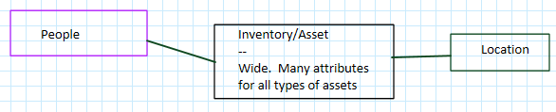
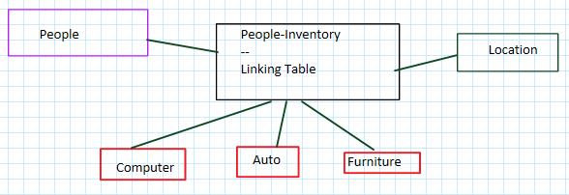
Relational
Notes:
SQL: database->tables->rows & fields/columns
Color code the columns fixed color to indicate type
MongoDB: database ->collections -> documents -> fields
Varying document sizes
Field types can change

Slide 29
Document Design
How would we organize this same sort of information in a document oriented system like MongoDB?
Consider the access pattern(s).
Inventory part of Personnel System
Inventory part of Location Review
Inventory the primary focus

Slide 30
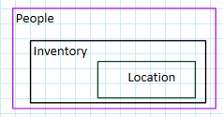
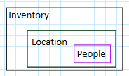
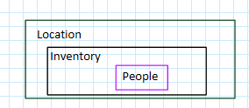
Potential Document Design

Slide 31
Document Oriented Schema Design
Naming
avoid the . (dot)
key name length matters
No Joins
Consider the Access Pattern

Slide 32
Would you like to know more?

Slide 33
Who is using MongoDB?
Lots of people
Disney
Expedia
LinkedIn
eHarmony
Sourceforge
SAP
MTV
http://www.mongodb.org/about/production-deployments/

Slide 34
MongoDB Resources
MongoDB University
Python, Java, node.js
Administration & Operations
https://university.mongodb.com/
http://docs.mongodb.org/manual/
http://mongodb.org

Slide 35
Conferences
MongoDB World
Strata
PyData & PyCon
Kansas City Developer Conference
BigDataSummitKC.org

Slide 36
Mentors
From MongoDB
User Groups and Forums
Within your company

Slide 37
Experiment
Set up a development environment
Try out stuff
Work related
Something you are passionate about
Share your experiences
blog, tweet, present
GitHub and Gists

Slide 38


Slide 39
MongoDB Questions?
Bryan Nehl
@k0emt
dbBear.com
(Links to Twitter, blog, GitHub, gists)

