Slide 1
MSE Presentation 2 MultiAgent Control of Traffic Signals (MACTS)
Bryan Nehl
MSE Candidate

Slide 2
Agenda
Action Item update
Vision Document 2.0
Project Plan 2.0
Test Plan
Formal Technical Inspection Checklist
System Architecture Design 1.0
Formal Requirements Specification
Executable Architecture Prototype
Risk Log Update

Slide 3
Action Items Update
Revise Use Case diagram
Track SLOC (project code)
Alternate code size estimate
COCOMO 6400, Me ~1500-2000
System evaluation should include and describe comparison baseline.
Request Technical Inspectors
Request Project Server Space

Slide 4
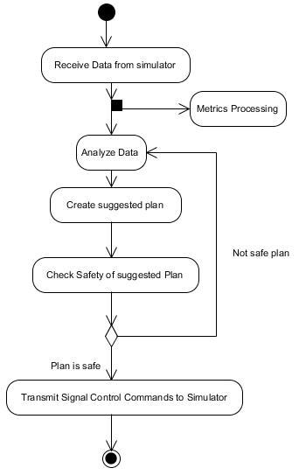
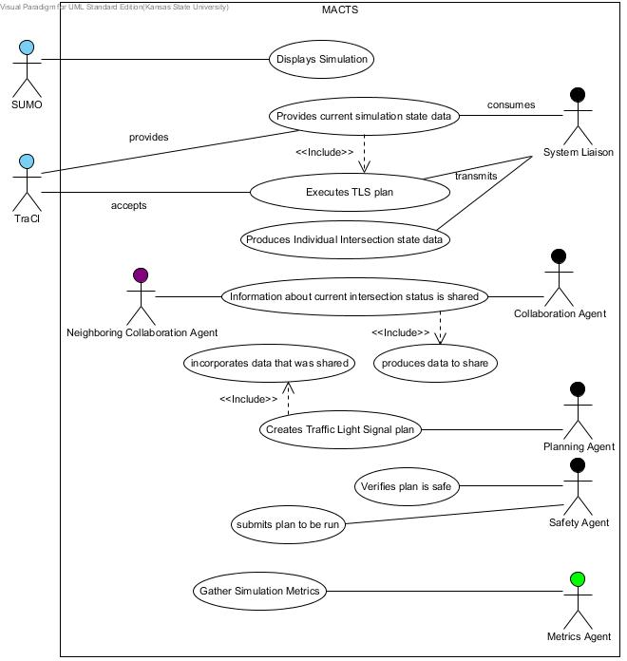
Vision Document 2.0
Critical Use Cases Diagram updated
Single Iteration Diagram updated

Slide 5
Project Plan 2.0
Updated with experience based estimate
COCOMO 6.4K
Experiential ~1.5K-2K
(not including comments or test code)

Slide 6
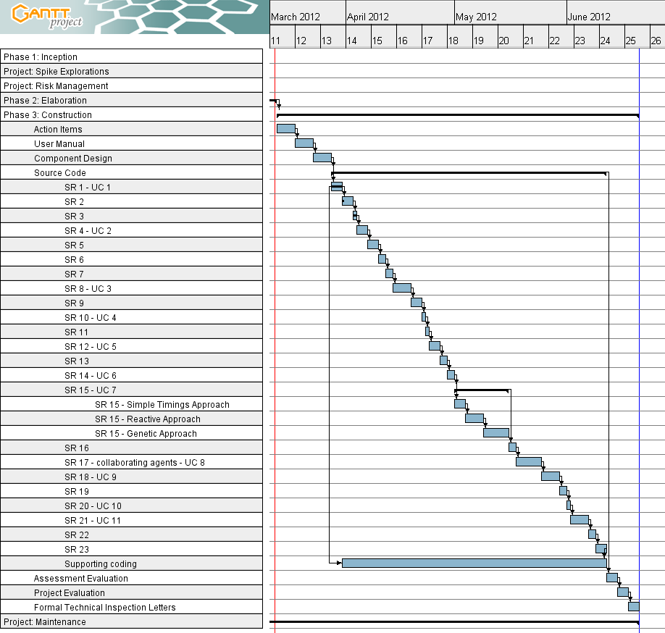

Slide 7
Test Plan
Inspections
Feature / Requirement Testing
Scenario Comparisons

Slide 8
Formal Technical Inspection Checklist
System Architecture Document
Diagrams
Interactions
Clarity and Consistency
USE/OCL
Inspectors
Denise Case
Sindhu Thotakura

Slide 9
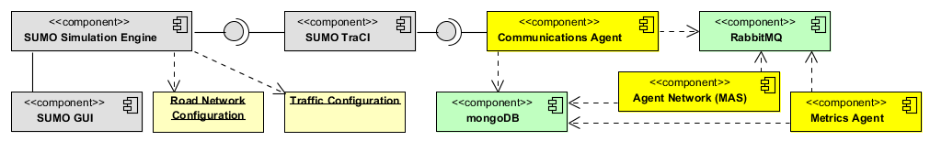
System Architecture Design 1.0
Includes Formal Requirements Specification

Slide 10
Project Risks and Spikes
Risks
Spikes
Python
SUMO
Time/Scope
Collaboration Agents
Genetic Agent
SUMO
Network Load
Network Double T
Read from TRACI
Send to TRACI
Network Metrics
Read Sensors
Add Sensors
Notes:
Am I trying to do too much in my time frame?
Quality concern by 100% test coverage of non-trivial code. Won’t test API/library calls. Will strive for low cyclomatic complexity.

Slide 11
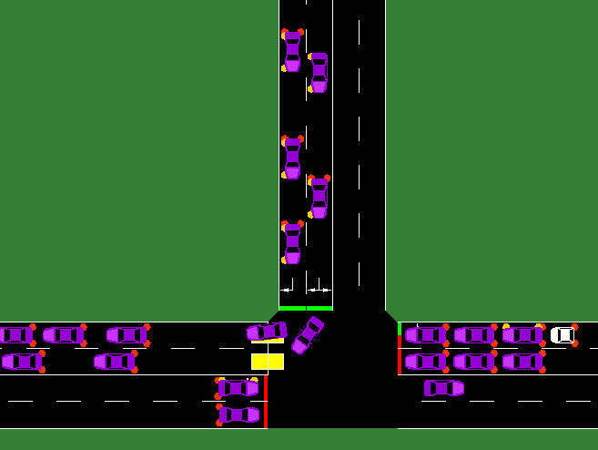
Demonstration Interaction with SUMO

Slide 12
Phase III Deliverables
Action Items from Phase II
Graph of project SLOC progress
Graph of project Rework effort
Project materials on gForge server
User Manual
Component Design
Source Code
Assessment Evaluation
Project Evaluation
References
Formal Technical Inspection Letters
Phase III Presentation
Time Log
Risk Log Update

Slide 13
Questions and Comments
?

Slide 14
References
SUMO, “Simulation for Urban MObility,” Sep. 2011; http://sourceforge.net/apps/mediawiki/sumo/index.php?title=Main_Page.
T. Masterton and D. Topiwala, “Multi-Agent Traffic Light Optimisation and Coordination,” white paper, Thales Group, Reference VCS081002, Issue 2, 2008.
W. Royce, Software Project Management: A Unified Framework, Addison-Wesley,1998, p. 34, pp. 265-281.
B. Boehm et al., “Cost Models for Future Software Processes: COCOMO 2.0,” Annals of Software Eng., Vol. 1, 1995, pp. 57-94.
K-State Master of Software Engineering web site, “MSE Portfolio Requirements,”
November 28, 2011; http://mse.cis.ksu.edu/portfolio.html.
Center for Systems and Software Engineering web site, “COCOMO II,” December 4, 2011: http://sunset.usc.edu/csse/research/COCOMOII/cocomo_main.html.
The Code Project web site, “Software Project Cost Estimates Using COCOMO II Model,” December 4, 2011: http://www.codeproject.com/KB/architecture/cocomo2.aspx.
Naval Postgraduate School web site, “COCOMO II - Constructive Cost Model,” December 4, 2011: http://diana.nps.edu/~madachy/tools/COCOMOII.php.
Center for Software Engineering, USC, COCOMO II: Model Definition Manual Version 2.1, 2000.
The Code Project web site, “Calculating Function Points,” December 4, 2011: http://www.codeproject.com/KB/architecture/Calculate_Function_Point.aspx.
USC Center for Software Engineering website, “COCOMO II Affiliates,” December 4, 2011: http://csse.usc.edu/csse/affiliate/private/COCOMOII_Driver+Calc_Ss/SpreadSheet-COCOMOII.html.

Slide 15
References 2
IEEE Std. 730-1998, IEEE Standard for Software Quality Assurance Plans, IEEE 1998.
IEEE Std. 730.1-1995 IEEE Guide for Software Quality Assurance Planning, IEEE, 1995.
Python Software Foundation, “PEP 8 -- Style Guide for Python Code”, Python, 24 Sep. 2011; http://www.python.org/dev/peps/pep-0008/.
Python Software Foundation, “PEP 257 – Docstring Conventions”, Python, 24 Sep. 2011; http://www.python.org/dev/peps/pep-0257/.
K. Hill, “GMoDS-based Runtime Agent Role Interpreter SQA Plan 1.0”, People, 15 Sep. 2011; http://people.cis.ksu.edu/~kylhill/phase_1/sqa_plan.pdf.
B. Nehl, “Multiagent Control of Traffic Signals Project Plan 1.0”, People, 26 Sep. 2011; http://people.cis.ksu.edu/~bnehl/repos/macts.git/.
W. Royce, Software Project Management; Addison-Wesley, 1998, pp. 290-291.

