Slide 1
MSE Presentation 1 MultiAgent Control of Traffic Signals (MACTS)
Bryan Nehl
MSE Candidate

Slide 2
Agenda
Project Vision
System Context
Project Requirements and Plan
Cost Estimation
Project Software Quality Assurance Plan
Candidate Architecture Overview
Demonstration Agent Communication
Demonstration Interaction with Simulator (SUMO)
Phase II Deliverables
Project Log, Risks, Spikes and Concerns
Questions/Comments
References

Slide 3
Project Vision
Goal
The goal of this project is to create a multiagent system that is capable of traffic light signal control which results in an improved travel experience.
Motivation
Most traffic light systems today are strictly timing based. Traffic flow studies are required to create timing plans and atypical conditions cause problems. It is also very frustrating to have to stop for a red light when there is no opposing traffic.

Slide 4
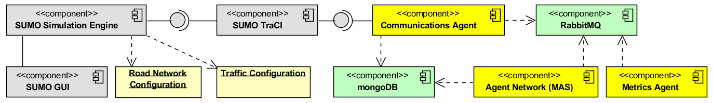
System Context

Slide 5
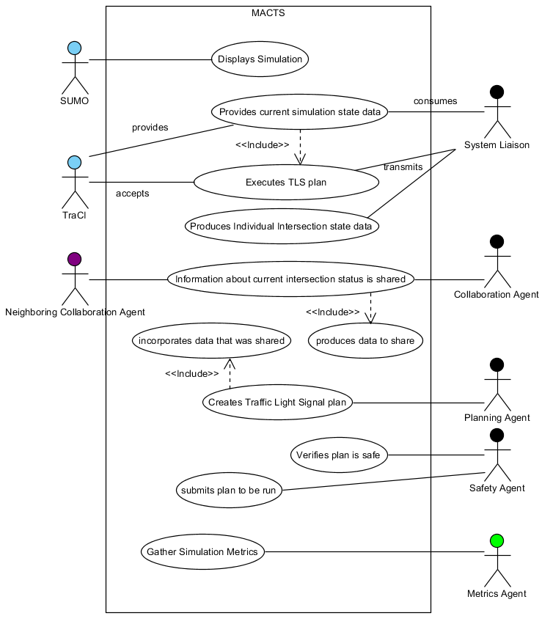
Project Requirements
Notes:
The system does not attempt to model the activity of individual cars. That is left to the simulator, SUMO.

Slide 6
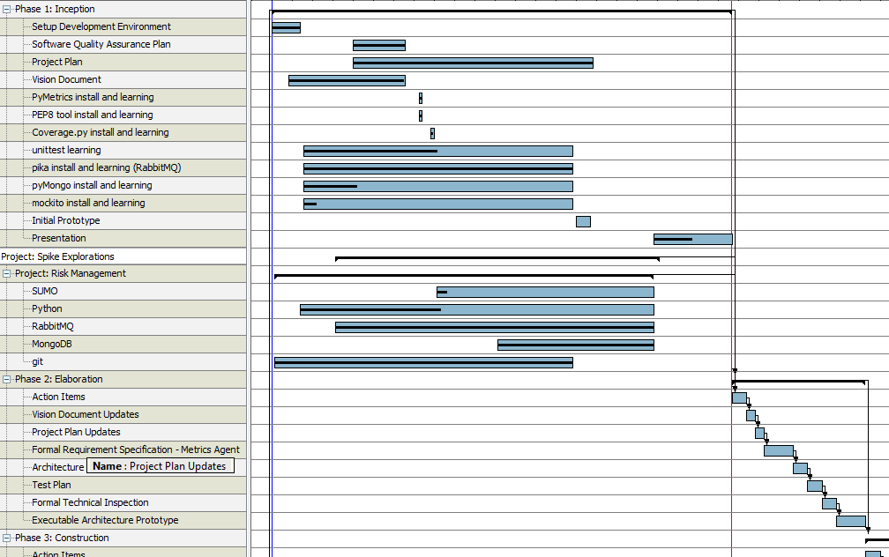
Project Plan
Notes:
Screen shot of Gantt Chart and switch to software application.
Discussion of incorporating risks, spikes and maintenance.Initial consideration for flow based approach?

Slide 7
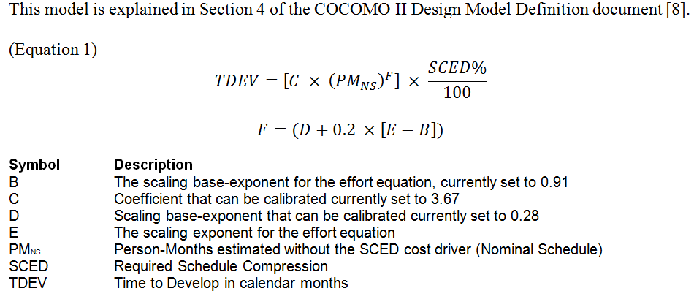
Cost Estimation
Notes:
COCOMO equation

Slide 8
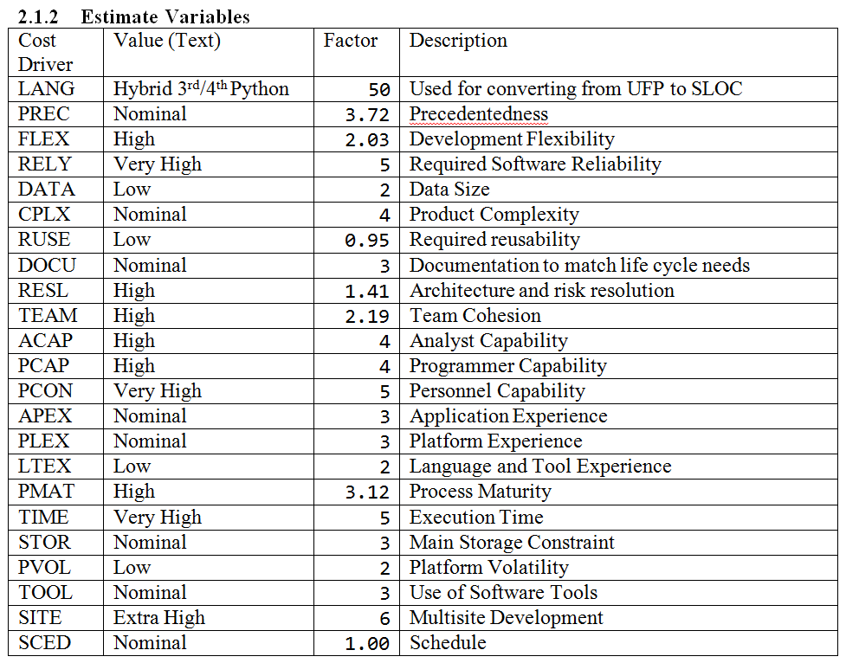
Notes:
COCOMO Factors

Slide 9
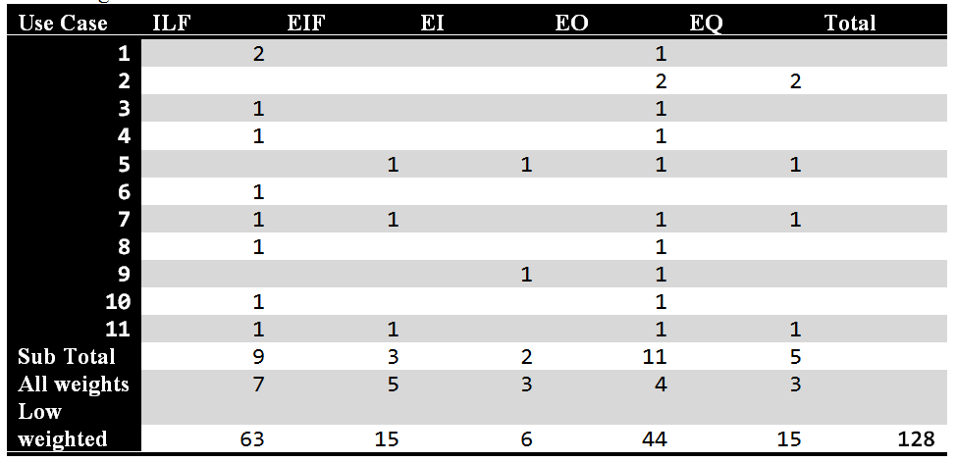
Cost Estimation: Size Estimates
Notes:
COCOMO size estimates
Unadjusted function points are used in the early design stage for project estimation. I followed the information I found about computing function points on the Code Project website[9]. Additional information included definitions of the function point types can be found in section 2.2 of COCOMO II: Model Definition Manual[8]. I reviewed my use cases and arrived at this table.

Slide 10
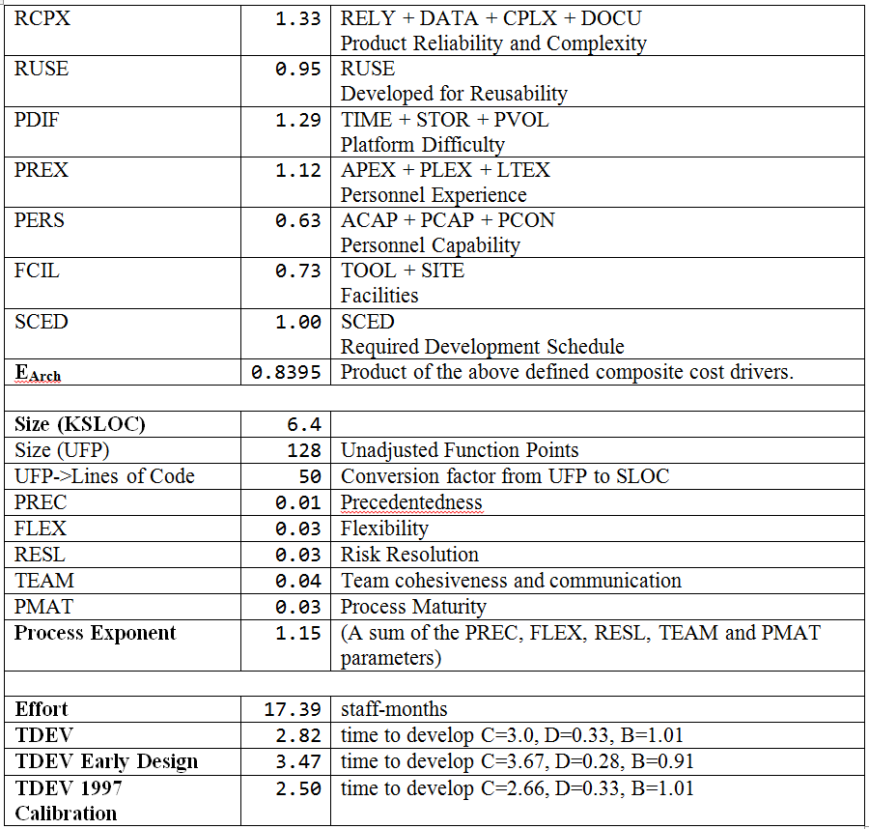
Early Design Calculations
Notes:
COCOMO variables and partial computations for full equation
Discuss UFP->Lines of Code
Discuss Effort and TDEV

Slide 11
Project Software Quality Assurance Plan (SQAP)
Management Organization
Documentation
Standards, Practices, Conventions and Metrics
Test plan
Problem reporting and corrective action
Tools, techniques and methodology
Record collection, maintenance and retention
Notes:
Technical Inspectors TBD
Documentation to delivery for each phase
meet PEP 8 and 257 code/documentation standards
rework metric as measure of code quality
Test plan will incorporate unit and integration tests.
Have blogged/experimented with/about tools. Notable: PEP8, PyMetrics, Google Docs and GanntProject.
Does the website with PDF documents and zip file work for them?

Slide 12
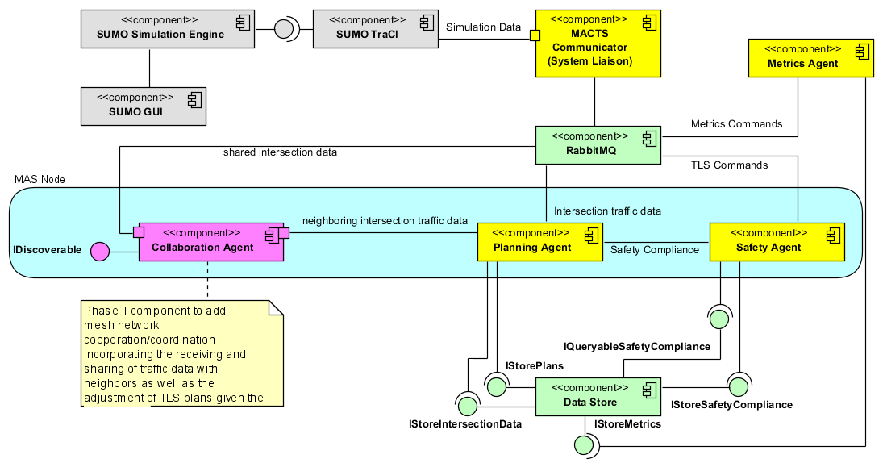
Candidate Architecture Overview

Slide 13
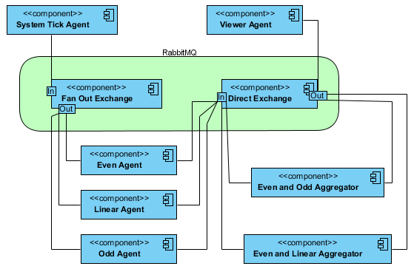
Demonstration: Agent Communication

Slide 14
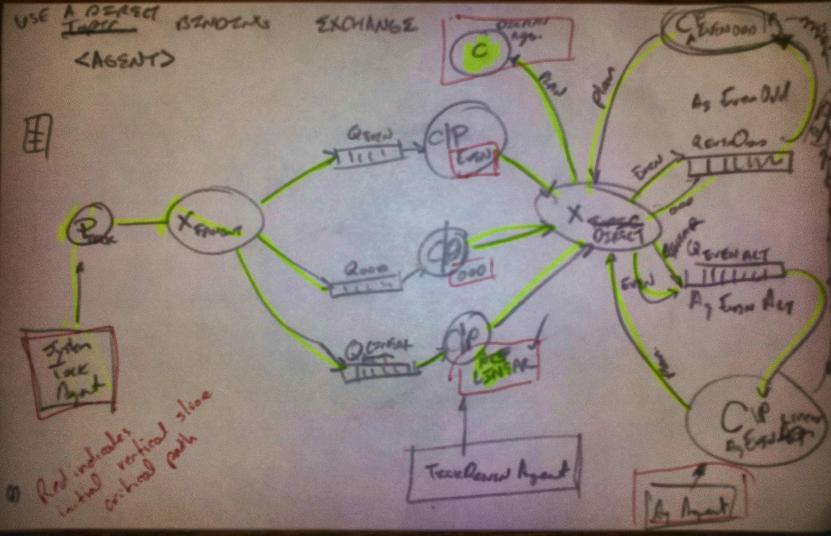
Demonstration Agent Communication
Notes:
Consumers, Producers and Queues
Agents denoted by red boxes

Slide 15
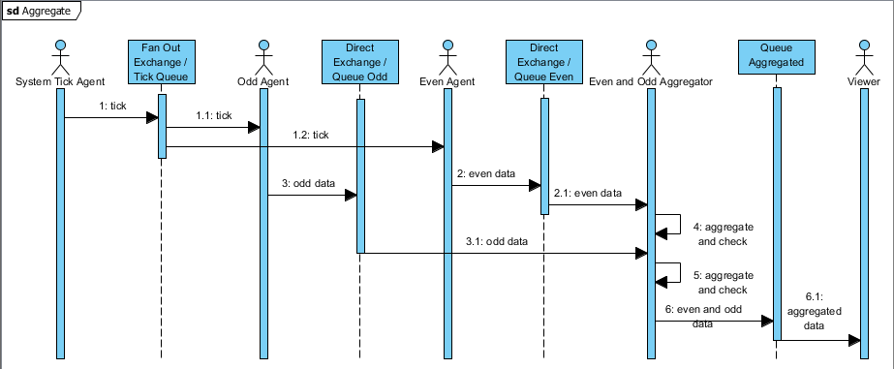
Demonstration Agent Communication

Slide 16
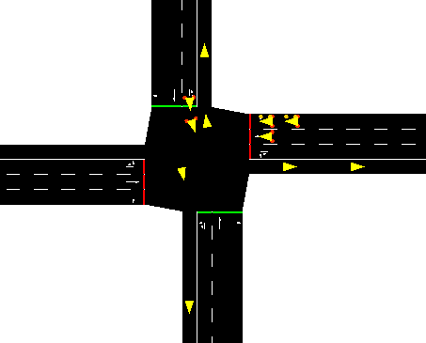
Demonstration Interaction with SUMO

Slide 17
Phase II Deliverables
Action Items from Phase 1
Vision Document 2.0
Project Plan 2.0
Formal Requirements Specification
Architecture Design 1.0
Test Plan
Formal Technical Inspection Checklist
Executable Architecture Prototype
Risk Log Update
Presentation 2
Notes:
Do the Metrics Agent for the Formal Requirements Specification?
I think my documentation was suggesting the safety officer agent.

Slide 18
Project Log
Maintained as a Google Document
Exported as PDF for website
Notes:
Share the Google document with them?
Cover benefits, pain points.

Slide 19
Project Risks and Spikes
Risks
Python
RabbitMQ
MongoDB
SUMO
git
Scope
Time
Spikes
Python
RabbitMQ
Q Fanout
Aggregation
MongoDB
training
git
reading
seminars
hands on use
Spikes
SUMO
Network Load
Network Double T
Read from TRACI
Send to TRACI
Network Metrics
Read Sensors
Add Sensors
Notes:
Am I trying to do too much in my time frame?
Quality concern by 100% test coverage of non-trivial code. Won’t test API/library calls. Will strive for low cyclomatic complexity.

Slide 20
Questions and Comments
?

Slide 21
References
SUMO, “Simulation for Urban MObility,” Sep. 2011; http://sourceforge.net/apps/mediawiki/sumo/index.php?title=Main_Page.
T. Masterton and D. Topiwala, “Multi-Agent Traffic Light Optimisation and Coordination,” white paper, Thales Group, Reference VCS081002, Issue 2, 2008.
W. Royce, Software Project Management: A Unified Framework, Addison-Wesley,1998, p. 34, pp. 265-281.
B. Boehm et al., “Cost Models for Future Software Processes: COCOMO 2.0,” Annals of Software Eng., Vol. 1, 1995, pp. 57-94.
K-State Master of Software Engineering web site, “MSE Portfolio Requirements,”
November 28, 2011; http://mse.cis.ksu.edu/portfolio.html.
Center for Systems and Software Engineering web site, “COCOMO II,” December 4, 2011: http://sunset.usc.edu/csse/research/COCOMOII/cocomo_main.html.
The Code Project web site, “Software Project Cost Estimates Using COCOMO II Model,” December 4, 2011: http://www.codeproject.com/KB/architecture/cocomo2.aspx.
Naval Postgraduate School web site, “COCOMO II - Constructive Cost Model,” December 4, 2011: http://diana.nps.edu/~madachy/tools/COCOMOII.php.
Center for Software Engineering, USC, COCOMO II: Model Definition Manual Version 2.1, 2000.
The Code Project web site, “Calculating Function Points,” December 4, 2011: http://www.codeproject.com/KB/architecture/Calculate_Function_Point.aspx.
USC Center for Software Engineering website, “COCOMO II Affiliates,” December 4, 2011: http://csse.usc.edu/csse/affiliate/private/COCOMOII_Driver+Calc_Ss/SpreadSheet-COCOMOII.html.

Slide 22
References 2
IEEE Std. 730-1998, IEEE Standard for Software Quality Assurance Plans, IEEE 1998.
IEEE Std. 730.1-1995 IEEE Guide for Software Quality Assurance Planning, IEEE, 1995.
Python Software Foundation, “PEP 8 -- Style Guide for Python Code”, Python, 24 Sep. 2011; http://www.python.org/dev/peps/pep-0008/.
Python Software Foundation, “PEP 257 – Docstring Conventions”, Python, 24 Sep. 2011; http://www.python.org/dev/peps/pep-0257/.
K. Hill, “GMoDS-based Runtime Agent Role Interpreter SQA Plan 1.0”, People, 15 Sep. 2011; http://people.cis.ksu.edu/~kylhill/phase_1/sqa_plan.pdf.
B. Nehl, “Multiagent Control of Traffic Signals Project Plan 1.0”, People, 26 Sep. 2011; http://people.cis.ksu.edu/~bnehl/repos/macts.git/.
W. Royce, Software Project Management; Addison-Wesley, 1998, pp. 290-291.

