Slide 1
MSE Presentation 1 MultiAgent Control of Traffic Signals (MACTS)
Bryan Nehl
MSE Candidate

Slide 2
Agenda
Project Overview
Project Vision
System Context
Project Requirements and Plan
Cost Estimation
Project Software Quality Assurance Plan
Candidate Architecture Overview
Demonstration Agent Communication
Demonstration Interaction with Simulator
Phase II Deliverables
Project Log, Risks, Spikes and Concerns
Questions/Comments
References

Slide 3
Project Overview
Goal
The goal of this project is to create a multiagent system that is capable of traffic light signal control which results in an improved travel experience.
Motivation
Most traffic light systems today are strictly timing based. Traffic flow studies are required to create timing plans and atypical conditions cause problems. It is also very frustrating to have to stop for a red light when there is no opposing traffic.

Slide 4
Project Vision

Slide 5
System Context

Slide 6
Project Requirements
Notes:
Use case diagram here

Slide 7
Project Plan
Notes:
Screen shot of Gantt Chart and switch to software application

Slide 8
Cost Estimation
Notes:
COCOMO equation

Slide 9
Cost Estimation
Notes:
COCOMO Factors

Slide 10
Cost Estimation
Notes:
COCOMO size estimates

Slide 11
Cost Estimation
Notes:
COCOMO full equation

Slide 12
Cost Estimation
Notes:
COCOMO variables and partial computations for full equation

Slide 13
Cost Estimation
Notes:
COCOMO Process Exponent

Slide 14
Cost Estimation
Notes:
COCOMO time to develop numbers

Slide 15
Project Software Quality Assurance Plan (SQAP)
Notes:
Major sections

Slide 16
Candidate Architecture Overview

Slide 17
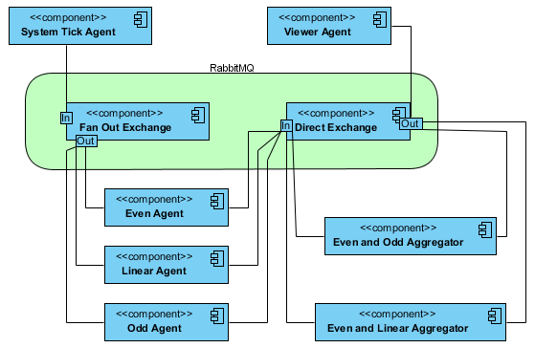
Demonstration: Agent Communication

Slide 18
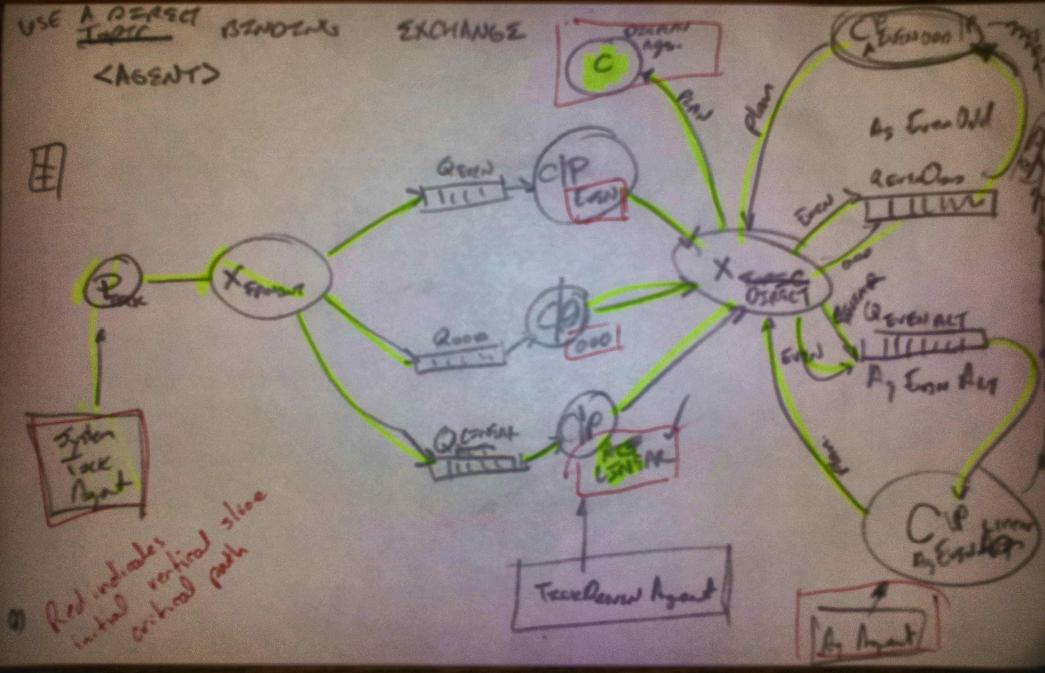
Demonstration Agent Communication
Notes:
Consumers, Producers and Queues
Agents denoted by red boxes

Slide 19
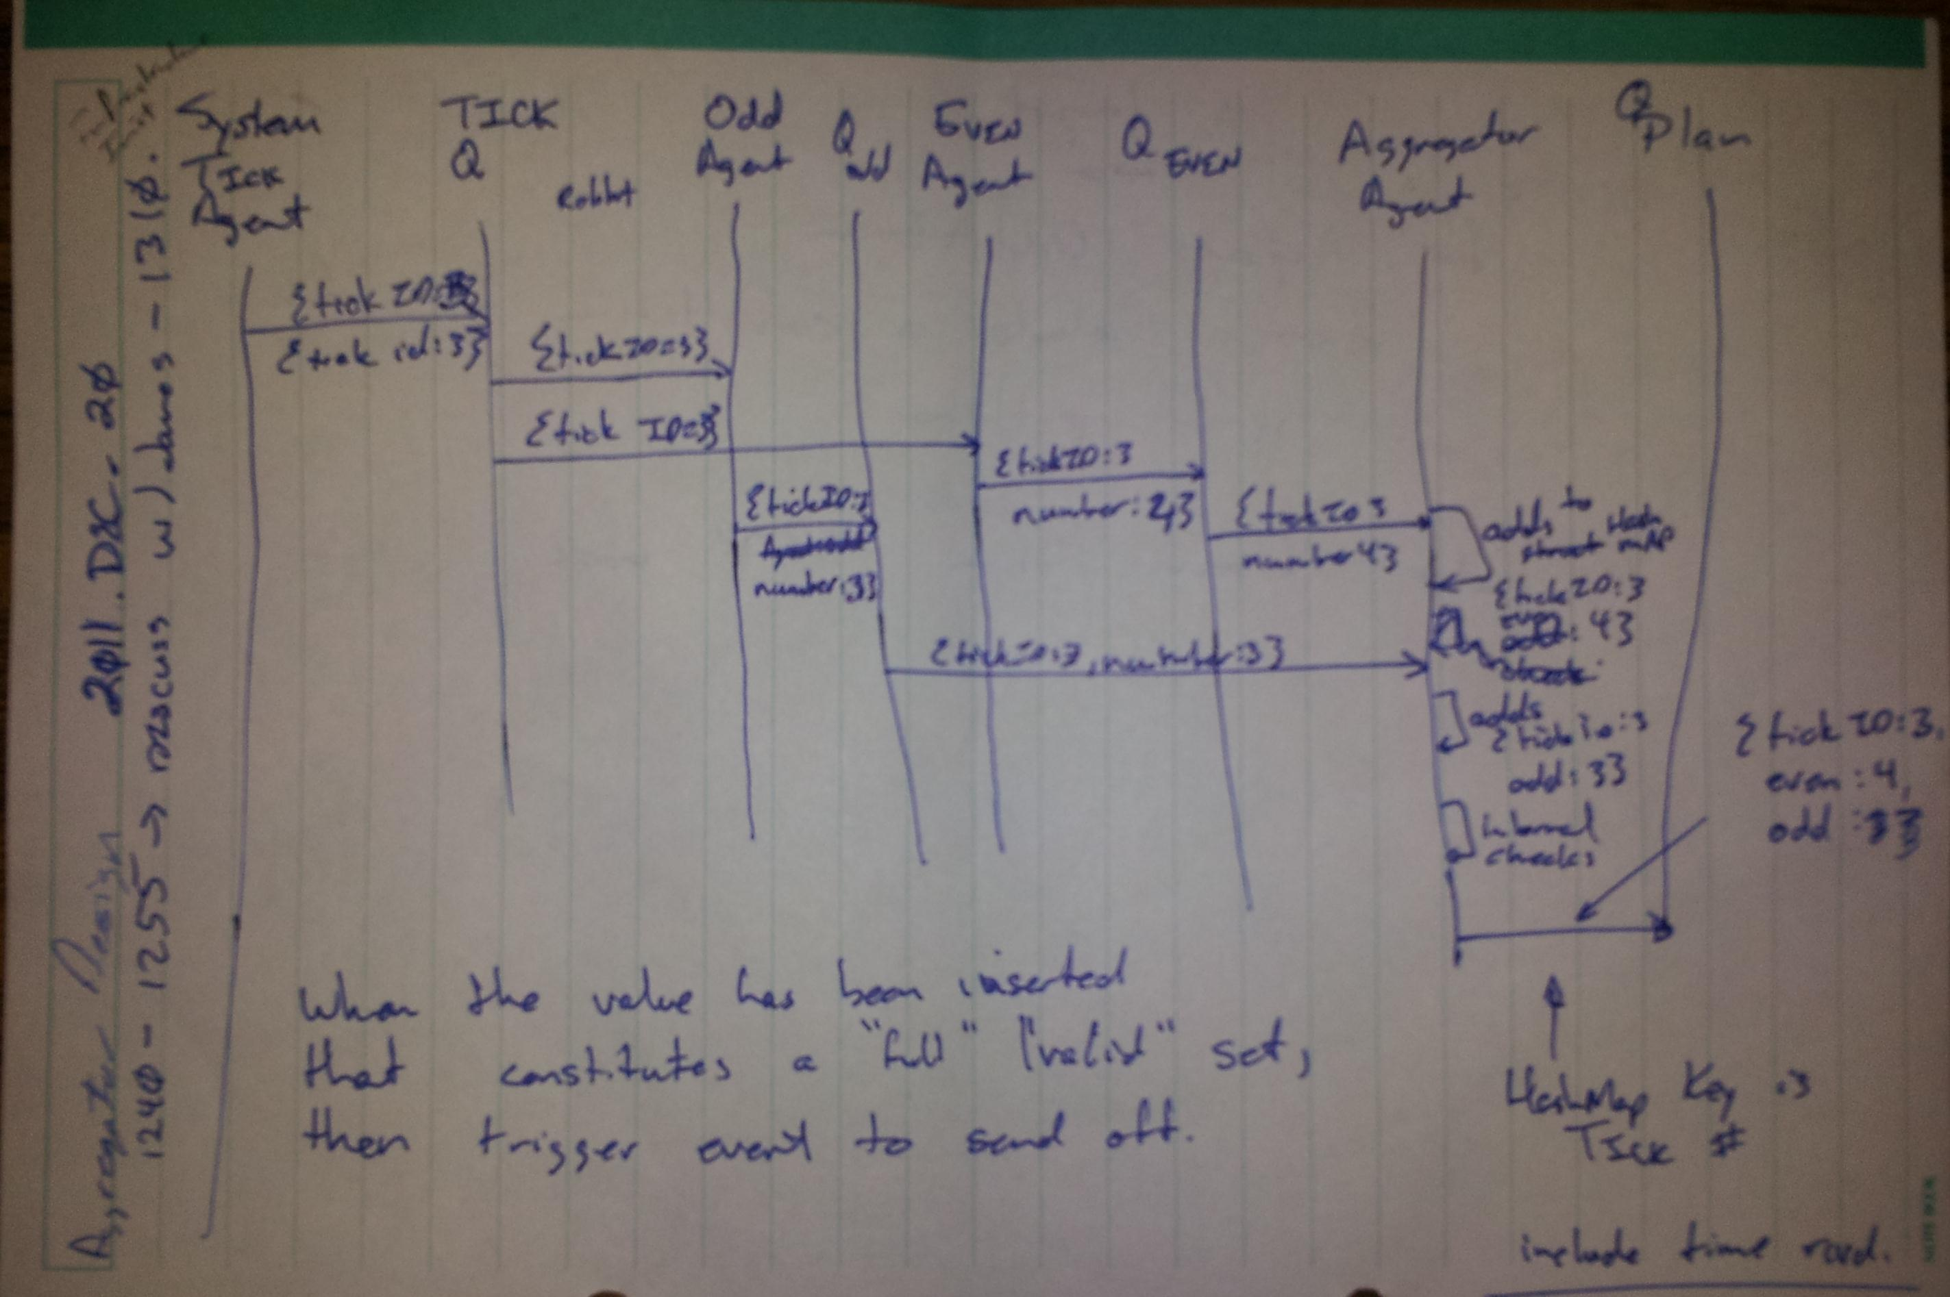
Demonstration Agent Communication
Notes:
Sequence Diagram?

Slide 20
Demonstration Interaction with Simulator

Slide 21
Phase II Deliverables

Slide 22
Project Log

Slide 23
Project Risks and Spikes

Slide 24
Project Concerns
Am I trying to do too much?

Slide 25
Questions and Comments

Slide 26
References

