Slide 1
MSE Presentation 2 MultiAgent Control of Traffic Signals (MACTS)
Bryan Nehl
MSE Candidate

Slide 2
Agenda
Action Item update
Vision Document 2.0
Project Plan 2.0
Formal Requirements Specification
Architecture Design 1.0
Test Plan
Formal Technical Inspection Checklist
Executable Architecture Prototype
Risk Log Update

Slide 3
Action Items Update
Revise Use Case diagram
Track SLOC (project code)
Alternate code size estimate
COCOMO 6400, Me ~1500-2000
System evaluation should include and describe comparison baseline.
Request Technical Inspectors
Request Project Server Space

Slide 4
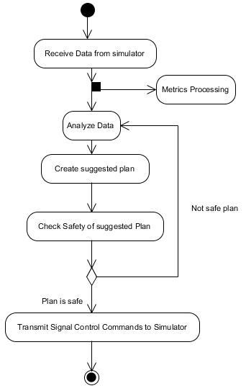
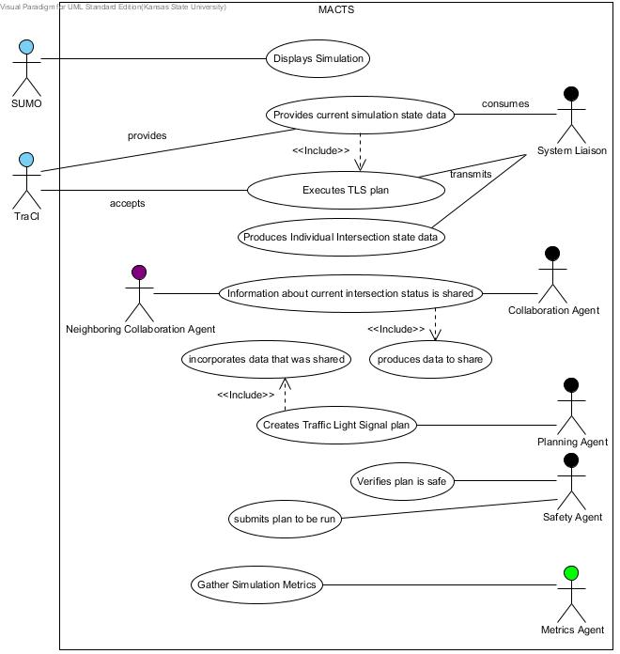
Vision Document 2.0
Critical Use Cases Diagram updated
Single Iteration Diagram updated

Slide 5
Project Plan 2.0
Updated with experience based estimate

Slide 6
Formal Requirements Specification

Slide 7
Architecture Design 1.0

Slide 8
Test Plan

Slide 9
Formal Technical Inspection Checklist

Slide 10
Project Risks and Spikes
Risks
Spikes
Python
SUMO
Scope
Time
SUMO
Network Load
Network Double T
Read from TRACI
Send to TRACI
Network Metrics
Read Sensors
Add Sensors
Notes:
Am I trying to do too much in my time frame?
Quality concern by 100% test coverage of non-trivial code. Won’t test API/library calls. Will strive for low cyclomatic complexity.

Slide 11
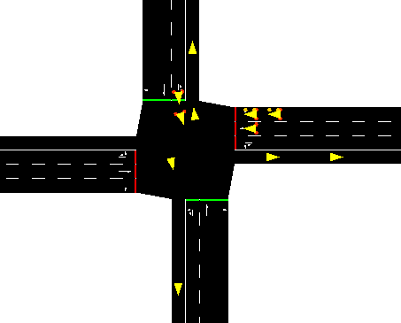
Demonstration Interaction with SUMO

Slide 12
Phase III Deliverables
Track SLOC (graph)
Track Rework (graph)
Notes:
Do the Metrics Agent for the Formal Requirements Specification?
I think my documentation was suggesting the safety officer agent.

Slide 13
Questions and Comments
?

Slide 14
References
SUMO, “Simulation for Urban MObility,” Sep. 2011; http://sourceforge.net/apps/mediawiki/sumo/index.php?title=Main_Page.
T. Masterton and D. Topiwala, “Multi-Agent Traffic Light Optimisation and Coordination,” white paper, Thales Group, Reference VCS081002, Issue 2, 2008.
W. Royce, Software Project Management: A Unified Framework, Addison-Wesley,1998, p. 34, pp. 265-281.
B. Boehm et al., “Cost Models for Future Software Processes: COCOMO 2.0,” Annals of Software Eng., Vol. 1, 1995, pp. 57-94.
K-State Master of Software Engineering web site, “MSE Portfolio Requirements,”
November 28, 2011; http://mse.cis.ksu.edu/portfolio.html.
Center for Systems and Software Engineering web site, “COCOMO II,” December 4, 2011: http://sunset.usc.edu/csse/research/COCOMOII/cocomo_main.html.
The Code Project web site, “Software Project Cost Estimates Using COCOMO II Model,” December 4, 2011: http://www.codeproject.com/KB/architecture/cocomo2.aspx.
Naval Postgraduate School web site, “COCOMO II - Constructive Cost Model,” December 4, 2011: http://diana.nps.edu/~madachy/tools/COCOMOII.php.
Center for Software Engineering, USC, COCOMO II: Model Definition Manual Version 2.1, 2000.
The Code Project web site, “Calculating Function Points,” December 4, 2011: http://www.codeproject.com/KB/architecture/Calculate_Function_Point.aspx.
USC Center for Software Engineering website, “COCOMO II Affiliates,” December 4, 2011: http://csse.usc.edu/csse/affiliate/private/COCOMOII_Driver+Calc_Ss/SpreadSheet-COCOMOII.html.

Slide 15
References 2
IEEE Std. 730-1998, IEEE Standard for Software Quality Assurance Plans, IEEE 1998.
IEEE Std. 730.1-1995 IEEE Guide for Software Quality Assurance Planning, IEEE, 1995.
Python Software Foundation, “PEP 8 -- Style Guide for Python Code”, Python, 24 Sep. 2011; http://www.python.org/dev/peps/pep-0008/.
Python Software Foundation, “PEP 257 – Docstring Conventions”, Python, 24 Sep. 2011; http://www.python.org/dev/peps/pep-0257/.
K. Hill, “GMoDS-based Runtime Agent Role Interpreter SQA Plan 1.0”, People, 15 Sep. 2011; http://people.cis.ksu.edu/~kylhill/phase_1/sqa_plan.pdf.
B. Nehl, “Multiagent Control of Traffic Signals Project Plan 1.0”, People, 26 Sep. 2011; http://people.cis.ksu.edu/~bnehl/repos/macts.git/.
W. Royce, Software Project Management; Addison-Wesley, 1998, pp. 290-291.

