Slide 1

5CS021 - Object Oriented Design and Programming
Introduction to Java
Tutorial 01
Herald College, University of Wolverhampton

Slide 2
Object Oriented Programming
Object Oriented Programming(OOP) is a programming that uses classes and object. It helps in binding the data and methods. Abstraction, inheritance, encapsulation, polymorphism are the features of OOP which helps to create solutions based on real-world entity.

Slide 3
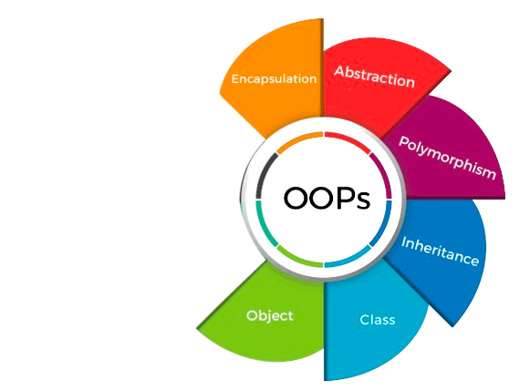
Objects and Class
Class: Class is not a real-world entity but a template or prototype.
Class in Java doesn't occupy memory, but it imparts an idea about the features of objects.
Object:: An object in Java is a basic unit of Object Oriented Programming and represents real-life entities.

Slide 4
Introduction to Java
Java is a high-level, class-based, object-oriented programming language.
Java is popular for its portability and security.
Developed by James Gosling, in Sun Microsystem (current acquired by Oracle Corporation), in 1995.
OOP is at the core of Java.

Slide 5
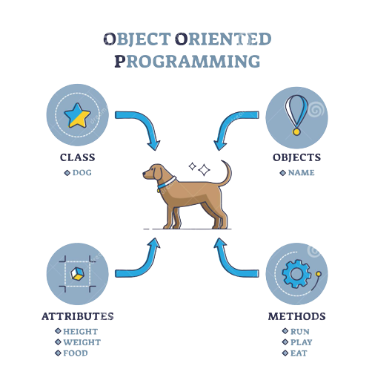

Slide 6
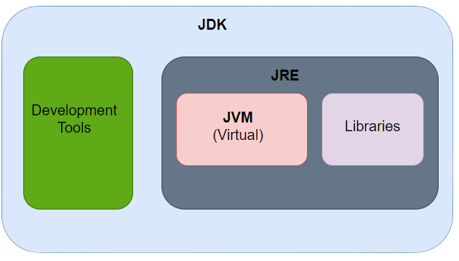
Fig: Java Development Kit (JDK)

Slide 7
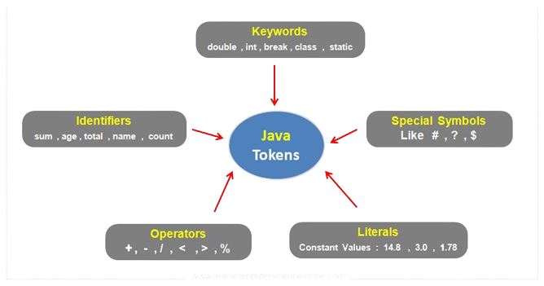
Tokens in Java

Slide 8
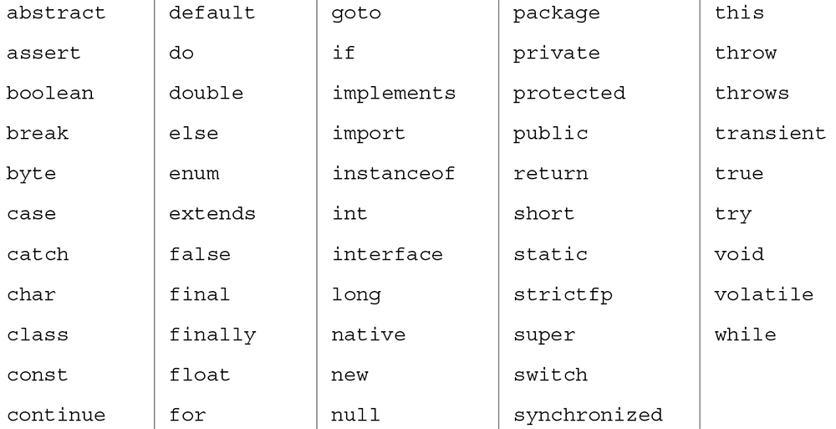
Keywords in Java

Slide 9
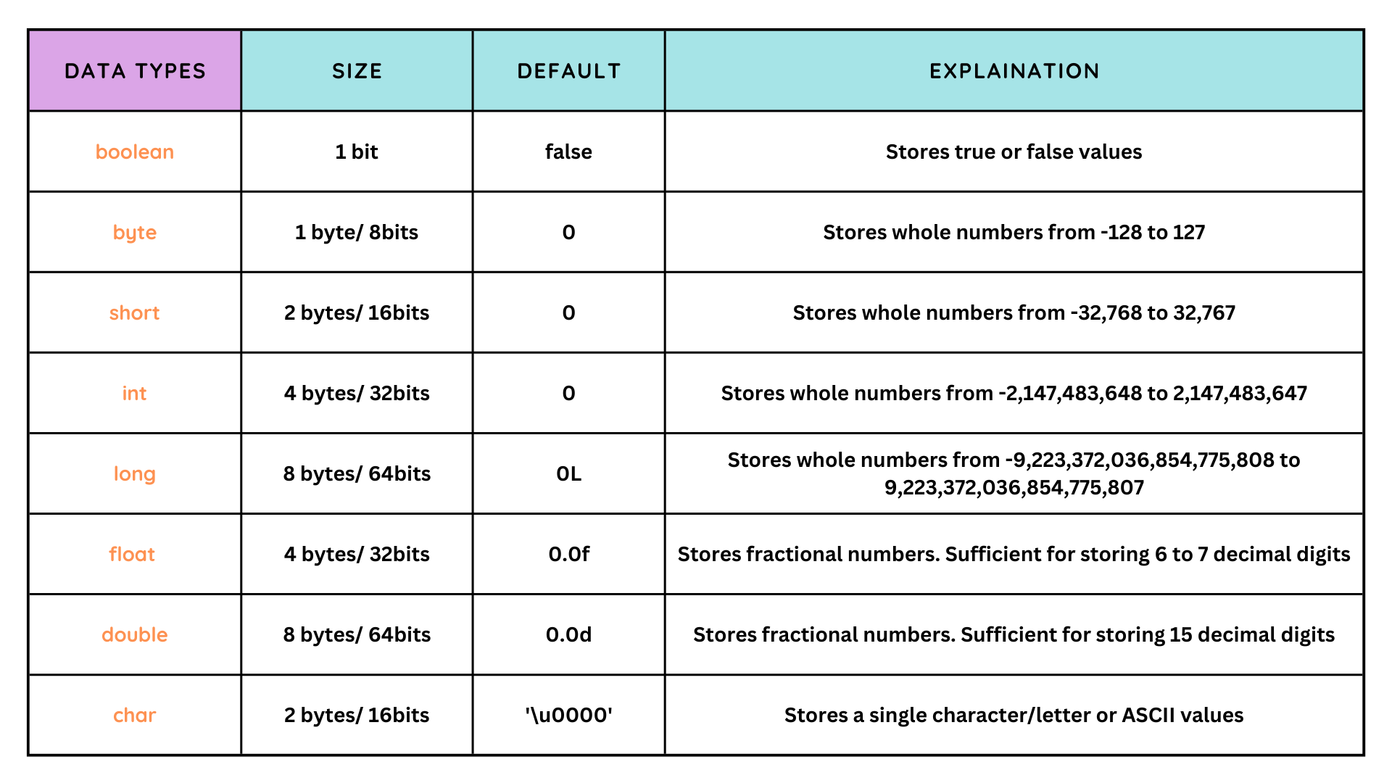

Slide 10
Task 1:
What are the basic data types in Java used to store whole numbers and decimal numbers?
Task 2:
Explain the difference between int and double data types in Java.
Task 3:
What is the difference between the float and double data types in terms of precision and storage space?

Slide 11

Declaring a Variable
When declaring a variable, you often specify an initial value. This is also where you tell the compiler the size (type) it will hold
Each variable must have:
•A data type
•A unique identifier (or name)
•A value
Variable name or Identifier
Datatype
value

Slide 12
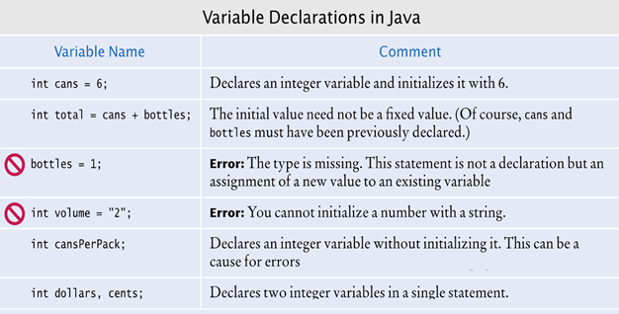

Slide 13
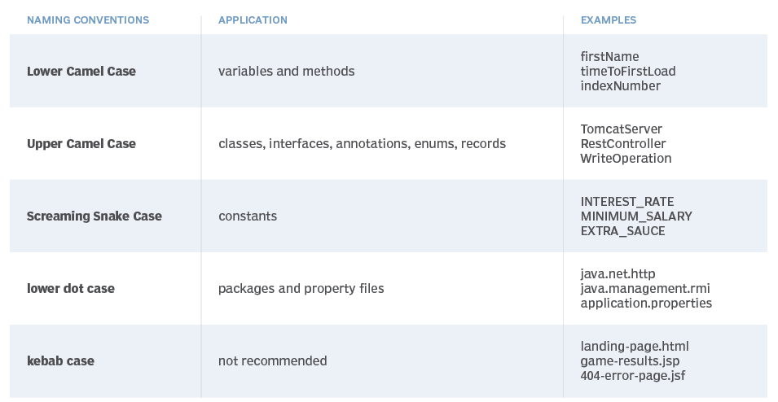
Naming conventions in Java

Slide 14
Task 4:
How do you declare an integer variable in Java, and what is the range of values it can hold?
Task 5:
What is the significance of variable naming conventions in Java, and what are some best practices?
Task 6:
How do you determine the data type of a variable in Java?

Slide 15
Operators in Java
Operators are symbols that perform operations on variables and values/ operands.
Example:
For, int x = 10 + 30;
x is variables,
+ is operator,
30 is value

Slide 16
Type of Operators
Arithmetic Operator
Assignment Operator
Comparison Operator
Logical Operator
Bitwise Operator

Slide 17
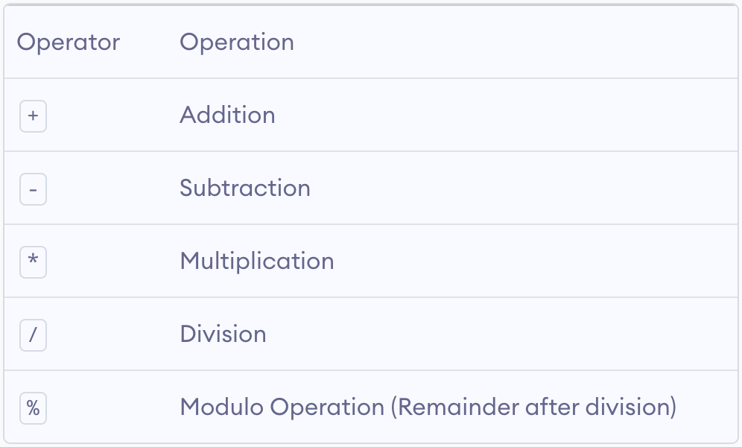
Arithmetic Operator
Arithmetic operators are used to perform arithmetic operations on variables and data.

Slide 18
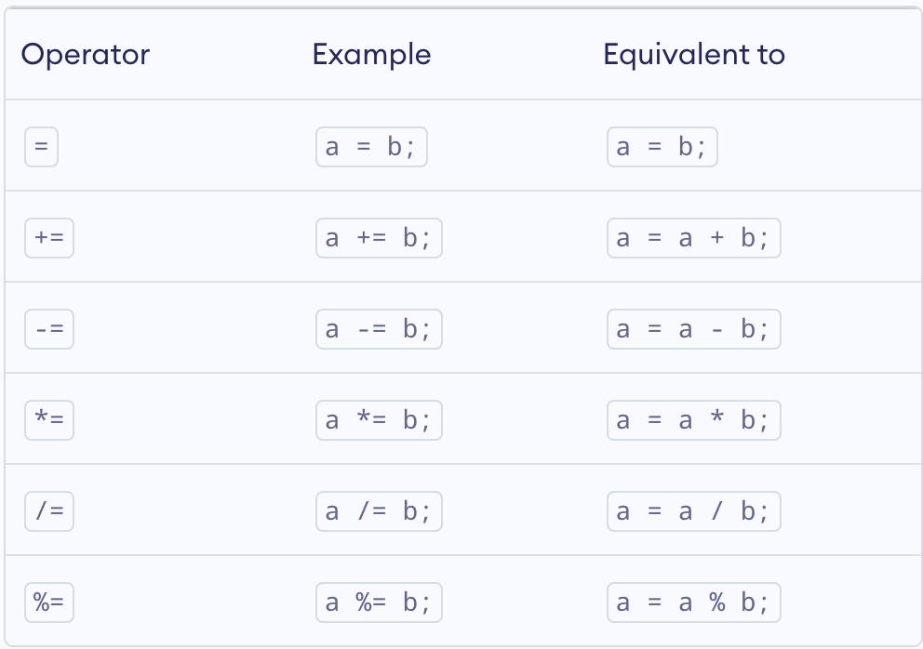
Assignment Operator
Arithmetic operators are used to assign values to variables.

Slide 19
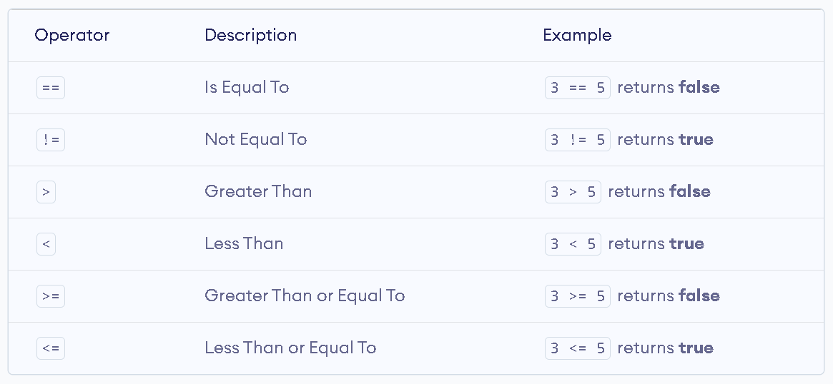
Comparison Operators
Comparison operators are used to check the relationship between two operands. It returns boolean values.

Slide 20
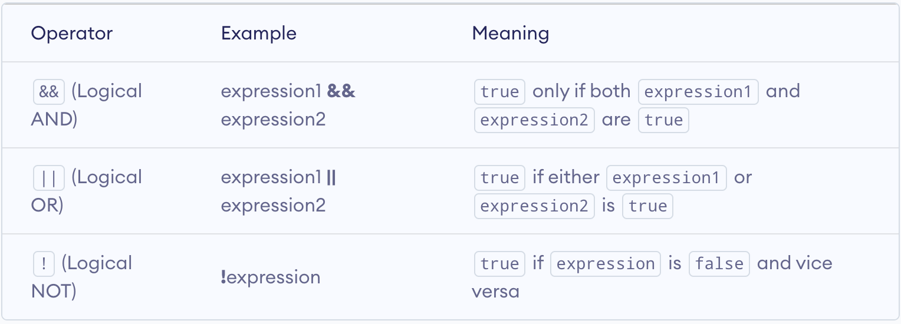
Logical Operators
Logical operators are used to check whether an expression is true or false. They are used in decision making.
They return boolean values.

Slide 21
Task 7:
How can you perform addition, subtraction, multiplication, and division in Java using arithmetic operators?
Task 8:
What is the result of the expression 7 / 2 in Java, and how can you get the correct result if you want to include the remainder?

Slide 22
Task 9:
Explain the purpose of the modulus operator (%) in Java and provide an example.
Task 10:
Write a Java program to convert celsius to fahrenheit.
Task 11:
Write a Java program to calculate the sum of two numbers the user enters and display the result.

Slide 23
toString Method
An in-built method in the java.lang.Object class, which converts an object into a string format.
By default, it returns a string consisting of the class name followed by the @ symbol and the object’s hashcode in hexadecimal form.
By overriding the method, it can:
Provides meaningful information about the object.
Used for debugging, logging, or displaying object data.

Slide 24
Constructor
A constructor in Java is a special method that is used to initialize objects. The constructor is called when an object of a class is created. It can be used to set initial values for object attributes.
Types of constructors:
Default Constructor
No-Arg Constructor
Parameterized Constructor

Slide 25
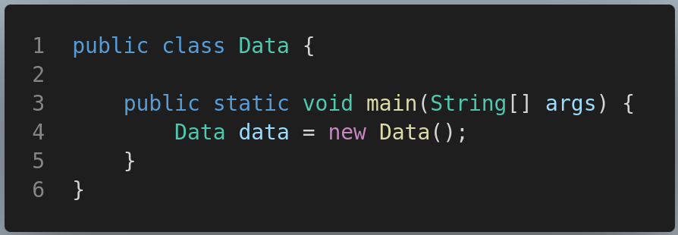
Default Constructor
If we do not create any constructor, the Java compiler automatically creates a no-arg constructor during the execution of the program.

Slide 26
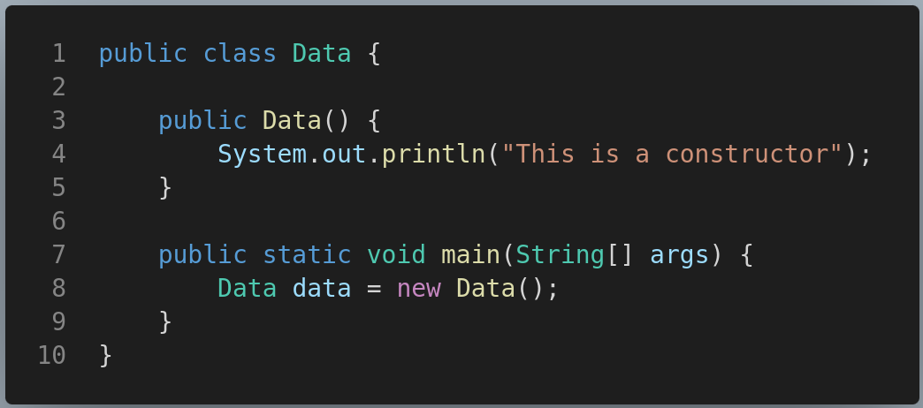
No-Arg Constructor
If a constructor does not accept any parameters, it is known as a no-argument constructor.

Slide 27
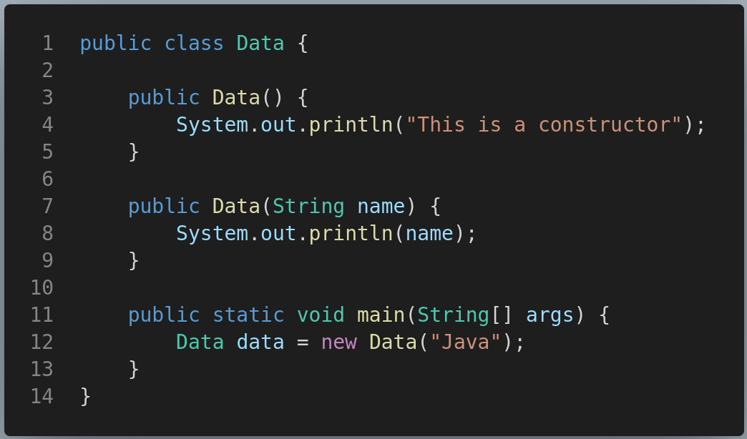
Parameterized Constructor
A constructor can also accept one or more parameters. Such constructors are known as parameterized constructors.

Slide 28
Task 12:
Can a constructor have a return type? Why or why not?
Task 13:
What is the return type of the toString() method?
Task 14:
How do you override the toString() method and why is it considered a good practice to override it?

