Slide 1
Fake video detection
Popov Nikolay

Slide 2
Plan:
Techniques of fake media generation
Common steps of face swap
Common steps of reenactment
Baseline algorithm
Proposed improvement
Datasets
Results

Slide 3
Fake media creation techniques
Face swap
Reenactment
Non-existent portrait synthesis
Attribute Editing
Morphing Attacks

Slide 4
2) Face swap
Pre-processing:
Face detection/segmentation
Face landmarks
Face crop
2) Generative network:
Encode-decoder
CycleGAN
face recognition model + cGAN
3) Post-processing:
Boundary smoothing or blending

Slide 5
2) Face swap
Vulnerabilities:
Generated face is merged with the old background
New face is generated using convolutional generators
Background for the resulting image is taken from the pristine image

Slide 6
3) Reenactment
Head pose and face expression are stored in:
feature maps from encoder network
3DMM head parameters
Reenactment pipelines:
Convolutional encoder-decoder
Encoders for source and target images, decoder to create from mixed feature maps
Encoder to map images to StyleGAN’s W+ space, another net for modifying the latent code for inputed 3DMM parameters
GAN conditioned on facial landmarks and identity embedding
Reenactment either includes the face merging step or performs full synthesis.

Slide 7
Common vulnerabilities of the fake videos:
Temporal incoherence as consequence of frame-by-frame generation
Teeth unnaturality - if there is no image with target person smiling
Eyes inconsistency - coherence of gaze direction and color of human eyes
Mouth movement incoherence and unnaturality

Slide 8
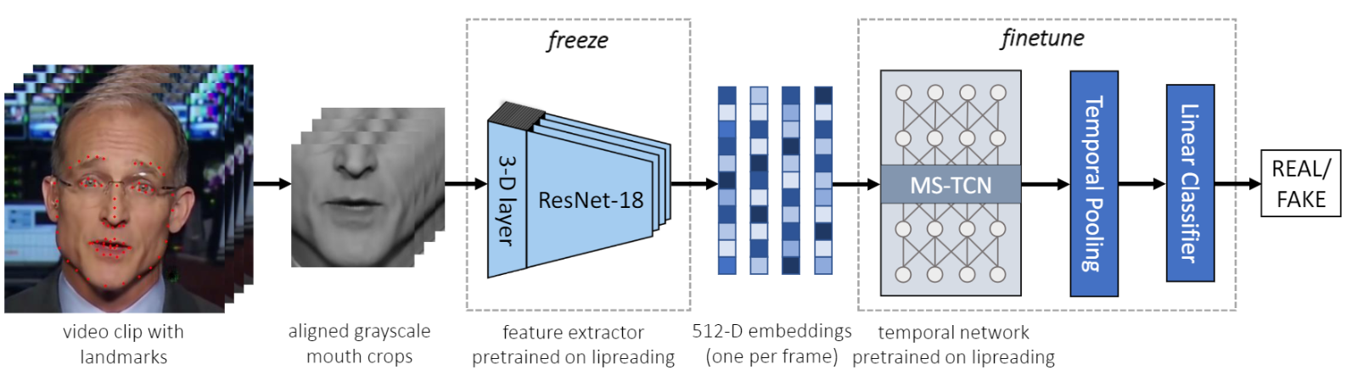
4) Baseline detection method - LipForensics net

Slide 9
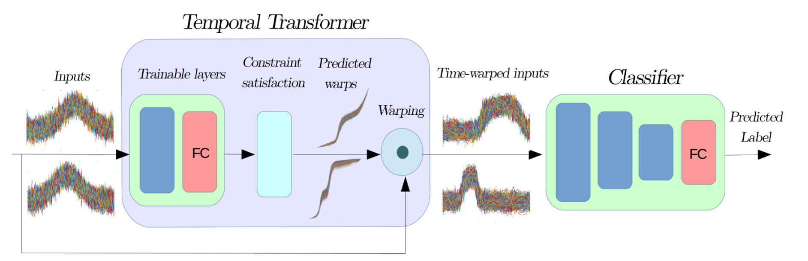
5) Improvement - adding TTN

Slide 10
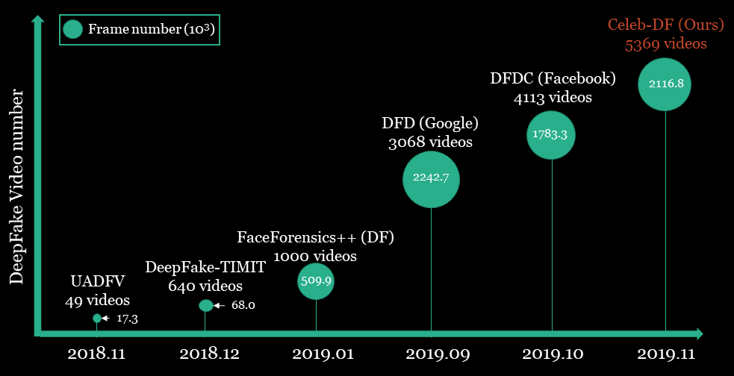
6) Deepfake datasets
Source - https://www.cs.albany.edu/~lsw/celeb-deepfakeforensics.html

Slide 11
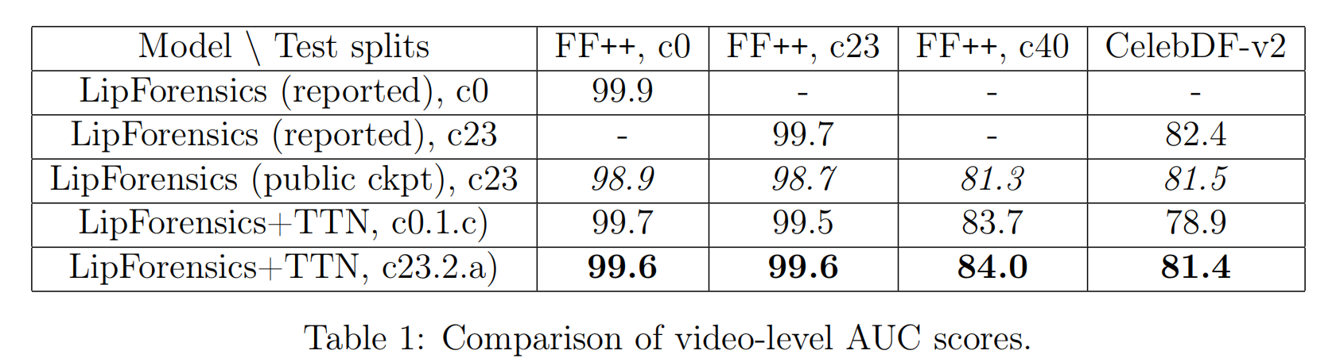
7) Results

Slide 12
Questions

