Slide 1
Finding the Most Suitable Code: Cyclomatic Complexity Analysis
Objective:
To identify the most suitable code for the user by analyzing code complexity.
Method:
A MATLAB function that written by us, calculateCyclomaticComplexityWithNesting, is used to determine
- Cyclomatic Complexity.
- Number of lines in the code.
Additionally, the complexity_selection file is designed to identify the most suitable code based on the user's preferences. For instance, the user may prioritize having fewer lines of code over lower complexity, or vice versa.

Slide 2
Case 1: Nested Loops
Function:
[complexity,number_of_line]=calculateCyclomaticComplexityWithNesting(file_path)
Number of Lines Calculation: Simple count of total lines in the code.
Cyclomatic Complexity: Derived to measure the control flow of the code.
for i = 1:n
...
for j = 1:m
end
end
Cyclomatic Complexity: 2 statements + 1 inner loop.
Not O(n×m) as calculated in time complexity.

Slide 3
Case 2: Sequential Loops
for i = 1:n
end
for j = 1:m
end
Cyclomatic Complexity:2 statements + 0 inner loops.

Slide 4
Results from Test Cases
Two different code examples were analyzed using the functions.

Slide 5
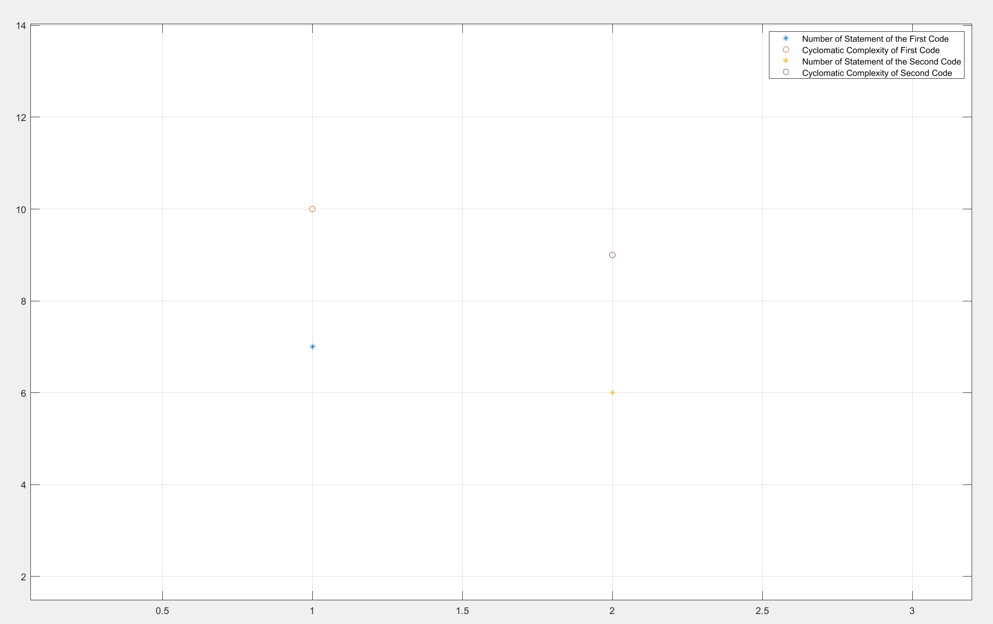
Figure 1: Number of Statements and Complexity

Slide 6
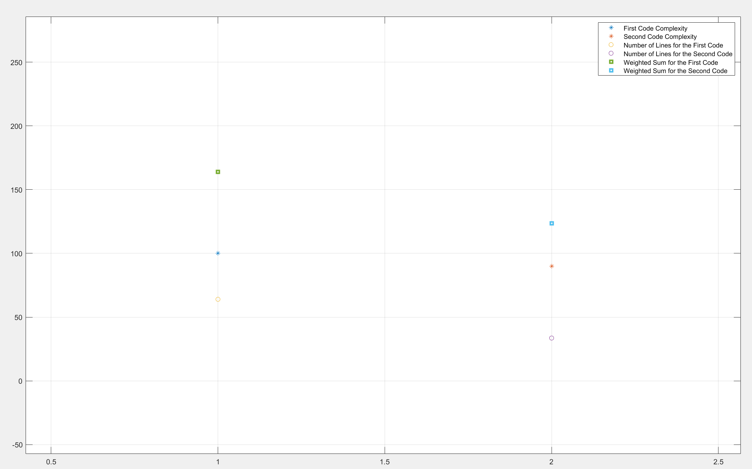
Figure 2: Weighted Sum to Identify the Most Suitable Code for the User

Slide 7
Conclusion
Cyclomatic Complexity is a useful metric for evaluating code suitability.
The function allows automated and efficient complexity analysis.
Results help in identifying code with optimal structure and maintainability.

