Slide 1
Selenium Locator Review
By {{-- k0x4ll --}}

Slide 2
WebDriverManager.chromedriver().setup();
WebDriver driver = new ChromeDriver();
String URL = "www.com";
driver.get(URL);
driver.manage().window().maximize();

Slide 3
To be able to do any action on any web element we need to locate that web element for the selenium webdriver
We will use findElement method that comes from Selenium to locate web elements
.findElement(By.locator)
This method finds and returns a single WebElement
return type is WebElement
Whenever it cannot find a webElement by given locator, it will throw NoSuchElement exception

Slide 4
LOCATORS : There are 8 different types of locators in Selenium
name
linkText
partialLinkText
id
className
tagName
cssSelector
xpath

Slide 5
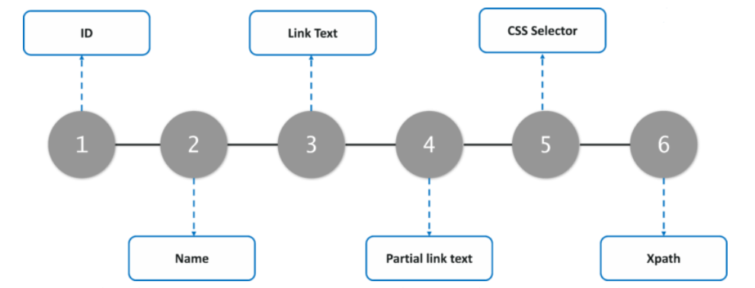

Slide 6
LAST TWO LOCATORS IN SELENIUM cssSelector & xpath
When do we use these last two selectors?
When you do not have any other option, you need to go for cssSelector or xpath.
They both have their own syntaxes.
These two locators allows you to create your own CUSTOM locator. Which allows you to locate pretty much everything you need to locate.

Slide 7
id
id will locate by matching id attribute's value
id is unique for that specific web element
if you have id and it is not dynamic (meaning the attribute value is not changing when you refresh the page) you should always use id
syntax: driver.findElement(By.id("id attribute's value"))

Slide 8
name
This locator will be looking into the whole HTML code, and return the WebElement with matching name attribute value
It will find and return the first webElement it finds
syntax: driver.findElement(By.name("String"));

Slide 9
linkText
This locator allows us to locate LINKS by their texts
This locator will ONLY WORK ON LINKS
How do I know if the webELement is a link or not?
If it is stored inside of <a>, it is a link
<a href="https://www.google.com"> TEXT HERE </a>
TagName --> a --> anchor tag --> used for HTML links
attribute --> href
attribute value --> https://www.google.com
LINK TEXT --> TEXT HERE
ex: driver.findElement(By.linkText("TEXT HERE"));

Slide 10
partialLinkText
This locator allows us to locate LINKS by their texts, BUT it does not expect the exact text to be passed. Only check if the given text is contained in the link
ex: <a href="https://www.google.com"> TEXT HERE </a>
driver.findElement(By.partialLinkText("TEXT"));
driver.findElement(By.partialLinkText("HERE"));
You can compare this with .equals and .contains methods from Java.
linkText --> .equals --> checks for the exact match
partialLinkText --> .contains --> checks for partial match of the text

Slide 11
className
className is not unique, there could be multiple values of the same attribute value
this locator will return the first one it finds
snytax: driver.findElement(By.className("class attribute's value"))

Slide 12
tagName
tagName locates using the tagName itself
the use case for this locator is very small
usually good for when you want to locate all of the same type of web Elements
ex: if you want to return all of the links on the page you can use it with findElements
syntax : driver.findElement(By.tagName("a"))
syntax : driver.findElement(By.tagName("div"))
syntax : driver.findElement(By.tagName("input"))
syntax : driver.findElement(By.tagName("h1"))

Slide 13
cssSelector
It has its own syntax
Syntaxes for commonly used cssSelectors;
tagName[attribute='value’]
tagName.value --> . in css selector means class
Looks for the tagNames that has given class attribute values
tagName#value --> # is css selector looks for id attribute value

Slide 14
cssSelector
<div class="uh7" id="fa83" name="uk94">
<a href="www.tesla.com"> TESLA WEBPAGE! </a>
</div>
1-> div[class='uh7'] --> driver.findElement(By.cssSelector("div[class='uh7']"));
2-> div.uh7
3-> to go to child with cssSelector: you need to use > sign, and pass the child name you want to go
div[class='uh7'] > a

Slide 15
cssSelector
<div class="container"></div>
tagName[attribute='value’]
- div[class='container'] > div > div

Slide 16
cssSelector
<input type="text" id="twotabsearchtextbox" value="" name="field-keywords" autocomplete="off" placeholder="" class="nav-input" dir="auto" tabindex="19">
- tagName[attribute='value']
--> input[tabindex='19']

Slide 17
xpath
When to use xpath?
When you are not able to use other 6 locators.
xpath has its own syntax different from cssSelector
There are two types of xpath locators:
Absolute xpath
Relative xpath

Slide 18
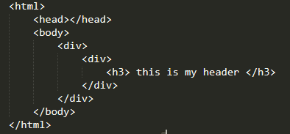
Absolute xpath
Absolute xpath starts with single slash -> /
It starts from the very beginning of the HTML code
Absolute xpath is not reliable, because if there is any minimal structural change in your HTML code, your locator will not work
Try avoid using it

Slide 19
Absolute xpath
ex: if I want to locate using absolute xpath:
/html/body/div/div/h3
/html/body/div/div[3]
/html/body/div[1]/div[5]/div[1]/div/div[3]/ul/li[1]/a
You use the [] in your xpath, when you have more than one sibling, and you are specifying which sibling you are trying to get

Slide 20
Relative xpath
starts with double slash //
when you say // it allows you to start anywhere in the html code
more reliable
you can start from anywhere in the HTML code
more specific
syntax : driver.findElement(By.xpath("xpath locator here"));

Slide 21
Relative xpath
1- //tagName[@attribute='value']
2- //tagName[contains(@attribute, 'value')]
3- //tagName[.='text’]
1- //tagName[@attribute='value'] --> looks for tagName attribute and value
1- //*[@attribute='value'] --> * means look for all of the webElements
2- //tagName[contains(@attribute, 'value')] --> locates all web elements with the given value
3- //tagName[.='text'] --> looks for exact text match in webElement

Slide 22
Relative xpath
ex: <li class="nav-item">
<a class="nav-link" href="/">Home</a>
</li>
tagName --> li
attribute --> class
attribute value --> nav-item
- //tagName[@attribute='value']
- //li[@class='nav-item']
TO GO from parent to child using xpath: use /
ex --> //li[@class='nav-item']/a
TO GO from child to parent using xpath : use /..
This will take you to the direct parent of the current web element

Slide 23
The End

