Slide 1
MERN STACK PROJECT
DARSHAN
EDGE
A Modern Full-Stack Web Application
React.js
Node.js
Express.js
MongoDB
Presented by Darshan Edge Team

Slide 2
INTRODUCTION
02
Darshan Edge is a modern web application designed to simplify online services.
PROJECT OVERVIEW
Full-Stack
4
Users can access services quickly and efficiently from a single platform.
MERN App
Core Modules
Combines cutting-edge frontend, backend, and database technologies.
100%
REST
Responsive
API Driven
Goal: Deliver a user-friendly, responsive interface for all users.
Darshan Edge • MERN Stack Project

Slide 3
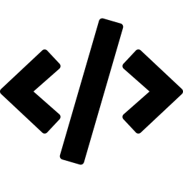



OBJECTIVES
03
Clean UI
Data Security
Create a clean and attractive user interface with intuitive navigation and modern aesthetics.
Ensure secure and reliable storage of user data with proper authentication and validation.
Performance
Scalability
Implement fast data processing and response times using optimized backend architecture.
Design a scalable and maintainable system built to grow with user demand.
Darshan Edge • MERN Stack Project

Slide 4

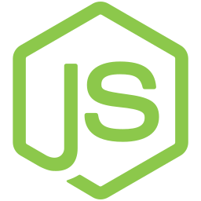
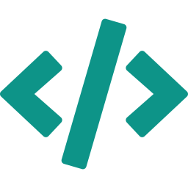
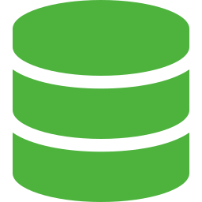
TECHNOLOGY STACK
04
React.js
Node.js
Express.js
MongoDB
Frontend
Backend
Backend
Database
HTML, CSS, JavaScript
Server-side runtime
API & business logic
Data storage & queries
Darshan Edge • MERN Stack Project

Slide 5





KEY FEATURES
05
User Auth
Dashboard
Data Management
Secure registration & login
Services & data at a glance
Add, edit, delete records
Responsive Design
Secure Comms
Mobile & desktop ready
Protected API endpoints
Darshan Edge • MERN Stack Project

Slide 6



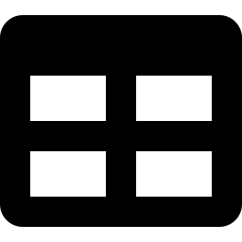
SYSTEM MODULES
06
01
User Module
Profile creation, editing and complete account management for every user.
02
Login Module
Secure authentication system with encrypted password handling and session management.
03
Dashboard Module
Displays statistics, analytics and quick access to all available services.
04
Data Management
Full CRUD operations for records — create, read, update, and delete with validation.
Darshan Edge • MERN Stack Project

Slide 7
DATABASE DESIGN
07
Users
Services
Transactions
_id
_id
_id
name
title
userId
email
description
serviceId
password
category
amount
role
status
date
Darshan Edge • MERN Stack Project

Slide 8
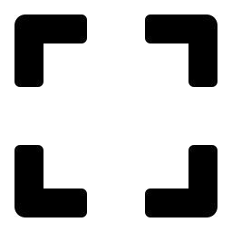

ADVANTAGES
08
Fast Performance
Secure Backend
Optimized with React rendering and Node.js async processing.
End-to-end authentication with encrypted tokens and sessions.
~200ms
JWT
API Response
Auth Method
Scalable Arch
Easy Maintenance
Modular design built to scale horizontally with demand.
Clean separation of concerns enables fast debugging and updates.
∞
MVC
Growth Ready
Architecture
Darshan Edge • MERN Stack Project

Slide 9




FUTURE ENHANCEMENTS
09
Phase 1
Phase 2
Phase 3
Phase 4
Mobile App
Payment Gateway
Notifications
Advanced Security
Native iOS & Android application with full feature parity to the web platform.
Integrate secure online payment processing for service transactions.
Real-time push notifications and email alerts for user activities.
Two-factor authentication, biometrics and enhanced encryption protocols.
Darshan Edge • MERN Stack Project

Slide 10
THANK YOU
DARSHAN EDGE
✦ Delivers a modern, efficient service platform
✦ MERN stack ensures high performance & scalability
✦ Improves accessibility and user experience
React.js
Node.js
Express.js
MongoDB
Darshan Edge • MERN Stack Project • 2024

