Slide 1
Introduction to AWS IAM
Session 2 - Managing Access and Permissions in AWS

Slide 2
Agenda
What is AWS IAM?
Key Features of IAM
Components of IAM
How IAM Works
IAM Policies and Permissions
Best Practices
Demo/Use Cases
Q&A

Slide 3
What is AWS IAM?
Definition: IAM is a web service in AWS for securely controlling access to AWS resources.
Purpose:
Manage users and permissions
Ensure security and compliance
Benefits:
Fine-grained access control
Secure multi-user environment
Centralized resource access management

Slide 4
Key Features of IAM
Granular Permissions: Assign precise permissions for resources.
Multi-Factor Authentication (MFA): Enhance account security.
IAM Roles: Delegate permissions without sharing credentials.
Identity Federation: Access AWS using external identity providers.
Logging and Monitoring: Track activities using AWS CloudTrail.

Slide 5
Components of IAM
Users: Individual accounts for people or services.
Groups: Collection of users with shared permissions.
Roles: Temporary access permissions for AWS services or users.
Policies: JSON documents defining permissions.
Identity Providers: Use SAML or OIDC for single sign-on.

Slide 6
How IAM Works
Authentication: Verifying identity (username, password, MFA).
Authorization: Granting permissions via policies.
Access Control:
Allow/Deny based on policy evaluation.
Hierarchical resource control using policies.

Slide 7
IAM Policies and Permissions
Types of Policies:
Managed Policies
Inline Policies
Service Control Policies (SCPs)
Policy Structure:
Effect: Allow/Deny
Action: Specifies API operations (e.g., ec2:StartInstances).
Resource: Specifies resources the policy applies to.
Condition: Optional, fine-tune permissions.

Slide 8
Best Practices
Principle of Least Privilege: Only grant permissions required.
Enable MFA: For all root and IAM users.
Use Roles Instead of Sharing Credentials: Secure service-to-service communication.
Regularly Rotate Credentials: Including access keys.
Monitor and Audit Activities: Use AWS CloudTrail and AWS Config.

Slide 9
Demo/Use Case
Use Case 1: Granting EC2 access to a developer team.
Use Case 2: Setting up an IAM role for S3 bucket access.
Demo Steps:
Create a user.
Attach a managed policy.
Use temporary credentials to access resources.

Slide 10
Conclusion
IAM ensures secure access to AWS resources.
Central to implementing security and compliance.
Key for managing a multi-user AWS environment.

Slide 11
Q&A
Questions?

Slide 12
References
AWS Documentation: IAM User Guide
AWS Security Best Practices

Slide 13
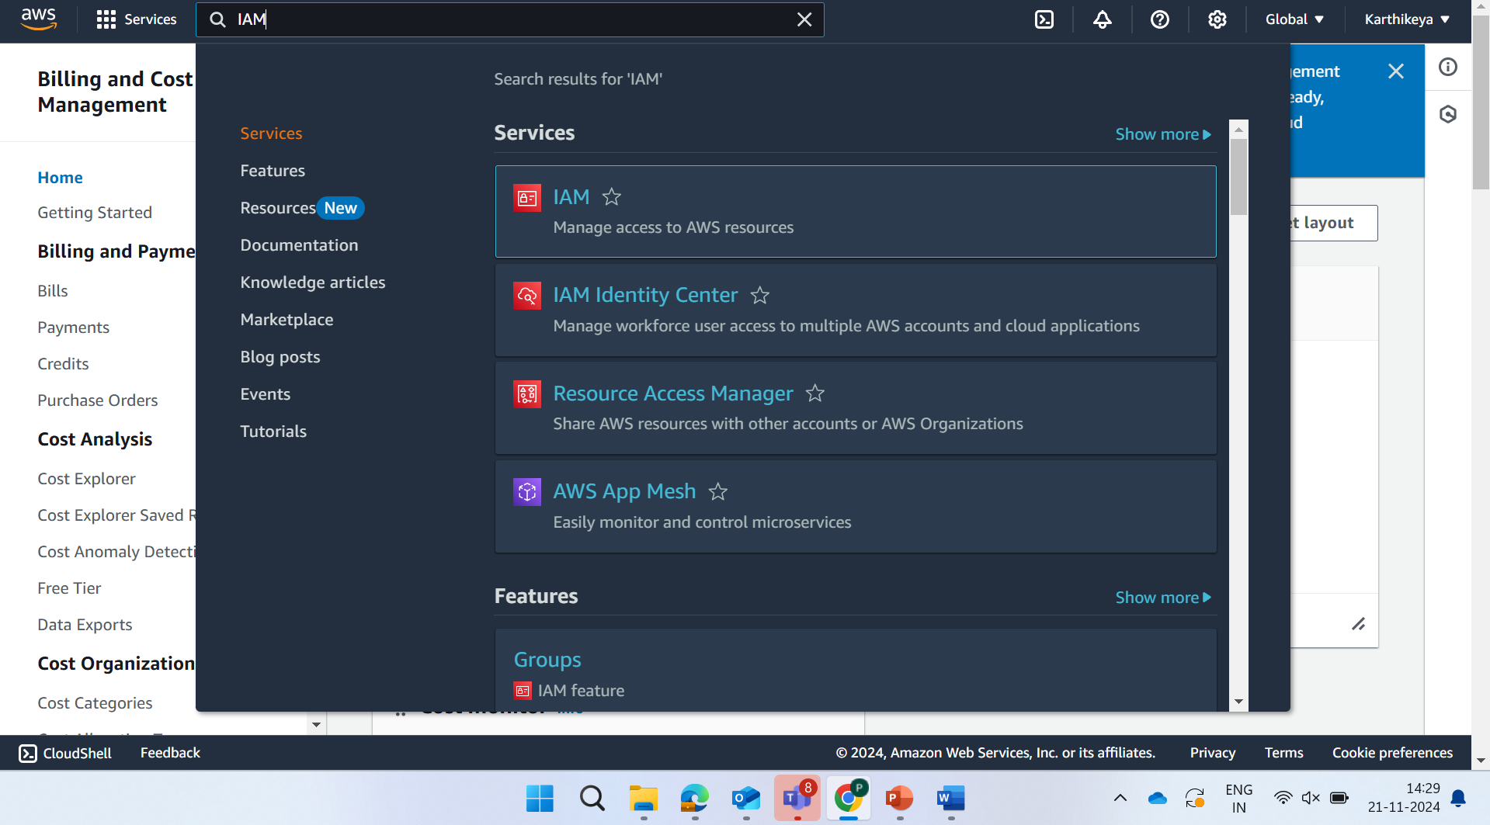
Step 1:

Slide 14
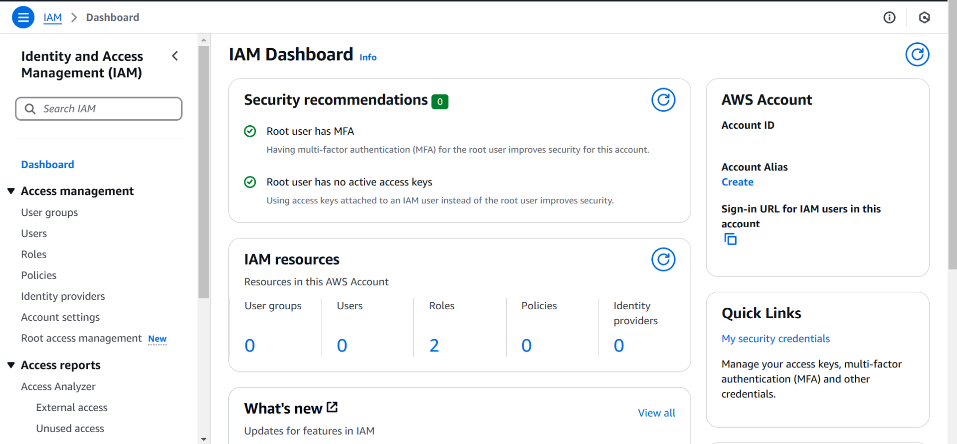
Step 2:

Slide 15
Step 1:

Slide 16
Step 1:

Slide 17
Step 1:

Slide 18
Step 1:

Slide 19
Step 1:

Slide 20
Step 1:

