Slide 1
EE 201 Final Project: TETRIS
Mike Schlesinger, EE
Kyle Sum, CS
Danny Cantwell, CECS

Slide 2
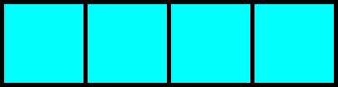
TETRIS
Tetris is a well-known arcade game based on stacking falling blocks to create lines. The goal is to never reach the top of the board.
Tetris is one of the most famous games ever created. Its sole purpose is to be entertaining.
We chose Tetris because it is a simple game that everyone both knows and enjoys.

Slide 3
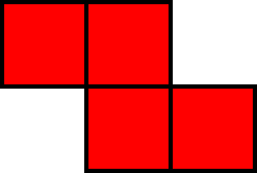
User Interface
Buttons
Up – Rotate Clockwise
Down – Soft Drop
Left – Move Left
Right – Move Right
Center – Pause
Switches
Switch 0 – Reset/‘ACK’

Slide 4
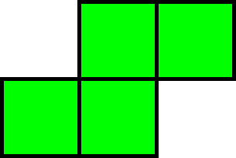
Main State Machine
Four States
Initial
Resets Parameters
Select
Selects Piece
Falling
Game play
Game Over
Ends Game

Slide 5
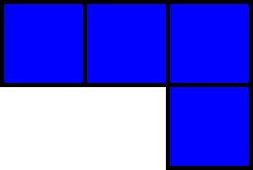
SCEN State Machine
Three States
INI
Resets Parameters
WQ
Waits for 2 Clocks
SCEN_st
Validates Button Press

Slide 6
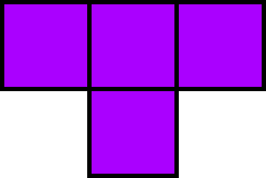
Block Diagram
Our implementation required a vast amount of logic
We probably could have been more efficient, but that would have required more time than we had for this project
Our block diagram is on the board

Slide 7
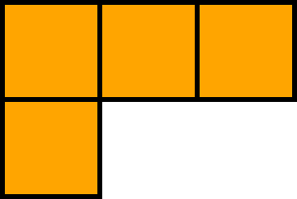
Testing and Verification
Careful Planning
Xilinx Synthesis
Testbench
“Corner Cases”
Random Piece Select
Button Holding
Overlapping Pieces
Overall Size

Slide 8
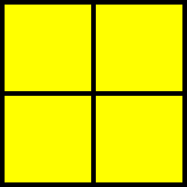
Future Additions
Optimization
Update GUI
Scoring
‘Next Piece’ Window
Piece Color
Audio

Slide 9
Questions?

