Slide 1
Unsupervised human height estimation from a single image
Guan, Y. P. (2009).
Journal of Biomedical Science and Engineering, 2(06), 425.
從單個圖像進行無監督的人體高度估計

Slide 2
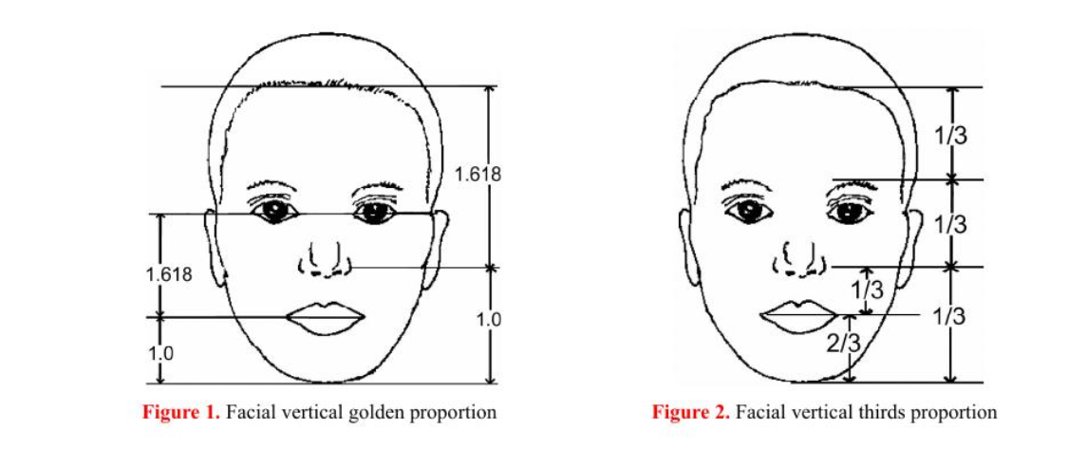
面部垂直黃金比例 與 面部垂直三等分比例

Slide 3
根據黃金比例計算提取的面部特徵的3D位置。
由於面部垂直比例保持不變，如果在人類成長過程中保持相對恆定，則可以確定所提取面部特徵的3D位置（如果已知某個長度或距離）

Slide 4
如果在人類成長過程中保持相對恆定[21]，則可以確定所提取面部特徵的3D位置（如果已知某個長度或距離），
嘴唇和下巴忽略不計。為了簡化計算，假設下巴點（u1，v1）的3D坐標為（X，Y，Z），其水平線與穿過眼睛中心的垂直線相交。
唇點（u2，v2）的坐標為（X，Y，Z + h），其水平線與上述相同的垂直線相交。
根據黃金比例，眼睛中心點（u3，v3）的坐標為（X，Y，Z + 2.618h）。

Slide 5
he camera model used is a central projection. Effect such as radial distortion can be removed and is not det-rimental to the method.
The camera perspective projection model can be represented by a 34 matrix M. The image coordinates (ui, vi) of a point Pi expressed in a homogenous coordinate system are given as follows:

Slide 6
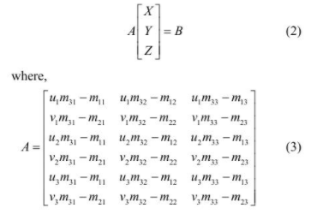
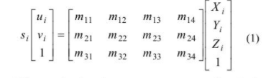
（1）可用於推斷下巴點的3D坐標。擴展（X，Y，Z）的結果如下：

Slide 7
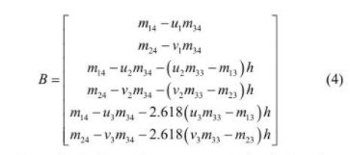

知道人的頭頂點（u4，v4）後，我們可以使用坐標（X，Y）重新排列（2）以估計身高為（6）。發現（6）作為v4的函數可以更穩定地估計身高
From (2), the linear least-squares solution is given by

Slide 8
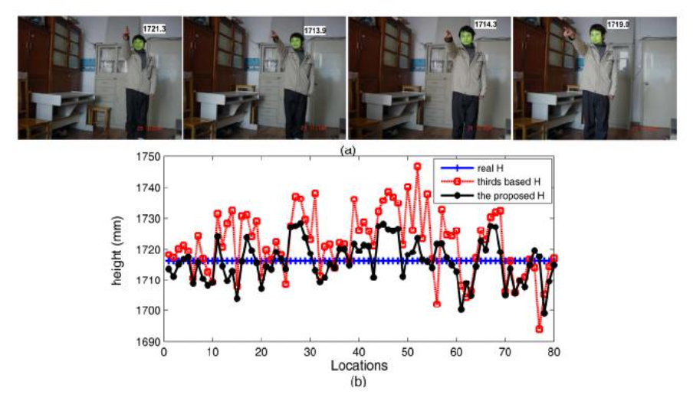
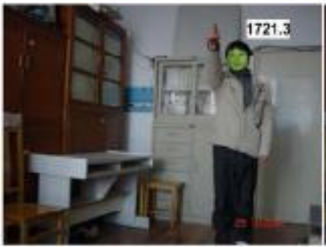

Slide 9
The deviation is due to the fact that relative error in-crease with the distance between the camera and the user since the pixel size is proportional to the view angle, which means smaller resolution from a larger distance
in the experiment a pixel difference corresponds to about 5.26 mm resolution ambiguity from the distance of 3 m. Besides, inaccurate camera calibration affects the meas-urement results

