Slide 2
01
TOPIC ONE
  Insert Sub Header Here
02
TOPIC TWO
  Insert Sub Header Here
03
TOPIC THREE
  Insert Sub Header Here
04
TOPIC FOUR
  Insert Sub Header Here

Slide 3
COMPANY
STRUCTURE

Slide 5
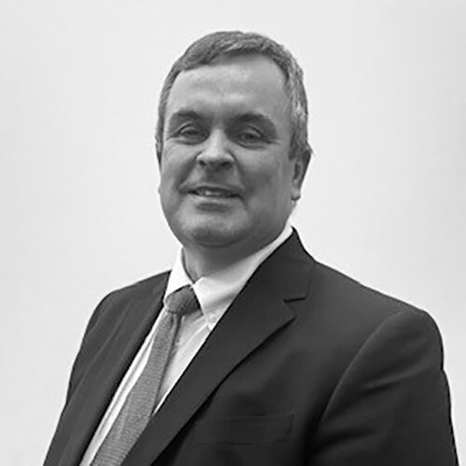
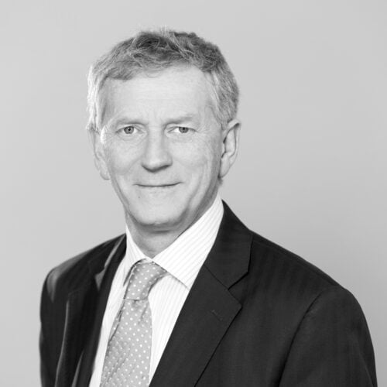
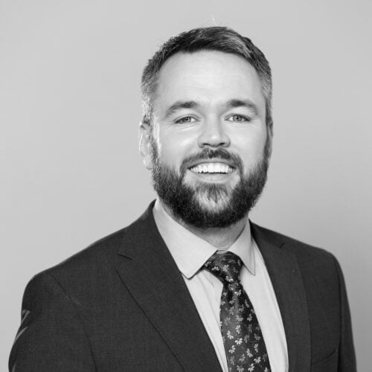
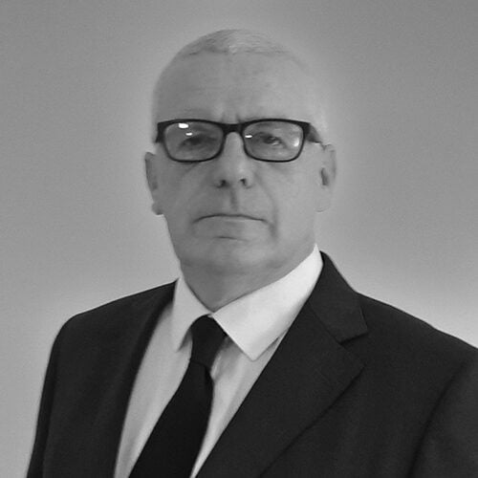
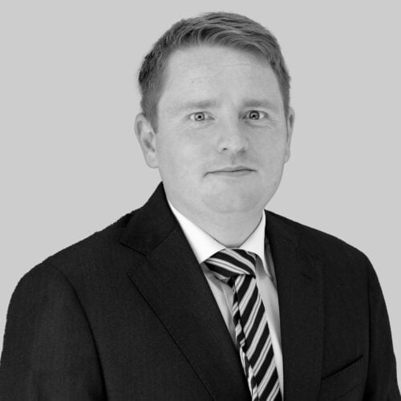

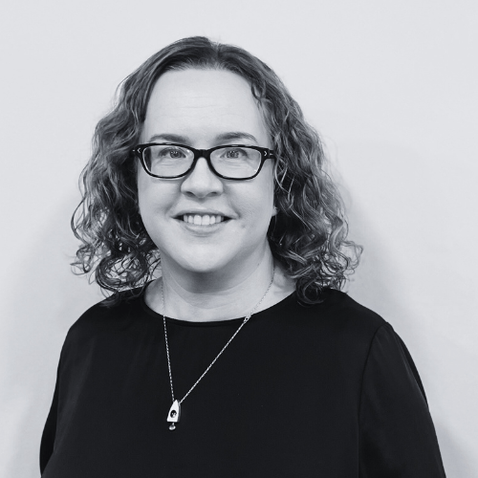
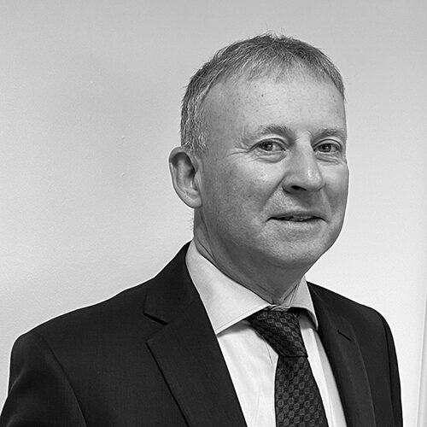
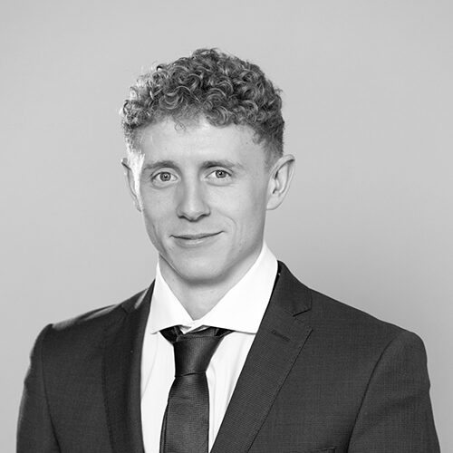
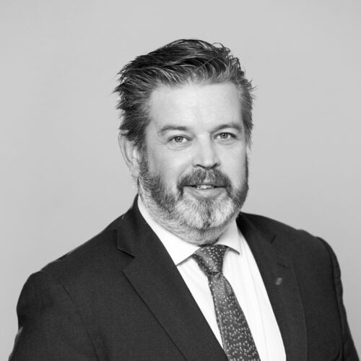
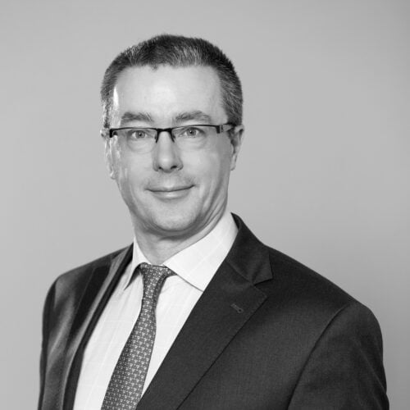
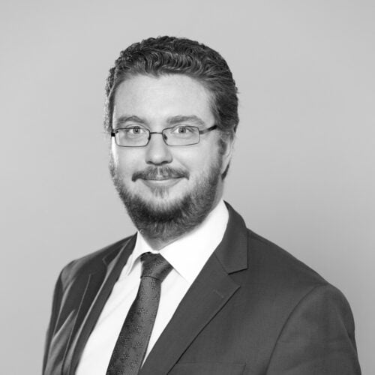
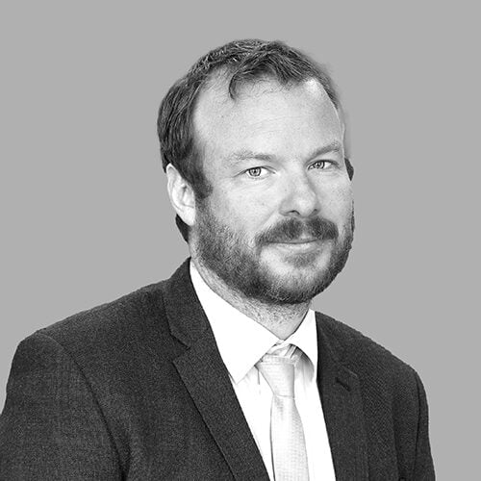
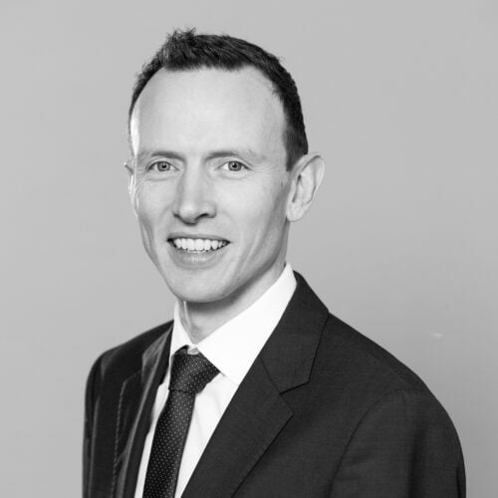
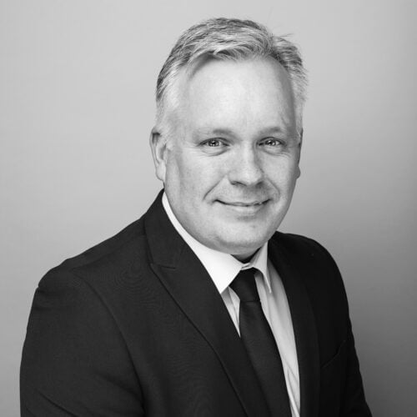
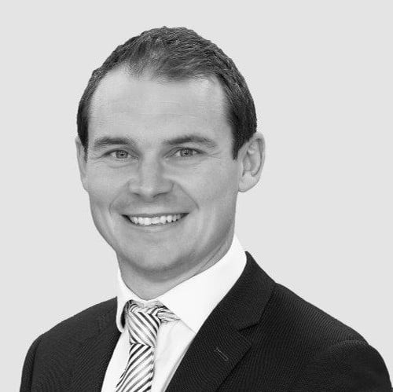
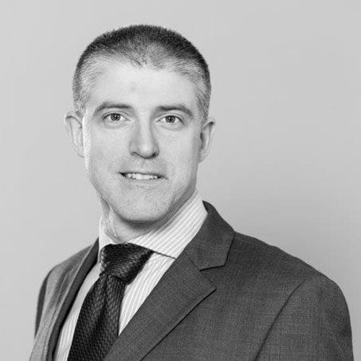
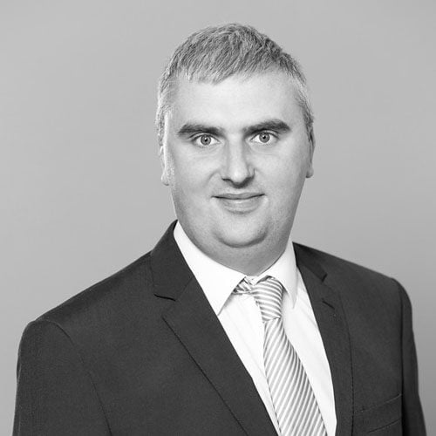
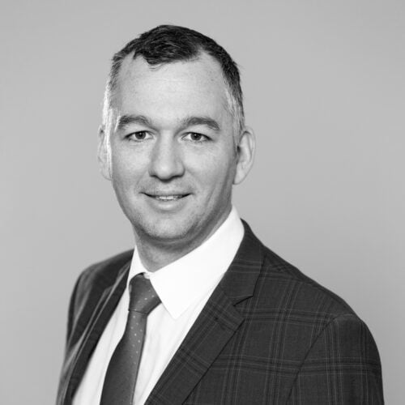
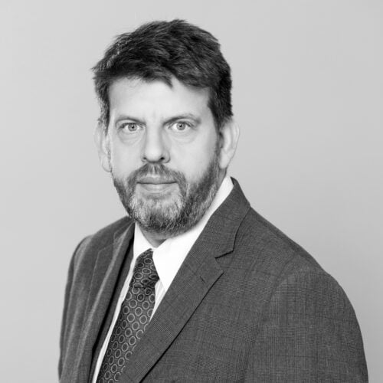
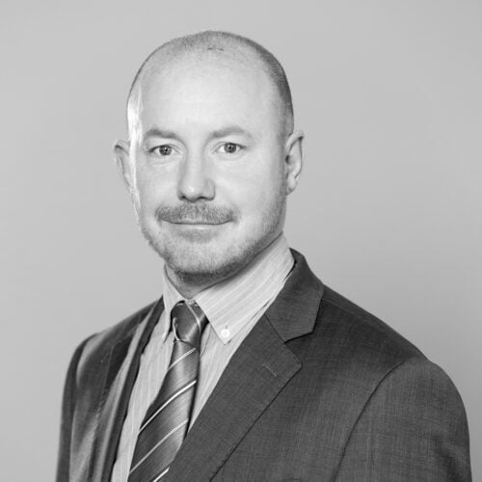
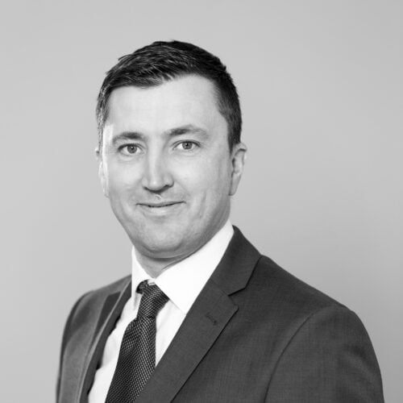
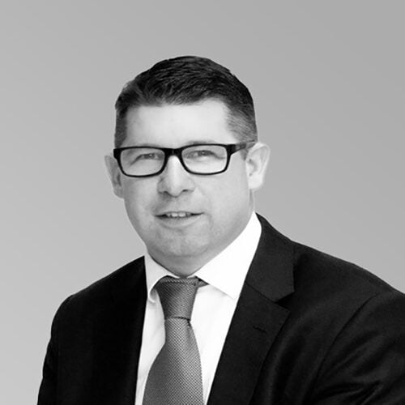
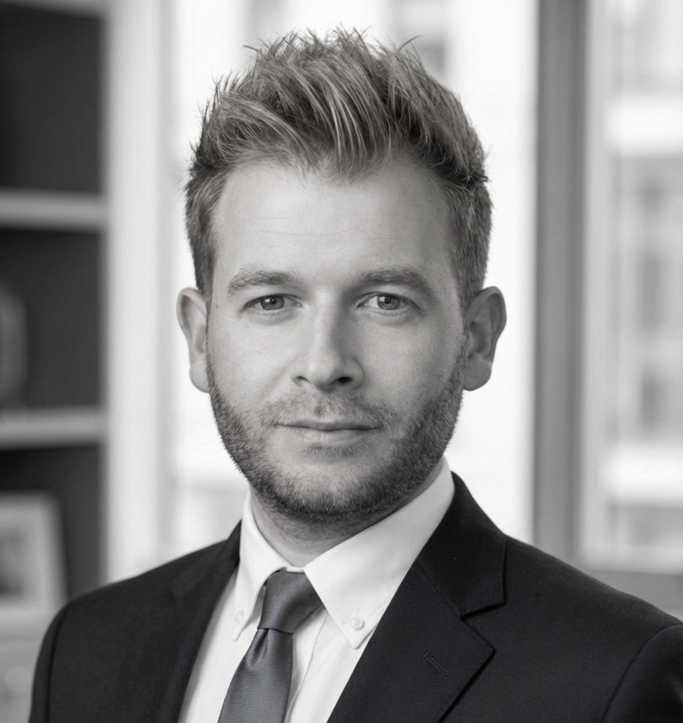
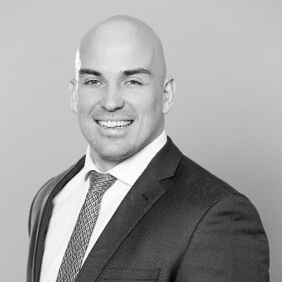





Civil & Structural
Company Organogram
Paul Healy
Director
Martin McGrath
Group Managing Director
Patrick Field
Managing Director M&E
John McBeath
Director/Cork
Ciaran O’Meachair
Director Belfast
Eleanor Burke
Environmental Director
Andrew McDermott
Director Galway
John Rogers
Manager Birmingham
Michael O’Reilly
Director
James Barrett
Director/Company
Secretary
Patrick Raggett
Associate Director/
Safety Officer
Colin Wilson
Associate Director
Paul McSteen
Associate Director
Thomas Johnston
C/S Production Director
Seamus Doyle
Associate Director
Niall McMenamin
Associate Director
Ian Crehan
Associate Director
Anthony Horan
Director
Brian O’Rourke
Director
ASSOCIATES
Gavin Mullins
Ciaran Murphy
Mark Hogan
Derek Connolly
Paul Devine
Jack O’Shea
Andrew Cross
Brian Heron
Director
Edward Lyons
Director
Mark Killian
Conor Harrington
Choon Siong Voon
Colm McNamara
Zeljana Rotim
Luke Grainger
Laurent Hadfield
Niall Rooney
Tender & Compliance Manager
Douglas Silva
Safety Officer
John Millar
Director
Keith Knox
Chief Technology Officer
Sustainability
Environmental Engineers,Scientists,
Geologists, Ecologists
Civil,Structural
Mechanical & Electrical
Administration & IT
Shaun Doody
Director

Slide 6
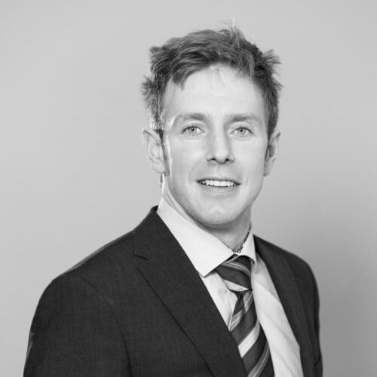

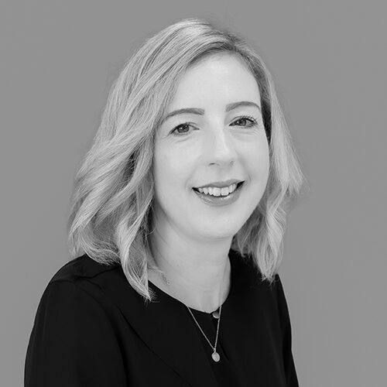
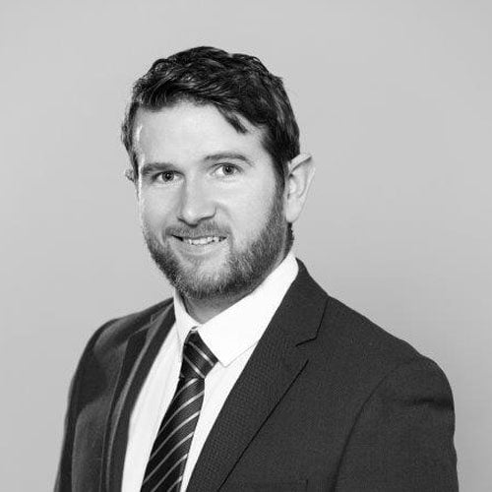
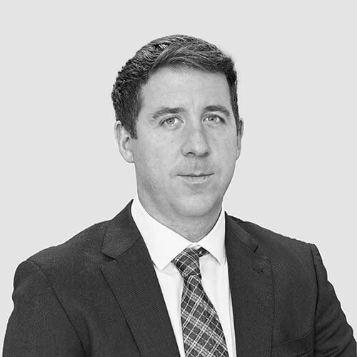
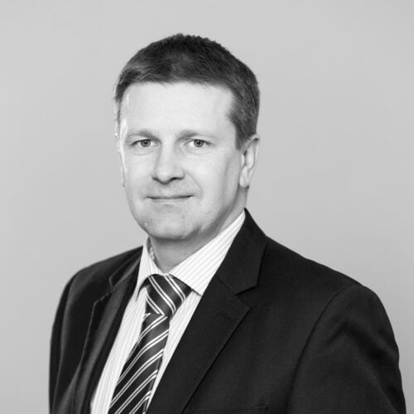
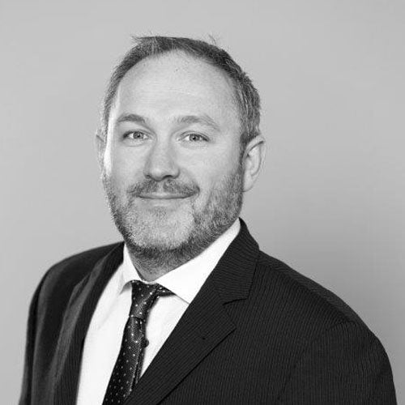
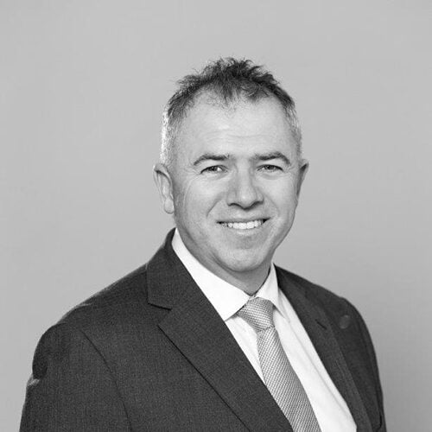
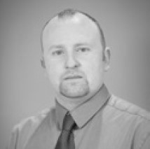
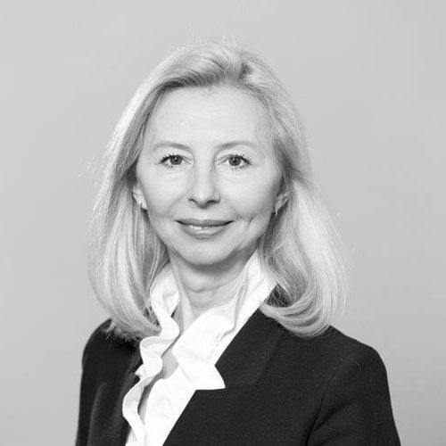
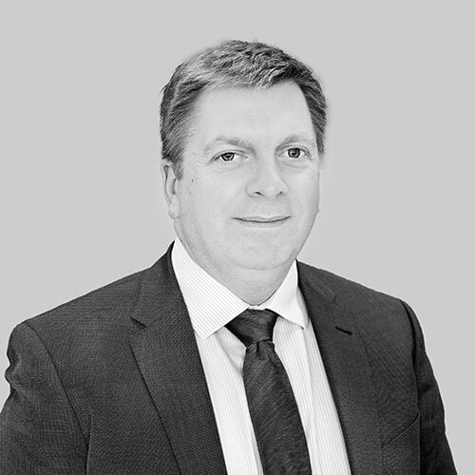
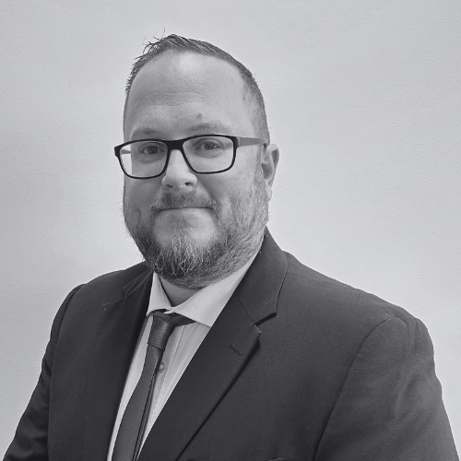
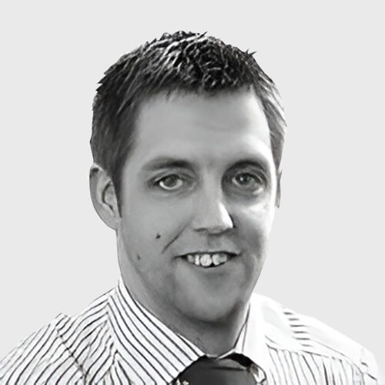
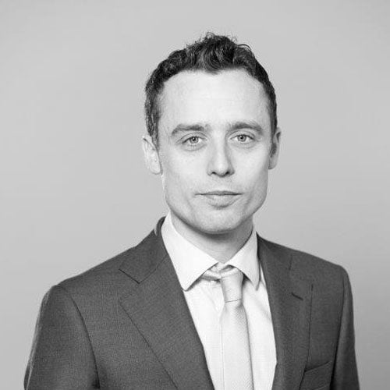

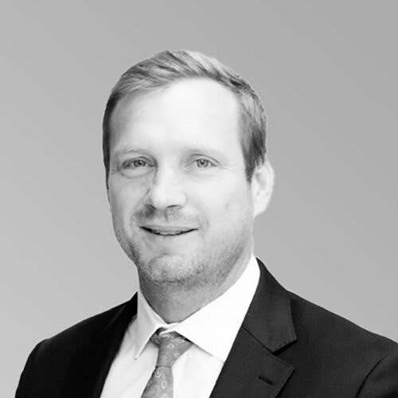
Mechanical & Electrical
Company Organogram
Declan Barry
Director
Patrick Field
Managing Director
Martin McGrath
Group Managing Director
William O’Mahony
Project Director
Patrice McVeigh
Associate Director
Mark Hopkins
Associate Director
Conor McCarthy
Associate Director
Richard Brennan
Director
James Barrett
Director/Company
Secretary
Brian Mulligan
Associate
Brian Raymond
Associate
John Kenny
Associate
Elena Olefirenko
Associate
William Forsyth
Director
Michael O’Reilly
Director
William Forsyth
Director Cork
+
Ciaran O’Meachair
Director Belfast
Andrew McDermott
Director Galway
Rob Shipman
Director Birmingham
Rob Shipman
Director
(London)
John Millar
Director
Douglas Silva
Safety Officer
Patrick Raggett
Safety Officer
Brian Farrington
Director
Eamon Prendergast
Director
CAD Technicians
Environmental
Engineers
Mechanical &
Electrical
Administration & IT
Sam Budin
Director
(London)

Slide 7
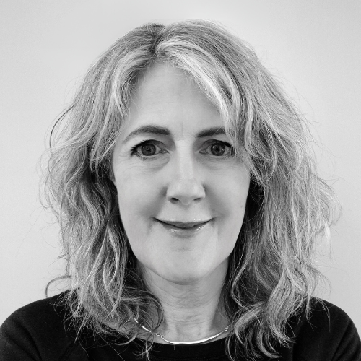
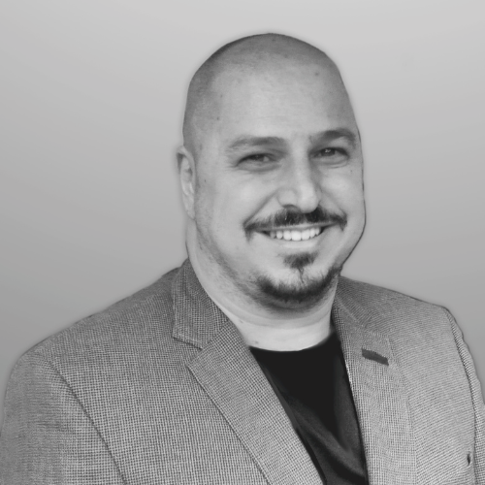
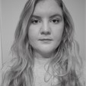
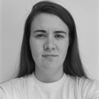
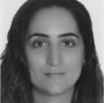
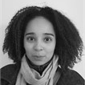
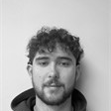

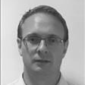
Environmental
Company Organogram
Eleanor Burke
Environmental Director
+
Team of Environmental Engineers, Scientists, Geologists, Ecologists
James Barrett
Director
Martin McGrath
Group Managing Director
Glenda Barry
Environmental Associate
Luis Iemma
Ecology Associate
Rebecca Duane
Consultant
Ecologist
Eadaoin Butler
Consultant
Ecologist
Bruna Guasti
Environmental
Engineer
Kate Moraes Dos Santos
Environmental
Consultant
Brian Heron
Director
Paul Healy
Director
Eoin Toomey
Graduate Ecologist
Aideen O’Rourke
Graduate Environmental
Consultant
Ronan Davis
Company Secretary

Slide 8
ABOUT
OCSC

Slide 9
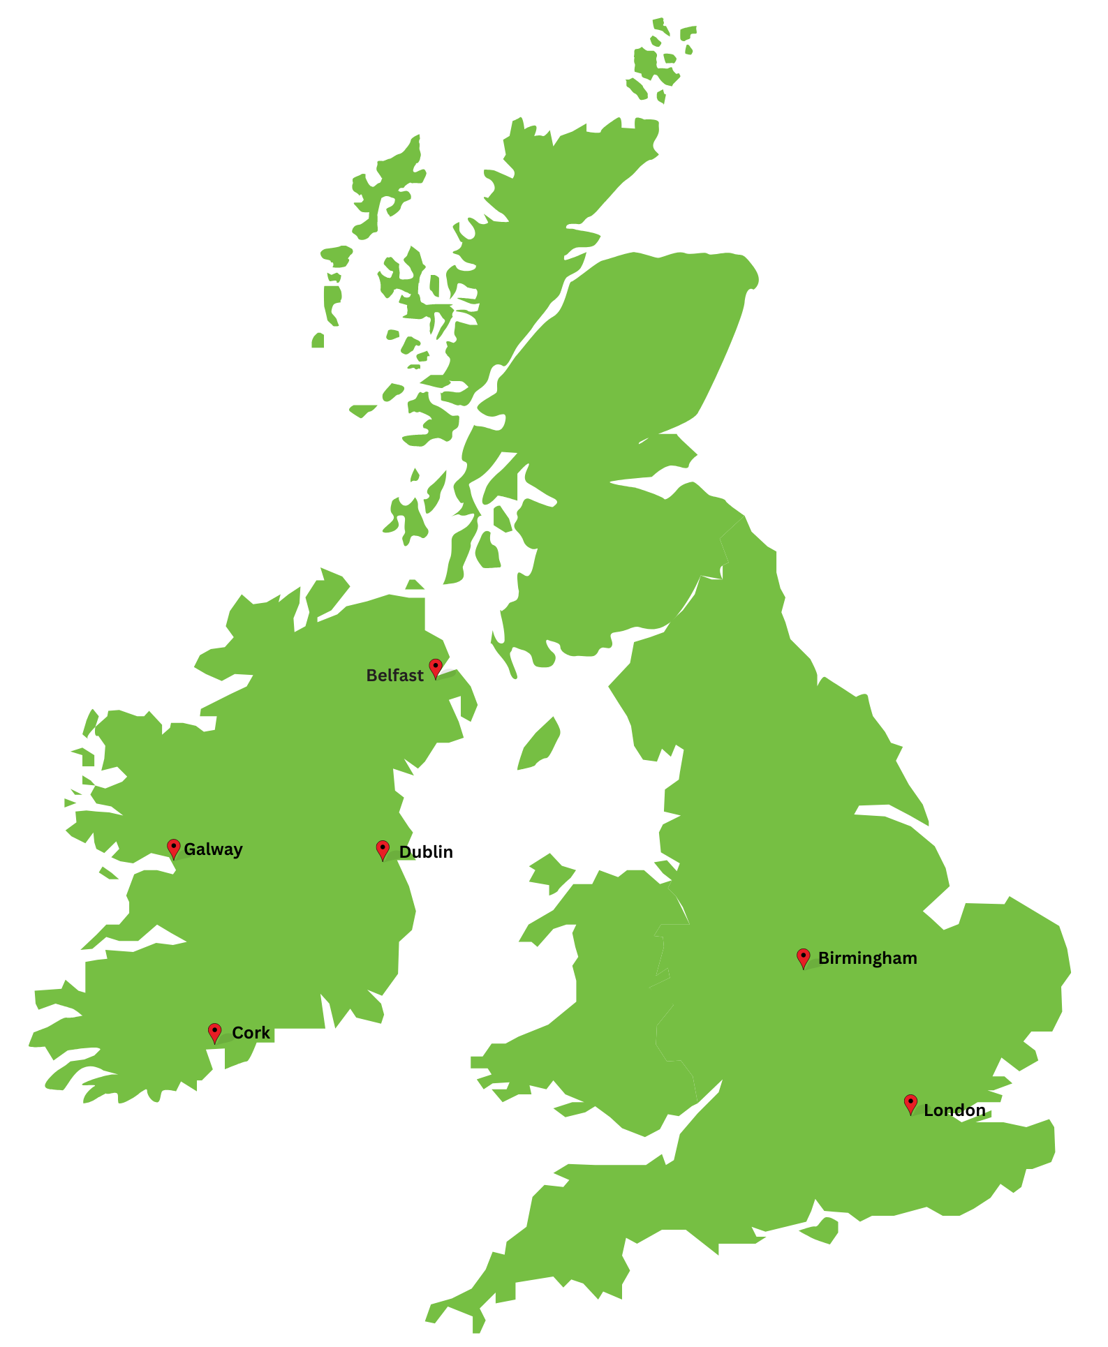
ABOUT OCSC
Our Offices
Founded over 35 years ago as a small Dublin Structural Engineering practice we today stand proud as an International Multidisciplinary Consulting Engineering Practice having delivered over 11,000 projects in 15 countries. Multidisciplinary is a key focus of the practice.
The Mechanical and Electrical practice was established in 2008.
OCSC are the pre-eminent Irish owned and operated Multidisciplinary Consulting Engineering Firm. Our Civil, Structural, Mechanical, Electrical, Sustainability, Traffic and Transport, Environmental Engineers and Ecologists provide expert advice to a diverse range of clients in all sectors of the economy. When we say we will deliver we do!
OUR OFFICES
Dublin
London
Belfast
Birmingham
Cork
Galway

Slide 10
O’CONNOR SUTTON CRONIN
Services & Sectors
OCSC SERVICES
BIM
Contracts
Civil
Due Diligence
Employers Representative
Environment & Ecology
Expert Witness
Health & Safety /PSDP
Infrastructure
Mechanical & Electrical
Planning
Project Management
Public Procurement
Strategic Purchase Advice
Structural
Temporary Works & Construction Engineering
Traffic & Transport
OCSC SECTORS
Bridges
Commercial
Education
Environmental
Health Care
Industrial
Infrastructure
Leisure & Tourism
Multidisciplinary
PSDP
Public Buildings
Refurbishments
Residential
Sustainability
Transport

Slide 11
INFO & IMAGERY
OPTIONS

Slide 24
INFOGRAPHIC
OPTIONS

Slide 33
IMAGERY
OPTIONS

