Slide 1
Bot-Tech Robotics
Project preview

Slide 2
Project Description
A single platform robot that has the ability to move, recognize its environment, pick up and move objects in its environment, and to follow a pre-described list of voice commands

Slide 3
Main Components
Robotic arm
For manipulating the environment
Two wheel drive train
For moving around
Sensors
To gather input
Circuit board with micro-processor
To analyze all inputs and decide actions for all outputs

Slide 4
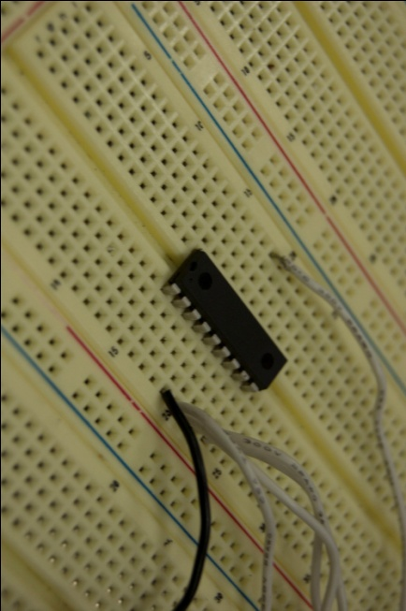
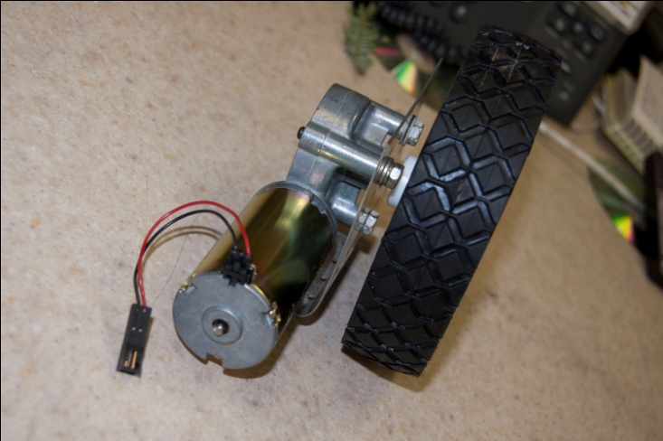
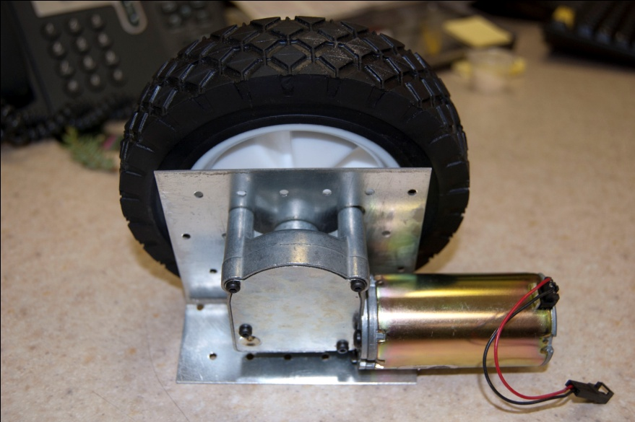
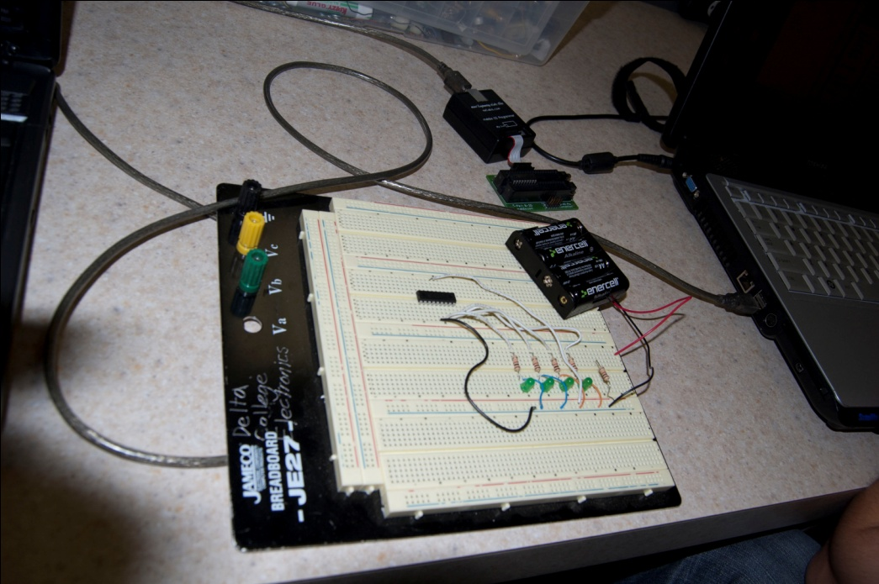
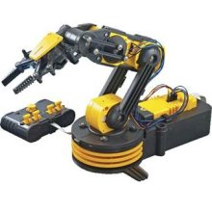
Hardware aspects

Slide 5
Use cases
Use cases for our robot are broken down into two main Actors
The robot itself
Which will control many of its own functions
Users Speech input
Voice commands to give the robot directions or overrides
As well as a variety of minor actors
Which would include our sensors and the environment around the robot

Slide 6
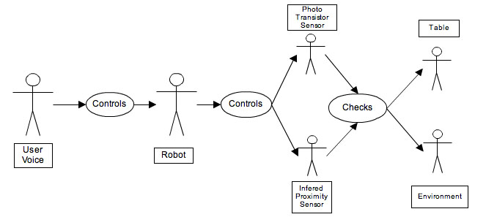
Use case diagram [1]
- This diagram represents the Use cases for the basic movement functions

Slide 7
Project phases
Hardware phase 0 – buy parts/ build robot
Software phase 1 – intelligent movement
Software phase 2 – arm movements/ grabbing objects
Software phase 3 – voice commands
Software phase 4 – recognizing objects and retrieving them

Slide 8
Sample code for Pic-Microprocessor And a look into circuitry
http://www.rentron.com/Micro-Bot/IR_Nav.htm

