Slide 1


Artificial Intelligence Final Project
Kin NG

Slide 2
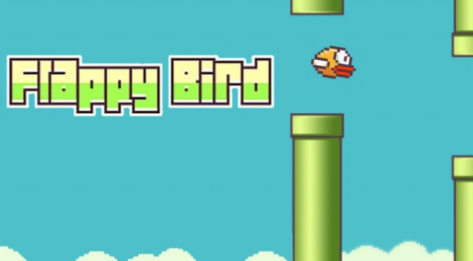
Problem Selection
How is the game played ?
The Game of Flappy Bird
The game of flappy bird consists of a bird that navigates through a pair of pipes. The game usually has one input that allows the bird to jump while no input will simply make the bird fall.
What are the rules of the game?
Game loop condition: The game will continue if the bird does not collide with any of the pipe objects or the base floor.
Scoring system: 1 point per each pair of pipes completed.
Goal for the Project
Create a flappy bird AI capable of surpassing a 200-score point mark in the game.

Slide 3


Algorithm Selection
What type of algorithm can be advantageous for this type of game ?
Agents need to be trained under the rules of the game.
More combination of agents used to identify wrong game states is better.
Improvement by iteration.
Genetic Algorithm
Create a greater combination of bird agents (population property)
Able to improve upon generational iterations (generation property)
Select the best bird agents that advance through the game properly (fitness function property)
The best bird agents can be combined to create a population of birds that is most likely to produce the optimal bird (crossover property)

Slide 4
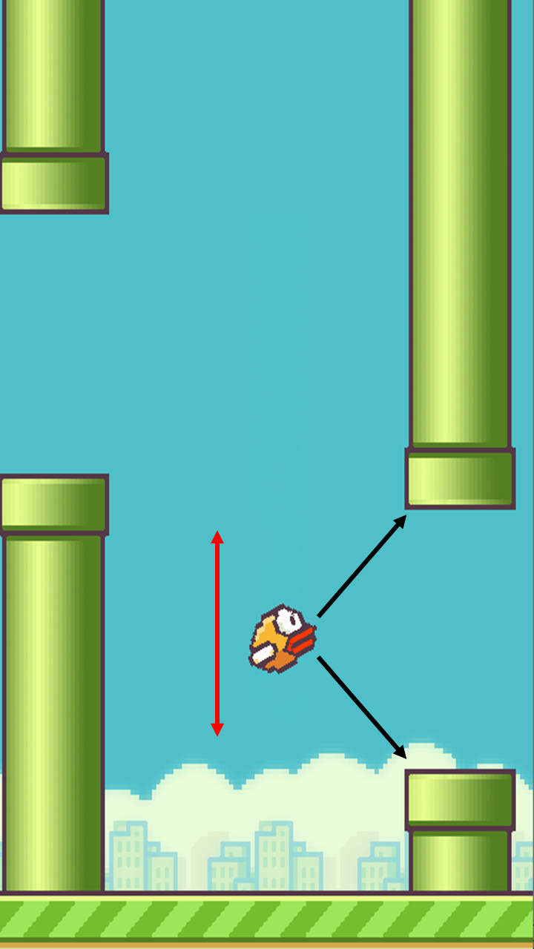
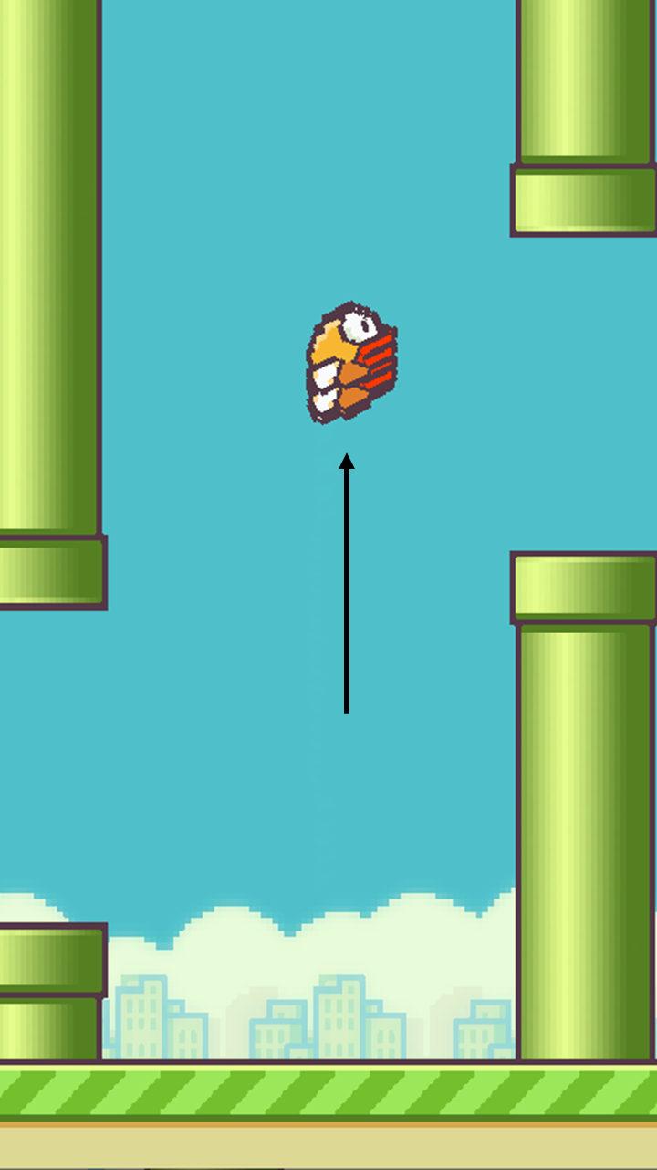
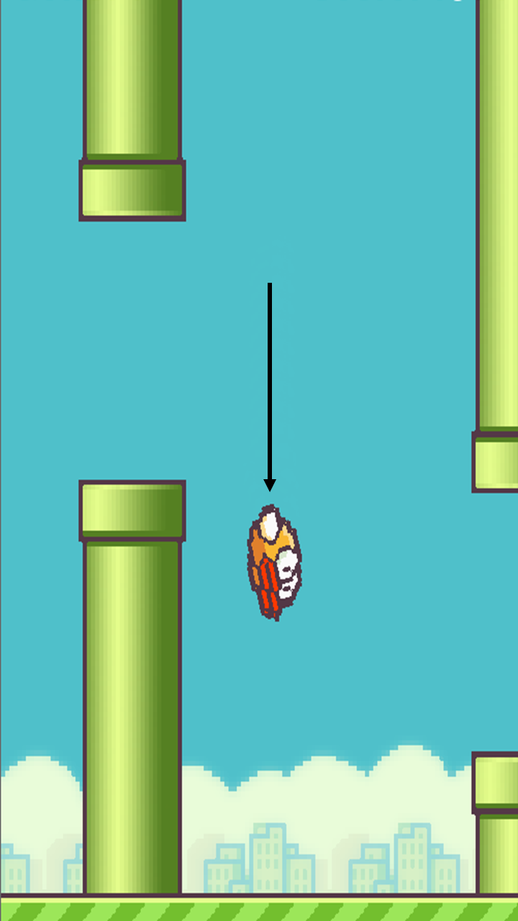
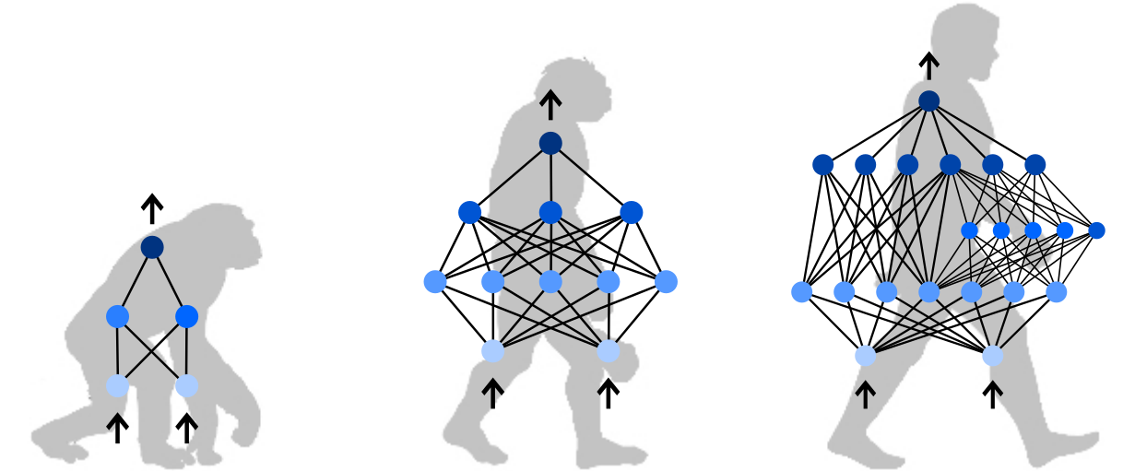
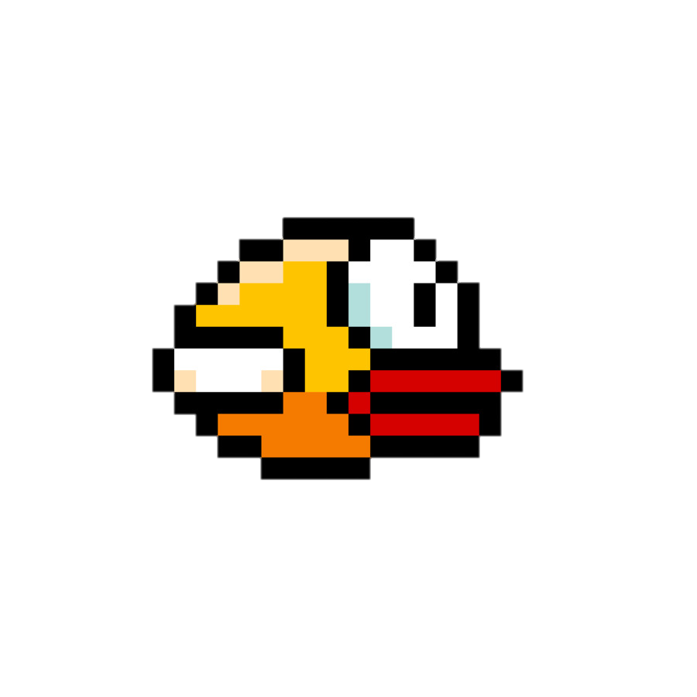
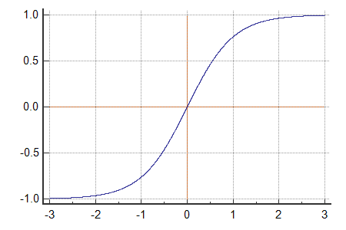

How was the Artificial Intelligence Built?
Library Selection
Input Layer
Output Layer
NEAT
Fitness Evaluation
Activation Function
Neuro- Controllers
+1
+5
+7
All agent birds started with 0 fitness level.
For every second a bird AI stayed alive, its fitness increase by 0.1.
Map neural output to a common domain.
Act according to the threshold.
From the NEAT library, each bird agent was assigned a neuro-controller.
Decisions are made based on a weighted sum of the percepts.
Heuristic bias is used to adjust errors that might happen.
For every pair of pipes completed, its fitness increased by 5.
A collision decreased the fitness by 1 and removed the bird from the run.

Slide 5
Results
Average Fitness and Best Fitness
1) Continuous peaks, at least 5 consecutive peaks, in best fitness were indicative of optimality and goal test completion.
2) High average fitness was not always indicative of goal test completion.

Slide 6



Thank You for listening! Do you have any questions ?

