Slide 1
An Seo !

Slide 2
Do Something Cool with Python
Network based Chat Application
  Client : GUI using Swing Toolkit
  Server : Using Twisted Framework

Slide 3
Do Something Cool with Python
Client GUI
  Jython : Java Libraries
  Swing : GUI Toolkit

Slide 4
Do Something Cool with Python
Client GUI
  Group Layout Manager
  Component Creation
  Functionality
  Cosmetics

Slide 5
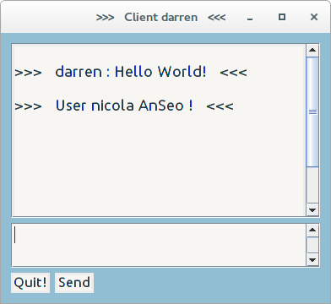
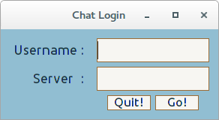
Do Something Cool with Python
User Login
Main GUI

Slide 6
Do Something Cool with Python
Server Side
  Listens on the default port
  Hands off new connections to a new thread of control
  Returns to listening

Slide 7
Do Something Cool with Python
Program listens on
the default port
Makes a new
connection
New Thread
dispatched
to handle client
communication

Slide 8
Do Something Cool with Python
Thread 1
Program listens on
the default port
Makes a new
connection
Thread 2
New Thread
dispatched
to handle client
communication

Slide 9
Do Something Cool with Python
Server Side
  Input / Output Issues
  Locks, Queues, Semaphores
  Select() method
  Twisted Framework

Slide 10
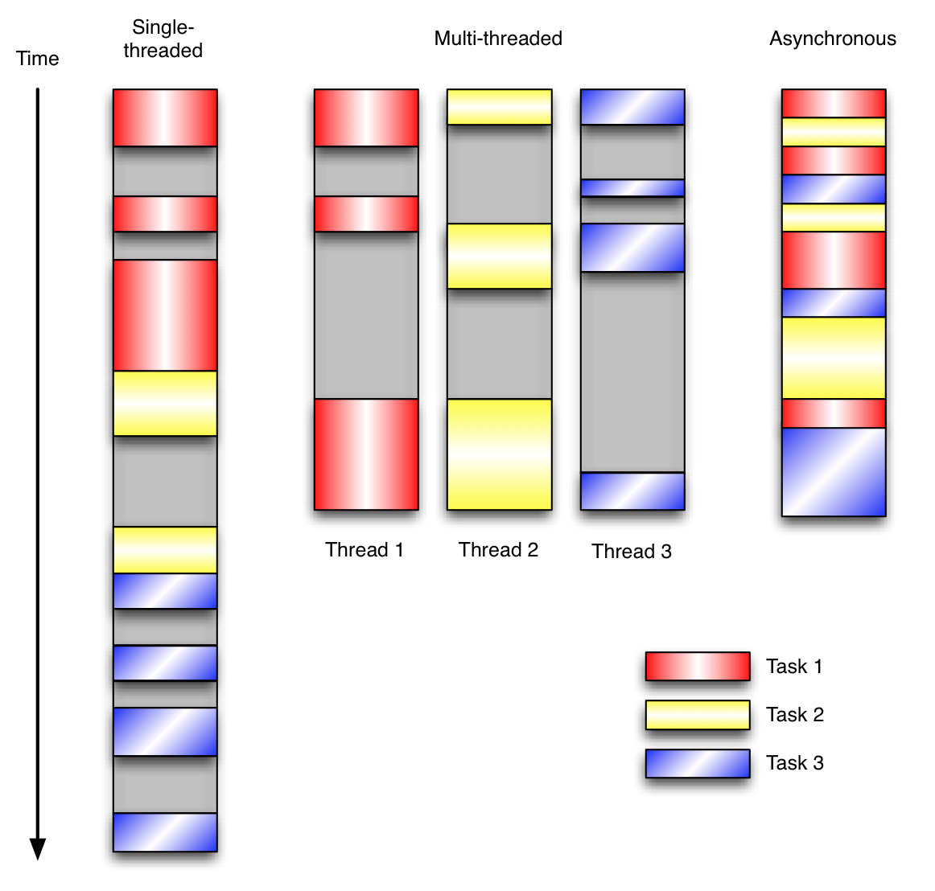
Do Something Cool with Python

Slide 11
Do Something Cool with Python
Twisted Framework
  Network Programming API
  Event Driven
  Creates Factories & Reactors
  Separates Protocols and Transports

Slide 12
Do Something Cool with Python
Twisted Framework
  Reactor attaches to the connection
  Responds to network events

Slide 13
Do Something Cool with Python
Twisted Framework
  Line Receiver
    ConnectionMade()
    ConnectionLost()
    LineReceived()

Slide 14
Do Something Cool with Python
Testing
  Multiway chat established using telnet
  Integrate telnet into the client?

Slide 15
Do Something Cool with Python
Client Side
  “telnetlib” module
  “\r” + “\n”
  A working network chat program

Slide 16
Do Something Cool with Python
Client Side
  Cosmetics
  Error Dialogs
  Scroll Panes ( pains more like )

Slide 17
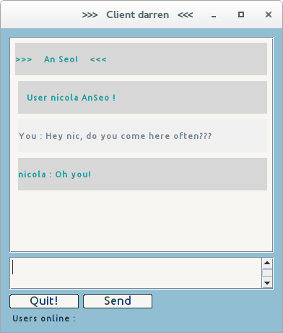
Do Something Cool with Python

Slide 18
Do Something Cool with Python
Demonstrations
  Power of Twisted
  An Seo program
Questions ???

