Slide 1

C編譯選項、除錯、逆向工程及在資訊安全中的應用
NLS - Native Language Security
Next Generation and Low-Level Security Startup Program
Speaker: 黃廷宇(Edwin)

Slide 2
大綱
我是誰?
基礎概念
ASM IN C
Linux APIs
IA-32
再談第一支程式
載入器: 執行檔檔頭到進入點
PE程式設計
ELF程式設計
編譯器選項
手動逆向的框架
動態分析
除錯(Debugging)
儀控(Binary Instrumentation)
模擬(emulation)
靜態分析
符號執行(Symbolic Execution)
反組譯(Disassembly)
逆向工程(Reverse Engineering)

Slide 3
基礎概念
800次國際駭客組織攻擊資料分析

Slide 4
基礎概念
Windows API 架構
Win32 APIs
DeviceIoControl
Ntdll.dll
User
Mode
System call
IOCTL
Kernel
Mode
System Service Dispatch Table (SSDT)
I/O Manager
System Service Routine
(CreateFile, OpenProcess, …etc.)
Kernel-Mode Drivers
(ntfs.sys, tcpip.sys, http.sys, … etc.)

Slide 5
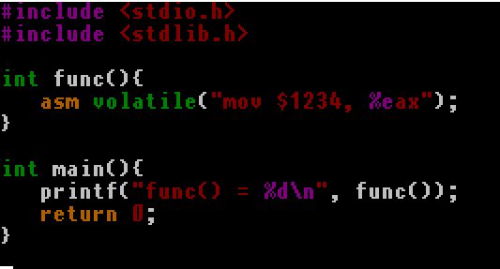
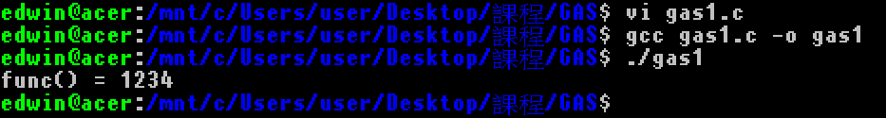
基礎概念
Inline assembly: gas
return 1234 => mov $1234, %eax

Slide 6
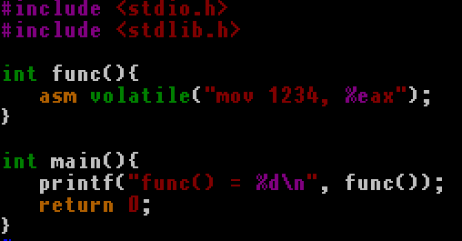
基礎概念
Inline assembly: gas
return 1234 => mov $1234, %eax
mov 1234, %eax => access violation

Slide 7
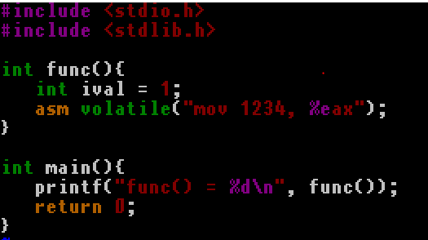
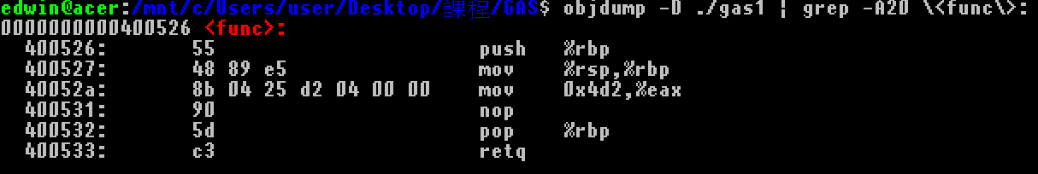
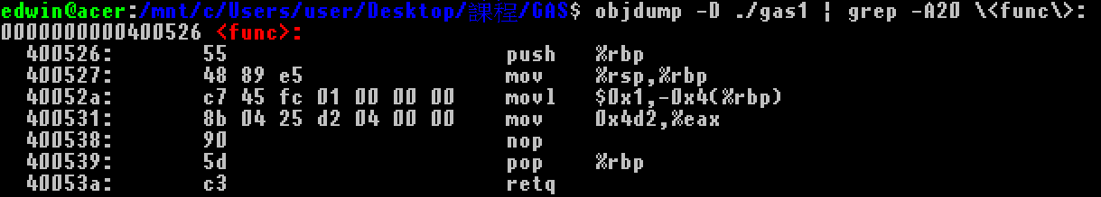
基礎概念
Function Stack
mov 1234, %eax => return value address 1234
編譯前:
編譯後:

Slide 8
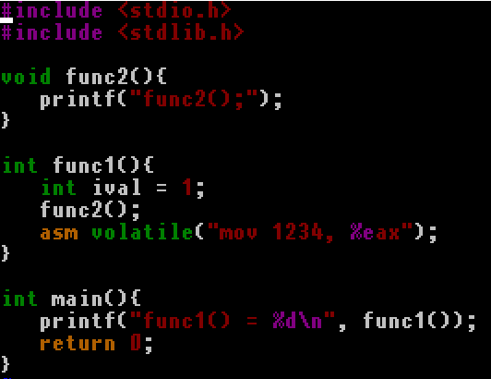
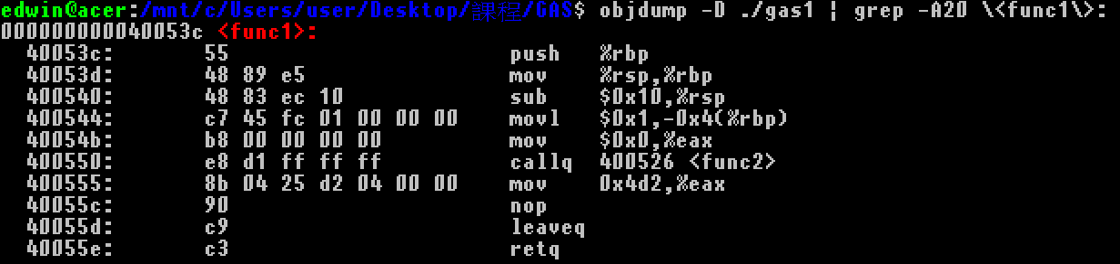
基礎概念
Inline assembly: gas
Stack static analysis
push rbp
rbp = rsp
rsp -= 10

Slide 9
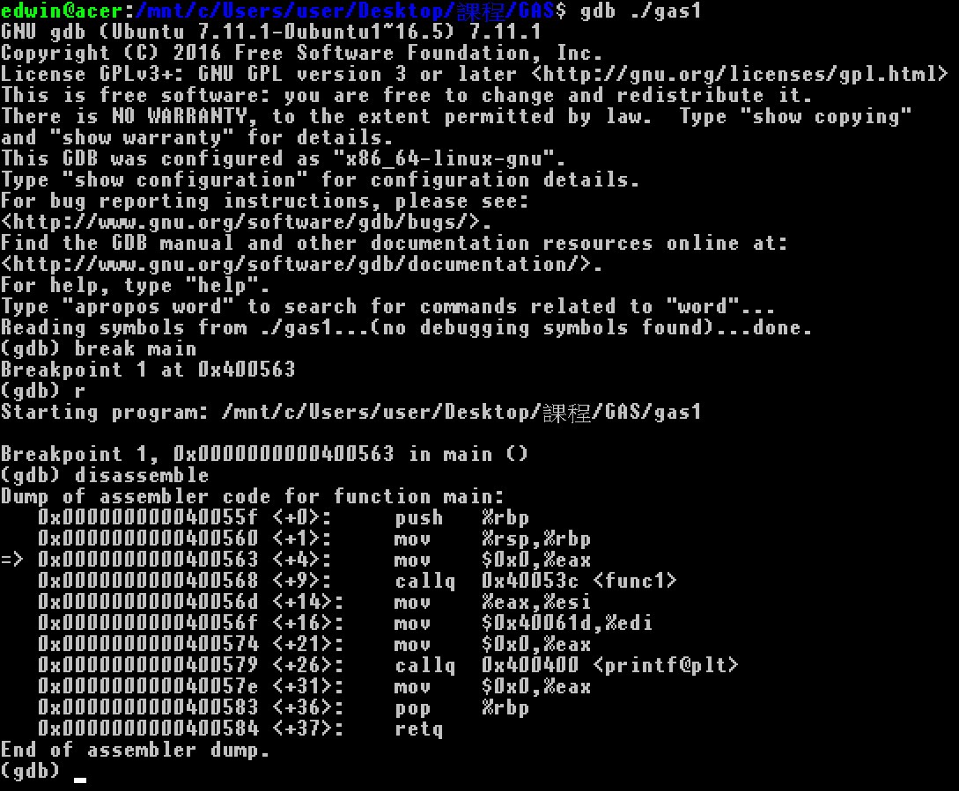
基礎概念
Inline assembly: gas
Dynamic analysis
Break main

Slide 10
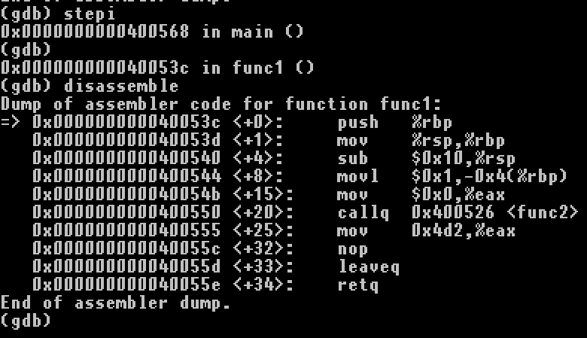
基礎概念
Inline assembly: gas
Stepi: step instruction

Slide 11
基礎概念
callq: 64 bits call
tempDEST ← SignExtend(DEST);
tempRIP ← RIP + tempDEST;
IF stack not large enough for a 8-byte return address
THEN #SS(0);
FI;
Push(RIP);
RIP ← tempRIP;
X64 instruction | stack
call | Old RIP

Slide 12
基礎概念
pushq
RSP ← RSP – 8
Memory[SS:RSP] ← SRC
pointer | stack
RSP | [TOP DATA]
… | …
RBP
pointer | stack
RSP
 | [TOP DATA]
… | …
RBP
pointer | stack
RSP | [DATA]
 | [TOP DATA]
… | …
RBP

Slide 13
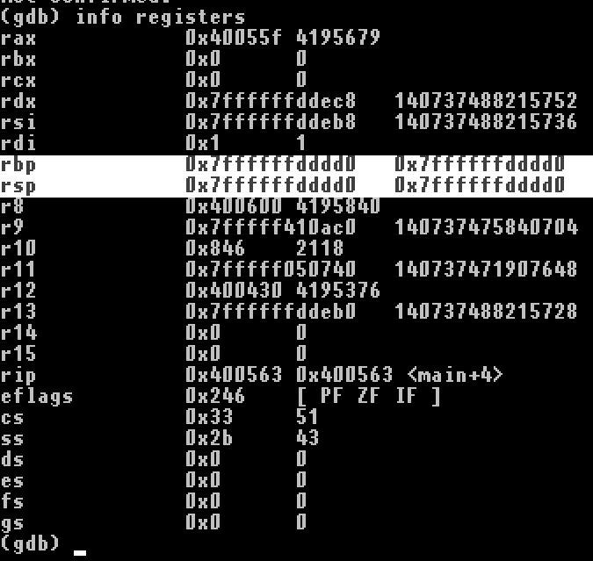
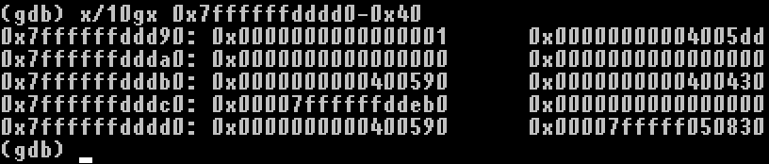
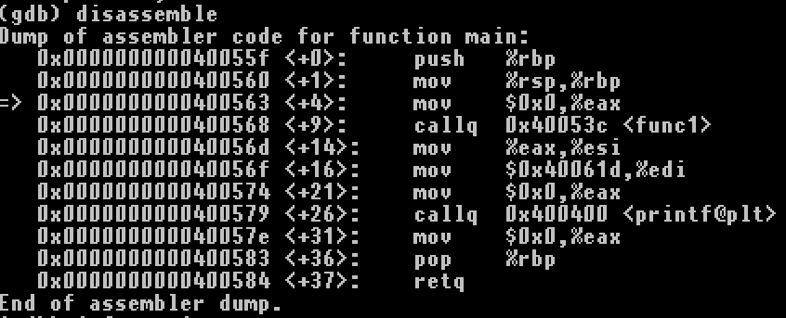
基礎概念
Dynamic analysis of callq
觀察堆疊、RIP
New stack: empty、no variable
Old stack top = old RSP = RSP+4
X64 instruction | stack
<-ESP
<-EBP

Slide 14
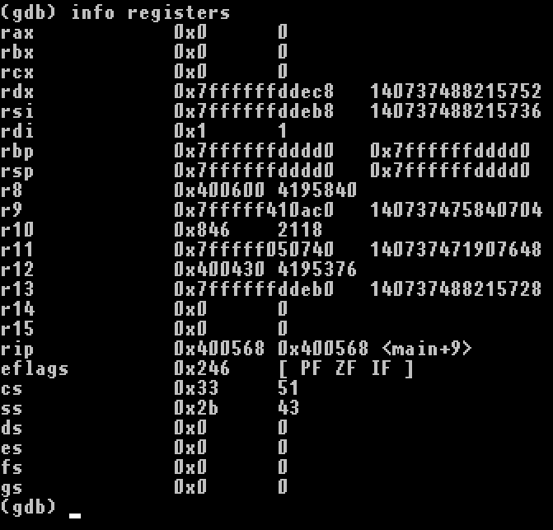

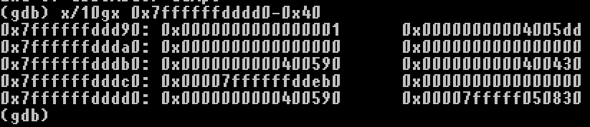
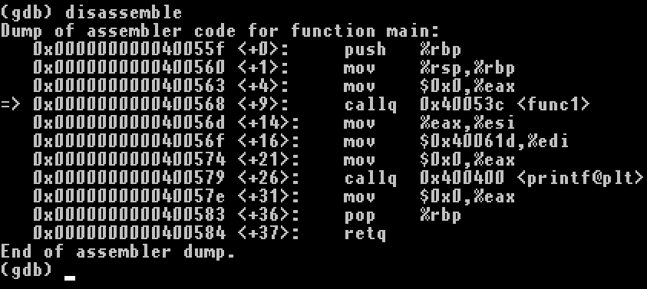
基礎概念
Dynamic analysis of callq
觀察堆疊、RIP
Eax=0, before call function
Old stack top = old RSP = RSP+4
X64 instruction | stack
call
<-ESP
<-EBP

Slide 15
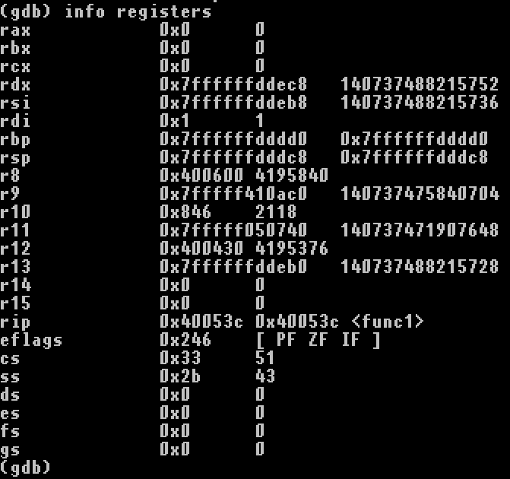

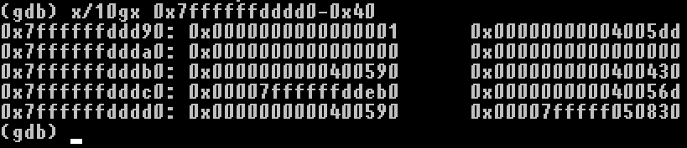
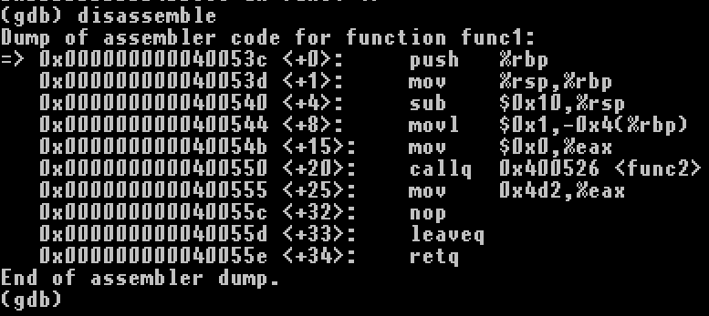
基礎概念
Dynamic analysis of callq
觀察堆疊、RIP
Called function
eip is pushed: after called
Old stack top = old RSP = RSP+4
X64 instruction | stack
call | Old RIP
<-ESP
<-EBP

Slide 16
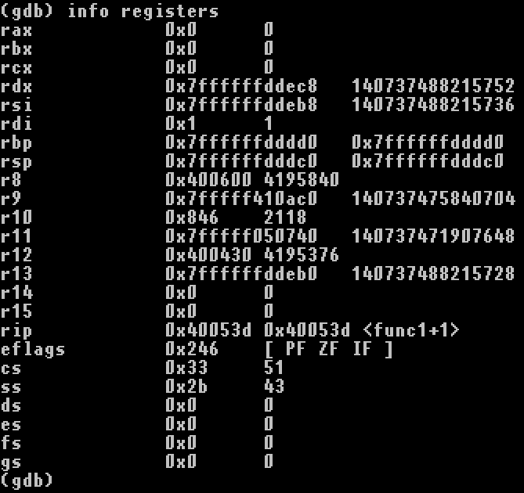

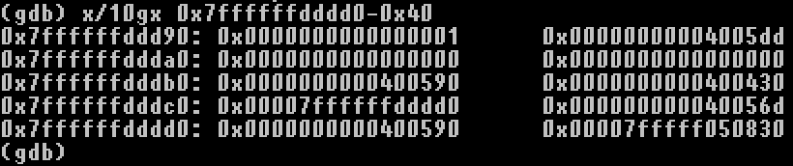
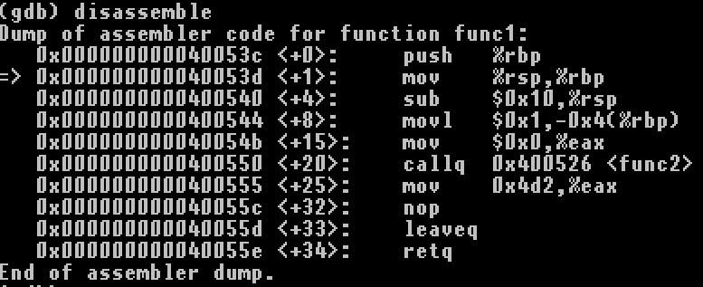
基礎概念
Dynamic analysis of callq
觀察堆疊、RIP
Called function
Push old RBP
eip is pushed: after called
X64 instruction | stack
Calling convention
 | Old RBP
call | Old RIP
<-ESP
<-EBP

Slide 17
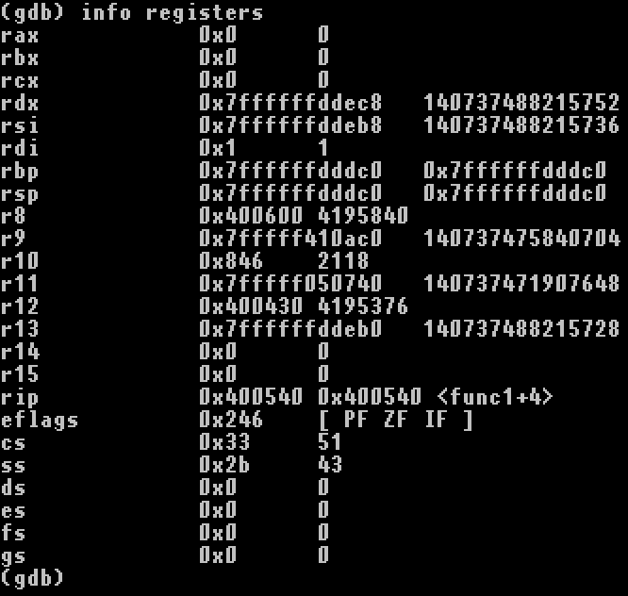

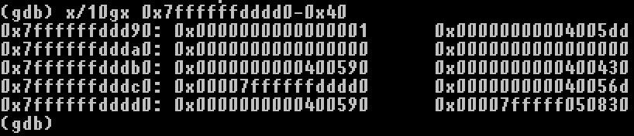
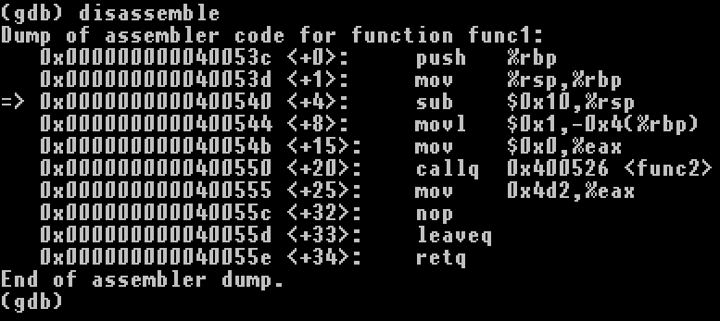
基礎概念
Dynamic analysis of callq
觀察堆疊、RIP
Called function
Push old RBP
eip is pushed: after called
X64 instruction | stack
Calling convention
 | Old RBP
call | Old RIP
<-ESP
<-EBP

Slide 18

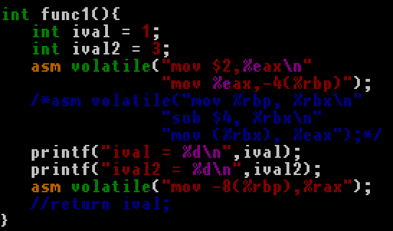
基礎概念
Make It’s execuable
mov %ebp, %ebx
sub 4, %ebx
mov (%ebx), %eax
 | 0 | 1 | 2 | 3 | 4 | 5 | 6 | 7
Address | <func1> space?
Address+8 |  |  |  |  | <func1> var1
Address+16 | <func1>old RBP
Address+24 | <func1>old RIP
Address+32 | <main> old RBP
Address+40 | <main>old RIP

Slide 19
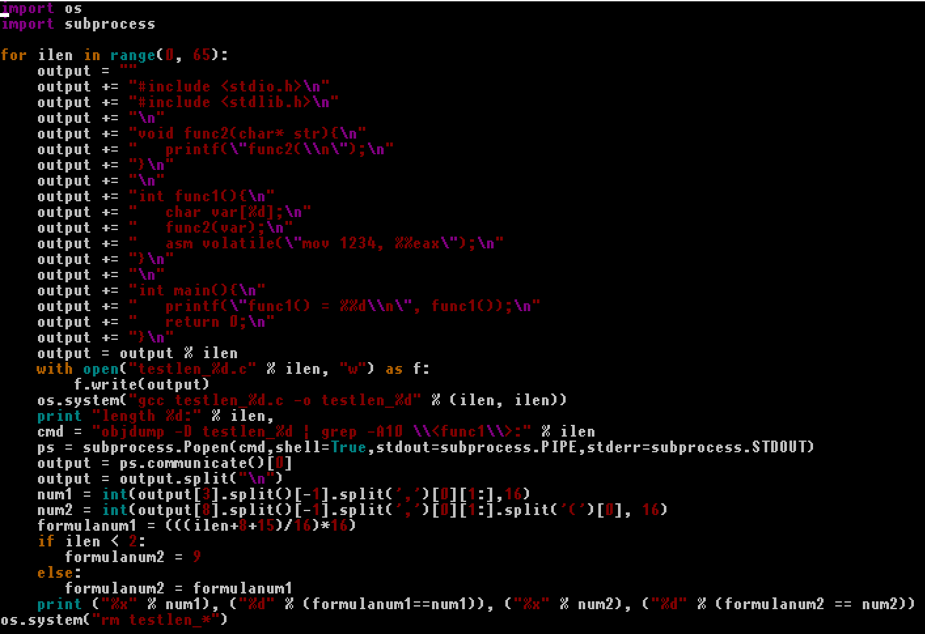
基礎概念
Why ebp – 0x10?
Try metaprogramming the stack:
長度公式:
16*ceil((4+8)/16)
=16=0x10
-0x8(%rbp) =%fs:0x28
Stack cookie

Slide 20
基礎概念
Stack cookie
C string, arrays
Memory protection
%fs:0x28
 | 0 | 1 | 2 | 3 | 4 | 5 | 6 | 7
Address | <func1> C string
Address+8 | <func1> stack cookie
Address+16 | <func1>old RBP
Address+24 | <func1>old RIP
Address+32 | <main> old RBP
Address+40 | <main>old RIP

Slide 21
基礎概念
Function stack LinkedList: (__cdecl)
typedef struct _BackTrace{
struct _BackTrace *next_frame;
void *inst_pointer;
}BackTrace;

Slide 22
基礎概念

Slide 23
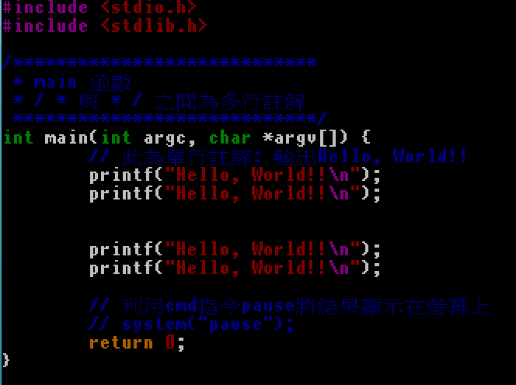
再談第一支程式
‘main’ function reverse

Slide 24
再談第一支程式
‘main’ C pseudocode
int main(int argc, char* argv[]){
printf(“Hello, World!!\n”);
printf(“Hello, World!!\n”);
printf(“Hello, World!!\n”);
printf(“Hello, World!!\n”);
return 0;
}
Gcc option: gcc FirstProg.c -o FirstProg

Slide 25
再談第一支程式
‘main’ C pseudocode
int main(int argc, char* argv[]){
char* string = “Hello, World!!\n”;
printf(string);
printf(string);
printf(string);
printf(string);
return 0;
}
Gcc option: gcc FirstProg.c -o FirstProg

Slide 26
再談第一支程式
‘main’ C pseudocode compare to ASM
int main(int argc, char* argv[]){
char* string = “Hello, World!!”;
puts(string);
puts(string);
puts(string);
puts(string);
return 0;
}
Gcc option: gcc FirstProg.c -o FirstProg

Slide 27
再談第一支程式
‘main’ C pseudocode
int main(int argc, char* argv[]){
char* string = “Hello, World!!”;
puts(string);
puts(string);
puts(string);
puts(string);
return 0;
}
位址 | 位元組 | 組合語言
0x400526 | 55 | push rbp
0x400527 | 48 89 e5 | mov rbp,rsp
0x40052a | 48 83 ec 10 | sub rsp,0x10
0x40052e | 89 7d fc | mov DWORD PTR [rbp-0x4],edi
0x400531 | 48 89 75 f0 | mov QWORD PTR [rbp-0x10],rsi
0x400535 | bf f4 05 40 00 | mov edi,0x4005f4
0x40053a | e8 c1 fe ff ff | call 400400 <puts@plt>
0x40053f | bf f4 05 40 00 | mov edi,0x4005f4
0x400544 | e8 b7 fe ff ff | call 400400 <puts@plt>
0x400549 | bf f4 05 40 00 | mov edi,0x4005f4
0x40054e | e8 ad fe ff ff | call 400400 <puts@plt>
0x400553 | bf f4 05 40 00 | mov edi,0x4005f4
0x400558 | e8 a3 fe ff ff | call 400400 <puts@plt>
0x40055d | b8 00 00 00 00 | mov eax, 0x0
0x400562 | C9 | leave
0x400563 | C3 | ret
0x400564
Gcc option: gcc FirstProg.c -o FirstProg

Slide 28
再談第一支程式
Gcc option: gcc FirstProg.c -o FirstProg
‘main’ C pseudocode
int main(int argc, char* argv[]){
push rbp
mov rbp, rsp
char* string = “Hello, World!!”;
sub rsp,0x10
mov DWORD PTR [rbp-0x4],edi
mov QWORD PTR [rbp-0x10],rsi
puts(string);
mov edi,0x4005f4
call 400400 <puts@plt>
puts(string);
mov edi,0x4005f4
call 400400 <puts@plt>
puts(string);
mov edi,0x4005f4
call 400400 <puts@plt>
puts(string);
mov edi,0x4005f4
call 400400 <puts@plt>
return 0;
mov eax, 0x0
}
leave
ret
位址 | 位元組 | 組合語言
0x400526 | 55 | push rbp
0x400527 | 48 89 e5 | mov rbp,rsp
0x40052a | 48 83 ec 10 | sub rsp,0x10
0x40052e | 89 7d fc | mov DWORD PTR [rbp-0x4],edi
0x400531 | 48 89 75 f0 | mov QWORD PTR [rbp-0x10],rsi
0x400535 | bf f4 05 40 00 | mov edi,0x4005f4
0x40053a | e8 c1 fe ff ff | call 400400 <puts@plt>
0x40053f | bf f4 05 40 00 | mov edi,0x4005f4
0x400544 | e8 b7 fe ff ff | call 400400 <puts@plt>
0x400549 | bf f4 05 40 00 | mov edi,0x4005f4
0x40054e | e8 ad fe ff ff | call 400400 <puts@plt>
0x400553 | bf f4 05 40 00 | mov edi,0x4005f4
0x400558 | e8 a3 fe ff ff | call 400400 <puts@plt>
0x40055d | b8 00 00 00 00 | mov eax, 0x0
0x400562 | C9 | leave
0x400563 | C3 | ret
0x400564

Slide 29
C using ASM

Slide 30
IA-32
General Purpose Registers
EAX
EBX
ECX
EDX
ESI
EDI
EBP
ESP

Slide 31
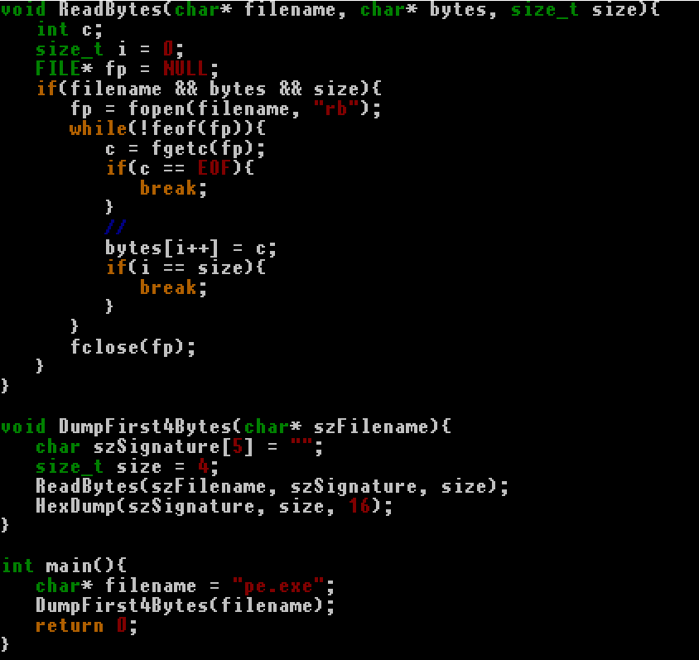
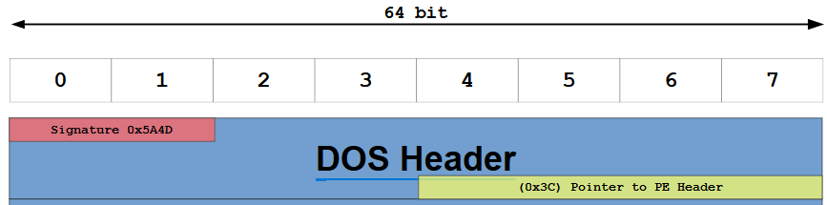
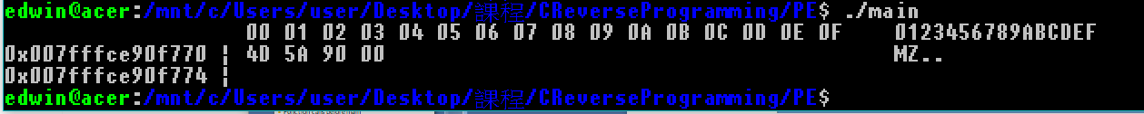
PE程式設計
hexdump executable
從PE檔頭我們知道執行檔的標頭為0x5A4D (“MZ”)
參考: https://upload.wikimedia.org/wikipedia/commons/1/1b/Portable_Executable_32_bit_Structure_in_SVG_fixed.svg

Slide 32
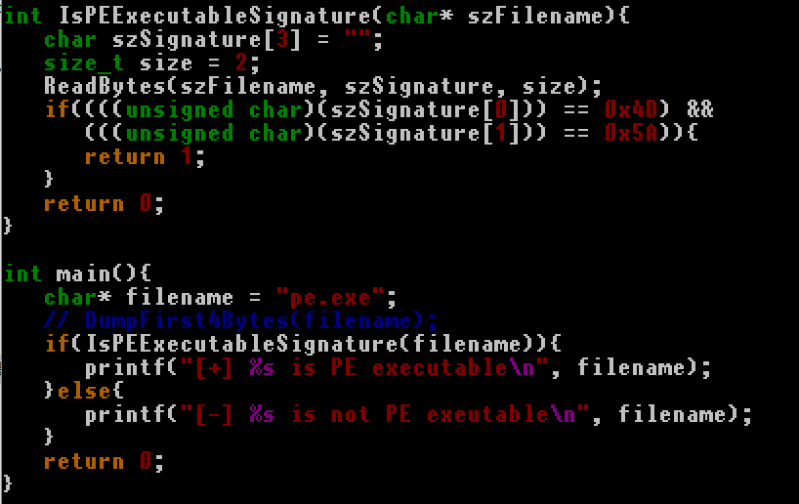
PE程式設計
Check PE executable: IsPEExecutableSignature();

Slide 33
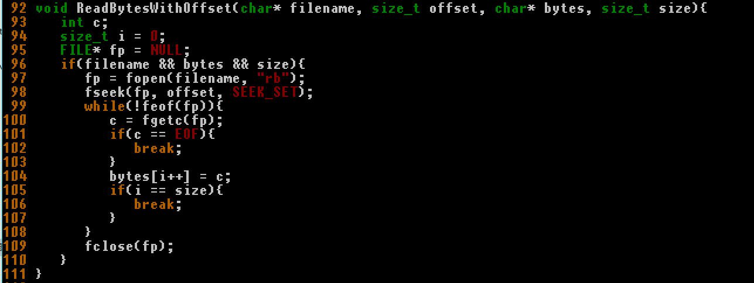
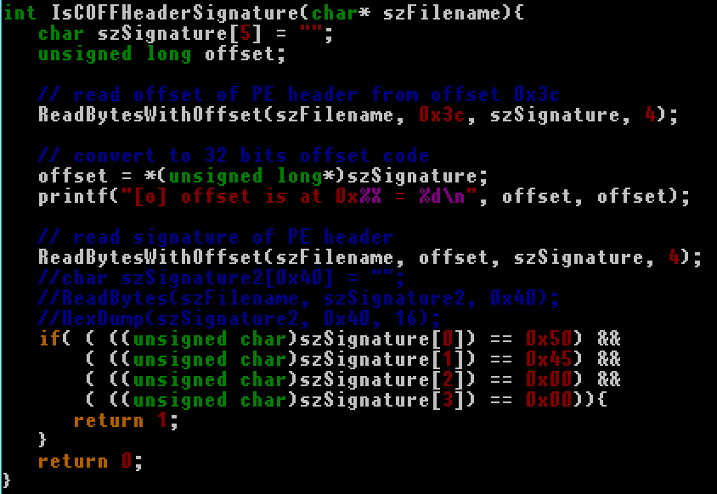
PE程式設計
Locate PE header
參考:https://upload.wikimedia.org/wikipedia/commons/1/1b/Portable_Executable_32_bit_Structure_in_SVG_fixed.svg

Slide 34
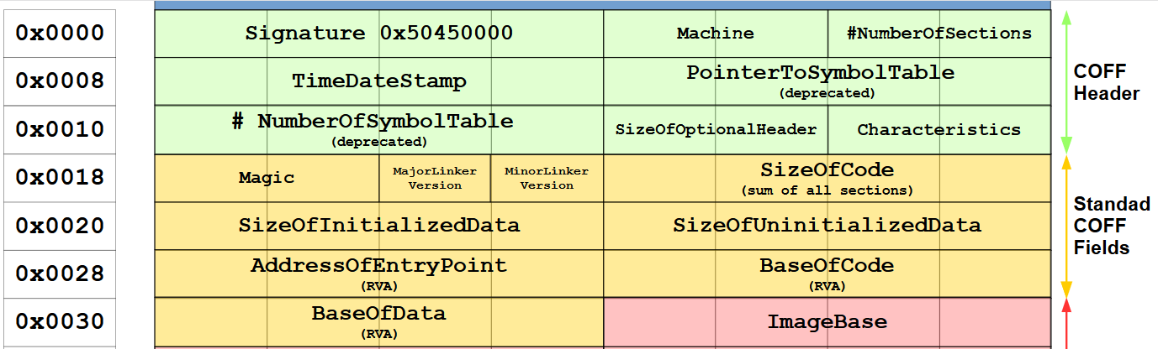
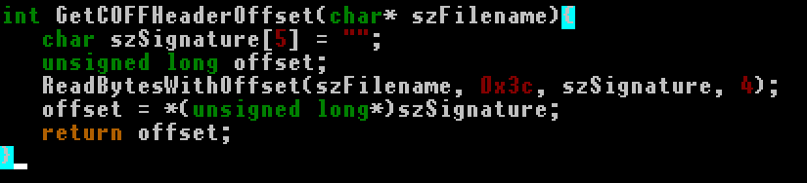
PE程式設計
參考: https://upload.wikimedia.org/wikipedia/commons/1/1b/Portable_Executable_32_bit_Structure_in_SVG_fixed.svg
Get Offset as Tool
From offset 0x3c to get COFF header’s offset

Slide 35
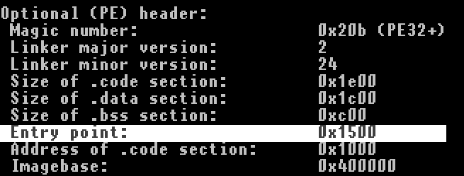
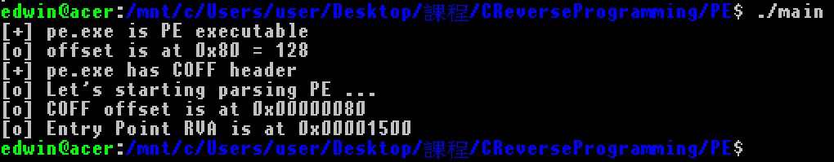
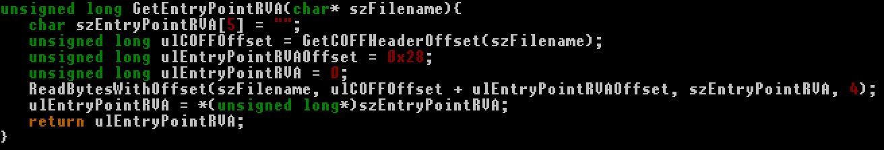
PE程式設計
Entry Point RVA is at COFF+0x28
RVA is at file
VA is at memory
RVA -> VA is need

Slide 36
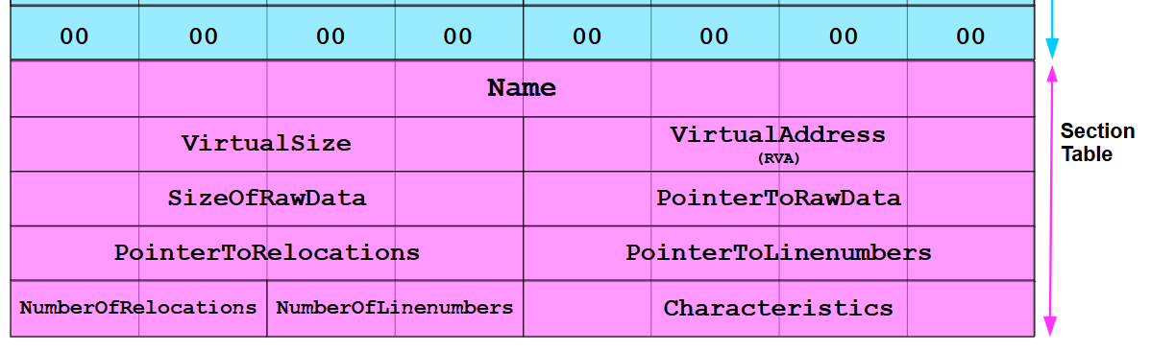
PE程式設計
Section Headers
執行檔會分成幾個區段
.text: code
.data: datas, strings
參考: https://upload.wikimedia.org/wikipedia/commons/1/1b/Portable_Executable_32_bit_Structure_in_SVG_fixed.svg

Slide 37
PE程式設計
載入點判斷
IMAGE_FILE_HEADER::Characteristics是否包含IMAGE_FILE_RELOCS_STRIPPED 。
IMAGE_OPTIONAL_HEADER32(64)::ImageBase被占用。
(XOR)以上兩者都為真或都為否皆會讀取section table
Let
A_{i} is Address of section i
S_{i} is Size of section i
A₁
A₁+S₁
A₂
A₂+S₂
A₃
A₃+S₃
A₄
A₄+S₄
A₅
A₅+S₅

Slide 38
PE程式設計

Slide 39
ELF程式設計

Slide 40
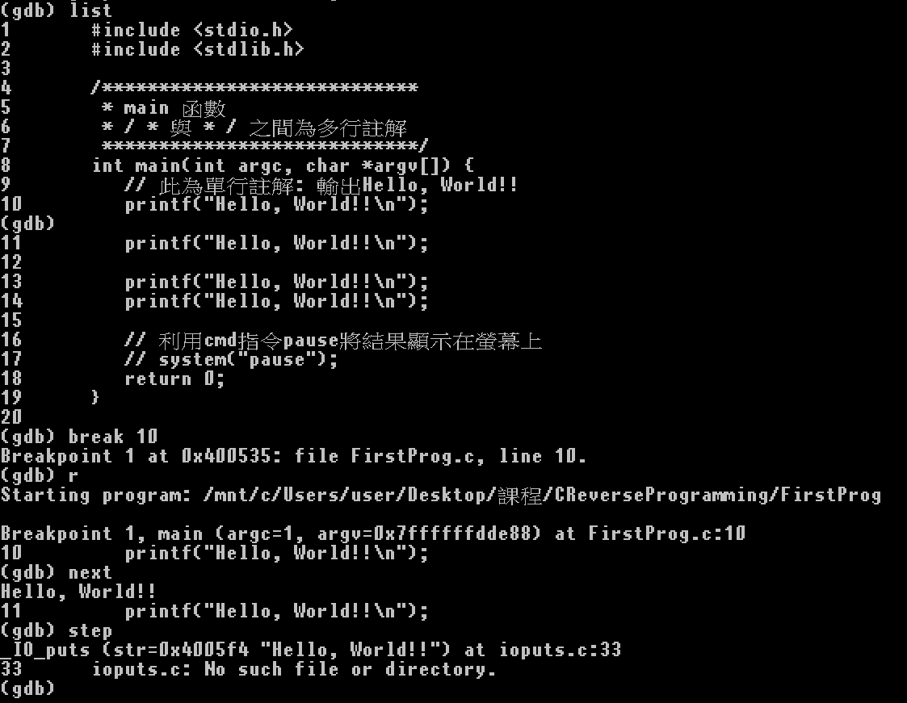
增加除錯符號
增加除錯符號的選項: -g
gcc -g main.c -o main
除錯: gdb
list: 原始碼
break [num]: 原始碼行數的斷點
next/step: 原始碼的trace

Slide 41
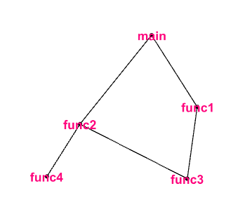
流程分析
由程式進入點(entry point)開始進行程式碼追蹤
C語言進入點為main
graph g{
main -> func1;
main -> func2;
func1 -> func3;
func2 -> func3;
func2 -> func4;
}
void func1(){
func3();
}
rettype func2(){
func3();
res = func4();
return res;
}
Void func3(char* msg){
printf(“[%s] Here\n”);
}
rettype func4(){
return (rettype)0;
}
main(){
…
func1();
res = func2();
}
root

Slide 42
流程分析
Backtrace
Breakpoint的回朔堆疊:main, func2
void func1(){
func3();
}
rettype func2(){
func3();
res = func4();
// breakpoint 在這
return res;
}
Void func3(char* msg){
printf(“[%s] Here\n”);
}
rettype func4(){
return (rettype)0;
}
main(){
…
func1();
res = func2();
}
root

Slide 43
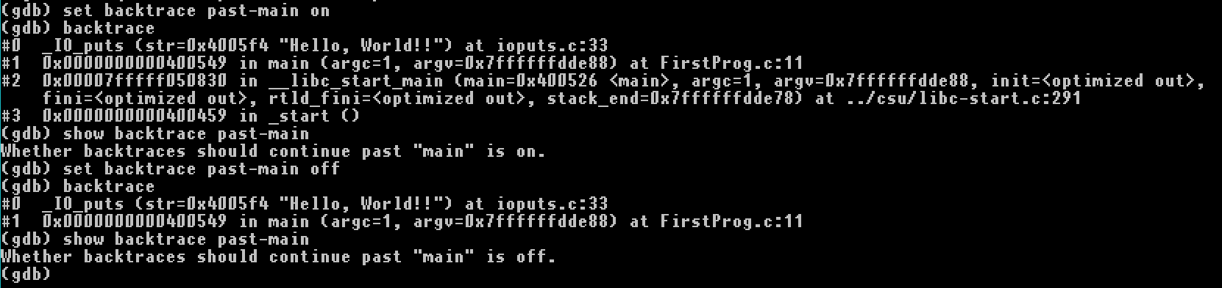
流程分析
Function calls before main
set backtrace past-main on set backtrace past-main off show backtrace past-main
設定backtrace顯示main之前的呼叫堆疊

Slide 44
流程分析
Intel 斷點技術
Interrupt 3 - trap to debugger
Code: 0xCC Mnemonic: INT 3
Code: 0xCD03 Mnemonic: INT imm8
Interrupt 4 - if overflow flag is 1
Code: 0xCE Mnemonic: INT 4
DebugBreak - Causes a breakpoint exception to occur in the current process.
DebugBreakProcess - Causes a breakpoint exception to occur in the specified process.

Slide 45
流程分析
Windows injection int3 Debugging原理
Int 3 <=> 0xCC
1 bytes code
指令第一個byte保存下來
換為 0xCC
除錯器收到後將指令恢復
換為原byte值

Slide 46
C迴圈與逆向
while

Slide 47
手動逆向的框架
1. Function Call
Offset calculation(especially jmp/call-like instruction)
Calling convention identify
Windows/Linux APIs
External Library
Call Graph
Object-Oriented Identify

Slide 48
手動逆向的框架
Jump-like instructions
Offset calculate
Function pointer/callback (array) identify
Object-Oriented Identify

Slide 49
手動逆向的框架
Example:
Compiled Open-Source Library
Network-relatived
(P.S. I am choice those, because you can find big vulnerability/0 day after this course, maybe you will famous tomorrow. For real, it’s can directly jump into the real world security problem, and help you escape from over-look in security problem.)

Slide 50
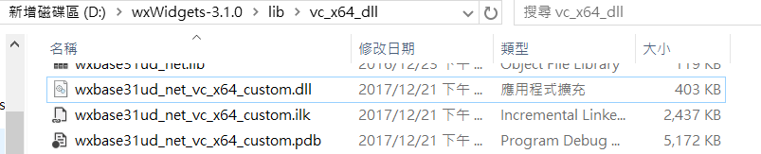
手動逆向的框架
wxWidgets 3.1.0 VC x64 dll

