Slide 1
CRC-16 serial packet checker
Assignment 5 — complete Cadence ASIC flow: RTL design, functional verification at 100% toggle coverage, logic synthesis, formal equivalence checking, physical design to GDS, and an ASIC implementation study of the feedback XOR network.
Kirthana S · 23BEC1412

Slide 2
How CRC works ?
Initialize: Start with a 16-bit CRC register containing FFFF.
Feed data: Send the message one bit at a time, starting with the MSB.
Calculate feedback: XOR the incoming data bit with the current CRC's MSB.
Update CRC: Shift the CRC register left by one bit. If feedback is 1, XOR the result with 1021; otherwise, leave it as it is.
Repeat: Continue until all message bits are processed.
Compare: Compare the final calculated CRC with the expected CRC received for the packet.
Report: If both match, match = 1; otherwise, match = 0. The done signal indicates completion.

Slide 3
Interface
Inputs
Outputs
Signal | W | Meaning
clk | 1 | Rising-edge clock
rst_n | 1 | Active-low synchronous reset
start | 1 | Begin a packet; accepted only while idle
bit_valid | 1 | data_bit is valid this cycle
data_bit | 1 | Serial payload, MSB first
last_bit | 1 | This accepted bit is the final one
expected_crc | 16 | Captured on the accepted start cycle
Signal | W | Meaning
busy | 1 | High while a packet is in flight
crc_result | 16 | Final CRC, held until the next packet
match | 1 | crc_result equals the captured expected
done | 1 | One-cycle pulse after the last bit
Two design choices worth stating
expected_crc is sampled once, at start, into exp_reg. The sender may drive it for a single cycle and the end-of-packet comparison is still against a value that cannot have drifted.
crc_result and match are registered outputs that hold their value until the next packet completes, so a reader does not have to catch the done pulse.

Slide 4
The CRC-16 algorithm
Three operations per accepted bit
Known-answer anchor
1
feedback = crc[15] XOR data_bit
The ASCII string “123456789”, 72 bits, must produce:
The bit about to leave the top of the register, mixed with the arriving data bit.
0x29B1
2
crc = crc << 1 (within 16 bits)
This is the published check value for CRC-16/CCITT-FALSE. The testbench proves its own reference model against this and four more hard-coded answers before the model is ever allowed to judge the RTL.
A zero is shifted into the bottom.
3
if feedback: crc = crc XOR 0x1021
Applied only when the feedback bit is 1.
The other four anchors
Message | CRC
“A” (8 bits) | 0xB915
“AB” (16 bits) | 0x4B74
0x00 (8 bits) | 0xE1F0
0xFF (8 bits) | 0xFF00
0x1021 = 0001 0000 0010 0001, so the polynomial touches only bits 12, 5 and 0. That is why the feedback bit has a fanout of three, not sixteen.

Slide 5
Block diagram
The microarchitecture the assignment asks for: a 16-bit CRC register, a feedback XOR network, an expected-value register, an equality comparator and a small controller.
crc_reg[15]
feedback XOR
crc_reg[15] ⊕ data_bit
XOR 0x1021 network
taps at bits 12, 5, 0
crc_reg [15:0]
shift left by 1
data_bit
crc_result
crc_next
exp_reg [15:0]
captured at start
equality comparator
16-bit ==
expected_crc
match
start
bit_valid
last_bit
controller
busy is the only state bit
busy, done
accept = busy & bit_valid gates the CRC register, so a stall holds it. An accepted bit with last_bit high publishes crc_result and match, drops busy and pulses done for one cycle.

Slide 6
How a packet flows
Cycle by cycle
Cycle | Inputs | What the hardware does | Outputs
idle | start = 0 | Nothing. crc_result and match hold the previous packet's values. | busy = 0
start | start = 1, expected_crc valid | exp_reg ← expected_crc, crc_reg ← 0xFFFF, busy ← 1. | busy → 1
data | bit_valid = 1, data_bit | accept = 1. crc_reg ← crc_next for this bit. | busy = 1
stall | bit_valid = 0 | accept = 0. crc_reg holds. data_bit and last_bit are ignored entirely. | busy = 1
last | bit_valid = 1, last_bit = 1 | crc_result ← crc_next, match ← (crc_next == exp_reg), busy ← 0. | done pulses
after | — | crc_result and match hold until the next packet completes. | busy = 0
The one subtlety
last_bit is only meaningful on an accepted bit. If last_bit is driven high during a stall it has no effect at all — the testbench deliberately drives junk onto data_bit and last_bit during every stall to prove this.

Slide 7
RTL design
01
crc.v — module crc16_checker

Slide 8
crc.v — interface and combinational core
`timescale 1ns/1ps
module crc16_checker (
input wire clk,
input wire rst_n, // active-low synchronous reset
input wire start, // pulse: begin new packet (idle only)
input wire bit_valid, // data_bit is valid this cycle
input wire data_bit, // serial data, MSB-first
input wire last_bit, // this accepted bit is the last
input wire [15:0] expected_crc, // captured on start
output reg busy, // 1 while processing a packet
output reg [15:0] crc_result, // final CRC after last_bit
output reg match, // crc_result == expected_crc
output reg done // 1-cycle pulse after last_bit
);
reg [15:0] crc_reg; // working CRC
reg [15:0] exp_reg; // captured expected value
wire feedback;
wire [15:0] crc_next;
wire accept;
assign feedback = crc_reg[15] ^ data_bit;
assign crc_next = {crc_reg[14:0], 1'b0} ^ (feedback ? 16'h1021 : 16'h0000);
assign accept = busy & bit_valid;
Notes
crc_next is one expression, not a shift into a named wire and then an XOR — that is the fix for the toggle-coverage hole.
The conditional XOR is the whole polynomial: 0x1021 is applied only when feedback is 1.
accept is the single gate for consuming a bit.

Slide 9
crc.v — the sequential block
Reset, and starting a packet
Consuming a bit, and finishing
always @(posedge clk) begin
if (!rst_n) begin
busy <= 1'b0;
crc_reg <= 16'hFFFF;
exp_reg <= 16'h0000;
crc_result <= 16'h0000;
match <= 1'b0;
done <= 1'b0;
end
else begin
done <= accept & last_bit; // 1-cycle pulse
if (!busy) begin
if (start) begin
busy <= 1'b1;
crc_reg <= 16'hFFFF;
exp_reg <= expected_crc;
end
end
else if (accept) begin
if (last_bit) begin
crc_result <= crc_next;
match <= (crc_next == exp_reg);
busy <= 1'b0;
crc_reg <= 16'hFFFF;
end
else begin
crc_reg <= crc_next;
end
end
// stall (busy && !bit_valid):
// hold everything
end
end
endmodule
Four things to notice
done is assigned exactly once, unconditionally — a clean one-cycle pulse, never a multiply-driven signal.
The stall case is the absence of an assignment: if busy is high and bit_valid is low, nothing in the block fires.
Reset is synchronous and clears the published outputs as well as the working state, which aborts a packet in flight.
crc_reg returns to 0xFFFF after the last bit, so the next start already finds it initialised.

Slide 10
Functional verification
02
crc_tb.v — self-checking testbench with an independent reference model, run in NCLaunch

Slide 11
Verification strategy
A self-checking Verilog-2001 testbench. No packet is judged against a hand-computed number: every result is compared with a reference model written separately from the RTL, and that model is itself proved against published check values before it is trusted.
Reference model
Model self-check
A bit-by-bit CRC computed inside the testbench from the stated convention, independent of the RTL.
Five hard-coded published answers (0x29B1, 0xB915, 0x4B74, 0xE1F0, 0xFF00) must match before the model judges anything.
Lengths
Random stalls
Every nonzero length from 1 to 40 bits, plus 64, 72, 128 and 256.
bit_valid gaps driven from an LFSR, with junk on data_bit and last_bit during the gaps.
Final-bit handling
Expected values
last_bit asserted during a stall must be ignored; asserted on an accepted bit it must publish and pulse done exactly once.
Correct value, all sixteen single-bit flips, and the fully inverted value — match must follow.
Protocol abuse
Reset in a packet
start while busy, input noise while idle, and back-to-back packets with no idle cycle.
Mid-packet, and on the exact cycle that would otherwise have accepted the last bit.

Slide 12
crc_tb.v — the reference model
// 32-bit Galois LFSR, used to generate packets and stall patterns
function [31:0] lfsr_next;
input [31:0] x;
begin
lfsr_next = {x[30:0], 1'b0} ^ ({32{x[31]}} & 32'hB400_0000);
end
endfunction
// Reference CRC. bit_stream[255] is the first transmitted bit.
// init FFFF, poly 1021, MSB first, no reflect, no final XOR.
task ref_compute;
input [255:0] bit_stream;
input [31:0] num_bits;
output [15:0] crc_out;
integer k;
begin
ref_crc = 16'hFFFF;
for (k = 0; k < num_bits; k = k + 1) begin
ref_fb = ref_crc[15] ^ bit_stream[255 - k];
ref_crc = {ref_crc[14:0], 1'b0};
if (ref_fb) ref_crc = ref_crc ^ 16'h1021;
end
crc_out = ref_crc;
end
endtask
Why this counts as independent
It is written from the convention in the specification, not from the RTL. It uses a loop over a bit vector; the RTL uses a shift register and a conditional XOR.
It shares no code with the design under test — no function, no parameter, no include.
It is validated first: the known-answer task compares the model against five published values and fails the run if any disagrees.
Generate test data.
Calculate the expected CRC independently.
Send data to your actual CRC hardware (dut).
Check whether the hardware outputs match the expected values.
Report errors and count successful tests.

Slide 13
crc_tb.v — driving a packet
// mode[0] random stalls mode[1] junk on stall/start cycles
// mode[2] bogus start pulse in the middle of the packet
for (j = 0; j < n_bits; j = j + 1) begin
// ---- optional stall cycles (bit_valid = 0) ----
if (mode[0]) begin
lfsr = lfsr_next(lfsr);
sp_stall = (lfsr[1:0] != 2'b00);
end else sp_stall = 1'b0;
while (sp_stall) begin
bit_valid = 1'b0;
if (mode[1]) begin
data_bit = lfsr[4];
last_bit = lfsr[5] | lfsr[6]; // last_bit=1 while invalid
end else begin
data_bit = 1'b0; last_bit = 1'b0;
end
@(posedge clk); #1;
if (busy !== 1'b1) fail(id, "busy dropped during stall");
if (done !== 1'b0) fail(id, "done during stall");
if (crc_result !== prev_res) fail(id, "crc_result changed in stall");
if (match !== prev_match) fail(id, "match changed in stall");
lfsr = lfsr_next(lfsr);
sp_stall = (lfsr[1:0] == 2'b11);
end
// ---- the accepted bit ----
bit_valid = 1'b1;
data_bit = bits[255 - j];
last_bit = (j == n_bits - 1) ? 1'b1 : 1'b0;
if (mode[2] && (n_bits >= 4) && (j == (n_bits >> 1)))
start = 1'b1; // bogus start while busy
@(posedge clk); #1;
start = 1'b0;
end
What this proves
Stall cycles drive deliberately wrong values onto data_bit and last_bit. If the RTL ever consumed them, the CRC would diverge from the reference.
The held outputs are re-checked on every single stall cycle, not just at the end.
A start pulse is injected halfway through the packet; it must be ignored.

Slide 14
crc_tb.v — checking a packet
// called on the edge that accepted the last bit
task check_packet;
input [15:0] ref_val;
input exp_match;
input [31:0] id;
begin
pkt_cnt = pkt_cnt + 1;
if (done !== 1'b1) fail(id, "done not asserted");
if (busy !== 1'b0) fail(id, "busy still high after last bit");
if (crc_result !== ref_val) fail(id, "crc_result != reference");
if (match !== exp_match) fail(id, "match wrong");
prev_res = ref_val;
prev_match = exp_match;
end
endtask
// the following cycle: done must drop, results must hold
task check_done_drop;
input [31:0] id;
begin
@(posedge clk); #1;
if (done !== 1'b0) fail(id, "done longer than 1 cycle");
if (busy !== 1'b0) fail(id, "busy high while idle");
if (crc_result !== prev_res) fail(id, "crc_result did not hold");
if (match !== prev_match) fail(id, "match did not hold");
end
endtask
Checks applied to every packet
busy rises on the accepted start and stays high for the whole packet
done is asserted on the last-bit edge and is low again the next cycle
crc_result equals the reference model's value
match equals (expected == reference), both when correct and when wrong
crc_result and match hold afterwards, through idle noise and the next start
prev_res / prev_match
The testbench tracks what the outputs are supposed to be holding and re-checks it on every stall, every idle cycle and every start — this is what catches an output that updates when it should not.

Slide 15
The test matrix
 | Test | What it covers | Packets
T0 | Reset sanity | Outputs cleared by reset before anything else runs | —
T1 | Known answers | Five published check values; validates the reference model itself | 5
T2 | 1-bit packets | Shortest legal packet, bit = 0 and bit = 1, plus junk on the start cycle | 3
T3 | Lengths 1–40 | Every nonzero length, random data, no stalls | 40
T4 | Lengths 1–40 with stalls | Random stalls plus junk on data_bit and last_bit during the gaps | 40
T5 | Long packets | 64, 72, 128 and 256 bits with stalls | 4
T6 | Wrong expected | All 16 single-bit flips, the inverted value, then the correct value again | 18
T7 | Idle noise | bit_valid, data_bit and last_bit toggling while idle; results must hold | 1
T8 | Start while busy | Bogus start pulses mid-packet at several lengths | 12
T9 | Back-to-back | start on the cycle right after done, three packets, last one mismatching | 3
T10 | All-zeros / all-ones | 16- and 33-bit payloads of all 0 and all 1, with and without stalls | 4
T11 | Reset in a packet | Mid-packet, and on the exact cycle that would accept the last bit | 3
Roughly 130 packets in total. Any failure increments err_cnt and prints the test number, the simulation time and the mismatching values.

Slide 16
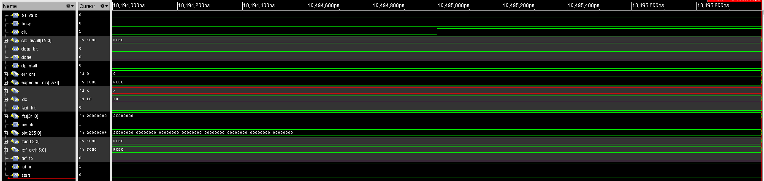
Simulation waveform
SimVision at the end of the run. The cursor sits after the final packet: err_cnt is 0, the reference CRC (ref_crc) and the design's crc_result both read 0xFCBC, expected_crc matches, and match is 1.
Reading the trace
Signals dumped
busy is low and done is low — the design is idle, not mid-packet
crc_result still holds 0xFCBC from the last packet, as required
err_cnt has stayed at 0 for the whole 10.496 ms run
$dumpvars(0, crc16_tb) captures the whole hierarchy, so the testbench's reference CRC (ref_crc) sits next to the design's crc_result in the same trace. Comparing them by eye is possible, but the testbench has already compared them automatically on every packet.

Slide 17
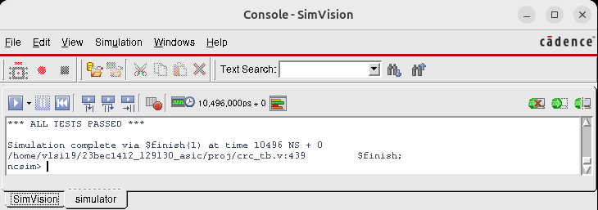
Simulation result
ALL
0
tests passed
errors reported
What the summary means
Every packet across all twelve test groups matched the reference model
No protocol violation was observed — busy, done and the held outputs behaved on every cycle
The reference model itself matched all five published check values
The SimVision console at $finish.
The pass criterion
#20;
$display("packets checked : %0d", pkt_cnt);
if (err_cnt == 0) $display("*** ALL TESTS PASSED ***");
else $display("*** %0d ERRORS DETECTED ***", err_cnt);

Slide 18
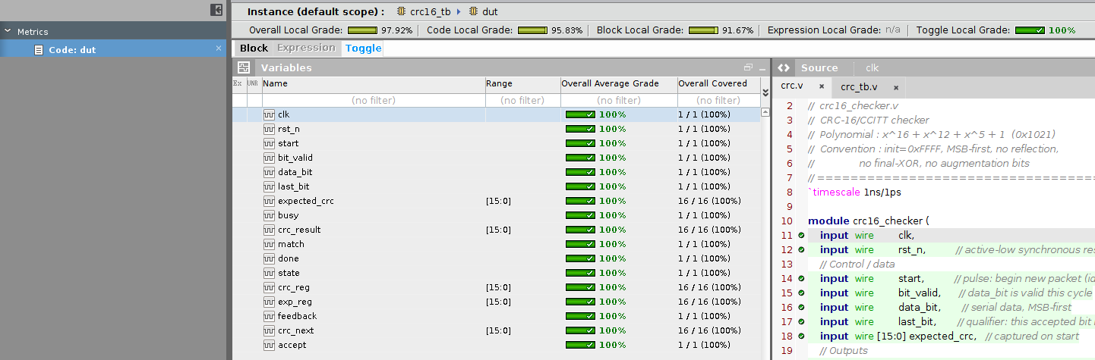
Toggle coverage — after the fix: 100%
100%
Toggle local grade
The change
// before
wire [15:0] crc_shifted;
assign crc_shifted =
{crc_reg[14:0], 1'b0};
assign crc_next =
crc_shifted ^ (feedback ?
16'h1021 : 16'h0);
// after
assign crc_next =
{crc_reg[14:0], 1'b0} ^
(feedback ? 16'h1021
: 16'h0000);
The same instance after folding the shift into crc_next. All sixteen bits of expected_crc, crc_result, crc_reg, exp_reg and crc_next now toggle.

Slide 19
Logic synthesis
03
Genus 21.14 — mapped to the slow library under SDC constraints

Slide 20
The Genus run
crc_script.tcl
Environment
set_db init_lib_search_path .
set_db library slow.lib
read_hdl crc.v
elaborate crc16_checker
read_sdc crc_constraints.g
syn_generic
syn_map
syn_opt
report_area > crc_area_vcd.rpt
report_gates > crc_gates_vcd.rpt
report_timing > crc_timing_vcd.rpt
report_power > crc_power_vcd.rpt
write_hdl > crc_netlist_vcd.v
write_sdc > crc_constraints_vcd.sdc
Item | Value
Tool | Genus 21.14-s082_1
Library | slow
Delay model | balanced_tree
Operating condition | slow corner
Wireload mode | enclosed (library default)
Top module | crc16_checker
Run date | 29 Oct 2026, 13:22:57 IST
Outputs
crc_netlist_vcd.v — gate-level netlist, the input to Conformal and Innovus
crc_constraints_vcd.sdc — the elaborated constraints, carried into Innovus
Four reports: area, gates, timing, power
The run was done twice: once vectorless, and once after read_vcd of crc16_tb.vcd so that report_power uses the testbench's real switching activity.

Slide 21
crc_constraints.g — the constraints written for this design
create_clock -name clk -period 10.0 -waveform {0 5.0} [get_ports clk]
set_clock_transition -rise 0.1 [get_clocks clk]
set_clock_transition -fall 0.1 [get_clocks clk]
set_clock_uncertainty 0.01 [get_clocks clk]
set_input_delay -clock clk -max 1.0 [get_ports {rst_n start bit_valid data_bit last_bit expected_crc[*]}]
set_input_delay -clock clk -min 0.2 [get_ports {rst_n start bit_valid data_bit last_bit expected_crc[*]}]
set_output_delay -clock clk -max 1.0 [get_ports {busy crc_result[*] match done}]
set_output_delay -clock clk -min 0.2 [get_ports {busy crc_result[*] match done}]
set_driving_cell -lib_cell INVX1 [remove_from_collection [all_inputs] [get_ports clk]]
set_load 0.15 [all_outputs]
What each line is doing
Why a driving cell and a load
A 10 ns clock, so the target is 100 MHz with a 50% duty cycle.
0.1 ns clock transition and 10 ps of uncertainty, applied to both setup and hold.
Inputs arrive up to 1.0 ns after the edge and no earlier than 0.2 ns; outputs must be stable 1.0 ns before the next edge.
Without them the tool assumes ideal drivers and zero capacitance at the boundary, which makes the input and output paths look faster than they are.
INVX1 is a realistic weak driver, and 0.15 pF is a realistic load for an output that leaves the block. The clock port is excluded from the driving cell so the clock is still treated as ideal at this stage — the clock tree is built later, in Innovus.

Slide 22
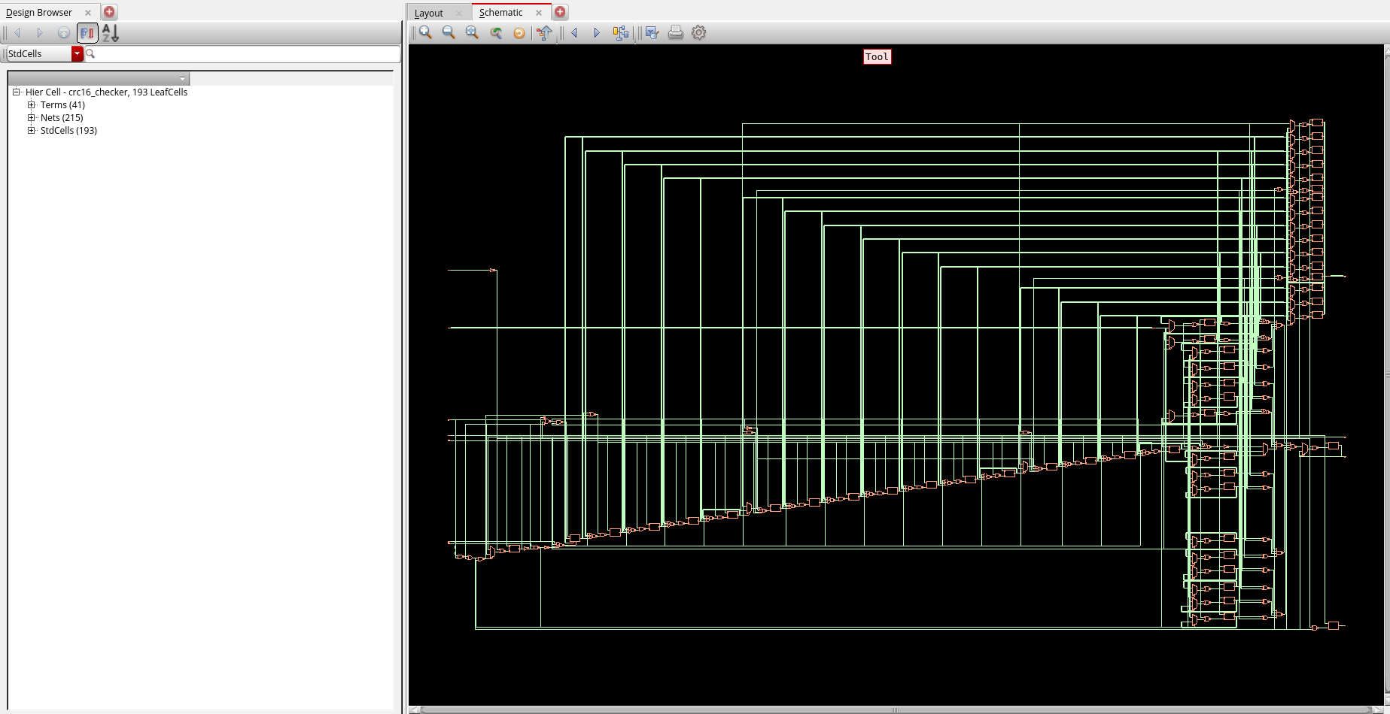
The synthesised design
Design browser summary
Item | Count
Leaf cells | 193
Terminals | 41
Nets | 215
41 terminals = 11 scalar ports plus the two 16-bit buses, counted bit by bit.
What the picture shows
The long horizontal runs on the left are the 16-bit buses — expected_crc into exp_reg, and crc_next out of the shift register. The dense column on the right is the comparator tree feeding match_reg, and the flip-flop bank sits along the right edge.
The Genus schematic view of crc16_checker after mapping.

Slide 23
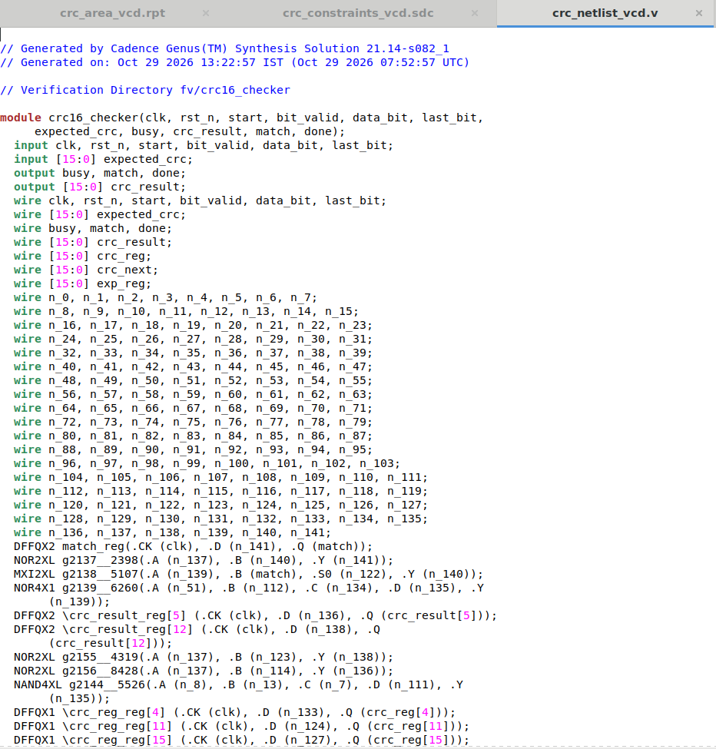
The gate-level netlist
Reading the netlist
The port list and bus widths are unchanged from the RTL, which is what lets Conformal map the two designs port for port.
crc_reg, crc_next and exp_reg survive as named nets, so the netlist can still be read against the RTL by hand.
141 internal nets, n_0 through n_141, carry the mapped logic.
One naming quirk to be aware of
DFFQX1 \crc_reg_reg[12] (.CK (clk), .D (n_121), .Q (crc_next[13]));
DFFQX1 \crc_reg_reg[5] (.CK (clk), .D (n_125), .Q (crc_next[6]));
Genus names the Q net of crc_reg_reg[N] as crc_next[N+1], because that bit of crc_reg feeds bit N+1 of the next value through the shift. The flop is still crc_reg[N] — only the net label looks shifted. This trips people up when tracing the netlist by hand.
crc_netlist_vcd.v

Slide 24
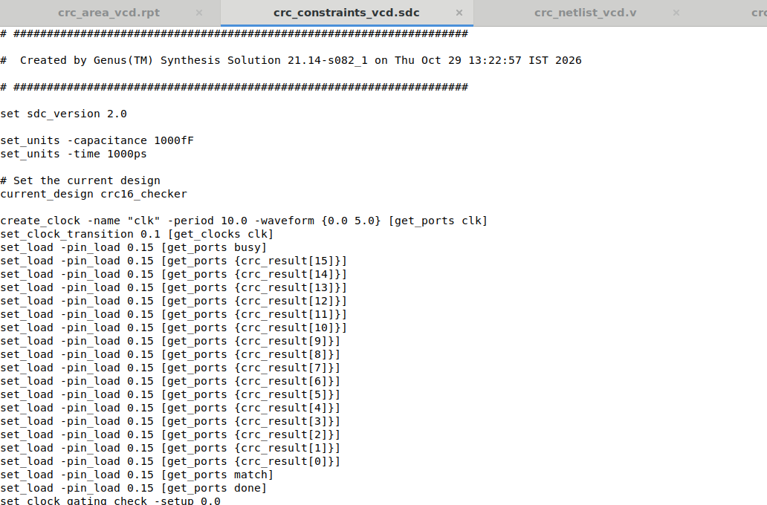
The elaborated SDC
Why this file matters
crc_constraints.g is written against collections — all_inputs, all_outputs, wildcards. Genus expands those into one explicit command per port and writes the result as SDC.
That expanded file is what Innovus reads, so the two tools are provably constraining the same ports with the same numbers. The set_units lines at the top fix the interpretation: capacitance in 1000 fF, time in 1000 ps.
One line Genus added by itself
set_clock_gating_check -setup 0.0
crc_constraints_vcd.sdc — written by Genus, read by Innovus.
There is no clock gating in this design, so the check is inert — Genus writes it as a default.

Slide 25
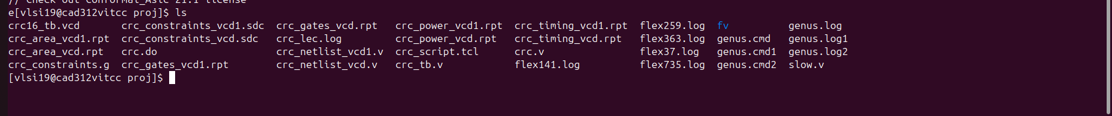
The project after synthesis
~/23bec1412_l29l30_asic/proj immediately after the Genus run, before Conformal was launched.
Source
Generated by Genus
Logs and simulation
crc.v
crc_tb.v
crc_constraints.g
crc_script.tcl
crc.do
slow.v
crc_netlist_vcd.v
crc_constraints_vcd.sdc
crc_area_vcd.rpt
crc_gates_vcd.rpt
crc_timing_vcd.rpt
crc_power_vcd.rpt
genus.log / .cmd (×3 runs)
flex*.log (licence)
crc16_tb.vcd
crc_lec.log
fv/ (Conformal directory)
The *_vcd and *_vcd1 pairs are the two Genus runs: one with the VCD annotated for power, one without. Both carry the same netlist and timing — only the power report differs.

Slide 26
The four synthesis reports
04
crc_area_vcd.rpt · crc_gates_vcd.rpt · crc_timing_vcd.rpt · crc_power_vcd.rpt

Slide 27
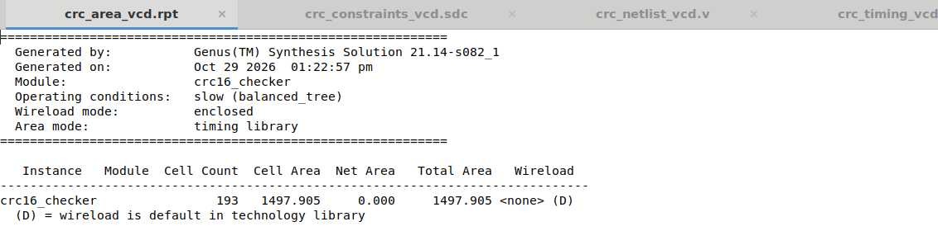
Report 1 — crc_area_vcd.rpt · area
1497.9
193
Total area
(library units)
Cells
Where the area goes
What it says
Type | Cells | Area | Share
Sequential | 51 | 829.562 | 55.4%
Logic | 137 | 656.989 | 43.9%
Inverters | 5 | 11.354 | 0.8%
Total | 193 | 1497.905 | 100%
Field | Value | Meaning
Cell count | 193 | Standard cells placed by synthesis
Cell area | 1497.905 | Sum of the library areas of those cells
Net area | 0.000 | No wire load model — interconnect area is not estimated
Total area | 1497.905 | Cell area + net area, in library area units
Wireload | <none> (D) | Library default; real parasitics come later, from Innovus
More than half the area is storage. The 51 flops are three 16-bit registers — the working CRC, the captured expected value and the published result — plus busy, match and done.

Slide 28
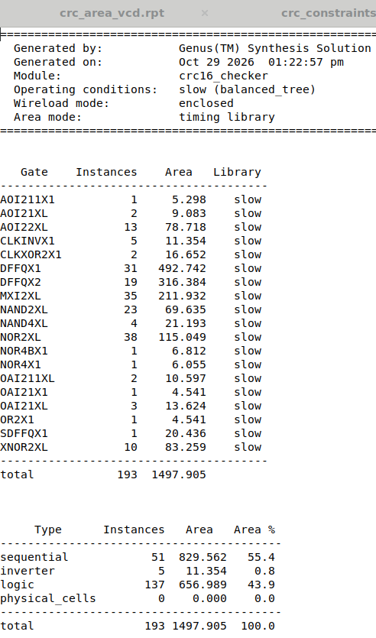
Report 2 — crc_gates_vcd.rpt · cell counts by type
Every cell type used
The XOR / XNOR answer
Cell | Qty | Area | Role
NOR2XL | 38 | 115.049 | logic
MXI2XL | 35 | 211.932 | muxes
DFFQX1 | 31 | 492.742 | flip-flops
NAND2XL | 23 | 69.635 | logic
DFFQX2 | 19 | 316.384 | flip-flops
AOI22XL | 13 | 78.718 | logic
XNOR2XL | 10 | 83.259 | comparator
CLKINVX1 | 5 | 11.354 | inverters
NAND4XL | 4 | 21.193 | comparator
OAI21XL | 3 | 13.624 | logic
AOI21XL, OAI211XL, CLKXOR2X1 | 2 each | — | mixed
7 further types | 1 each | — | misc
12
XOR-family cells in the
whole design
Cell | Qty | Area
XNOR2XL | 10 | 83.259
CLKXOR2X1 | 2 | 16.652
Total | 12 | 99.911
99.911 of 1497.905 = 6.7% of the design area is XOR-family logic.

Slide 29
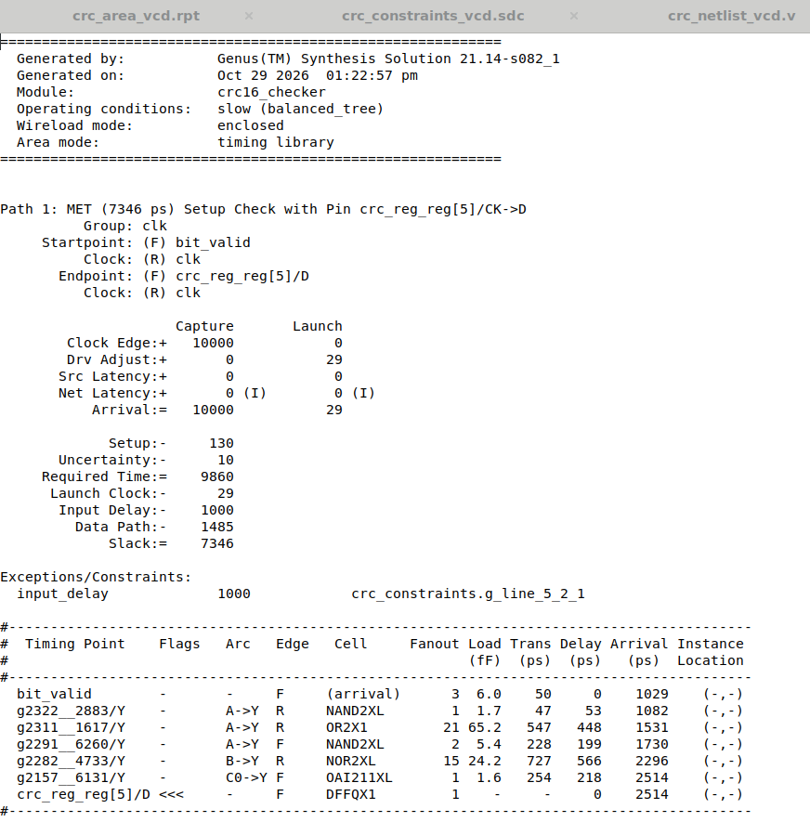
Report 3 — crc_timing_vcd.rpt · critical path
+7.346 ns
1.485 ns
Setup slack on a 10 ns clock
Data path delay
The worst path: bit_valid → crc_reg_reg[5]/D
Cell | Arc | Fanout | Load (fF) | Trans (ps) | Delay (ps)
NAND2XL | A→Y | 1 | 1.7 | 47 | 53
OR2X1 | A→Y | 21 | 65.2 | 547 | 448
NAND2XL | A→Y | 2 | 5.4 | 228 | 199
NOR2XL | B→Y | 15 | 24.2 | 727 | 566
OAI211XL | C0→Y | 1 | 1.6 | 254 | 218

Slide 30
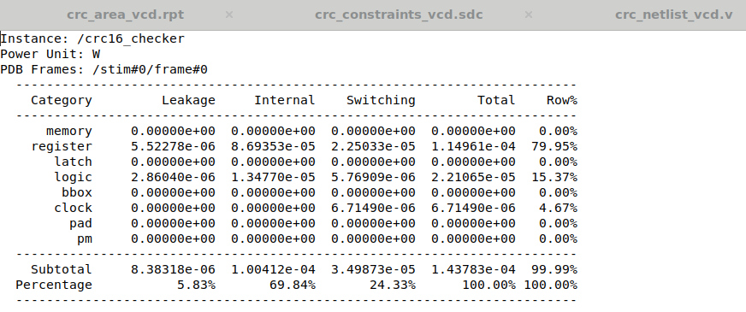
Report 4 — crc_power_vcd.rpt · power
114.1 µW
Total, with VCD-annotated
switching activity
By component
Component | Power | Share
Leakage | 8.4 µW | 7.3%
Internal | 89.9 µW | 78.7%
Switching | 15.9 µW | 13.9%
Total | 114.1 µW | 100%
The VCD-annotated run. Power unit is watts.
By block
Block | Leakage | Internal | Switching | Total | Share
Register | 5.5 µW | 81.1 µW | 6.0 µW | 92.7 µW | 81.2%
Logic | 2.9 µW | 8.7 µW | 3.1 µW | 14.7 µW | 12.9%
Clock | — | — | 6.7 µW | 6.7 µW | 5.9%
Registers dominate power at 81%, just as they dominate area at 55%. Internal power — the energy burnt inside the cells on each transition — is 79% of the total, which is typical for a flop-heavy block running at a modest clock.

Slide 31
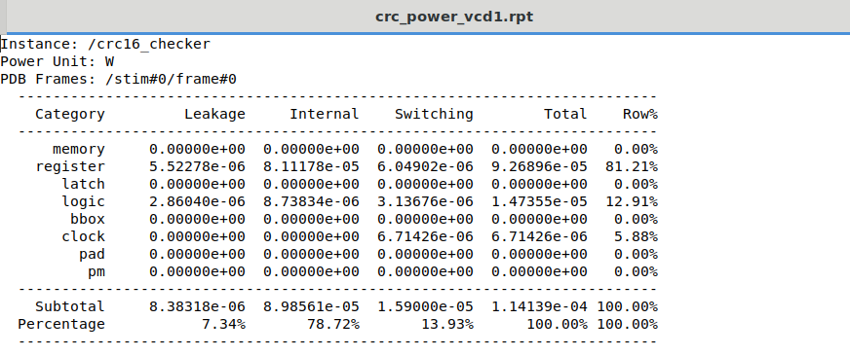
Power — with and without the VCD
The comparison
Component | Vectorless | With VCD | Change
Leakage | 8.4 µW | 8.4 µW | —
Internal | 100.4 µW | 89.9 µW | −10%
Switching | 35.0 µW | 15.9 µW | −55%
Total | 143.8 µW | 114.1 µW | −21%
The two reports side by side in the editor: crc_power_vcd1.rpt (vectorless) and crc_power_vcd.rpt (VCD-annotated).
Why they differ
Without a VCD the tool assumes a default toggle rate on every net. The testbench spends a large fraction of its time stalling or idle, with the CRC register deliberately held, so the real activity is far lower than the default assumption.
Leakage is unchanged, as it must be — it depends on the cells present, not on how often they switch.

Slide 32
Formal equivalence checking
05
Conformal LEC 21.10 — golden RTL against the revised gate-level netlist

Slide 33
crc_lec.do — the Conformal script
set log file crc_lec.log -replace
read library /home/vlsi19/23bec1412_l29l30_asic/proj/slow.v -verilog -both
read design /home/vlsi19/23bec1412_l29l30_asic/proj/crc.v -verilog -golden
read design /home/vlsi19/23bec1412_l29l30_asic/proj/crc_netlist_vcd.v -verilog -revised
set system mode lec
add compare point -all
compare
report verification
set gui on
Invoked as
What a key point is
lec_64 -gui -dofile crc.do
Conformal does not simulate. It splits both designs at their state elements and primary outputs, and proves the combinational logic feeding each one is a Boolean function of the same inputs.
What each command does
read library ... -both reads slow.v as both the golden and revised cell library.
read design -golden takes the RTL as the reference.
read design -revised takes the Genus netlist as the implementation.
add compare point -all makes every output and every flop a proof obligation.

Slide 34
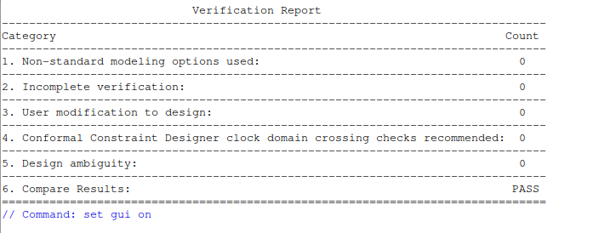
Run — PASS
PASS
Zero unmapped points. Zero non-equivalent points.
Key points mapped
 | PI | PO | DFF | Total
Golden | 22 | 19 | 51 | 92
Revised | 22 | 19 | 51 | 92
The verification report after removing the redundant state register.
Compared points
 | PO | DFF | Total
Equivalent | 19 | 51 | 70
92 key points map on each side; 70 of them are compare points (the 19 outputs and 51 flops — inputs are not compared, they are the proof's variables). All 70 are equivalent.

Slide 35
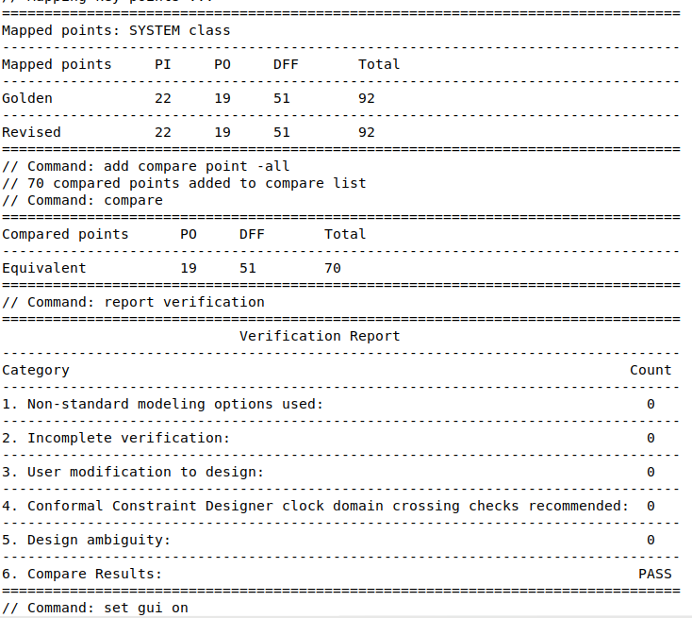
The Conformal log
The run, start to finish
slow.v read as the library for both sides; the warnings about weak attributes and unused ports are the library's own, not the design's.
crc.v read as golden, crc_netlist_vcd.v read as revised; both resolve to root module crc16_checker.
set system mode lec triggers modelling of both designs and then key point mapping.
92 key points map on each side with none left over.
add compare point -all adds 70 compare points; compare proves all 70 equivalent.
crc_lec.log

Slide 36
Physical design
06
Innovus 21.15 — floorplan, placement, clock tree, routing, extraction and streamout

Slide 37
The Innovus flow
01
02
03
Init
Floorplan
Place
Read the Genus netlist, the elaborated SDC, the LEF and the cap table. Create the RC corner and the analysis views.
Set the core area and aspect ratio, add the power rails and the standard-cell rows.
placeDesign — standard cells are placed and the design is legalised.
04
05
06
CTS
Route
Extract & sign off
create_ccopt_clock_tree_spec writes ccopt_output.spec, then ccoptDesign builds and balances the clock tree.
routeDesign — NanoRoute performs global and detail routing on Metal1 through Metal9.
RC extraction to SPEF, timeDesign for setup and hold, then streamOut to GDS.
Timing was reported four times — setup and hold, before and after clock tree synthesis — so that any degradation introduced by the clock tree would be visible.

Slide 38
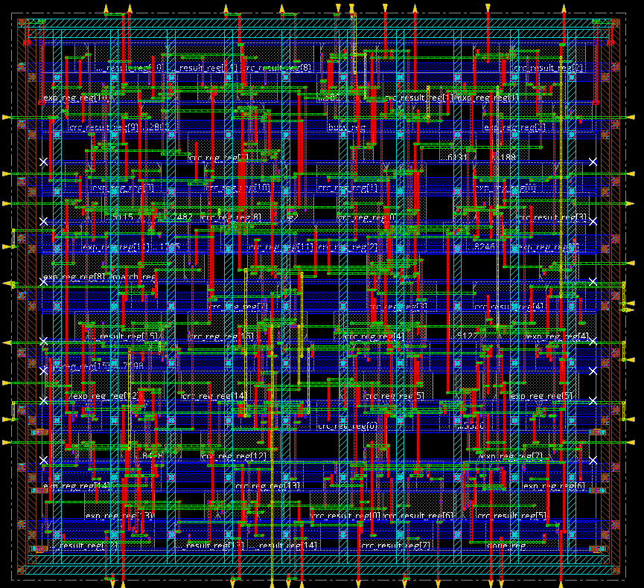
The routed design
What is in the picture
The hatched band around the edge is the core boundary with the power ring; the yellow triangles on all four sides are the I/O pins.
The blue blocks are the standard cells, placed in rows. The flop names are legible across the middle — crc_result_reg, exp_reg_reg, crc_reg_reg.
Green and red traces are the routed signal nets on different metal layers; the vertical red runs are the longer nets crossing the core.
The design is small enough that the register names are readable, which is a good sanity check that placement grouped the three 16-bit registers sensibly.
crc16_checker, fully placed and routed.
Routing completed with no DRC violations reported: Metal FillOPCs 0, Metal FillDRCs 0, blockages 0.

Slide 39
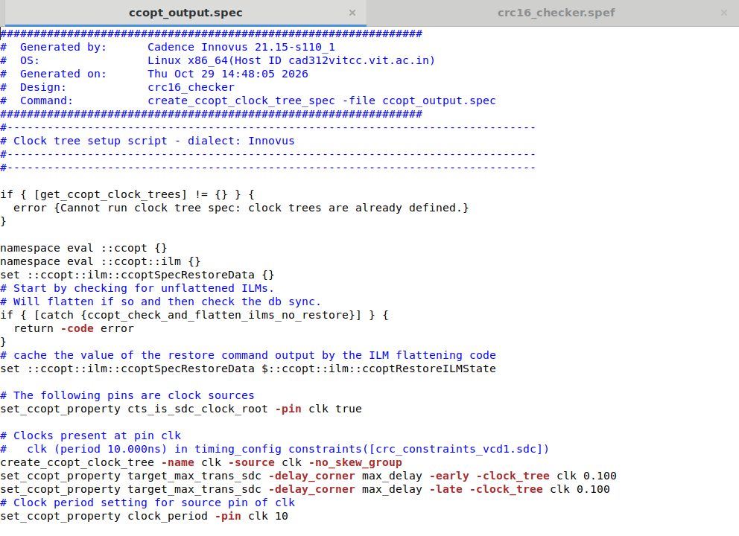
Clock tree synthesis — ccopt_output.spec
The key lines
set_ccopt_property cts_is_sdc_clock_root
-pin clk true
create_ccopt_clock_tree -name clk
-source clk -no_skew_group
set_ccopt_property target_max_trans_sdc
-delay_corner max_delay -early
-clock_tree clk 0.100
set_ccopt_property target_max_trans_sdc
-delay_corner max_delay -late
-clock_tree clk 0.100
set_ccopt_property clock_period -pin clk 10
What it is doing
The spec is derived from the SDC: clk is recognised as the clock root, one clock tree is created from it, the 0.1 ns transition target comes straight from set_clock_transition, and the 10 ns period from create_clock.
-no_skew_group means no explicit skew grouping is imposed; a single skew group is then created automatically to balance all the sinks.
The clock tree spec Innovus generated.

Slide 40
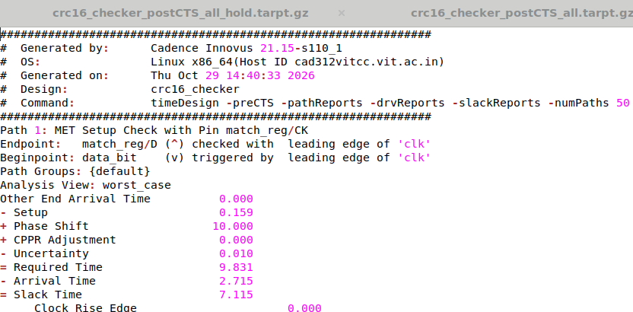
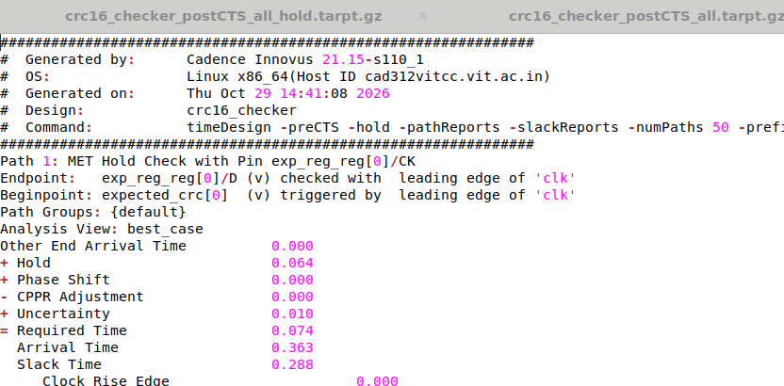
Timing before the clock tree — preCTS
Setup, worst path
Hold, worst path
Check | Begin | End | Arrival | Required | Slack
Setup | data_bit | match_reg/D | 2.715 ns | 9.831 ns | +7.115 ns
Hold | expected_crc[0] | exp_reg_reg[0]/D | 0.363 ns | 0.074 ns | +0.288 ns
Note the setup endpoint: match_reg. After placement the worst path runs data_bit → feedback XOR → comparator tree → match, eighteen cells deep — a different path from the one Genus reported, and the one that actually exercises the XOR network.

Slide 41
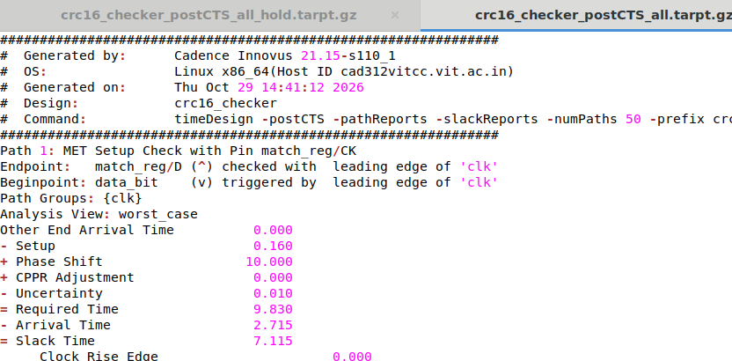
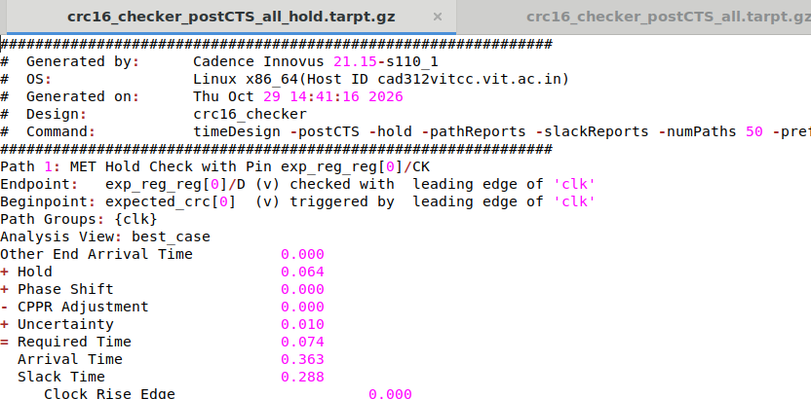
Timing after the clock tree — postCTS
Setup, worst path
Hold, worst path
Check | preCTS slack | postCTS slack | Change | Verdict
Setup | +7.115 ns | +7.115 ns | none | MET
Hold | +0.288 ns | +0.288 ns | none | MET
The clock tree cost nothing in slack. With 51 flops on a single clock in a small core, the tree is shallow and the insertion delay is nearly identical at every sink — so the setup requirement is unchanged and no hold buffers were needed.

Slide 42
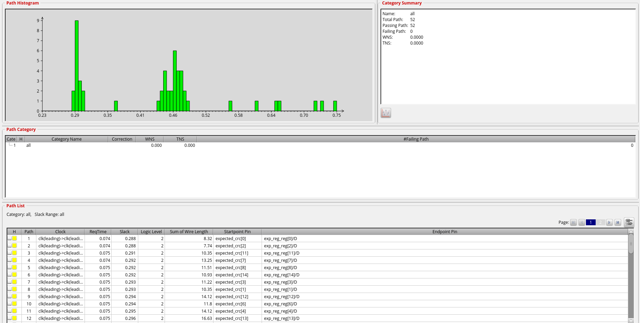
Hold signoff across every path
Category summary
Field | Value
Total paths | 52
Passing | 52
Failing | 0
WNS | 0.0000
TNS | 0.0000
The histogram
Slack is spread between 0.23 ns and 0.78 ns with no path near zero. The tall cluster at 0.29 ns is the sixteen expected_crc → exp_reg paths, which are all structurally identical — two cells, a mux and a NOR.
Innovus Timing Debug, reading top_hold.mtarpt.
WNS and TNS both exactly zero means no path is even marginally short. Hold is clean by construction, not by repair.

Slide 43
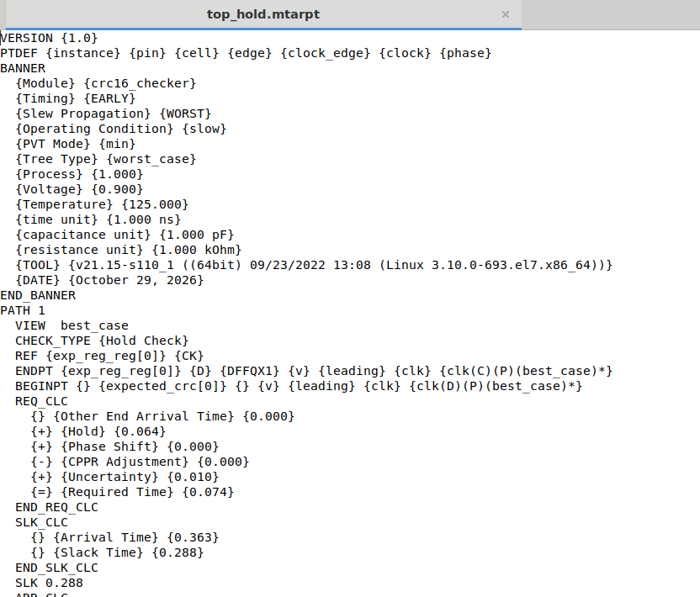
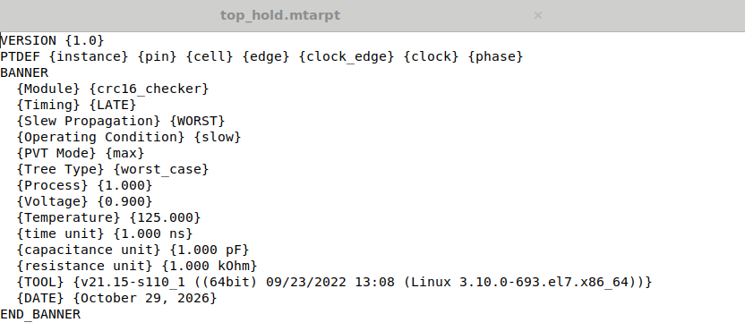
Signoff timing reports
top_hold.mtarpt
top_setup.mtarpt
A banner and nothing else — there is no violating setup path to list.
Path 1 of 52. Worst hold slack +0.288 ns at exp_reg_reg[0]/D.
Sign-off corner
Check | PVT mode | Condition | Process | Voltage | Temperature | Slew propagation
Hold | EARLY / min | slow | 1.000 | 0.900 V | 125 °C | WORST
Setup | LATE / max | slow | 1.000 | 0.900 V | 125 °C | WORST
Both checks sign off at the same slow corner, so the two reports are directly comparable.

Slide 44
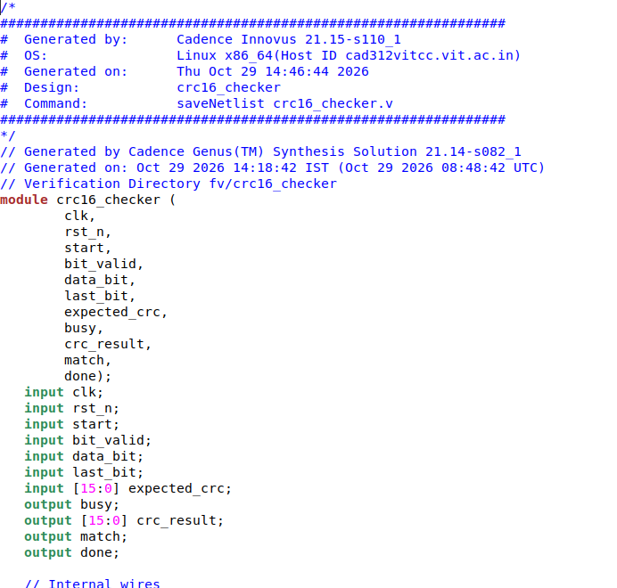
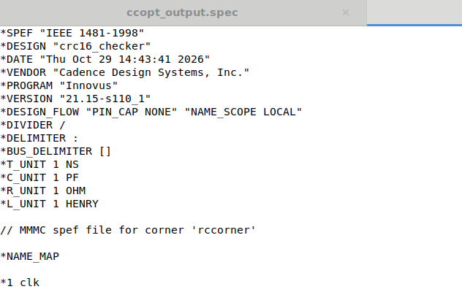
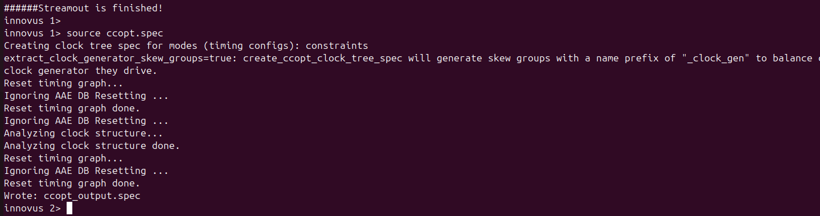
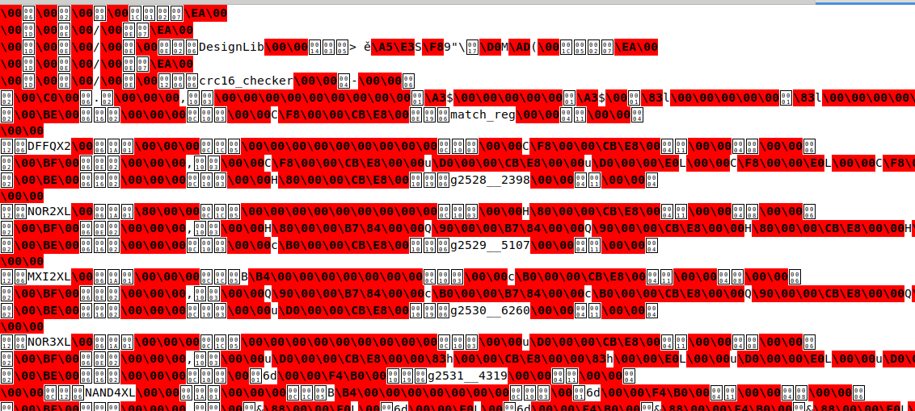
Physical design outputs
Post-route netlist
Extracted parasitics
Streamout
crc16_checker.spef — IEEE 1481-1998
crc.gds — the final layout
crc16_checker.v — saveNetlist

Slide 45
ASIC implementation study
07
Feedback XOR depth and fanout, and the serial versus multi-bit trade-off

Slide 46
Feedback XOR — depth
What Genus built
2
// crc_reg[15] ^ data_bit mapped as two gates:
NAND2XL g2325 (.A (data_bit), .B (crc_reg[15]),
.Y (n_0));
OAI21X1 g2310 (.A0 (data_bit), .A1 (crc_reg[15]),
.B0 (n_0), .Y (n_60));
CLKINVX1 g2304 (.A (n_60), .Y (n_61));
gate levels from inputs to
the feedback signal
Confirmed on the real critical path
# | Cell | Delay
1 | NAND2XL g2715 | 0.068 ns
2 | OAI21X1 g2705 | 0.190 ns
3 | CLKINVX1 g2700 | 0.120 ns
… | comparator tree, 15 more cells | 2.337 ns
OAI21 computes NOT((A0 OR A1) AND B0). With B0 driven by the NAND of the same two inputs, that is NOT(OR AND NAND) = XNOR.
Net | Function | Loads
n_60 | XNOR — the inverted feedback | 5
n_61 | XOR — the true feedback | 4
Taken from the Innovus preCTS setup report, worst path data_bit → match_reg/D. The first two cells are the feedback XOR; everything after is the comparator. The XOR itself costs 0.258 ns of a 2.715 ns path — under 10%.
Both polarities exist because different downstream gates want different senses. Together they drive nine pins.

Slide 47
Feedback XOR — fanout
Why the fanout is three, not sixteen
3
9
The feedback bit is XORed into the next CRC value only at the positions where the polynomial has a 1.
logical taps
physical pins driven
(5 on n_60, 4 on n_61)
0x1021 = 0001 0000 0010 0001
│ │ │
bit 12 bit 5 bit 0
Why that matters
A fanout of nine needs no buffering at all — the two-gate XOR drives it directly, with no cloning and no tree.
By contrast the enable nets on the Genus critical path drive 21 and 15 loads and are the slowest arcs in the design.
So in this block, control distribution is the fanout problem; the CRC arithmetic is not.
The other thirteen bits of crc_next are a plain shift of crc_reg and do not see the feedback signal at all. A 16-bit polynomial with only three set bits therefore costs three XOR gates per bit of input, not sixteen.
The three taps in the netlist
Bit | Expression | Cell
0 | feedback | NAND2XL g2263
5 | crc_reg[4] ^ feedback | MXI2XL g2280
12 | crc_reg[11] ^ feedback | MXI2XL g2281
Sparse polynomials are what make serial CRC hardware cheap. A dense polynomial with eight or ten set bits would multiply this cost directly.

Slide 48
Serial versus multiple bits per clock
Processing N bits per clock means unrolling N serial steps into one combinational block, so each next-state bit becomes a wide XOR of CRC bits and input bits.
Bits per clock | XOR2 gates for the update | Max terms in one bit | XOR tree depth | Throughput | Flops
1 (this design) | 5 | 3 | 2 | 1× | 16
8 | 56 | 7 | 3 | 8× | 16
16 | 160 | 16 | 4 | 16× | 16
32 | 332 | 28 | 5 | 32× | 16
What grows
What does not grow
What this means here
The XOR cloud in front of the register. Going from 1 to 32 bits per clock multiplies the update logic by roughly 66× while buying 32× the throughput — so area grows a little faster than throughput, and the return diminishes as N rises.
The register. All four designs hold exactly 16 state bits, because the CRC is 16 bits wide regardless of how many message bits are consumed per clock. The expected-value register and the comparator are also unchanged.
A serial checker is the right choice when the link delivers one bit per clock anyway — extra width would buy throughput the interface cannot use, and this design already closes timing with 7.1 ns of slack on a 10 ns clock.

Slide 49
Requirements checklist
Requirement from the brief | How it was met | Evidence
Polynomial x¹⁶+x¹²+x⁵+1, init 0xFFFF, MSB first, no reflection, no final XOR, no augmentation | Single-expression crc_next with a conditional 0x1021 XOR | RTL slides; known-answer 0x29B1
start accepted only while idle, captures expected_crc | if (!busy) if (start) — exp_reg loaded on that edge | Test T8, start while busy
Data accepted only when busy and bit_valid; CRC holds during stalls | accept = busy & bit_valid; no assignment in the stall case | Test T4, random stalls with junk
feedback = CRC[15] XOR data_bit; shift left; XOR 0x1021 if feedback | Three operations in one continuous assignment | Algorithm slide; netlist trace
last_bit only on an accepted bit; publish, compare, pulse done; hold until next packet | last_bit branch inside the accept branch; done assigned once | Tests T4, T7, T9
Reset clears outputs and aborts the packet | Synchronous reset clears busy, crc_result, match, done | Test T11, reset mid-packet
16-bit CRC register, feedback XOR network, expected register, comparator, controller | All five present and identifiable in the netlist | Block diagram; gates report
Independent reference model, known streams, variable lengths, stalls, final-bit, right and wrong expected, reset | Twelve test groups, ~130 packets, all self-checking | ALL TESTS PASSED; 100% toggle
Inspect feedback XOR depth and fanout | Depth 2 gates; 3 logical taps, 9 physical pins | ASIC study slides
Explain serial vs multi-bit area and throughput trade-off | 5 → 332 XOR2 gates for 1× → 32× throughput; flops constant at 16 | ASIC study slides

Slide 50
Where it ended up
100%
PASS
+7.1 ns
114 µW
Toggle coverage
Formal equivalence
Post-route setup slack
Power, VCD-annotated
The design passes every functional test against an independently written reference model, at 100% toggle coverage on the design under test.
RTL and gate-level netlist are formally proved equivalent: 92 key points mapped on each side, 70 compare points, all equivalent.
Synthesis closes with 7.3 ns of slack on a 10 ns clock, and place-and-route closes with 7.1 ns setup and 0.288 ns hold after extraction.
The feedback XOR is two gate levels deep with three taps — the sparse polynomial, not the register, is what makes the serial implementation cheap.
Two problems surfaced that simulation could not see: a redundant state register (caught by equivalence checking) and a structurally constant bit (caught by toggle coverage).

