Slide 1

Snake Game
Python-Based Interactive Game
Submitted By: Varshith Reddy
Registration Number: 12301407
Roll Number: 43
Institution: Lovely Professional University

Slide 2
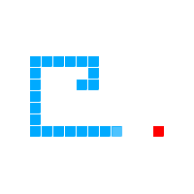
Introduction
The Snake Game is a classic arcade game where the player controls a snake to eat fruits and grow longer. The goal is to avoid running into the walls or the snake's own body. This project showcases my implementation of the Snake Game using Python, utilizing Tkinter for the graphical user interface and Turtle for the game graphics.

Slide 3
Objectives
Enjoy an Interactive Gaming Experience: Play a classic Snake Game with smooth controls and visually appealing graphics.
Select Preferred Difficulty Levels: Choose between Easy, Medium, and Hard modes to customize the gameplay based on individual skill levels
Challenge and Improve Skills: Enhance reflexes and decision-making abilities as the game becomes progressively faster with increasing scores.
Pause and Resume Flexibly: Utilize the pause feature to take breaks during gameplay and resume without losing progress.
Achieve High Scores: Compete to achieve personal best scores and challenge others to beat them, fostering a sense of accomplishment.

Slide 4
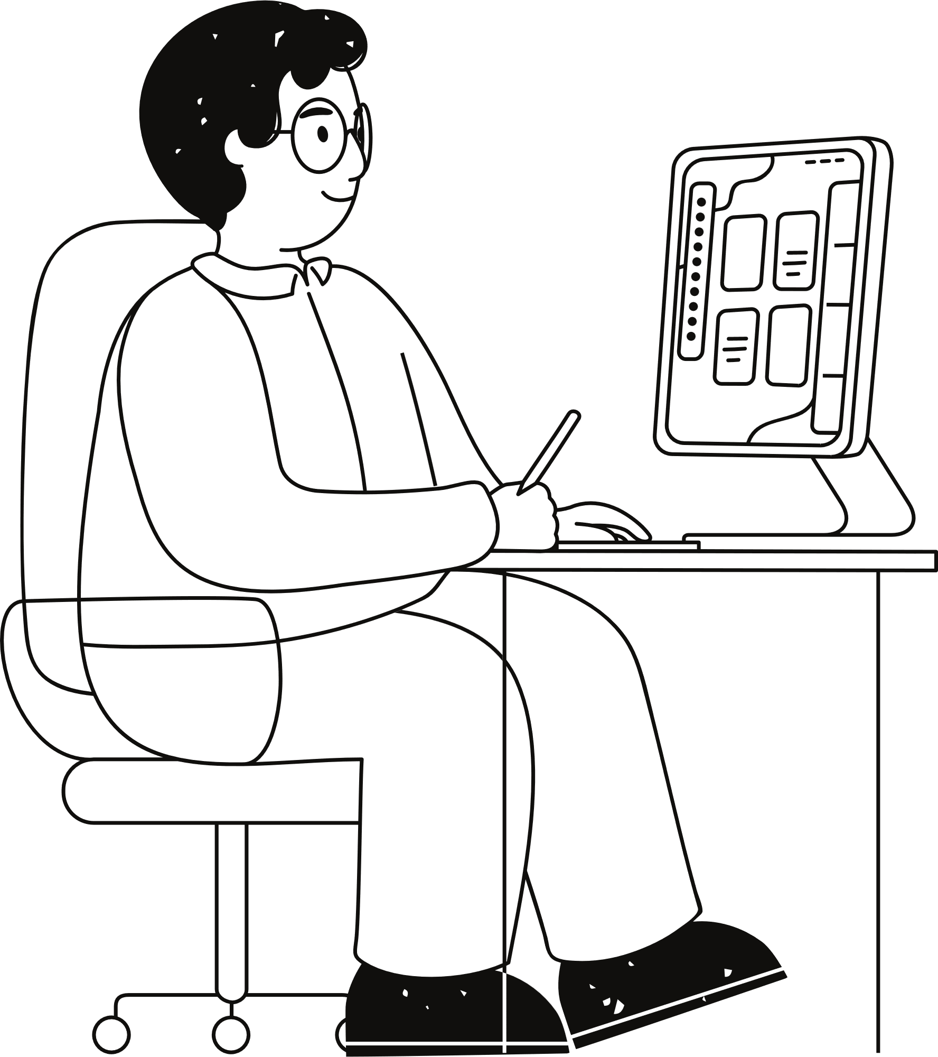
Scope
The application includes:
User Interface: Interactive interface with buttons for starting, pausing, and exiting the game.
Snake Gameplay: Movement controls for the snake and game over conditions.
Difficulty Levels: Options for Easy, Medium, and Hard difficulty, adjusting game speed
Pause/Resume: Allows pausing and resuming the game.
Scoring System: Displays and updates the score during gameplay.

Slide 5
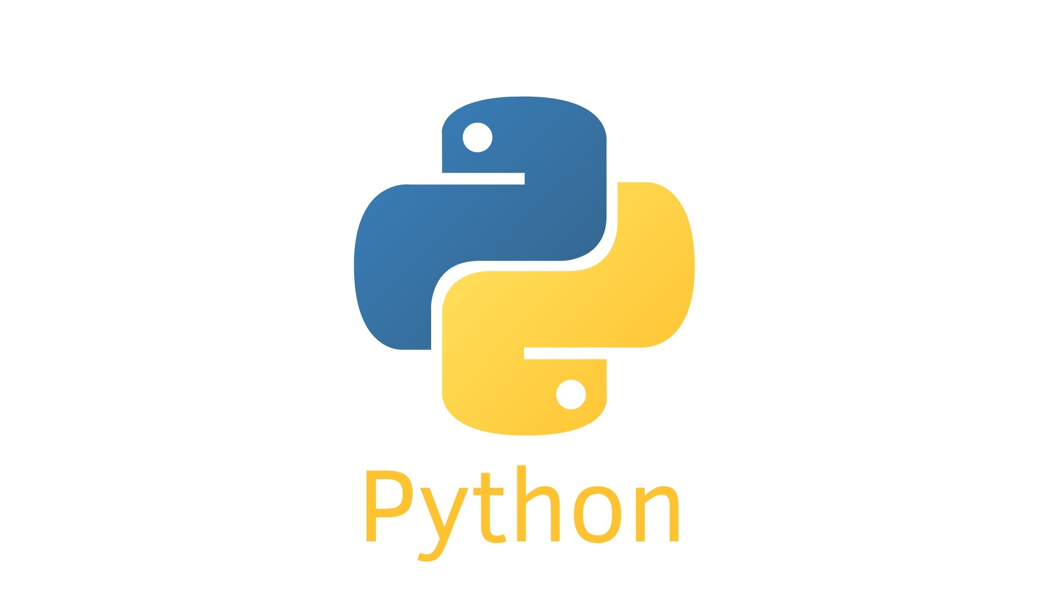
Application Tools
Python: The primary programming language used to develop the game, offering simplicity and flexibility.
Turtle Graphics: Utilized for creating the game’s graphical elements, including the snake, food, and game borders.
Tkinter: A Python library for building the graphical user interface (GUI), allowing user interaction through buttons and menus.
Random Module: Used to generate random positions for the fruit within the game area
Time Module: Manages game delays and the pause functionality to control the speed and flow of the game.
This Photo by Unknown Author is licensed under CC BY-NC-ND

Slide 6
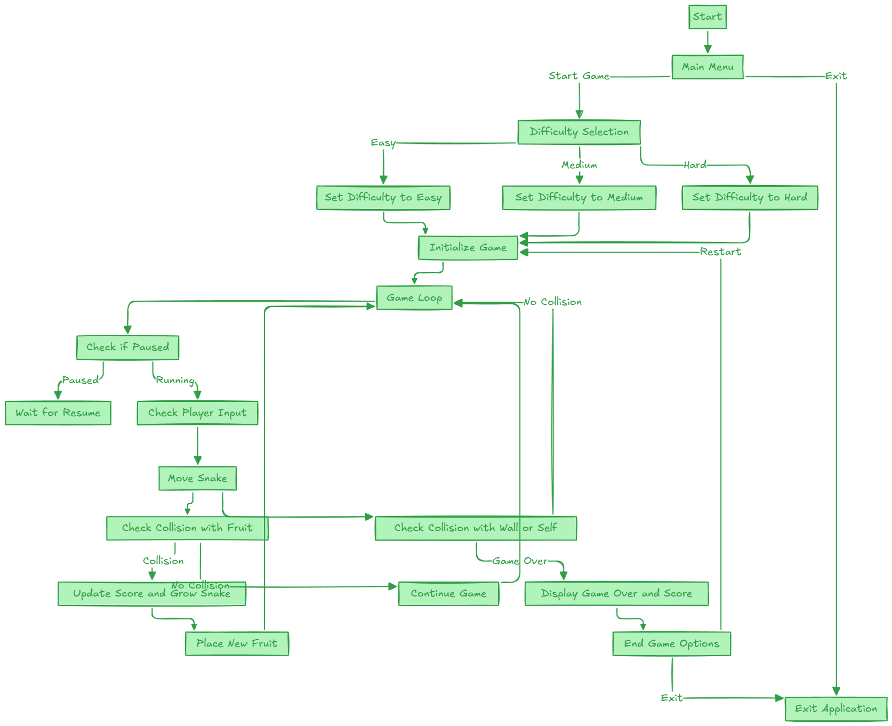
FLOWCHART

Slide 7
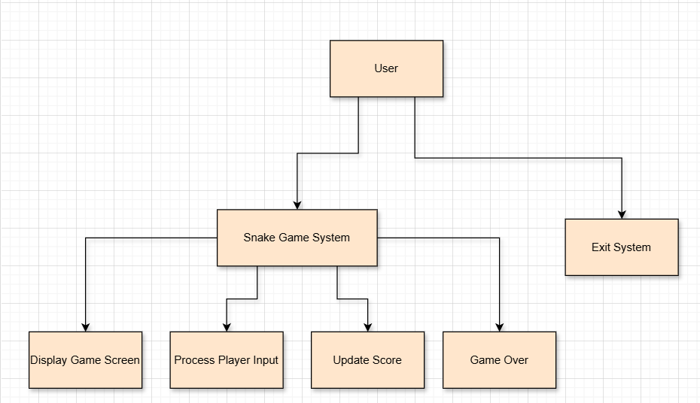
Level 0 DFD

Slide 8
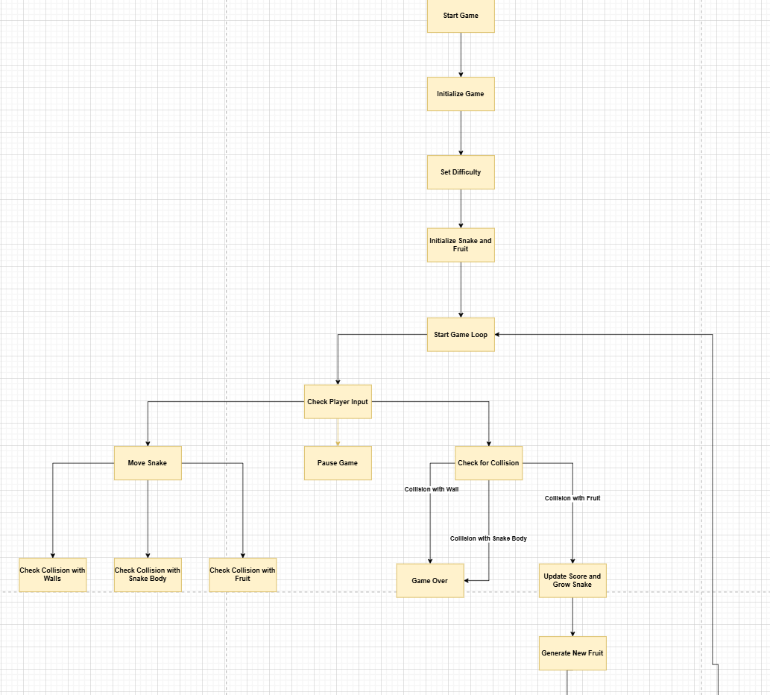
Level 1 DFD

Slide 9
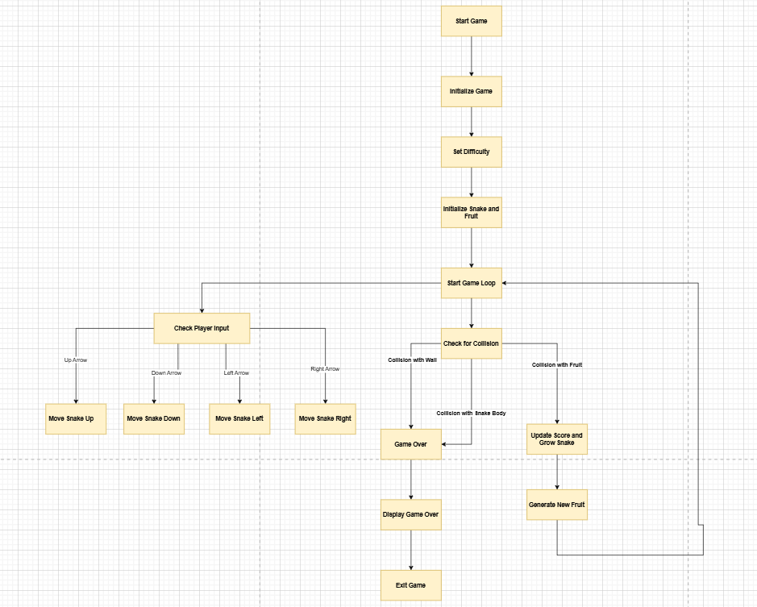
Level 2 DFD

Slide 10
Project Demonstration and Simulation

Slide 11

Conclusion
Achievements:
Dynamic Gameplay: The game adapts to different difficulty levels (Easy, Medium, Hard), providing a more engaging experience based on the player’s preferences.
Real-time Scoring: The system tracks and displays the player's score, creating an interactive gaming experience.
User-Friendly Interface: A graphical user interface (GUI) was designed using Tkinter for easy navigation and a smooth gameplay experience.
Game Functionality: Key functionalities like pause/resume, snake movement, fruit spawning, and game over screen were effectively implemented using Turtle graphics.
Future Enhancements:
Sound Effects
Multiplayer Mode
Leaderboard Integration
AI Opponents

Slide 12

Thank You!
Created and Presented by Varshith Reddy

