Slide 1
An Introduction to Project, Program, and Portfolio Management

Slide 2
What Is a Project?
A project is “a temporary endeavor undertaken to create a unique product, service, or result.”*
Operations is work done to sustain the business.
Projects end when their objectives have been reached or the project has been terminated.
*Project Management Institute, Inc., A Guide to the Project Management Body of Knowledge (PMBOK® Guide, Third Edition) (2004), p. 5.

Slide 3
Examples of Projects
A young couple hires a firm to design and build them a new house.
A college campus upgrades its technology infrastructure to provide wireless Internet access.
A group of musicians starts a company to help children develop their musical talents.
A pharmaceutical company launches a new drug.
A television network develops a system to allow viewers to vote for contestants and provide other feedback on programs.
A government group develops a program to track child immunizations.

Slide 4
Project Attributes
A project:
Has a unique purpose.
Is temporary.
Is developed using progressive elaboration or in an iterative fashion.
Requires resources, often from various areas.
Should have a primary customer or sponsor.
The project sponsor usually provides the direction and funding for the project.
Involves uncertainty.

Slide 5
The Triple Constraint
Every project of a given scope is constrained in different ways by its:
Time
Cost
Quality
It is the project manager’s duty to balance these three often competing goals.

Slide 6
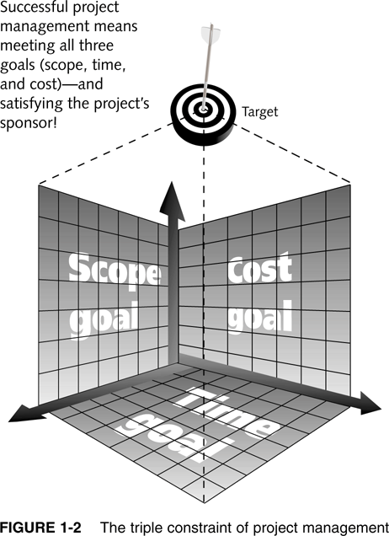
Figure 1-2. The Triple Constraint of Project Management

Slide 7
More on the Triple Constraint
It may be good enough to hit the target, or range, of triple constraint goals, but not the bull’s-eye.
It’s important to determine which aspects of the triple constraint are the most important.
The “quadruple constraint” includes quality as well as scope, time, and cost.

Slide 8
What is Project Management?
Project management is “the application of knowledge, skills, tools, and techniques to project activities to meet project requirements.”*
*Project Management Institute, Inc., A Guide to the Project Management Body of Knowledge (PMBOK® Guide, Third Edition) (2004), p. 8.

Slide 9
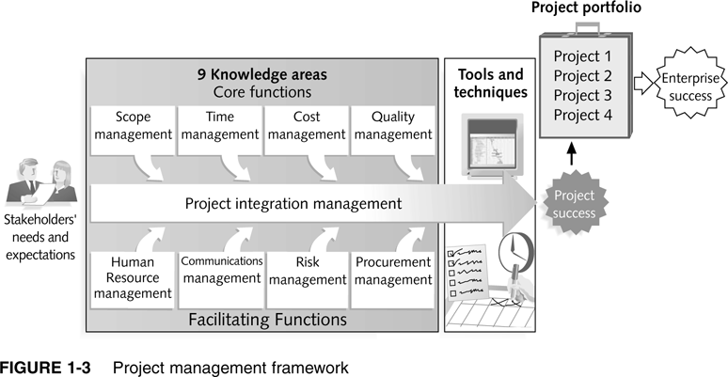
Figure 1-3. Project Management Framework

Slide 10
Project Stakeholders
Stakeholders are the people involved in or affected by project activities.
Stakeholders include:
The project sponsor
The project manager
The project team
Support staff
Customers
Suppliers
Opponents to the project

