Slide 1
Startup Seminar – Spring 2022
Introduction to Startup
Keith E. Kelly
1/18/2022

Slide 2
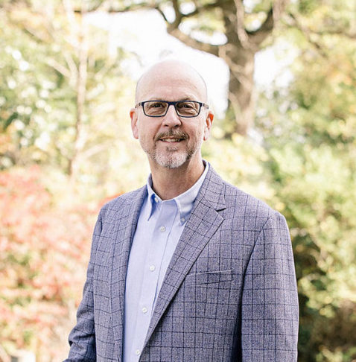
Keith E. Kelly
NMC – Faculty, Engineering Technology
– NMC Makerspace
Coordinator – Northern Michigan Startup Week
Founder - tccodes/tccyber
TCNewTech – Board of Directors

Slide 3

Building Traverse City’s Entrepreneurial Ecosystem Engaging NMC in Traverse City’s Startup Community
Keith E. Kelly

Slide 4
But what is Startup?
Engaging NMC in Traverse City’s Startup Community

Slide 5
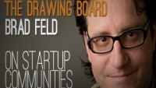

Slide 6
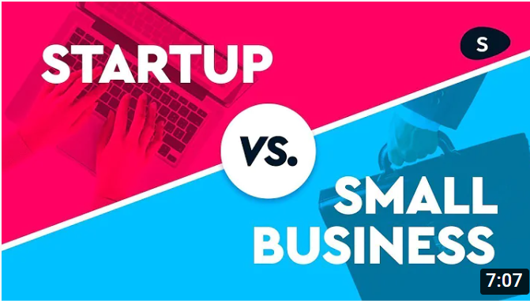

Slide 7
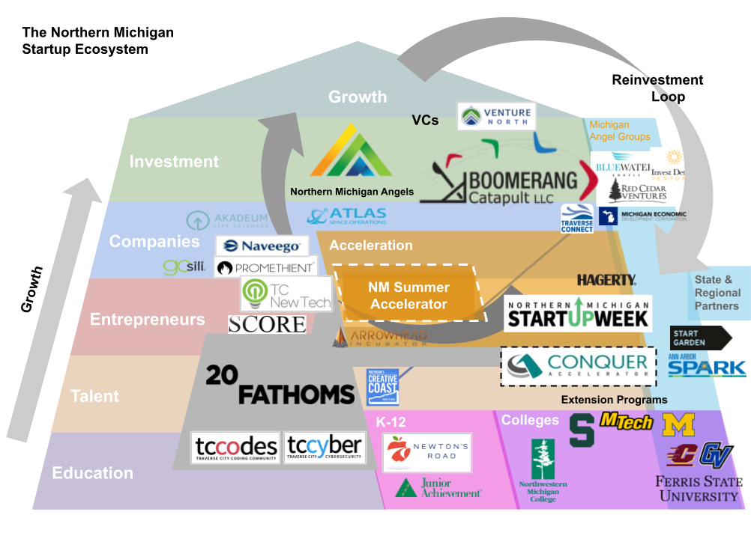

Slide 8

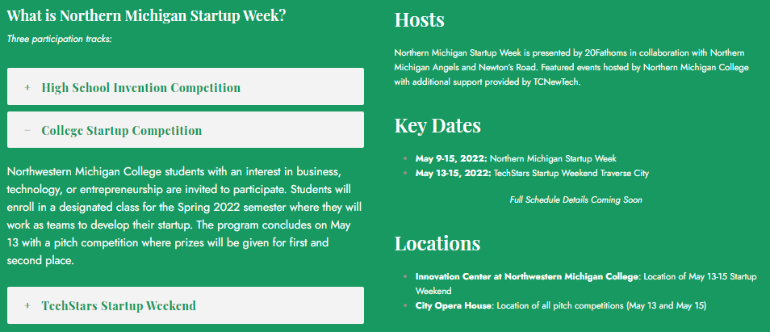

Slide 9

How to Start a Startup
By Sam Altman
How to Start a Startup (samaltman.com)

Slide 10

Innovation Doesn’t Just Happen.

Slide 11
The Plan
Sprint 1- Problem/Opportunity (individual)
Sprint 2 - Product (individual)
Sprint 3 - Team/Planning (Cofounder, Team?)
Sprint 4 - Execution
Sprint 5 - Pitch
*** Friday, May 9: NMSW Pitch Competition

Slide 12

Sprint 1

Slide 13
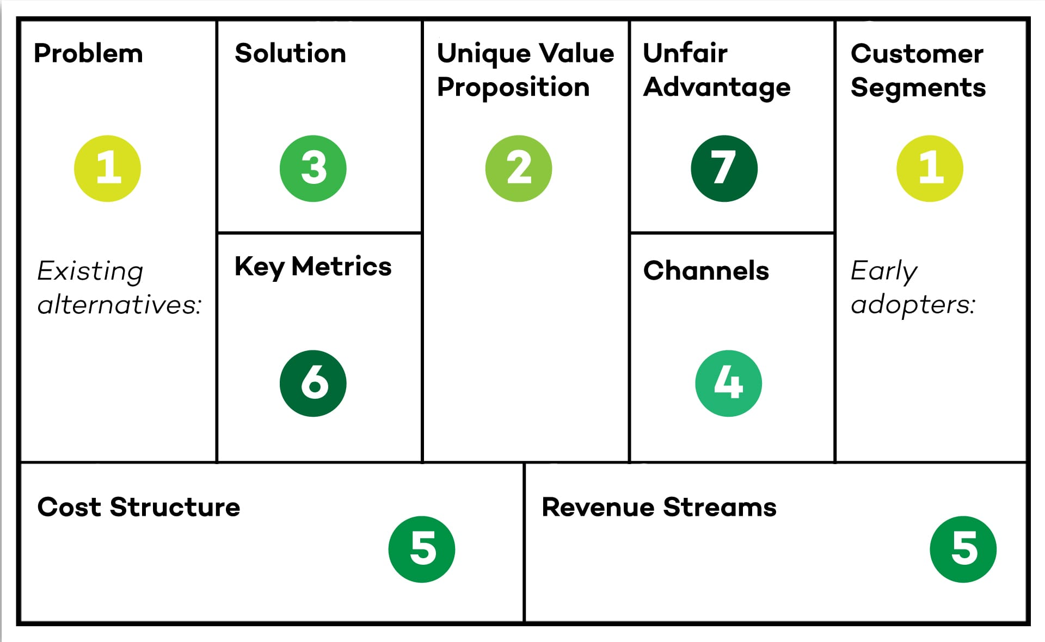
Example: Lean Canvas

Slide 14
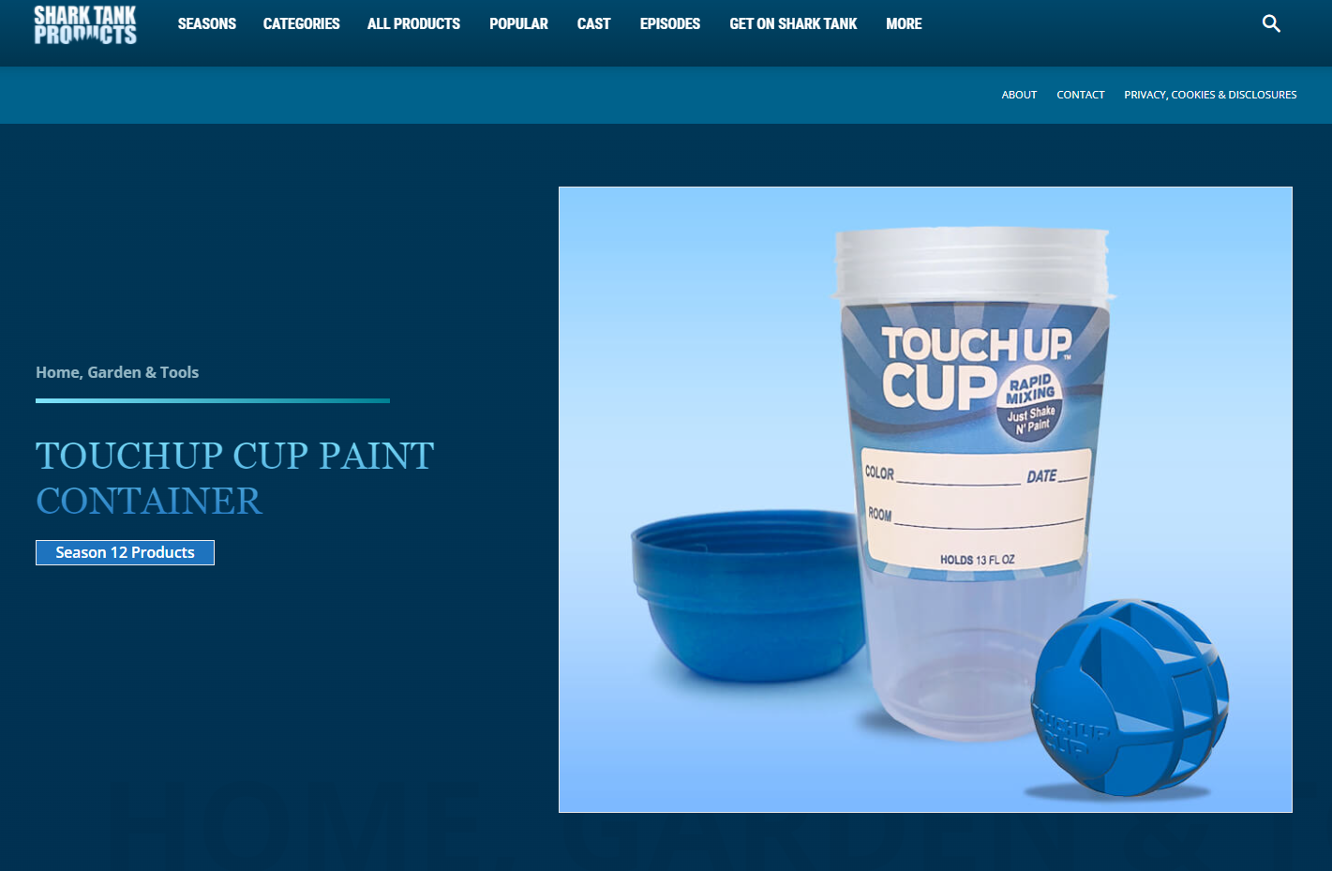
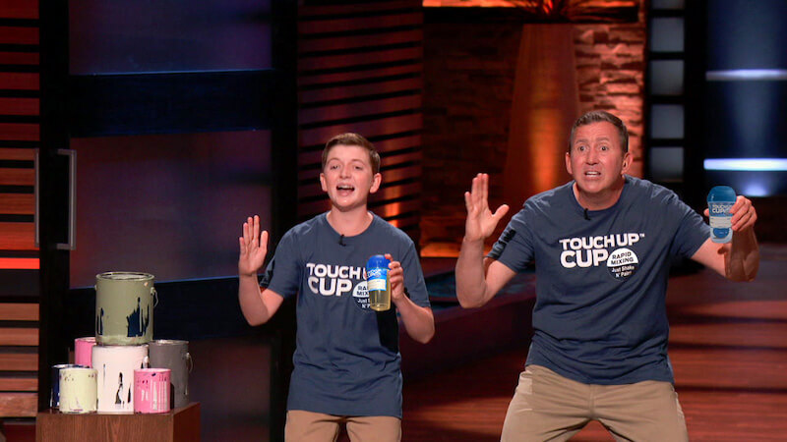

Slide 15
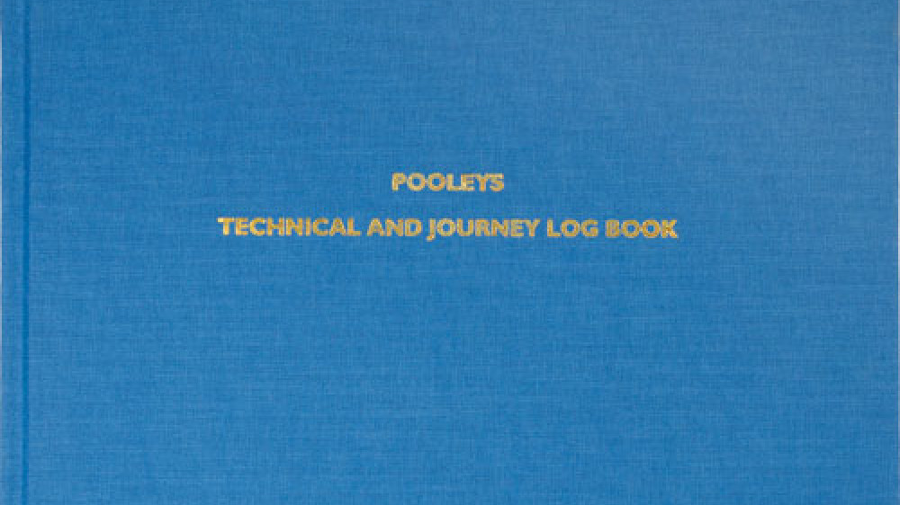

Slide 16
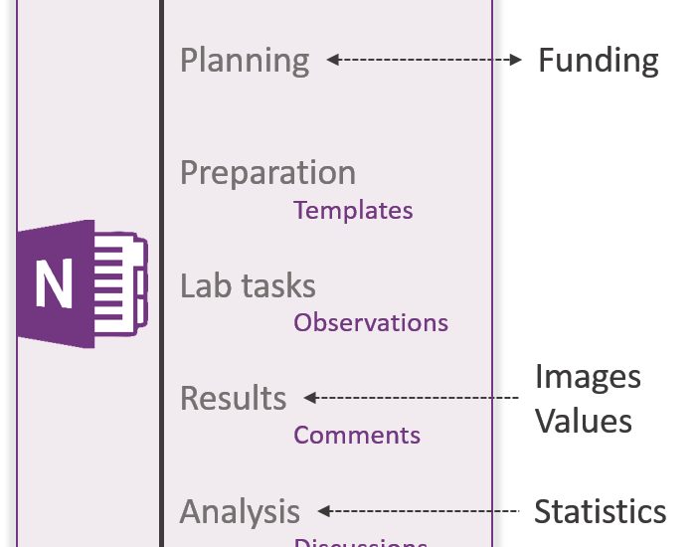

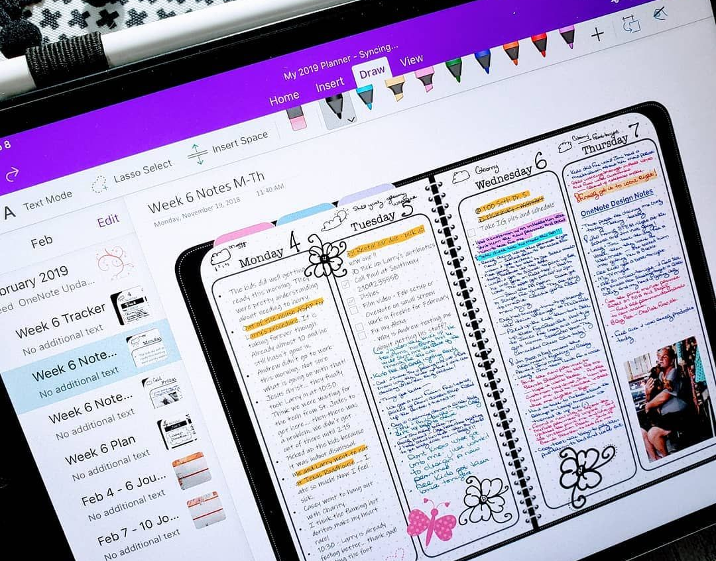
Your Log – Your Journey

Slide 17
Building Traverse City’s Entrepreneurial Ecosystem Engaging NMC in Traverse City’s Startup Community
Keith E. Kelly

