Slide 1
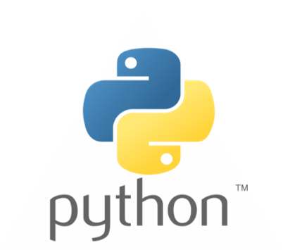
Python Programming
An introduction

Slide 2
Session Outline
Why Python?
Python 2 vs. Python 3
Python Installation
Jupyter Notebooks
Git and GitHub

Slide 3
Why Python?
1990 by Guido van Rossum
Python 3 released on 2008
Goal: Easy to use
Goal: Easy to read
More on Why
Easy to learn
Extensive libraries and tools!
Many applications
Focused on the developer

Slide 4
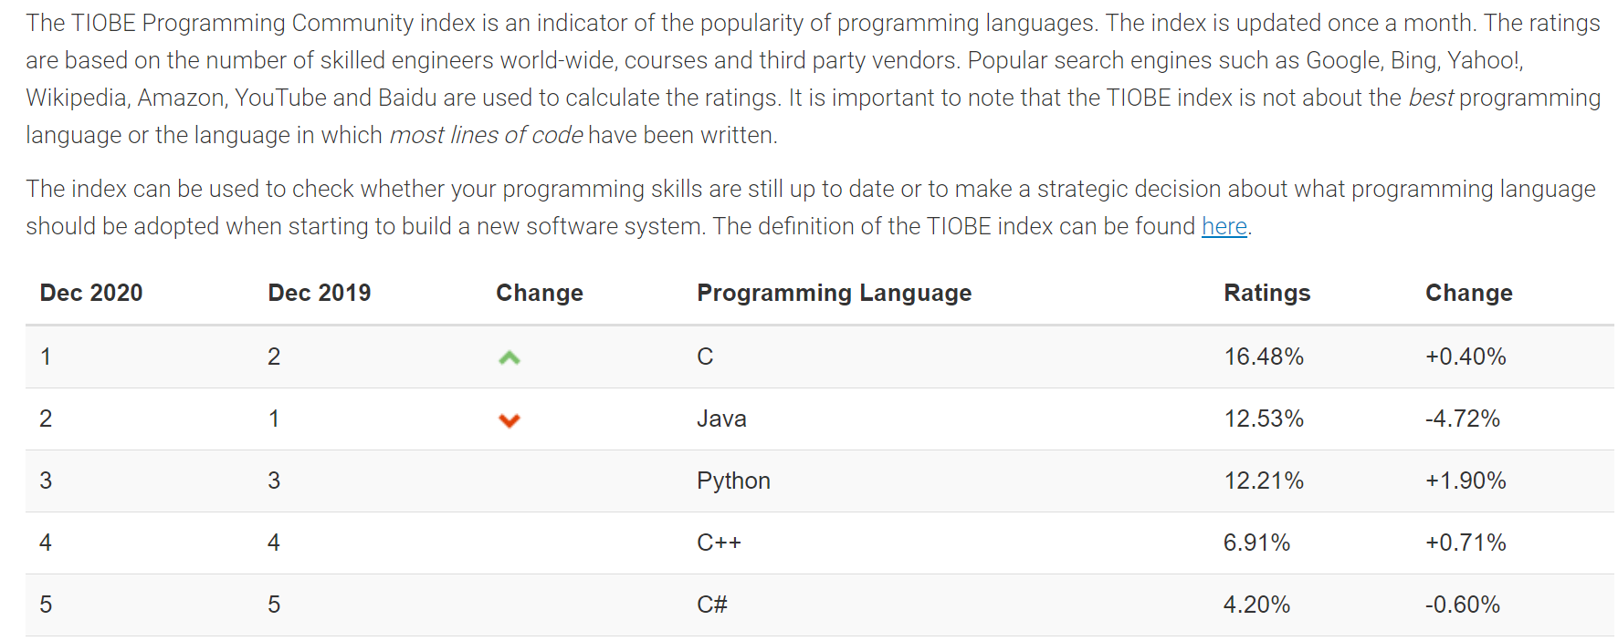
TIOBE Index

Slide 5
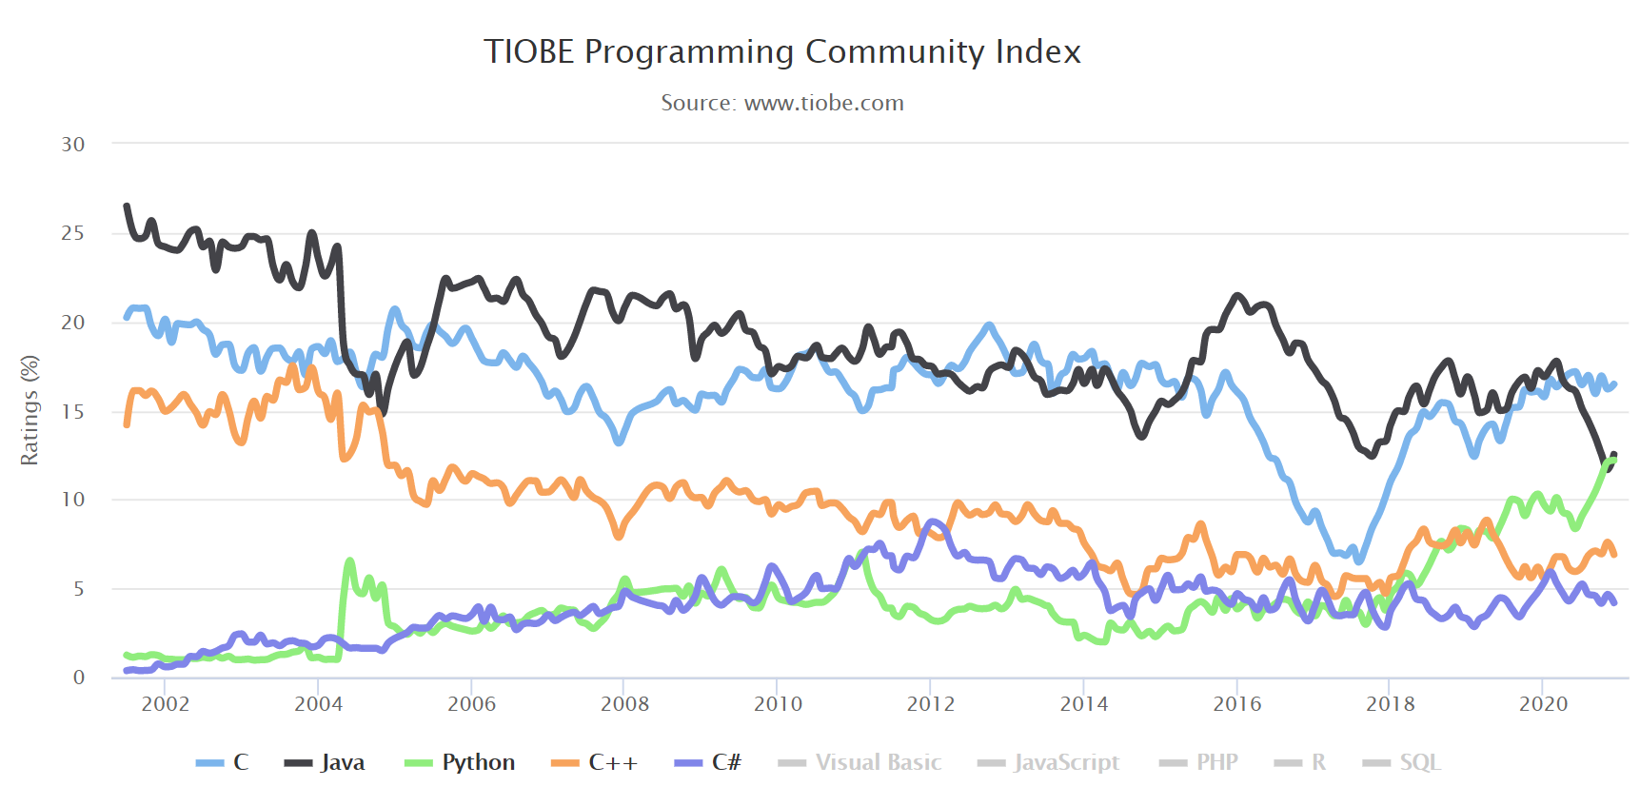
TIOBE Index

Slide 6
Data Analytics and Web
Libraries!
NumPy and Pandas - Data Analysis with Python
Large data sets
Visualizations
Machine Learning
Web – Django and Flask
piRover – Open Source CV

Slide 7


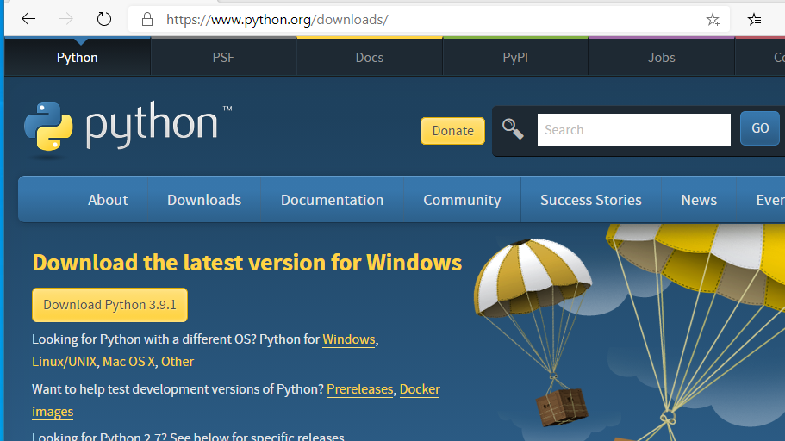
Installing Python

Slide 8
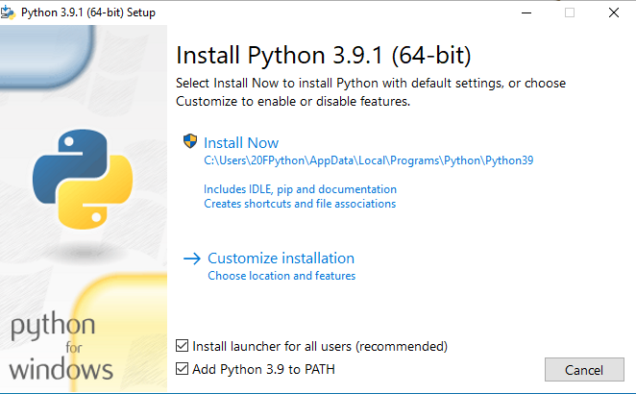
Installing Python

Slide 9
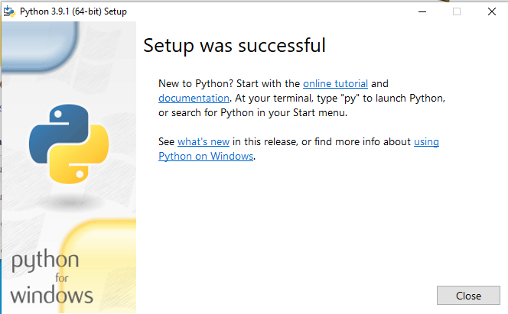
Installing Python

Slide 10
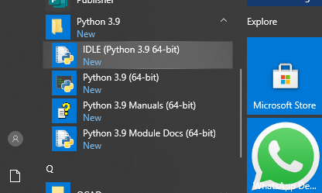
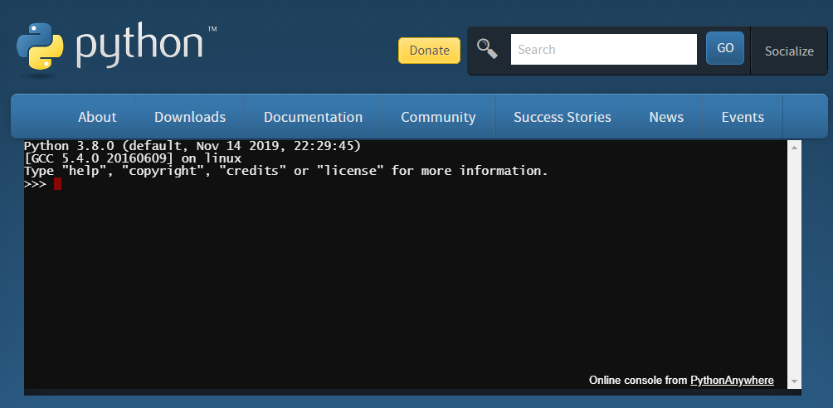
Launch Python – Interactive Shell

Slide 11
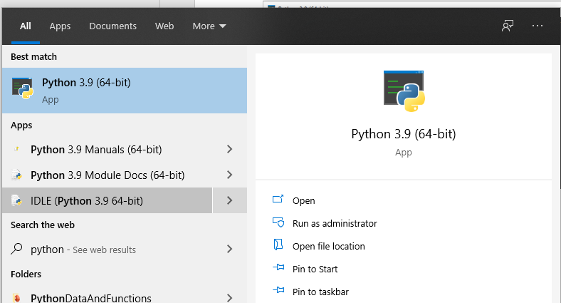
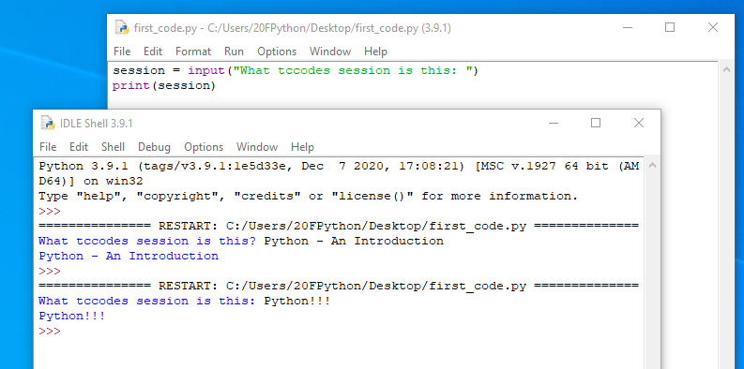
Launch Python – IDLE

Slide 12
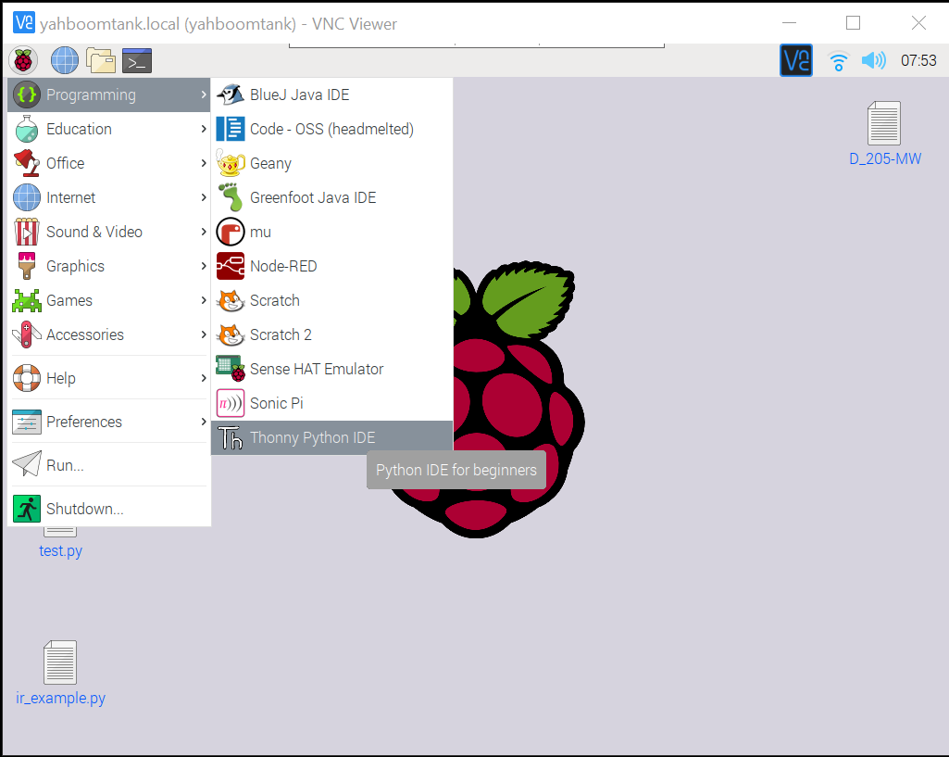
Python ON Raspberry PI

Slide 13
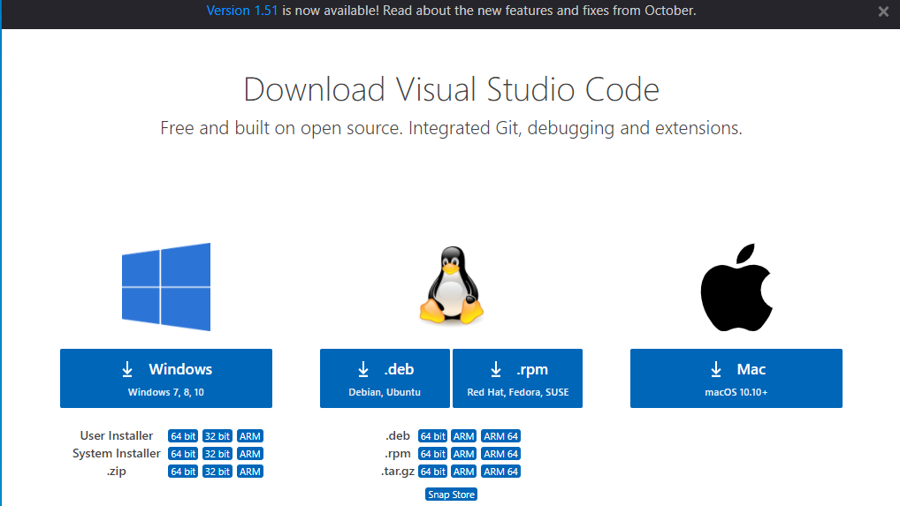
Visual Studio Code - Installation

Slide 14
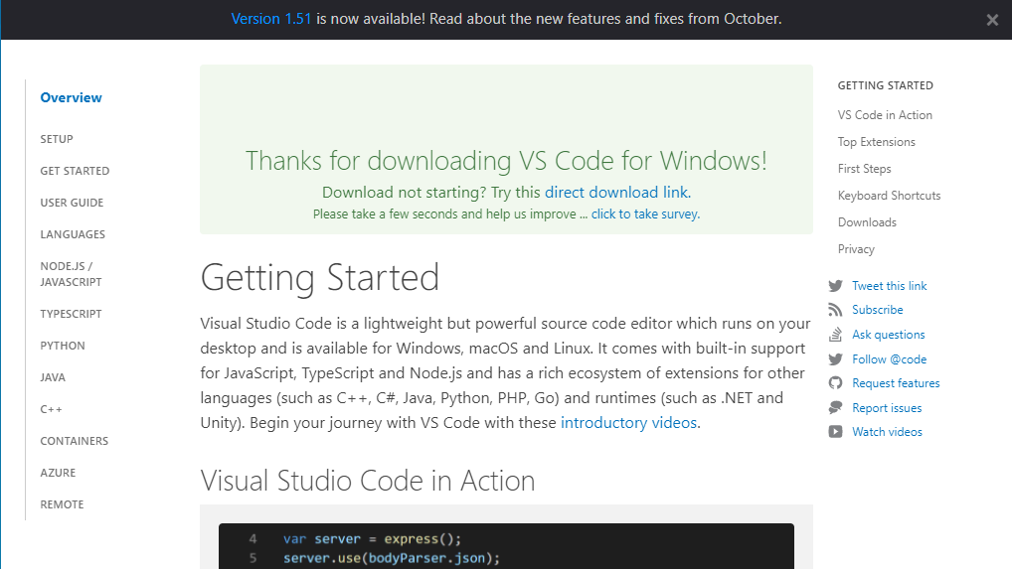
Visual Studio Code - Installation

Slide 15
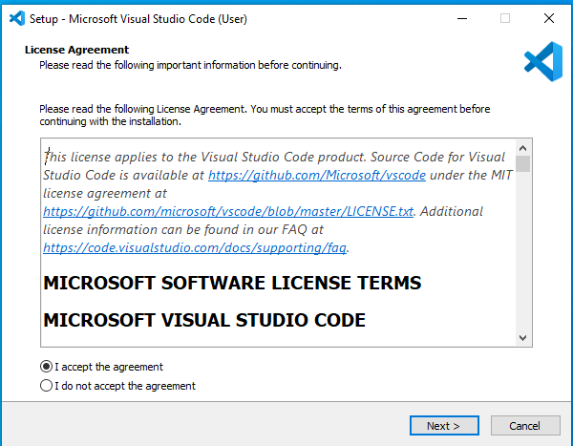
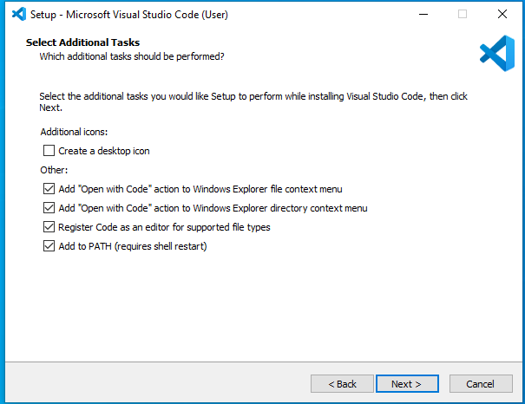
Visual Studio Code - Installation

Slide 16
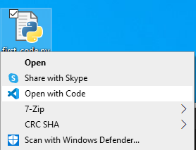
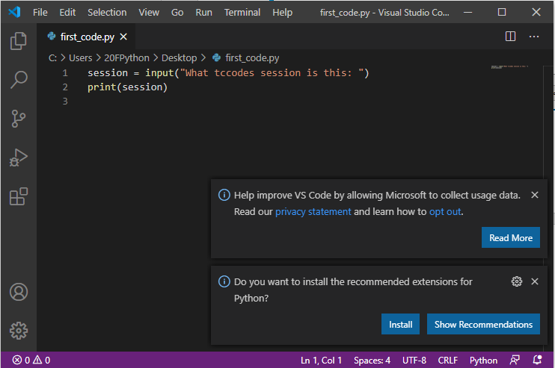
Create, Edit, Run – Python on VS Code

Slide 17
Installing VS Code Extension for Python

Slide 18
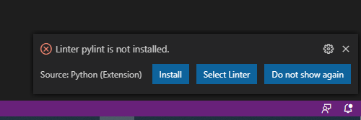
Installing Python Linter

Slide 19
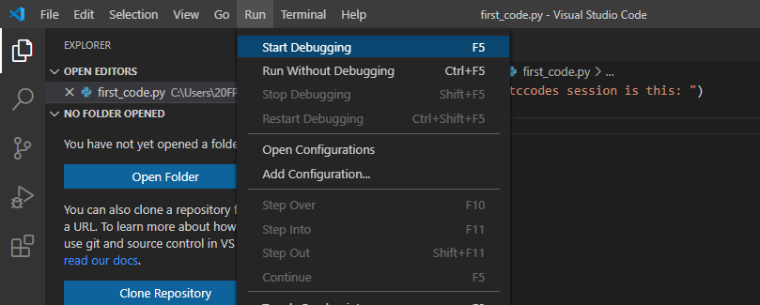
Edit and Run Python in VS Code

Slide 20
Edit and Run Python in VS Code

Slide 21
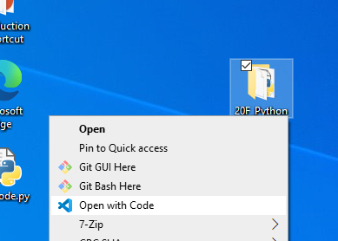
Project Folders

Slide 22
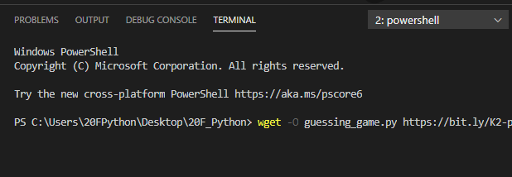
VS Code – IDE – Edit and Debug
wget –O guessing_game.py https://bit.ly/K2-python-guessing-game

Slide 23
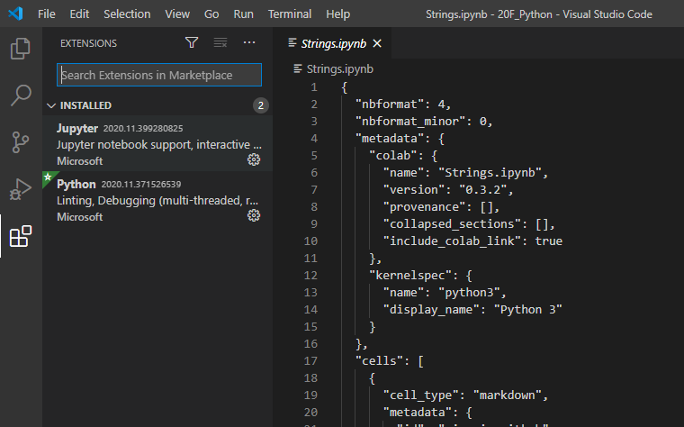
Working with Jupyter Notebooks in Visual Studio Code

Slide 24
Working with Jupyter Notebooks in Visual Studio Code
DEMO

Slide 25
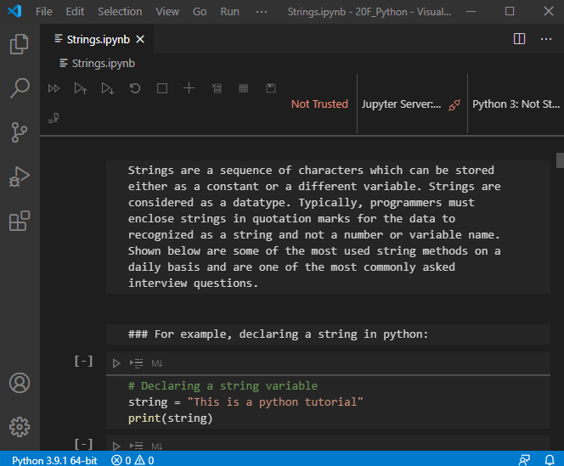
Working with Jupyter Notebooks in Visual Studio Code

Slide 26
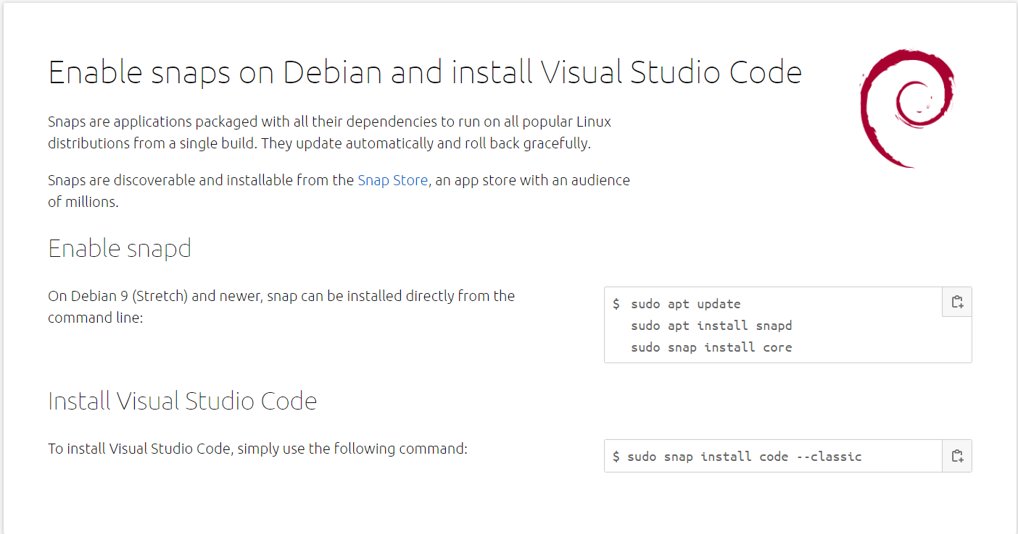
VS Code on the Raspberry Pi

Slide 27
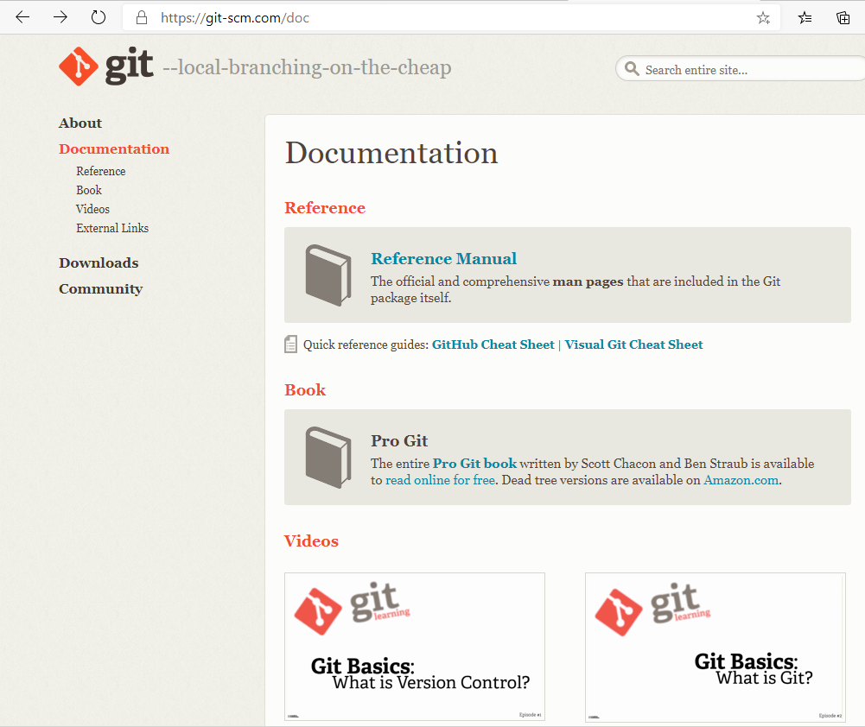
Git and GitHub

Slide 28
VS Code – IDE – Edit and Debug
wget –O guessing_game.py https://bit.ly/K2-python-guessing-game

Slide 29
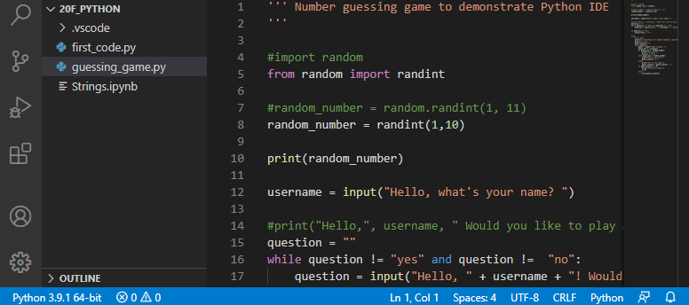
Guessing Game Example in VS Code

Slide 30
CPython
CPython is the reference implementation of the Python programming language. Written in C and Python, CPython is the default and most widely used implementation of the language.
CPython can be defined as both an interpreter and a compiler as it compiles Python code into bytecode before interpreting it.

Slide 31
Review
Machine, high-level, natural
Instruction list
Source code
Interpreter/compiler
Python 2 vs 3
CPython
IDLE
Debugger
Monty Python
Console/terminal
“script”
Lexis, syntax, and semantics

