Slide 1
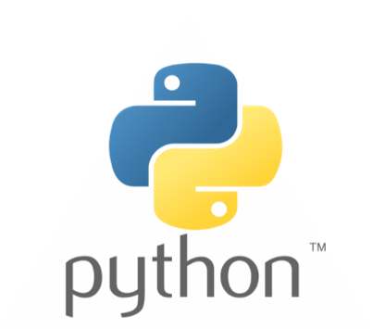
Python Programming
An introduction

Slide 2
Session Outline
Why Python?
Python 2 vs. Python 3
Python Installation
Jupyter Notebooks
Git and GitHub

Slide 3
Why Python?
1990 by Guido van Rossum
Python 3 released on 2008
Goal: Easy to use
Goal: Easy to read
More on Why
Easy to learn
Extensive libraries and tools!
Many applications
Focused on the developer

Slide 4
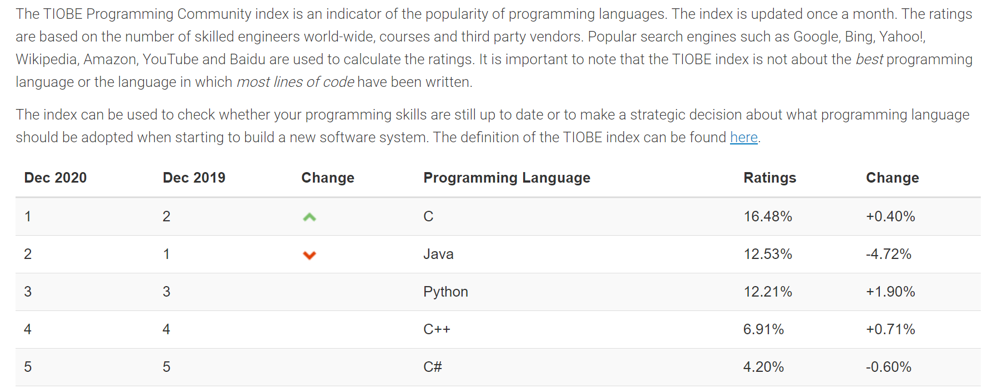
TIOBE Index

Slide 5
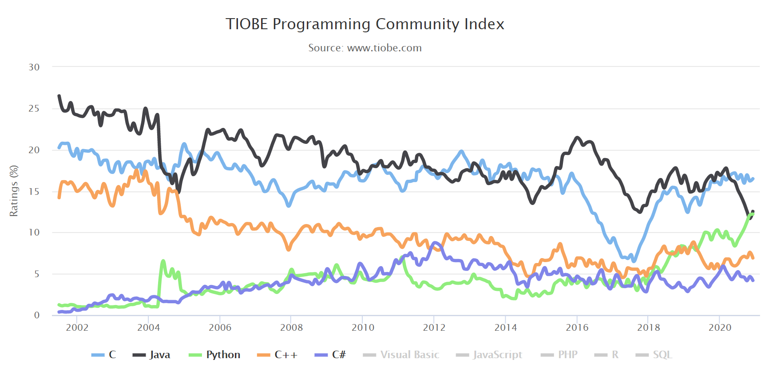
TIOBE Index

Slide 6
Data Analytics, Web, and Cybersecurity
Libraries! (most popular)
NumPy and Pandas - Data Analysis with Python
Large data sets, Visualizations
Machine Learning
Web – Django and Flask (full stack course by Jose Portilla)
Open Source CV (OpenCV tutorials)
Cybersecurity (Python for Cybersecurity)

Slide 7


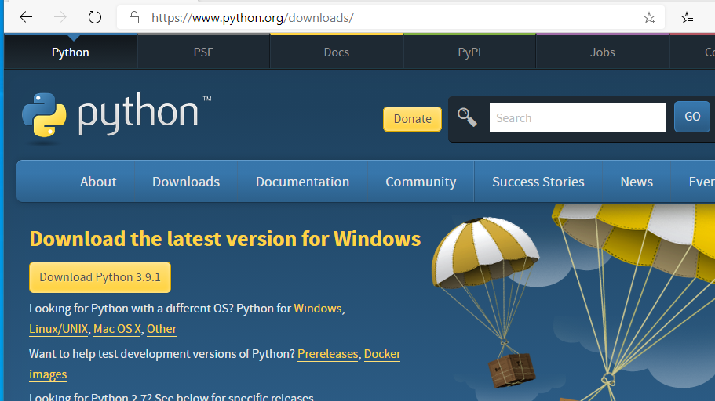
Installing Python

Slide 8
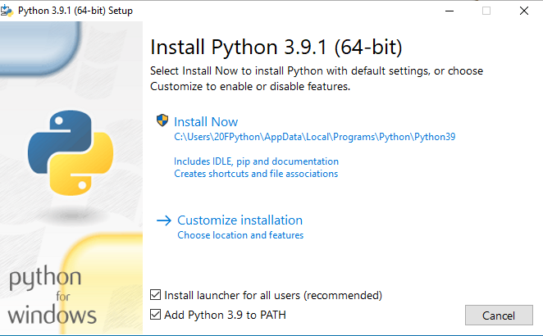
Installing Python

Slide 9
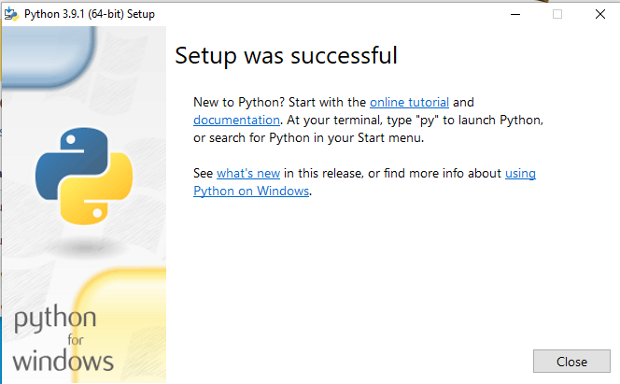
Installing Python

Slide 10
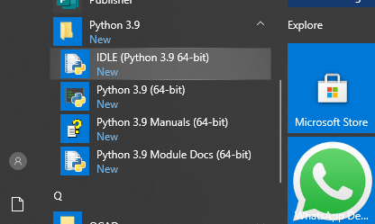
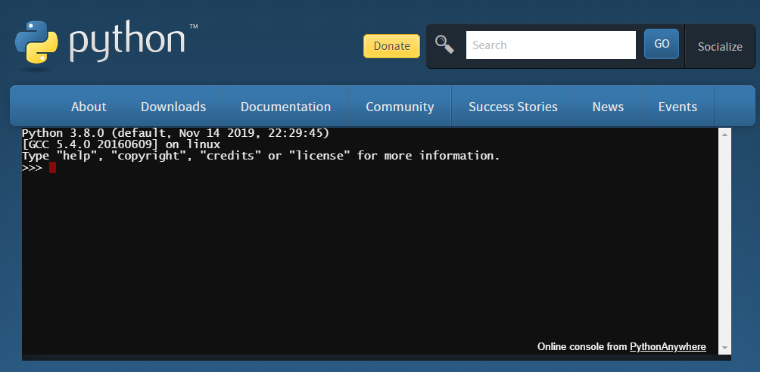
Launch Python – Interactive Shell

Slide 11
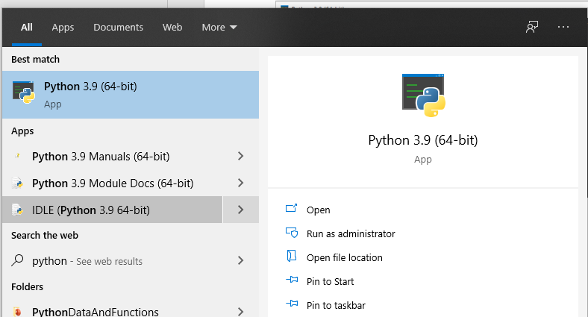
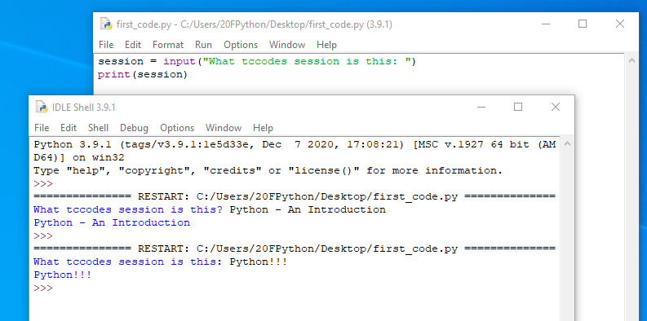
Launch Python – IDLE

Slide 12
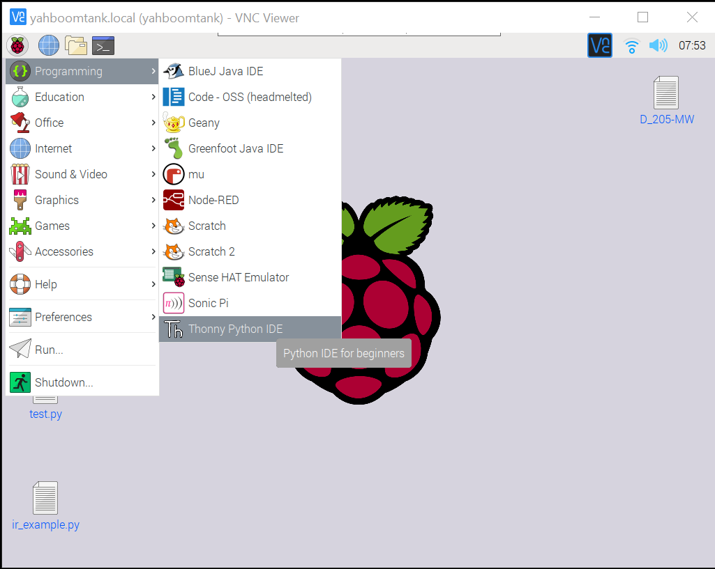
Python ON Raspberry PI

Slide 13
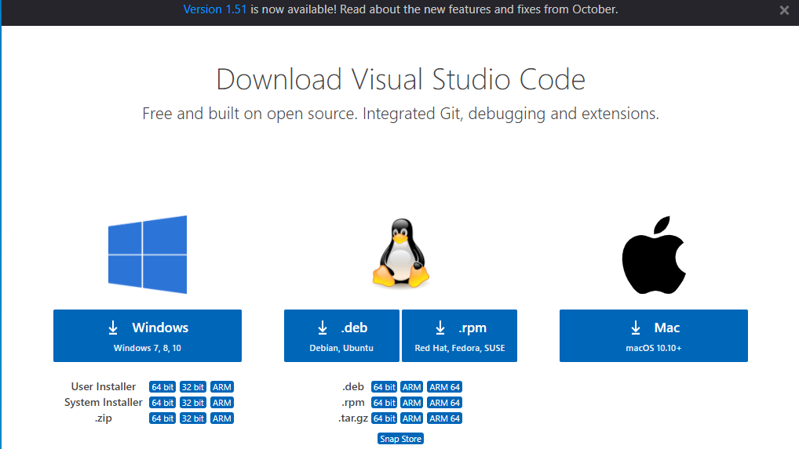
Visual Studio Code - Installation

Slide 14
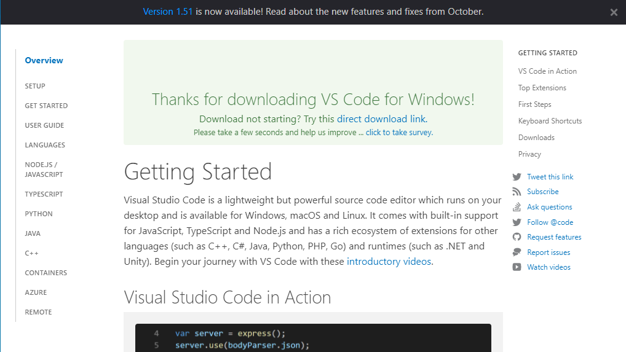
Visual Studio Code - Installation

Slide 15
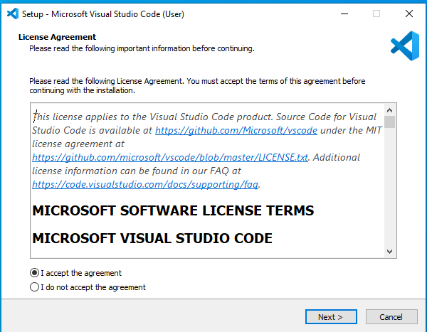
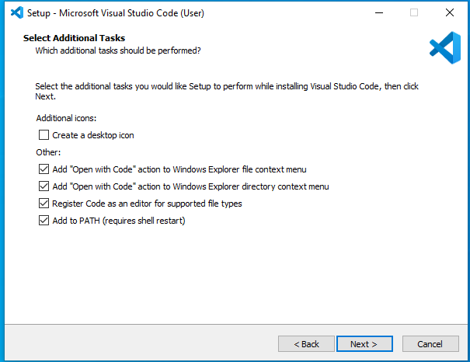
Visual Studio Code - Installation

Slide 16
Visual Studio Code – Installation sudo apt install code

Slide 17
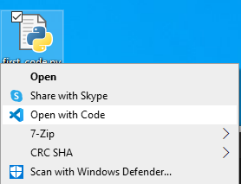
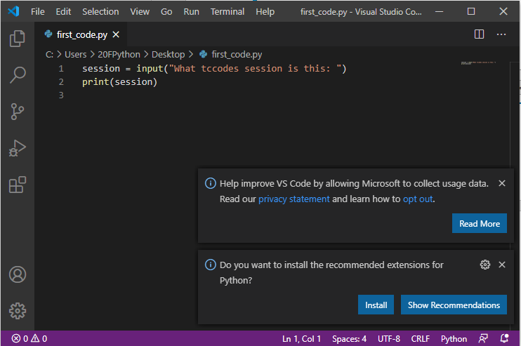
Create, Edit, Run – Python on VS Code

Slide 18
Installing VS Code Extension for Python

Slide 19
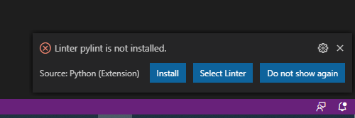
Installing Python Linter

Slide 20
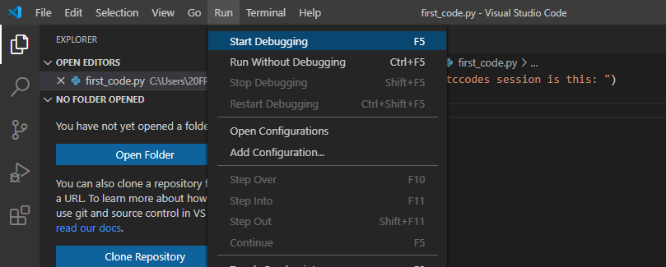
Edit and Run Python in VS Code

Slide 21
Edit and Run Python in VS Code

Slide 22
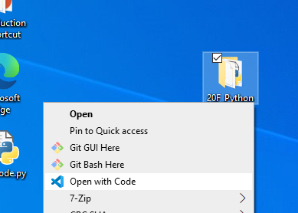
Project Folders

Slide 23
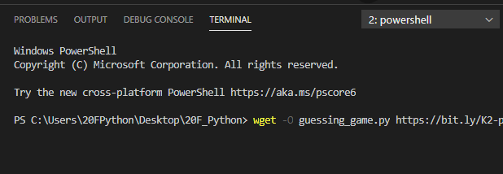
VS Code – IDE – Edit and Debug
wget –O guessing_game.py https://bit.ly/K2-python-guessing-game

Slide 24
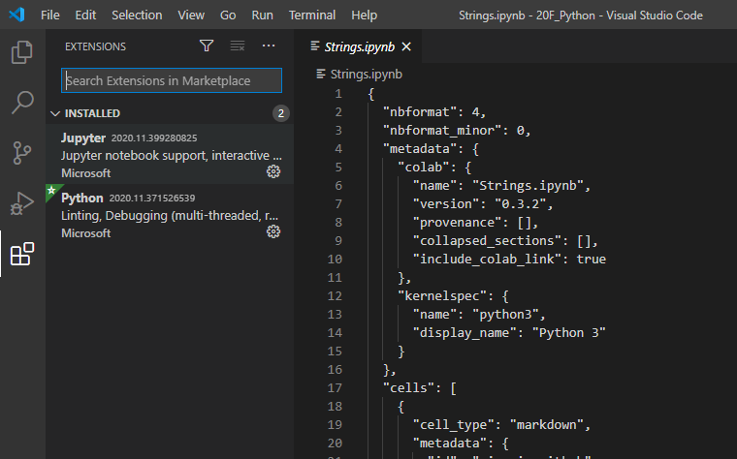
Working with Jupyter Notebooks in Visual Studio Code

Slide 25
Working with Jupyter Notebooks in Visual Studio Code
DEMO (Windows install)

Slide 26
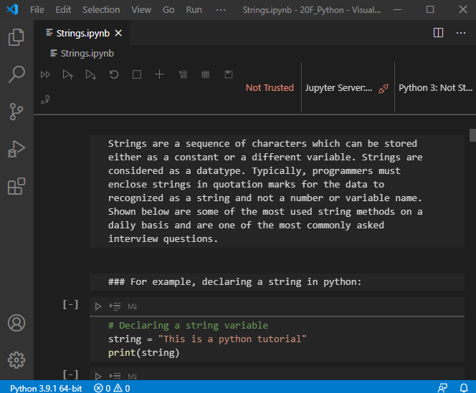
Working with Jupyter Notebooks in Visual Studio Code

Slide 27
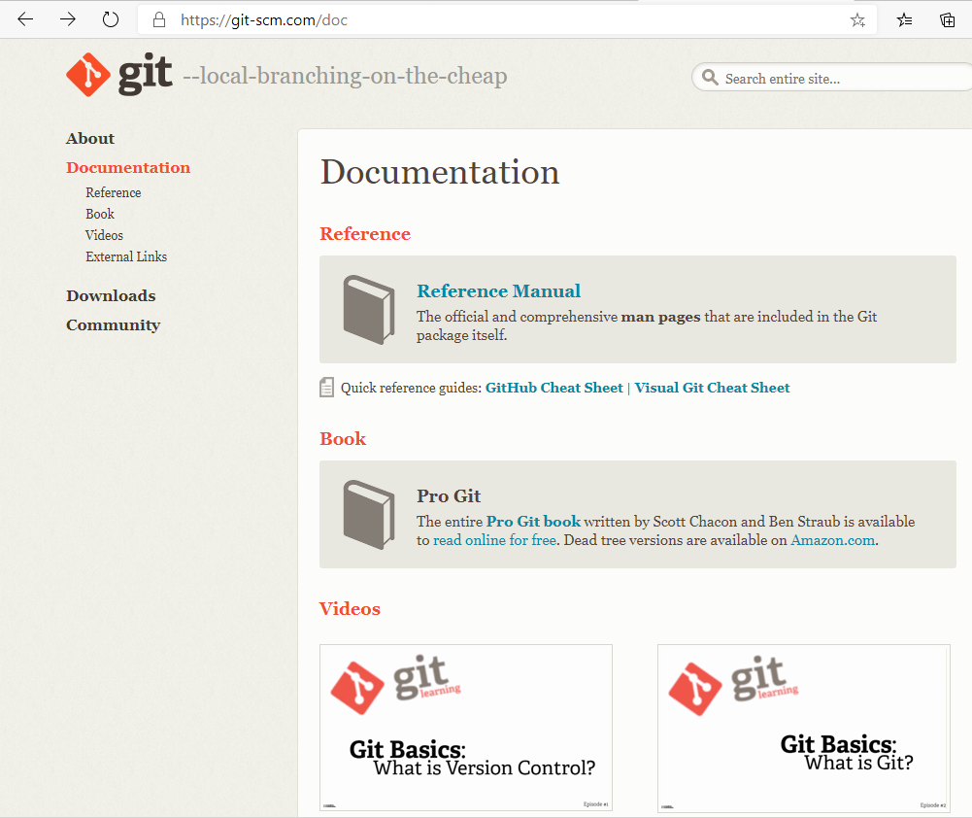
Git and GitHub
SEE SHORT TUTORIAL AT
Introduction to Git - Learn | Microsoft Docs

Slide 28
VS Code – IDE – Edit and Debug
wget –O guessing_game.py https://bit.ly/K2-python-guessing-game

Slide 29
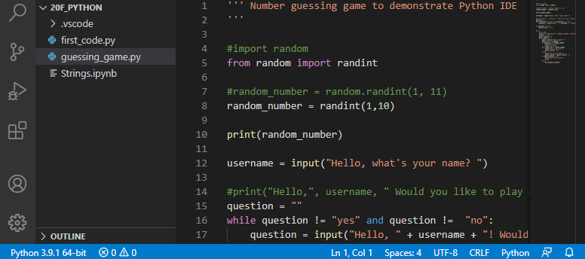
Guessing Game Example in VS Code

Slide 30
CPython
CPython is the reference implementation of the Python programming language. Written in C and Python, CPython is the default and most widely used implementation of the language.
CPython can be defined as both an interpreter and a compiler as it compiles Python code into bytecode before interpreting it.

Slide 31
Review
Machine, high-level, natural
Instruction list
Source code
Interpreter/compiler
Python 2 vs 3
CPython
IDLE
Debugger
Monty Python
Console/terminal
“script”
Lexis, syntax, and semantics

