Slide 1


June 22th 2021

Slide 2
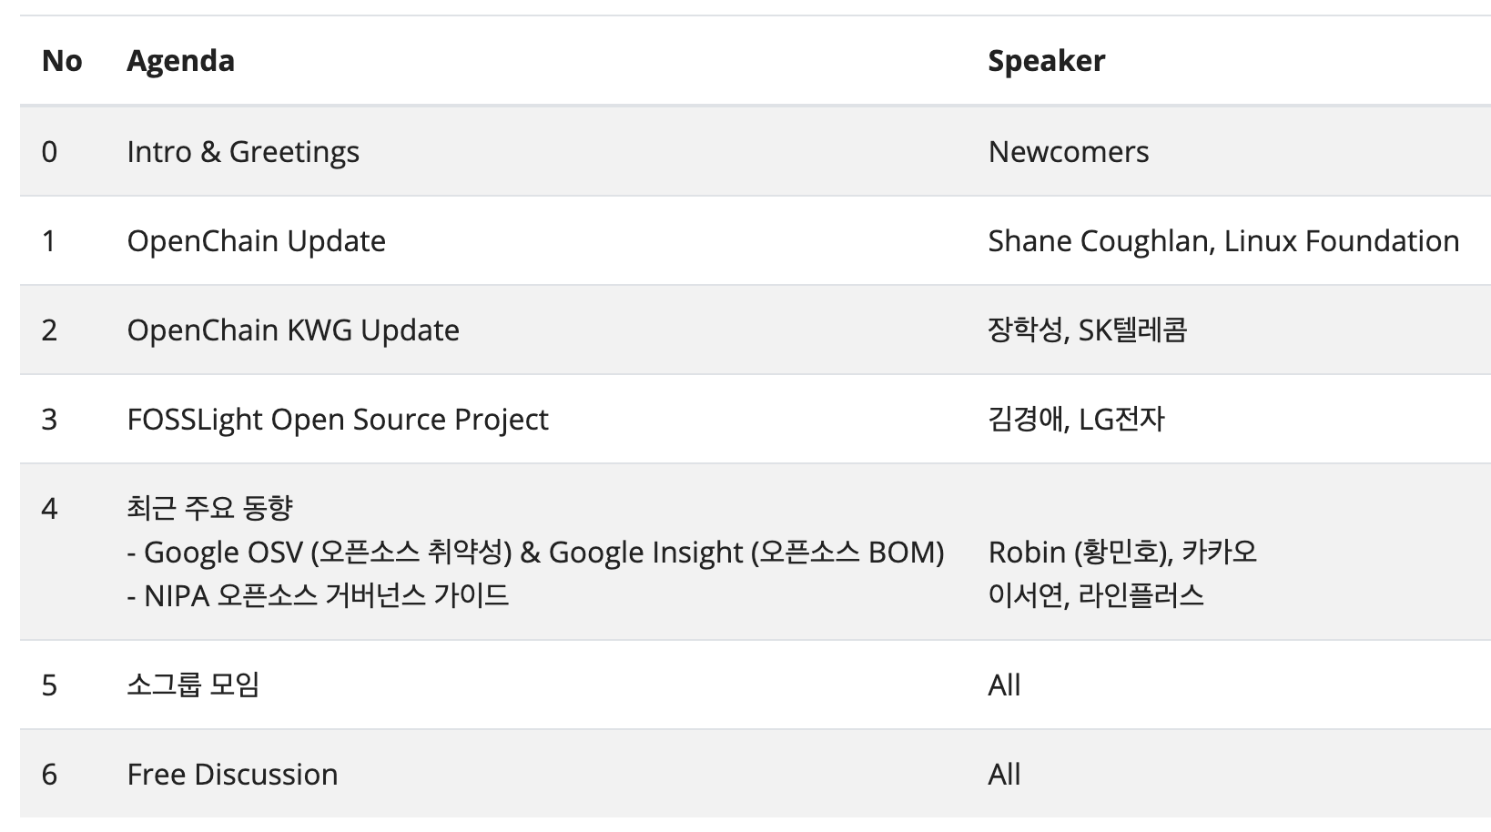
Agenda

Slide 3

Welcoming Newcomers

