Slide 1
angular.js
architecture
a few best practices
KL Hamilton
16 October 2015

Slide 2

What we’ll cover
MVW structure
UI drives everything
Modularize all the things
Obvious naming is obvious
Telling a story
Laser focus
6

Slide 3
Model-View-Whatever structure.
View
View-Model
Model
traditional rest/API
modern rest/API
declarative, visual
html, css
imperative, behavior
controller, service
data, logic
java, node
Originally Angular was an MVC. As it matured, it became more of an MVVM, since the $scope object could be considered a View-Model decorated by a Controller. To reduce confusion, the angular gods declared the framework an MVW.
7

Slide 4
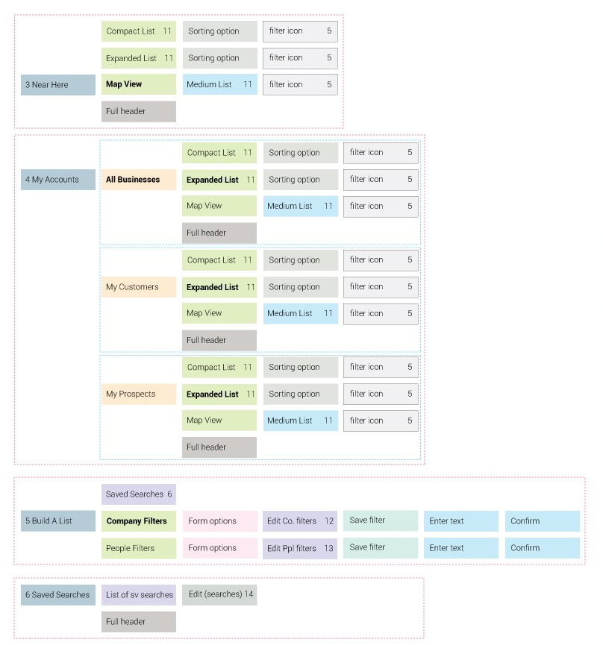
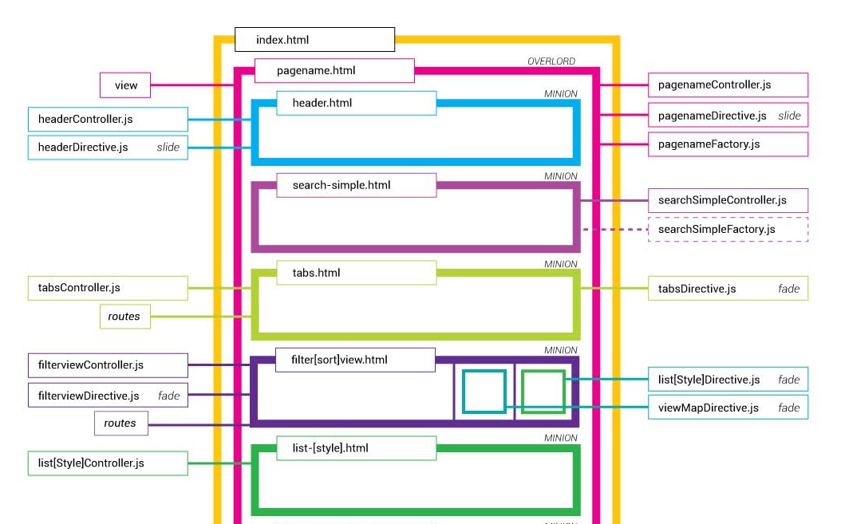
The UI drives everything.
5

Slide 5
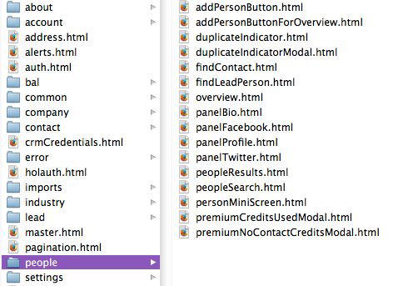
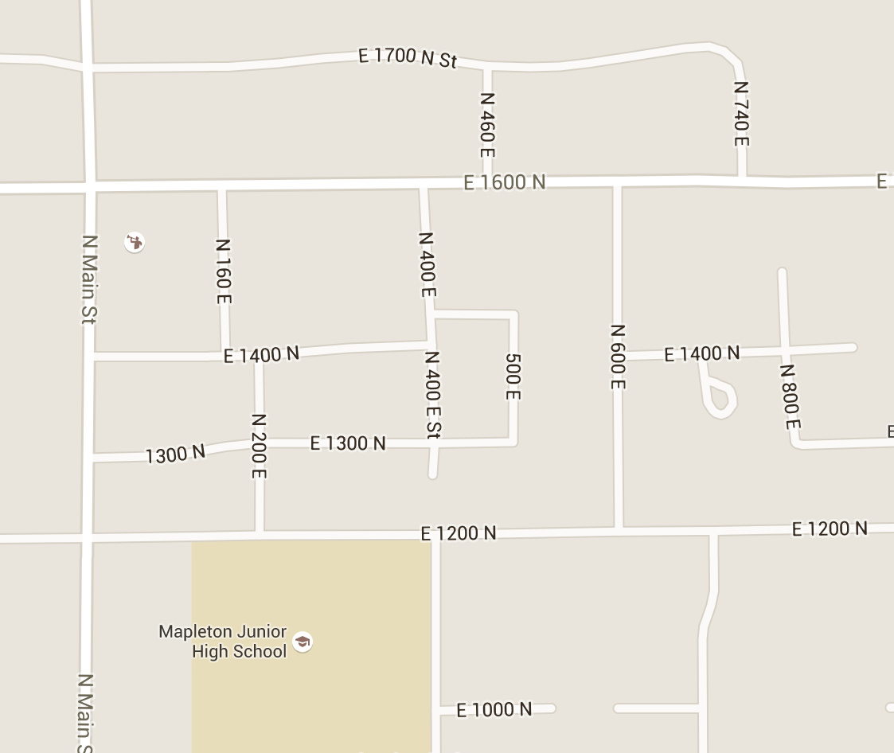
You can’t debug what you can’t find.
When naming items:
establish consistent patterns
reduce names to purpose
avoid global prefixes
5

Slide 6
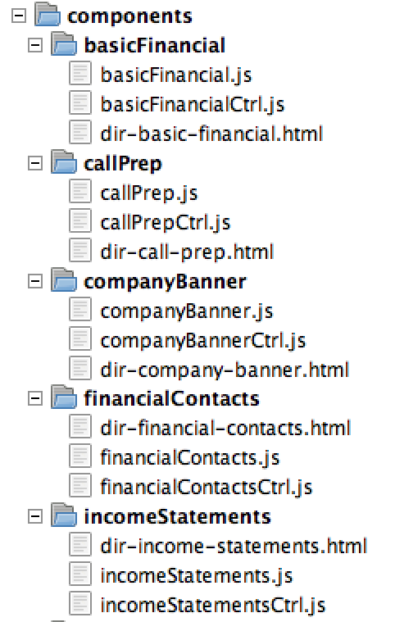
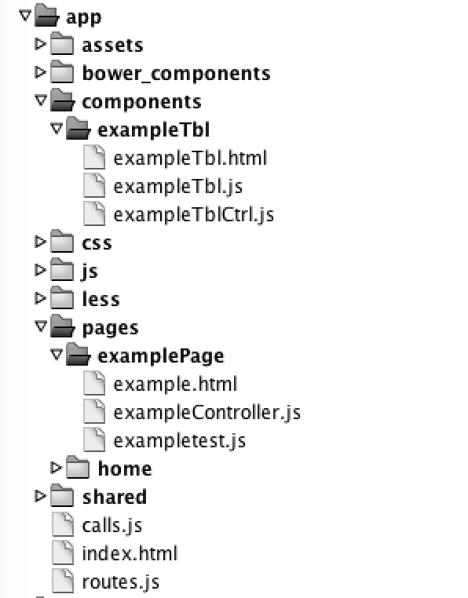
Make names obvious and explicit.
establish consistent patterns
content-based names are findable
if a component lives in a particular page, use a shared name
if a component lives anywhere, name the component for its use
avoid global prefixes
suffix/prefix indicates type
Remember, page names will probably be visible to users at some point. Stick to simple, purpose-driven, memorable titles.
5

Slide 7
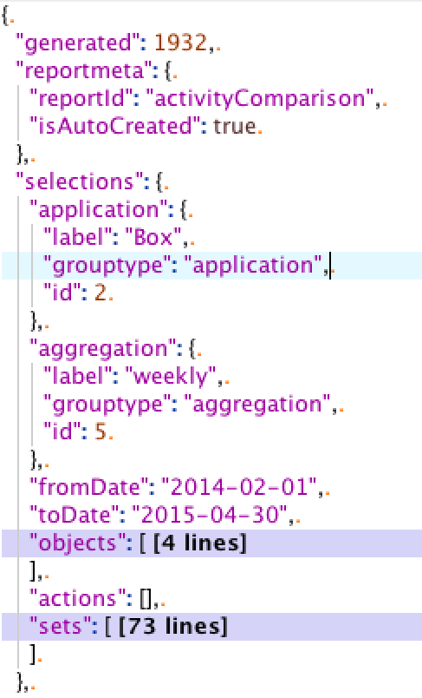
UI → HTML → JSON
Start with defined UI components
Create HTML for each component
Insert {{data}} placeholders
Combine parallel components into single call
Compile into JSON contracts
Create calls to retrieve JSON
→
5

Slide 8
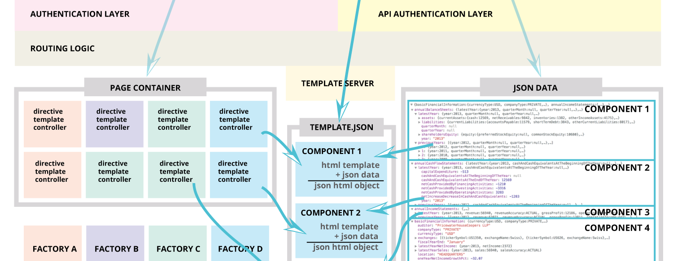
Modularize all the things.
5

Slide 9
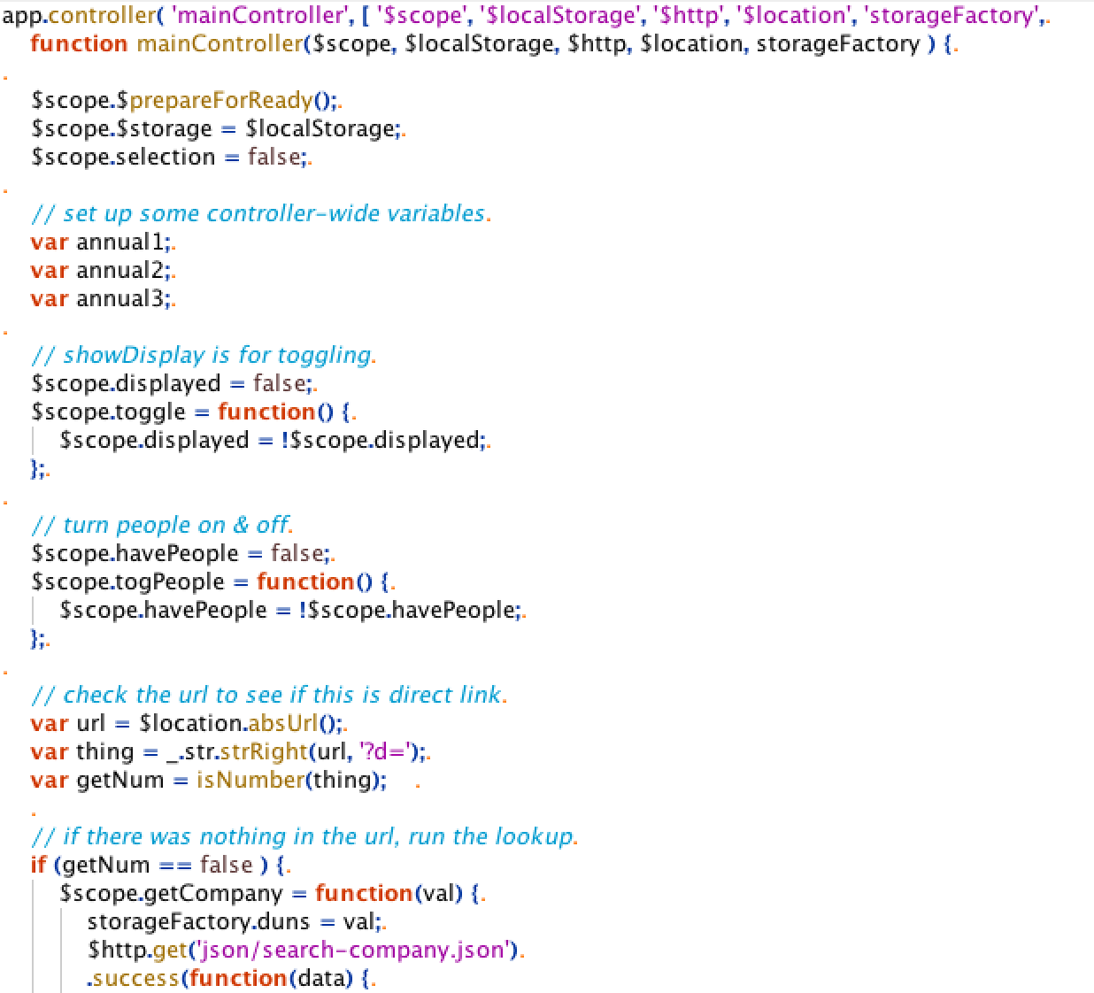
Code is a story.
type of story (genre)
list important characters
add some narration
call out the side quests
signal start of main quest
conflict and resolution

Slide 10
Laser focus = one thing, one purpose.
app.directive('boxDirective' ,
function boxDirective(){
return {
templateUrl: "components/box/dir-box.html",
link: function(scope, attrs) {
scope.boxdata = attrs.data;
}
}
});
Single purpose:
easier to maintain
simpler to unit-test
keeps concerns separate
Test-driven development helps with creating laser-focused code.
5

Slide 11
Thank you

Slide 12


