Slide 1
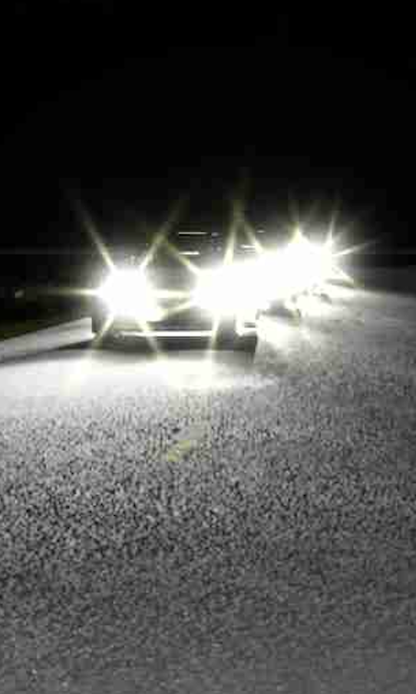
Headlight Glare in DeepSight's Closed Loop
How glared camera images reach the model while it drives
Internal technical overview · Khizer Naeem · October 2026
Notes:
You've all seen how we draw the glare. Today is about where it goes: how a glared image ends up in front of DeepSight while it's driving in CARLA, how we checked it, and what we run next. The picture on the right is a real frame DeepSight would read in our test run. For a 15-minute slot, spend most of the time on slides 3 to 7.

Slide 2
The Overall Idea
550 of 900
We never touch the model.
We change the photos it saves, and it reads those photos back.
steps had glare in the model’s front-camera input
0
frames reached the model without their glare
2
Notes:
This is the whole trick. DeepSight doesn't pass camera images straight to the model; it saves them to disk as JPEGs and then loads those files. We add glare one step before the save, so everything after that uses our version. The numbers are from our own Town07 night test: 900 steps, glare on 550 of them, never a missed frame, and every frame without glare came out byte-for-byte identical to the clean run.

Slide 3
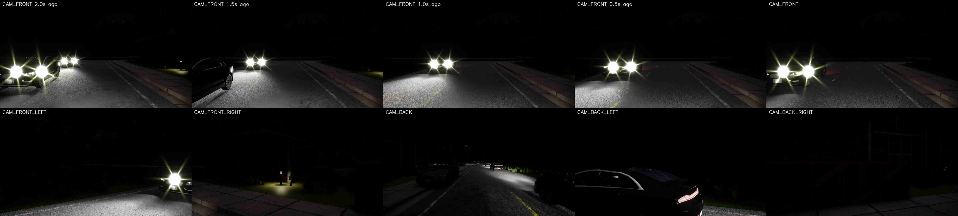
What DeepSight looks at, every 0.1 s
Top row
Front camera 2.0, 1.5, 1.0 and 0.5 s ago, and now
Bottom row
The other five cameras, now
Plus text
Route points ahead, recent path, speed, acceleration
Answer
Four points over the next 2 s; a controller steers to them
3
Notes:
DeepSight is Qwen2.5-VL, a vision-language model fine-tuned for driving. It doesn't get a video stream. Every tick it gets exactly these 10 pictures, resized to 644 by 364, plus a short text with route points, its recent path, speed and acceleration. Point at the top row: these five are all the front camera, just at different moments. It answers with four points half a second apart, and a simple controller steers toward them.

Slide 4
One tick, start to finish
Seg + depth cameras
CARLA tick
10 Hz, 6 cameras
Leaderboard
collects sensors
Glare added
3 front cameras
Saved to disk
JPEG quality 20
car moves; next tick
files
Control
steer, throttle, brake
Waypoints
4 points over 2 s
Qwen2.5-VL
reads 10 photos
10 photos picked
plus prompt text
Only the amber step is ours. Everything else is DeepSight’s own code, unchanged.
4
Notes:
Walk it once, left to right on the top row, then right to left on the bottom. CARLA renders the six cameras; the leaderboard hands them to DeepSight. Our step adds glare to the three front pictures, using extra segmentation and depth cameras so glare only sits on headlights the camera can actually see. DeepSight saves the photos, picks 10 of them, asks the model, and a controller moves the car. The next tick sees the new position. That arrow on the left is what makes it closed loop.

Slide 5
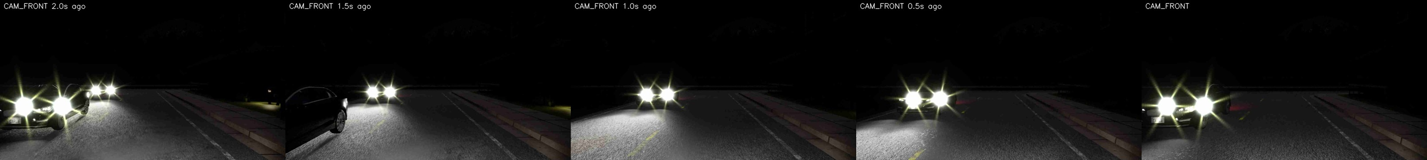
Glare is in its memory too
2.0 s ago
1.5 s ago
1.0 s ago
0.5 s ago
now
1
2
3
The history photos are old files
DeepSight’s memory is the front-camera JPEGs it saved 5, 10, 15 and 20 ticks ago.
Those files were glared when saved
So the model sees glare now and across the last 2 seconds.
Nothing extra was needed
One hook before the save covers both the present and the past.
6
Notes:
A nice side effect: we didn't do anything extra for the history. DeepSight's memory is just the old files on disk, and those were glared when they were saved. So an oncoming car's glare shows up across the whole top row, the way it would build up for a real driver over two seconds.

Slide 6
Current stand-in vs. the real DeepSight
What | Stand-in vs. DeepSight
Cameras, slicing, file names | Identical
JPEG quality 20, 10-photo input | Identical
History rule, 10 Hz | Identical
Resize to 644 × 364 | Close
Prompt text | Not built
Model and driving | None; Traffic Manager drives
Why a stand-in
No GPU needed, and the car takes the same path at every glare level.
Limits
Needs the simulator’s ground truth, so not usable on real video.
Saves images and speed only, so runs cannot be replayed through the model later.
8
Notes:
The stand-in is not an alternative to DeepSight; it's a copy of DeepSight's input path, checked line by line against its Bench2Drive agent, with the model removed. Everything about how images are saved and picked is identical. What it leaves out is the prompt text, the model and the driving. On the real Bench2Drive runs, DeepSight itself does all of that and saves its full prompt every step, so those runs can be replayed later.

Slide 7
Which cars glare
A car must pass these requirements
On Bench2Drive night routes
1
Four or more wheels, headlights on
Background traffic
Yes
2
Facing the camera
Oncoming scenario traffic
Yes
Trucks, vans, buses
Yes
3
In frame and within 70 m
Bikes, motorcycles
No
4
No objects in between headlight and ego camera
Anything on a day route
No
53 of the 220 routes are at night
9
Notes:
The gate is why we need segmentation and depth: a car hidden behind a truck fails check four because its pixels aren't at its own depth, so it gets no glare. On Bench2Drive, traffic managed by CARLA's Traffic Manager switches its headlights on at night, so it glares. Scenario cars set to sirens, hazards or parking lights only don't. Only the 53 night routes will show any glare at all.

Slide 8
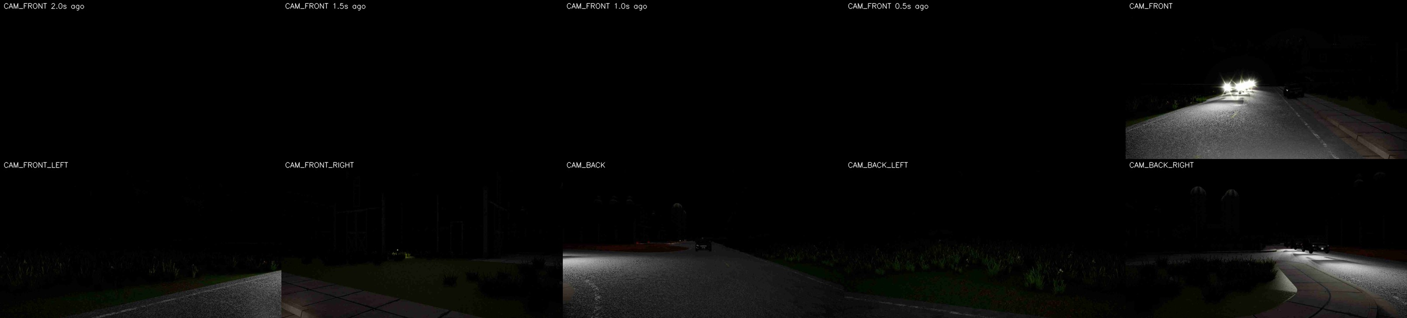
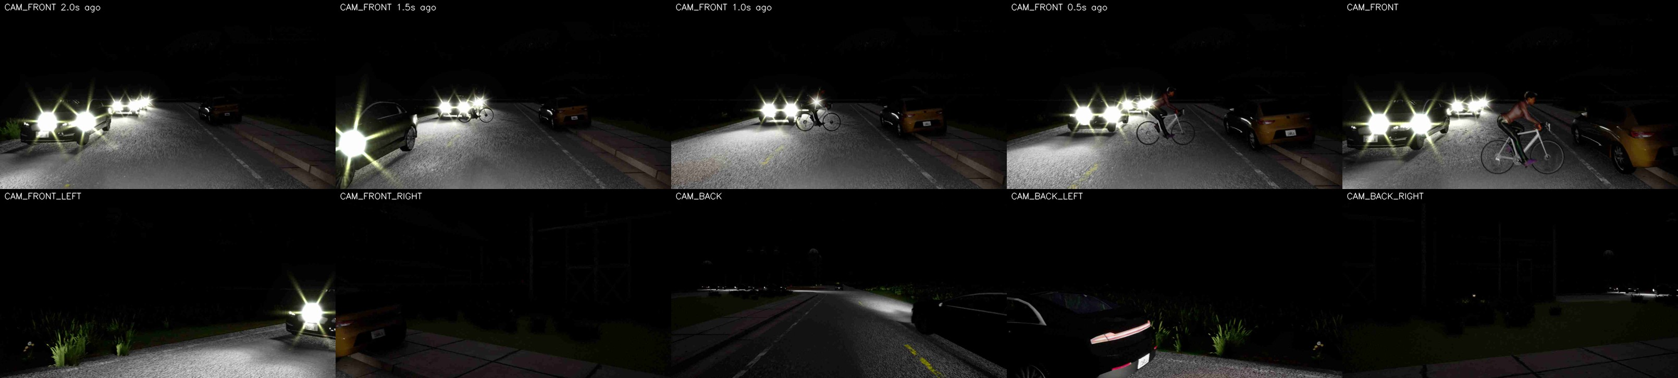
Different Results
11
Notes:
Each phase gates the next. Phase 1 is a rerun of our own test at 10 Hz, now matching DeepSight's leaderboard. Phase 2 runs the real DeepSight with glare on one night route. Phase 3 is the full sweep. No dates yet: Phase 2 depends on getting a DeepSight checkpoint. If anyone has one or spare GPU time, talk to me.

