Slide 1

Course 3 BW Actors
Alpinist

Slide 2

Agenda
WELCOME
DB Actors
Fabric Actors
JavaScript
Stage Condition
Strings
Dates
Collections
Parse & Stringify
Inner Flows
PubSub
Files
System
HTTP

Slide 3

BW – DB Actors
Broadway has a category of DB Actors that are useful for performing DB commands and actions like creating a new table, loading data or fetching it and executing other DB commands
DbLoad - Loads data into a database using an INSERT, UPDATE or UPSERT command. Batch Mode: When the batch input argument is set to true, the Actor accumulates statements and executes them as a batch to improve performance. It must run within a transaction, and any errors are reported upon committing the batch. The default batch size is 1,000 statements.

Slide 4
BW – DB Actors
DbCommand - Performs database commands on a DB interface. It has two extensions:
DbFetchField - Returns the first field of the first row
DbFetchFirstRow - Returns the first row
Parameters and Non-Prepared Statements Support:
?/${0} - for ordered parameters.
${param_value} - for named parameters.
${@param} - for non-prepared statement parameters.
For example: Select * From ${@table} where ${@column} = ${case_sts}

Slide 5
BW – DB Actors
DbCreateTable - Creates a new database table.
DbDelete - Deletes data from a database using DELETE based on keys
Db Actors Best practice:
Utilize the DBLoad Actor, as it has a built-in functionality of running INSERT, UPDATE or UPSERT commands (e.g. instead of DBCommand ).
Batch capabilities
IngloreNull
When selecting one value, take the following into consideration:
When selecting one row, use the DbFetchFirstRow Actor instead of the DbCommand Actor.
When selecting one value, use the DbFetchField Actor instead of the DbCommand Actor.

Slide 6
BW – Fabric Actors
Broadway has a category of fabric actors that are useful to execute the Fabric commands.
FabricGet - Performs the GET command on the current Fabric session. The FabricGet Actor supports fetching multiple instances from different LUs and enables setting parallel and stop_on_error arguments.
FabricDelete – Delete an instance from Fabric
FabricSet - Sets a global value on the Fabric session.
FabricSetRead – Read a global value from the session.

Slide 7
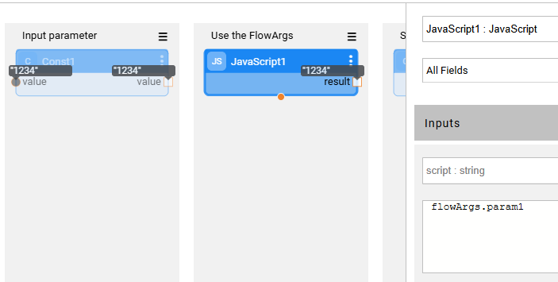

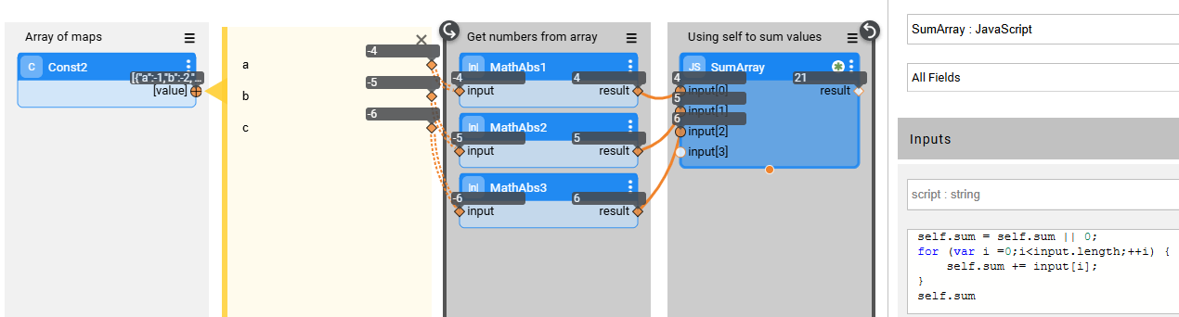
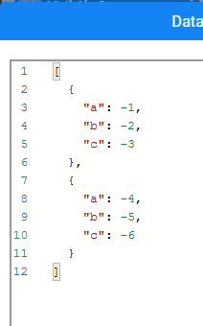
JavaScript
FlowArgs
The FlowArgs can be accessed by any JavaScript Actor, using FlowArgs.ExternalName
Self
The 'self' keyword provide access to the Actor state. It is kept between executions of the same actor

Slide 8
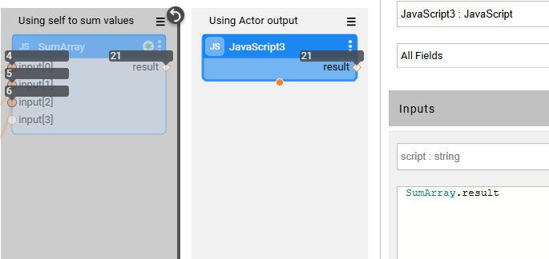
JavaScript
Actor’s output
Actor’s output can be referenced by JavaScript code

Slide 9
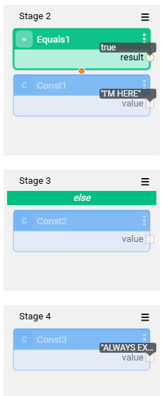
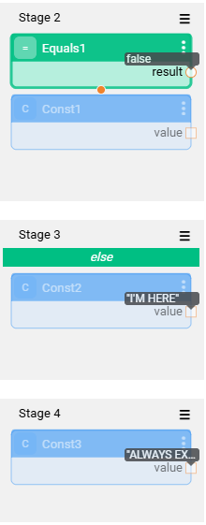
Control Flows: Stage Conditions
The Stage Condition splits the flow execution based on a condition
If a Stage condition is true, the actors in the stage will be executed
If a Stage condition is false, the ELSE stage actors will be executed
Stages without Stage Conditions are always executed and don't affect Stages with Conditions.
Fabric does not support two ‘ELSE’ stages on the same stage (do not split 1 stage to multiple if-else conditions)
Example 1: If is true
Example 1: If is false
Notes:
Orchestrate execution logic using powerful, visual actors

Slide 10
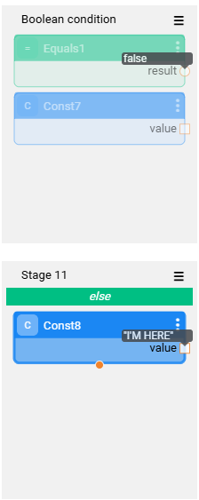
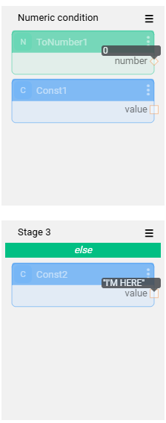
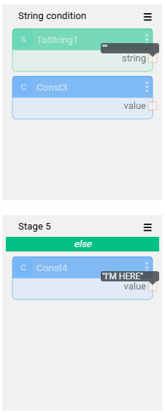
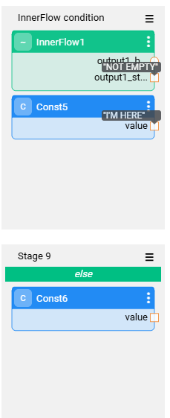
Control Flows: Conditions Actors
Any actor can be a Stage Condition actor – the first output parameter is automatically checked for True/False. The output parameter doesn’t have to be a Boolean. The Broadway will automatically cast its type to Boolean.
Empty string =false. Non-empty string = true
Inner flow: depends on the first output parameter
Boolean condition
0=false, != 0: True
Note:
The first Stage in the flow (root) cannot be split.

Slide 11
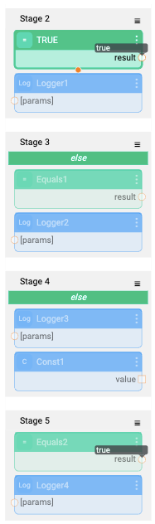
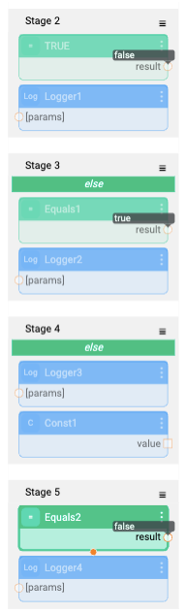
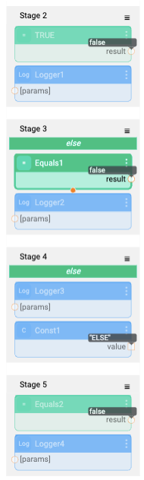
Control Flows: ElseIf Stage Condition (v8.0+)
ElseIf condition works when multiple Stages exists at the same level.
ElseIf logic is defined by adding Stage Condition and marking the same stage as else.
Notes:
Orchestrate execution logic using powerful, visual actors

Slide 12
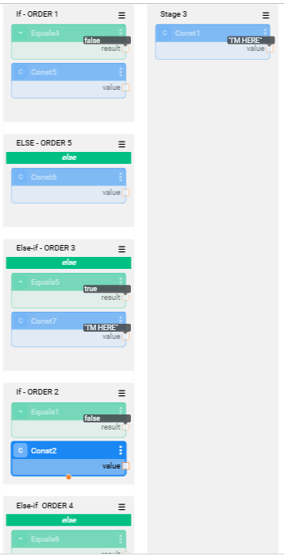
Control Flows: ElseIf Stage Condition (v8.0+)
The condition evaluation order (top to bottom):
Stage with a condition only (no else)
Stage with else and condition
Else stage ( default fallback)
Notes:
Orchestrate execution logic using powerful, visual actors

Slide 13
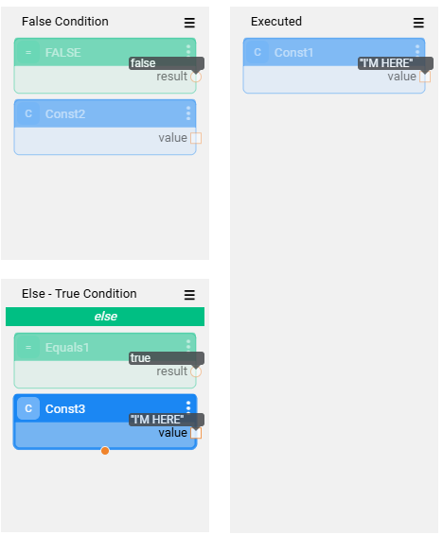
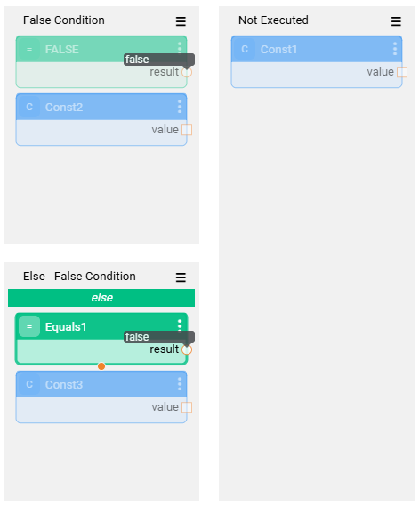
Control Flows: Merged Stage
A merged Stage acts like a joining point after a Stage Condition splits a flow
A merged Stage runs only after all its parent Stages are executed.
If none of the parent branches executed (e.g., all Stage conditions are false), the merged Stage will not execute.
Condition met – continue with the flow
No condition met – break from the flow
Notes:
Orchestrate execution logic using powerful, visual actors

Slide 14
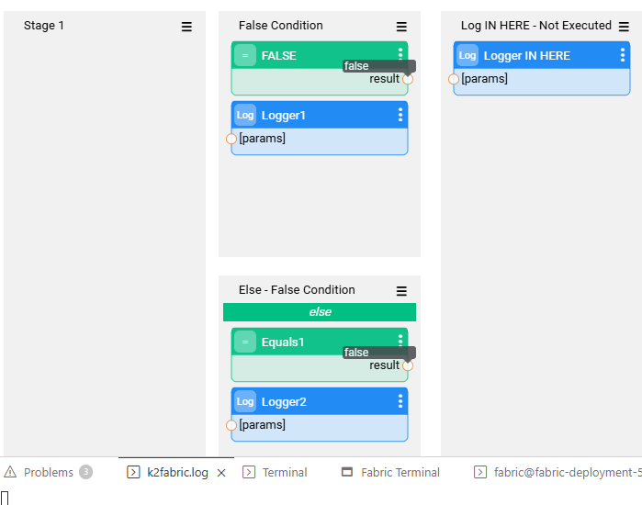
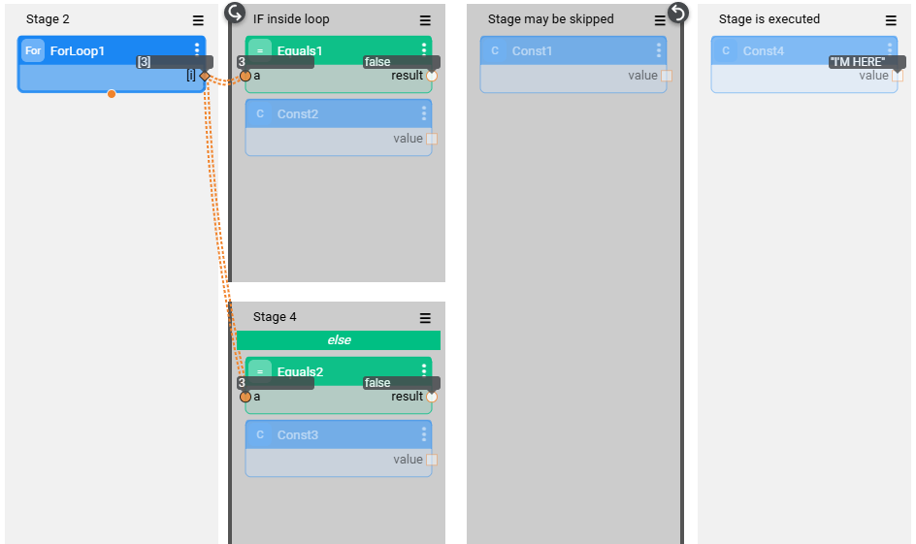
Control Flows: Merged Stage - "Break" Behavior
If none of the parent branches executed (e.g., all Stage conditions are false), the merged Stage is not executed and the flow will stop.
If the Merged Stage is inside a loop – only the loop is skipped
Notes:
Orchestrate execution logic using powerful, visual actors

Slide 15
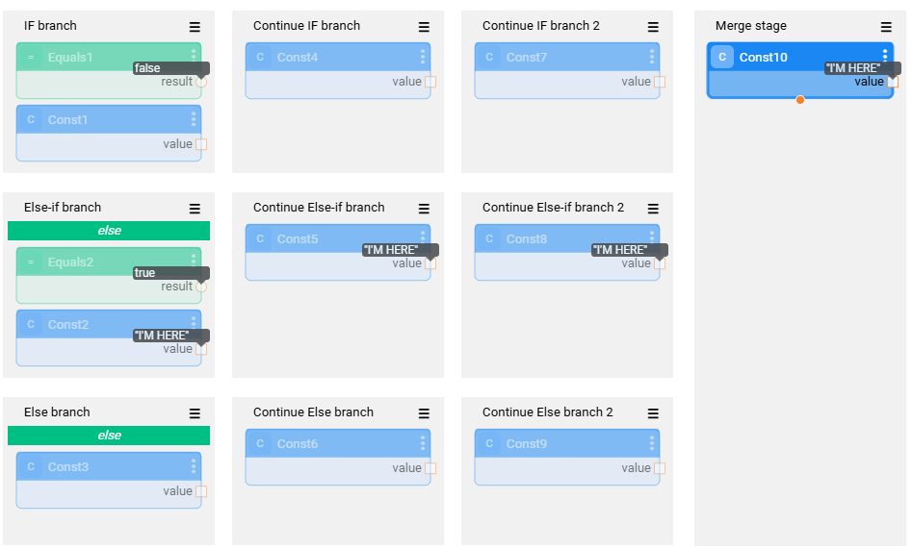
Control Flows: Condition Branch
Split stages appear after the IF stage acts as a "branch" of the IF statement. Only the branch with the met condition will be executed.
Notes:
Orchestrate execution logic using powerful, visual actors

Slide 16
Control Flows: Loops and Iterations
Flow Types
Key Benefits
Iterations (ForEach Style)
Repeats logic over a real data set
Similar to for-each loops
Stops when no more records remain
ForLoop Actor
Loops N times over a virtual data set
Based on a range of integers
While Actor
Executes as long as a condition is true
Doesn’t require a data set.
ForEach Actor
Traverses each value in a collection or stream
Invokes JavaScript and/or Broadway flow for each item
Acts as a stream termination point
Dynamic – Logic adapts in real-time to input data and conditions
Scalable – Efficiently process large sets, even with nested flows
Visual – intuitive design and debugging.

Slide 17
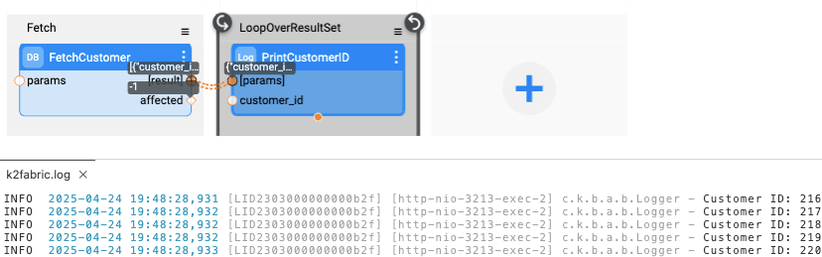
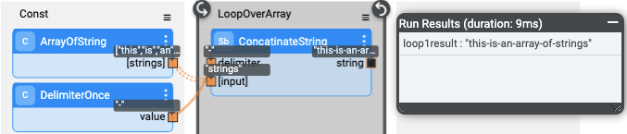
Iterations
What are Iterations for?
Automate repetitive logic over data sets using iteration actors
Runs logic until all data has been processed
Example: Iterate over Database result set, API/HTTP response, Kafka message stream

Slide 18
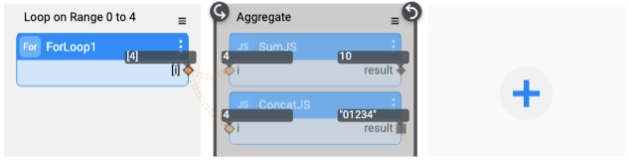
ForLoop
What is a ForLoop?
Repeat logic a fixed number of times over a synthetic range, without relying on a data set, running logic once per generated number.
Each run receives its iteration number as input.
Ideal for fixed-count logic and retries, but can be used with dynamic start/end numbers.

Slide 19
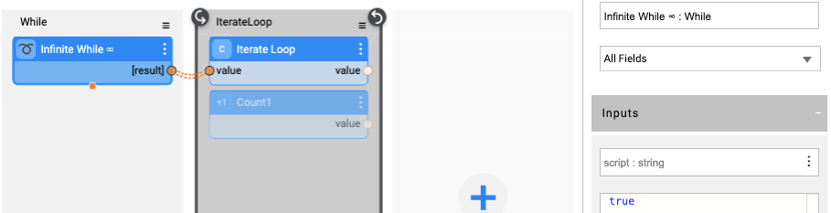
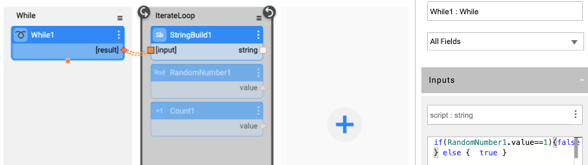
While
What is a While loop?
Repeat actions based on dynamic conditions—powered by JavaScript.
Executes as long as the JavaScript script returns a truthy value. Ends once the script returns a false value
Ideal for creating logical loops based on conditions: poll until a status changes, retry until success, etc.

Slide 20
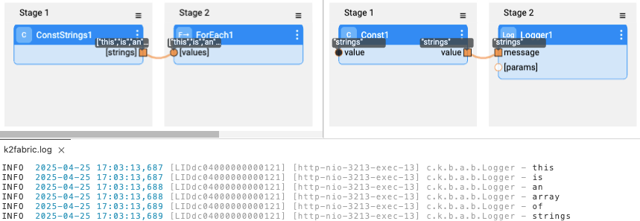
ForEach
What is a ForEach?
Iterate over values in a collection and apply custom logic per entry.
Each value is passed to logic as the 'value' parameter.
Parallel execution is available for faster processing of a large dataset (multithreading doesn’t preserve the collection order during execution).
Ideal for triggering downstream logic for each data item.

Slide 21
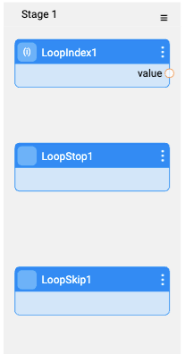
Controlling Loop Behaviour
LoopIndex Actor
Returns the current iteration index.
The index starts at 0.
Useful for logic based on the position within the loop.
LoopStop Actor
Stops the current loop immediately.
Continues flow execution after the loop section/iterate close.
Useful for early exits based on a condition.
LoopSkip Actor
Skips the current iteration
Moves directly to the next iteration in the loop
Helpful in ignoring certain steps of the loop conditionally

Slide 22
String Operations
Broadway provides a wide set of string manipulations utilities.
Key functions include:
Transformation (Case changes, Trimming, Padding)
Aggregation & Formatting
Pattern Matching & Substituion
Conversion & Randomization

Slide 23
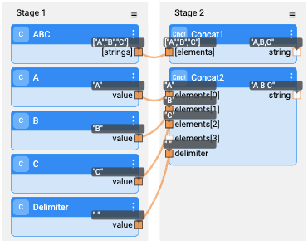
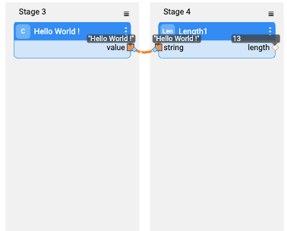
Concatenation and Length
Concat
Joins an array of strings using a specified delimiter.
Example: [‘A’,’B’,’C’] with delimiter , -> A,B,C.
Length
Returns the character count of the input string.
Example: “Hello” -> 5.

Slide 24
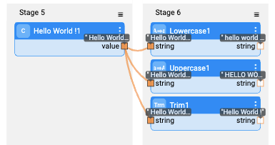
Case Conversion & Trimming
LowerCase
Converts all characters to lowercase.
UpperCase
Converts all characters to uppercase.
Trim
Removed whitespace from both ends of the string.

Slide 25
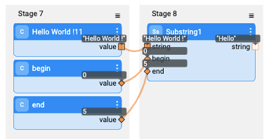
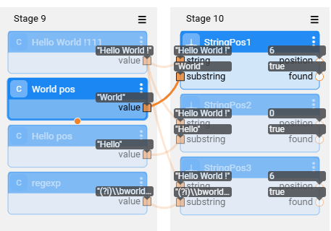
Substring Operations
Substring
Retrieves a segment of the input string based on a given start index and an optional end index.
If the end index is 0 or beyond the length of the string, it is automatically disregarded
StringPos
Returns the 0-based index of a substring within the input string. The search is case-sensitive.
If the substring is found, the index is returned and the found flag is set to true; otherwise, -1 is returned and found is false.
Supports a fromPosition parameter to define the starting point of the search; negative values initiate a reverse search from the end of the string.
The substring can be interpreted as a regular expression by enabling the regex input flag.

Slide 26
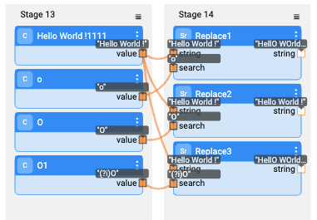
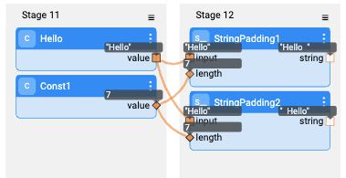
Padding and Replacement
String Padding
Extends the input string to a specified length using a provided padding character or string
Input: The original string to be padded.
Length: The desired total length of the final string
Padding: The character or string used to fill in the extra space
rightPadding: If set to true, padding is applied to the right; otherwise, it is added to the left.
Replace
Substitutes every instance of a specified substring within the input string with a replacement value (the search is case-sensitive).
String: The original string to modify.
Search : The substring or pattern to look for.
Replace: The value that will replace each occurrence of the pattern
Regex: Indicates whether the search pattern should be treated as a regular expression

Slide 27
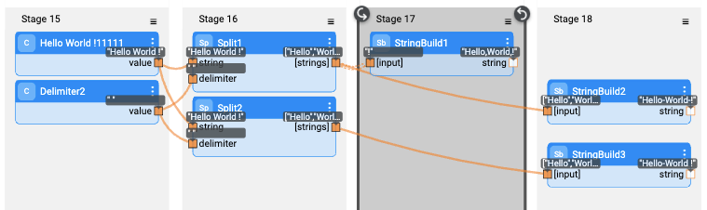
Split and StringBuild
Split
Breaks the input string into an array of substrings using the specified delimiter.
String: The string to be split.
Delimiter: The character or pattern used to divide the string
Regex flag: Specifies whether the delimiter should be interpreted as a regular expression.
Limit: The maximum number of elements in the resulting array. The final element will include any remaining content if the limit is reached. Use 0 for no limit
StringBuild
Aggregates strings across multiple loop iterations, joining them with a specified delimiter.
Input: The string(s) to append to the cumulative result during each execution.
Delimiter: The separator inserted between each string segment.
Limit=2

Slide 28
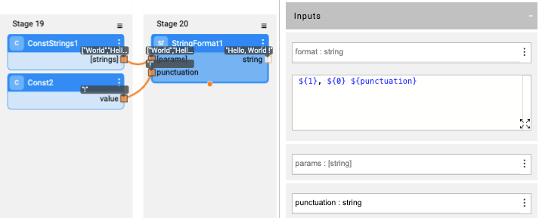
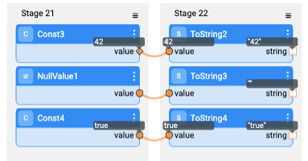
StringFormat and ToString
StringFormat
Enables dynamic string formatting using the ${} placeholder syntax.
Indexed placeholders: Use ${0}, ${1}, etc., to reference values by position
Named placeholders: Use ${name} to reference values by argument name
ToString
Transforms any input value into its string representation according to Broadway’s conversion rules.

Slide 29
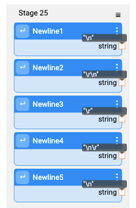
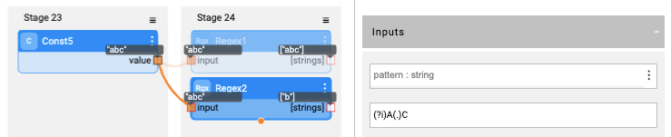
RegEx and NewLine
RegEx
Searches for substrings within the input using regular expression patterns..
Supports capturing groups for more precise matching.
NewLine
Returns the appropriate newline character(s) based on the selected mode:
LF -> n (Unix\Linux)
CR LF -> \r\n (Windows)
CR -> \r
LF CR -> \n\r
System Default - > Automatically uses the newline style of the operating system Broadway is running on

Slide 30
Date Utilities
Broadway flexible handling of date and time in your flows.
Perform date arithmetic (add/subtract)
Break down or build date objects
Calculate durations between dates
Access the current timestamp with ease
Use these utilities to manipulate, format, and analyze time-based data efficiently across your implementation

Slide 31
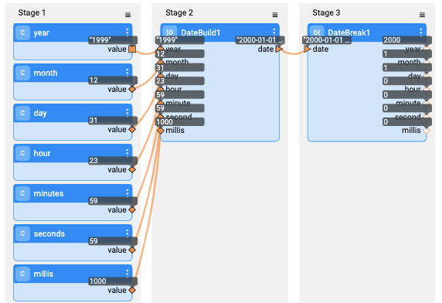
Date Construction & Decomposition
DateBuild
Assemble a date from components.
Inputs:
Year, Month, Day
Hour, Minute, Second, Millisecond
Time zone (default: UTC or ‘Local’)
Output: A complete Date object representing the specified time
Date Break
Decompose a date into its individual components.
Input: Date and Time zone (default: UTC or ‘Local’)
Outputs:
Year, Month, Day
Hour, Minute, Second, Millisecond.

Slide 32
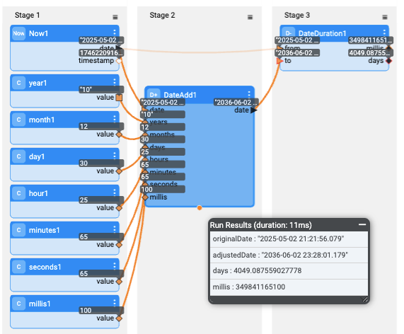
Current Date, Date Arithmetic & Duration
Now
Retrieve the current date and time.
Output:
A date object representing the current moment
Timestamp in milliseconds since 1970-01-01 00:00:00 UT
DateAdd
Perform arithmetic operations on a base date:
Add/Subtract Years, Months, Days, Hours, Minutes, Seconds, Milliseconds
Output: Adjusted date
Date Duration
Calculate the duration between two dates:
Inputs: From Date, To Date
Output:
Milliseconds (can be negative if reversed)
Real number of Days (includes fraction)

Slide 33
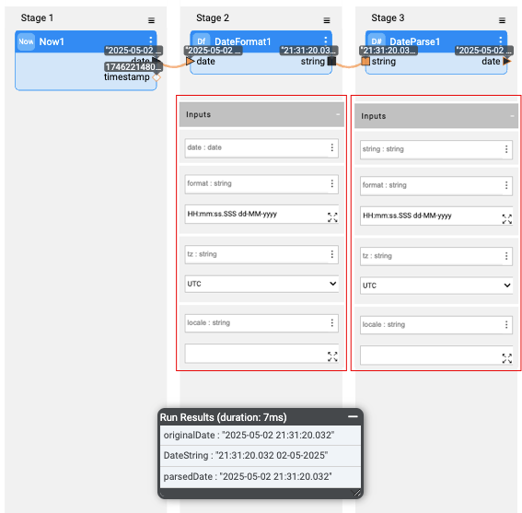
Date Formatting & Parsing
DateFromat
Transform a date into a string using a specified format
Inputs
Date, Format Pattern, Timezone (default: UTC), Locale (e.g., en, fr)
Examples:
yyyy = Year, MM = Month, dd = Day
HH:mm:ss = Time, Z = Timezone Offset
Output:
A formatted date string.
DateParse
Convert a formatted date string back into a date object
Inputs
Date, Format Pattern, Timezone (default: UTC), Locale (e.g., en, fr)
Examples:
yyyy = Year, MM = Month, dd = Day
HH:mm:ss = Time, Z = Timezone Offset
Output:
A Date object representing the parsed time.

Slide 34
Collections – Maps & Arrays

Slide 35
Maps
What is a Map?
Map is a data structure that stores key-value pairs. It allows you to associate a specific key with a value and retrieve the value later using that key.
Map Types supported by the Map Actors
LinkedHashMap uses the hash value of the keys to index the map. The fields are sorted by the order of insertion.
HashMap uses the hash value of the keys to index the map. The fields are sorted by the key's hash value.
TreeMap uses a tree structure to index the map. The fields are sorted by the key's natural order.
TreeMapIgnoreCase uses a tree structure to index the map. Strings that are equal under the same case are treated as the same key. Fields are sorted by the key's natural order, ignoring its case.

Slide 36
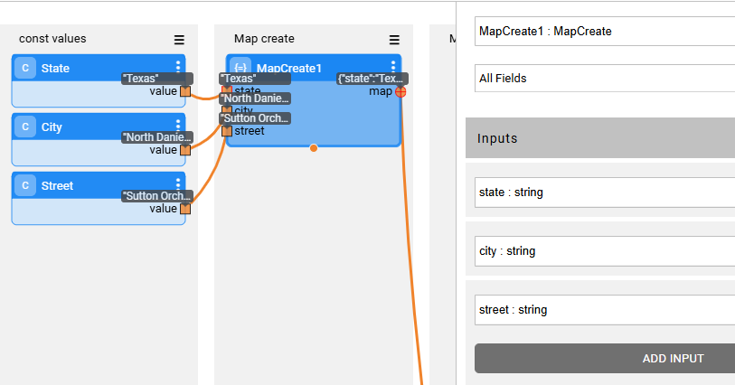
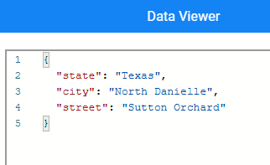
Maps
MapCreate Actor Return a map containing all input arguments. The keys are the names of the input arguments.

Slide 37
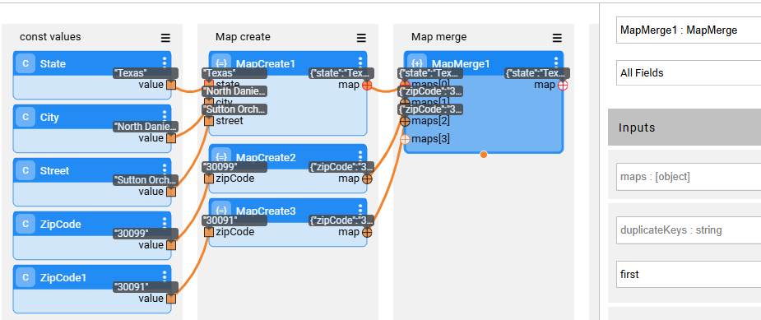
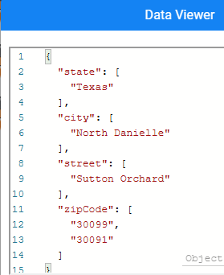
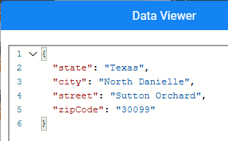
Maps
MapMerge Actor
Merge a list of maps into a single map
duplicate keys : determines how duplicate keys are treated.
last - the last value supplied to the key is kept.
first - the first value value supplied for each is kept.
all - All values for each key are kept. In this case each key will point at a list of values, even if only one value is supplied.
allUnique - All unique values for each key are kept. In this case each key will point at a set of values, even if only one value is supplied.
duplicate keys = All
duplicate keys = First

Slide 38
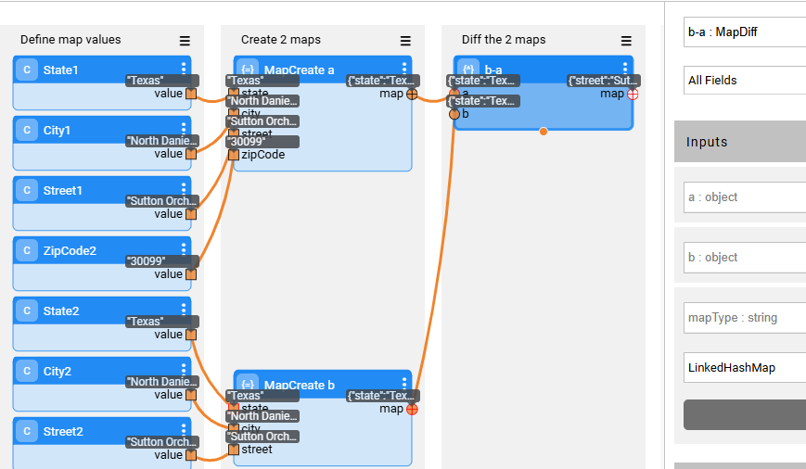
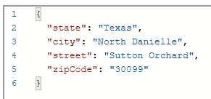

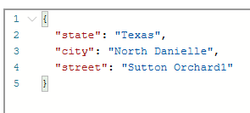
Maps
MapDiff Actor
Given 2 maps - a & b, the actor returns a new map with items in b that are not the same as a (b-a)
Map a
Diff result ( b – a )
Map b

Slide 39
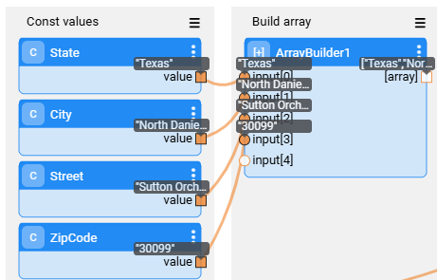

Arrays
ArrayBuild Actor
Joins all inputs into an array.
The array is aggregated in memory across multiple iterations.
Result

Slide 40


Arrays
ConstStrings Actor
Create an Array of Strings
Result

Slide 41




Arrays
ArrayConcat Actor
Flatten all input arrays into a single array.
The ArrayConcat Actor is useful for combining multiple arrays or streams into one, without the need to copy the data into memory, making it efficient for handling large datasets or real-time streams.
Result

Slide 42



Arrays
ArrayGrouper Actor
Gets an array and splits it into an array of arrays based on the size parameter.
This done by traversing the original array without copying its content into memory
Input
Output

Slide 43



Arrays
ArrayToMap Actor
Create a map from values arrays and key list
Input
Output

Slide 44



Collection Data Manipulation
Mapper
Transform values in a collection using JavaScript and/or Broadway flow logic.
The Actor maps the data on the fly and does not load the entire data set to memory.
threadCount parameter: the number of threads to execute the logic. If multiple threads are used, the order of the collection is not maintained.
Example 1: Using JavaScript, return single value

Slide 45


Collection Data Manipulation
Mapper
Example 2: Using JavaScript, return multiple values, using “value” as the last line in the script.

Slide 46




Collection Data Manipulation
Mapper
Example 3: Using InnerFlow. The external name for both the input and output of the Inner Flow must be “value”.
bwMapperInnerFlow: Inner flow return map of values. External parameter named “value”

Slide 47


Collection Data Manipulation
Filter
Filter a collection of values based on JavaScript or Flow and return the filtered list..
The Actor maps the data on the fly and does not load the entire data set to memory.
threadCount parameter: the number of threads to execute the logic. If multiple threads are used, the order of the collection is not maintained.
Example 1: Using JavaScript

Slide 48




Collection Data Manipulation
Filter
Example 2: Using InnerFlow. The external name for both the input and output of the Inner Flow must be “value”.
bwFilterInnerFlow: Inner flow return map of values if condition met. External parameter named “value”

Slide 49


Collection Data Manipulation
Peek
Same functionality as Mapper, without the need to return the “value” from the js/innerFlow. Useful if you want to act on the value or make changes on complex objects without the need to return the value for the next stage.

Slide 50


Collection Data Manipulation
Sort
Sort an input collection. Unless a specific sort has been requested, the actor will try to sort according to the type.
JavaScript parameter: compares o1 to o2. The return value should be an integer:
If the return value (last line) of the snippet is a positive integer, it means o1 is bigger.
A negative integer value means o2 is bigger.
0 means o1 is equal to o2.

Slide 51
Parser & Stringify

Slide 52


Json Parsing & Stringifying
JsonParser
Analyzing an input stream and outputting the JSON objects found in the stream.
Inputs:
[stream], an input stream represented by an iterable collection of blobs or strings. The parser will keep running until the end of the stream is detected
Single: if only a single object is expected in the input stream. In this case, the result will be a single object as opposed to an array.
Output:
object: a collection of parsed objects or a single object in case single is set to true

Slide 53


Json Parsing & Stringifying
JsonStringify
Transform Json object into a string format
Inputs
object: Json object
nice: Boolean, If true, will add new lines and indentations to make the JSON output more readable
Output: string: The stringified JSON
YamlStringify
Transform Yaml object into a string format
Inputs
object: Yaml object
nice: Boolean, If true, will add new lines and indentations to make the Yaml output more readable
Output: string: The stringified YAML

Slide 54




Yaml Parsing & Stringifying
YamlParser
Transform a string of Yaml format into unfoldable Yaml object.
Same input and output as JsonParser
XmlParser
Analyzing an input stream and outputting the objects found in the stream.
Inputs:
[stream]: An input stream represented by an iterable collection of blobs or strings. The parser will keep running until the end of the stream is detected
single (boolean): Expect only a single XML object in the input stream. In this case, the result will be a single object as opposed to an array.
skipRoot (boolean): In case true the actor will skip root element and will return stream of nested elements.
valueField: The key given to the XML element value field, used for mapping in output object. If empty, the valueField will not be created and the tag value/text will be created directly within the parent. Some XML structures cannot be successfully parsed without this level (when the XML has both attributes + a value in the same element)
attributesField: The key give to the XML element attributes field, used for mapping in output object. If empty, the attributesField will not be created and the attributes will be created directly within the parent.
namespaces (boolean): Determines if namespace information is added to the object
Output:
object: Return a collection of parsed objects or a single object in case single is set to true
info: An object containing additional information. XML document header and/or skipped root element information where applicable

Slide 55


XML Parsing & Stringifying
XmlStringify
Converts given map to XML document, it supports nested maps and arrays.
Inputs:
object: Any map contains any values, nested maps, arrays. XML element attribute should be in the format: {'TAG_NAME#ATTRIBUTE_NAME' : 'VALUE’}. The given map should contain only one root entity.
nice (bool): If true, will add new lines and indentations to make the XML output more readable
xmlDeclaration (bool): If true, will add XML declaration to the output string
valueField: The name of the key that contains the element value.
attributesField: The name of the key that contains the attributes values.
Output:
xmlString: The stringified XML.

Slide 56

CSV Parsing & Builder
CsvParser
A CSV parser, analyzing a CSV input stream and outputting an object for each row. If a header line is available, the labels in the header are used to mark the row object. If not, the labels will the order of the column starting at ‘0’
Inputs:
[stream]: An input stream represented by an iterable collection of blobs or strings. The parser will keep running until the end of the stream is detected
header (boolean): Select if a header row is to be expected. The header will be used to name the fields in the output object
delimiter: The column delimiter
quote: The quote character used to surround column values that contain a delimiter
escape: The escape character, used to escape quote characters in the column value
keepSpaces (boolean): If set to true, the parser will not trim the fields and keep their surrounding spaces
nullValue: A value that will be treated as null
Output: object: Return a collection of parsed objects.

Slide 57


CSV Parsing & Builder
CsvBuilder
Build a csv string from map or sequence of maps
Inputs:
maps: The input maps or a single map for a single row
stream(bool): Determine if the return value is a stream of strings or a single string. Non-streaming mode returns a String with the entire CSV and is best used within a loop so as not to consume too much memory. Streaming mode returns a stream of strings that is backed by the input stream of maps. For backward compatibility reasons the default is false.
header (bool): Determinate if the headers row should be added
columns: Columns names
escape_char: Escaping char that will be used to escape special characters (only if quote_char was not defined)
quote_char: Quote char that will be used to enclose fields that contains special characters
delimiter: The column delimiter
recordDelimiter: The record delimiter. The default is newline (\n).
Example:
maps: [{"customerId":"CUST123456","firstName":"John","lastName":"Doe","email":"john.doe@example.com","phone":"+1-555-123-4567","street":"123 Maple Street","city":"Springfield","state":"IL","postalCode":"62704","country":"USA","dateOfBirth":"1985-07-15","registeredAt":"2023-03-22T10:45:00Z","isActive":"true","loyaltyPoints":"240","newsletterSubscribed":"true","preferredLanguage":"en","contactMethod":"email"}]
stream: false, header: true, columns: , quote_char, delimiter: “,” , record_delimiter:
Output:
csv: the csv result.

Slide 58

Inner Flows
Broadway provides the ability to call one flow from another flow, enabling reuse of logic across multiple flows or stages. This is achieved with the following built-in Inner Flow Actors:
InnerFlow Executes a specific Broadway flow. Input and output parameters map directly to the inner flow.
InnerFlowDynamic A flexible version of InnerFlow, where the flow name and input arguments are provided dynamically at runtime. Returns a map of the inner flow’s outputs.
InnerFlowAsync Runs a flow asynchronously in a thread pool. The main flow continues immediately and the results from the inner flow will be available only when its completed
InnerFlowSession Runs a flow asynchronously, either locally (default) or on a random node.
Notes:
Need to add slide for the outputs of InnerFlowAsync

Slide 59
InnerFlowAsync
Executes a sub-flow asynchronously in a separate thread using a thread pool.
Threads:
The number of threads is set according to the available CPUs and can be overridden using the threadCount parameter.
If no threads are available, the flow will wait on this Actor for the thread to become available.
Async:
When called, the actor will return immediately once a working thread becomes available.
You can use the InnerFlowJoin component, to wait for all threads to complete.
When the flow completes, it will wait for all threads to complete.
Input/output parameters:
Actor's Input arguments reflects the External input parameters defined in the inner flow
All inner flows' output (non-empty one) is aggregated into [result] array. The [result] will be populated when all executions are finalized
Errors encountered will be counted and written to the log file.
Notes:
Need to add slide for the outputs of InnerFlowAsync

Slide 60



InnerFlowAsync - output
The [result] output of an InnerFlowAsync Actor remains empty until its threads finish execution
Note: The main flow does not complete until all asynchronous threads have finished.
Call the Inner Flow
Notes:
Need to add slide for the outputs of InnerFlowAsync

Slide 61


InnerFlowJoin
Used to synchronize after asynchronous execution
Waits for all threads (flows) triggered by InnerFlowAsync to complete.
To use this actor, hook the 'remaining' output argument to the 'remaining' input argument. Execution proceeds when the count of pending flows reaches zero.
The [result] output of InnerFlowAsync will contain all inner flows' output (non-empty one) past InnerFlowJoin

Slide 62

InnerFlowSession
Executes a sub-flow asynchronously in a separate thread using a thread pool.
Creates a new session context for each flow execution
Uses affinity to determine which Fabric node runs the flow
Example: Both the main flow and all InnerFlowSession instances are writing to and reading from the same thread-global variable. Each session maintains its own value.
Notes:
Need to add slide for the outputs of InnerFlowAsync

Slide 63
Pubsub

Slide 64
PubSub Configuration
Purpose: Defines the Fabric connection to message providers (e.g., Apache Kafka, JMS) using the PubSub abstraction layer.
Configuration Location: All connection settings are defined in the [default_pubsub] section of config.ini—not within the interface. This allows settings to be centrally managed and applied across various Fabric processes.
Interface Definition: The interface only includes the Config Section parameter, which references the name of the config.ini section containing connection settings. By default, it is set to default_pubsub.
Shared Usage: The [default_pubsub] section is also used by CDC and Common DB processes to connect to Kafka.
Multiple Connection Settings:
When different connection settings are required for various processes, you can create additional section(s) in config.ini and add their names to the interface’s Config Section parameter, separated by commas.
The first section name from this list that is found in the config.ini will be used.
If the section name defined in the interface does not exist in the config.ini, the settings will default to the [default_pubsub] section.
The new section does not have to include all the parameters, just those that override the default section's settings.

Slide 65
PubSub Configuration
[default_pubsub]
TYPE=KAFKA - pubsub type can be one of [MEMORY, KAFKA, NO_OP, ERROR]
MEMORY - execute the message handling via an internal queue that runs on localhost. This type can only be used for debug purpose.
NO_OP - do not send or receive the messages. This type can only be used for debug purpose.
ERROR - simulate throwing an Unsupported Operation exception. This type can only be used for debug purpose.
POLL_TIMEOUT=-1 - The timeout to wait for a new message. If the timeout elapses the collection will come to an end. If set to -1 the wait will be forever.
MAX_POLL_RECORDS – Max number of records that the consumer reads from Kafka in each poll (default: 500). For performance optimization.

Slide 66
PubSub Configuration
TRANSACTION_MODE - Determines how the publisher handles transactions. Publish Actor
The Publish Actor sends messages to a message bus or topic. It supports different transaction modes that define how and when the message is sent relative to the transaction context:
Async Mode
Description:
Messages are aggregated in an internal queue and sent asynchronously to Kafka upon commit (or discarded on rollback).
Key Points:
No Guaranteed Delivery: If any message fails, the remaining messages are still sent.
The commit command raises an exception for failed messages. Check the logs for details.
Faster than Broker or Ignore modes.
Recommended for scenarios where transactions are not critical.
Queue Size:
Controlled by PUB_QUEUE_LIMIT (a hidden parameter in config.ini).

Slide 67
PubSub Configuration
Broker Mode
Description:
Fully supports transactions, sending messages directly to Kafka without using an internal queue.
Key Points:
On commit, the transaction is committed to Kafka.
On rollback, the transaction is rolled back in Kafka as well.
Transaction size is limited only by Kafka, with no additional restrictions from Fabric.
Suitable for scenarios requiring transaction guarantees.
Ignore Mode
Description:
Messages are sent synchronously, one by one, and committed immediately.
Key Points:
No need to execute commit in Fabric.
Transactions are not supported, and each message is handled individually.
Recommended for scenarios where transaction handling is unnecessary.

Slide 68
PubSub Actors
Broadway Pub/Sub Actors
Broadway includes built-in queue category Actors for async message handling:
Publish: Sends messages via a provider.
Subscribe: Receives messages one by one.
SubscribeBatch: Receives messages in batches
SubscribeWithMetadata: Like SubscribeBatch, but includes metadata per message.
Note: Both Subscribe and SubscribeBatch can read messages in batches—the difference lies in the output:
Subscribe - Iterates over messages and returns them one by one.
SubscribeBatch - Returns the entire batch at once, which can then be iterated inside the flow.
Why it matters:
Use SubscribeBatch when transactions are needed and a commit should happen at the end of the batch commit not to Kafka, but for another source).
With Subscribe, since only one message is returned at a time, it is not possible to know where one batch ends and the next begins.

Slide 69
PubSub Actors
Supported Providers:
Apache Kafka
JMS (e.g., RabbitMQ, ActiveMQ)
Fabric in-memory queue (Broker memory) – used manly for Dev environments

Slide 70
Stream

Slide 71

Streams
FileRead Read data from a file given an interface and path.
The file is opened lazily when an actor reads the output stream.
Once the file is read completely, it is closed. If the file is not read completely, it is closed at the end of the flow.
Inputs:
interface: The interface to use.
path: The path to the file, relative to the interface.
Output:
stream: The result stream, represented by a collection of blobs.
Note:
A stream output can connect to only one input—linking it to multiple targets causes failure, since a stream is readable only once.

Slide 72

Streams
FileWrite
Write data to a file given an interface and a path.
The file is opened when the actor is first called with new data
If the file open happens within a transaction, the file is closed when the transaction is complete. If there is no transaction, the file is closed at the end of the flow.
When using a transaction in rewrite mode (append=false), if a rollback occurs, the file is deleted.
Use ioBufferSize to improve the performance; It holds a size of the memory buffer before flushing to the underlying file system. If left empty, uses the system default (8K).
Best practice:
When using FileWriter, always add ResetActors at the end of the flow to reset the FileWriter(s)- to ensure flush of the file buffer into file.

Slide 73


Http
Http Actor Send a request to a web server Supports streaming payload and result and sending and receiving header parameters
Inputs:
interface – The HTTP interface to use.
path – Path relative to the interface (e.g. /api/v1/employees)
params – A map of query string parameters (e.g. {“employee_id”:”519”} )
Values are encoded automatically; ? and & are added as needed.
If a value is an array, the key/value is repeated for each entry.
If not a map, the value is appended directly to the URL without escaping.
method – HTTP method; defaults to POST (if a body is provided), otherwise GET.
stream – Request body. If iterable, the entire stream is sent.
headers – Optional HTTP headers. Provided headers are not overridden.
format – Sets Content-Type and Accept headers automatically.
If these headers are provided explicitly, they are not overridden.
Does not affect serialization/deserialization; use HttpJson Actor for JSON conversion.
exceptionOnError – Defines behavior for error responses:
true – Throws an exception for bad status codes.
false – Continues execution, returning the status code and error content.
Networking errors always throw an exception.
timeout – Request timeout (ms). Throws an exception if exceeded.
noCertificateCheck – Disables certificate verification for HTTPS.
Allows connections to servers with self-signed or unknown certificates.
⚠️ Connection is encrypted but not secure (susceptible to MITM attacks). Use only if necessary.
debug – Enables debug logging of URI, method, headers, and parameters.
Outputs:
stream: The result stream, represented by a collection of blobs.
status: The status code returned by the http server.
header: A map of header parameters returned in the HTTP response.

Slide 74

Http
HttpJson Actor
Send a request to a web server stringifying the request into JSON and parsing the JSON result. In case of a JSON parsing error, the actor will throw an exception
HttpForm Actor
Send a request to a web server emulating form POST submission.
Best practice:
Where applicable, use the HttpJson Actor instead of the Http Actor.
The HttpJson Actor sends a request to a web server, stringifying the request into JSON and parsing the JSON result.
If there is a JSON parsing error, the Actor will throw an exception.

Slide 75

Streams
ConstBuffer Converts the input value to a byte array blob. The constant supplied is a string where every two bytes are a hexadecimal value of a single byte. For instance FF10 represents the byte array [255,16]. Other characters or characters that are nor paired are ignored so 'FF 10' is the same as 'FF,10!’..
Inputs:
value: A string representation of a binary value.
Example:
value :48656C6C6F20576F726C64.
Output:
value: The input converted to a byte array blob.
StringToBytes
BytesToString

Slide 76


Streams
Unzip Actor
Unzip data from a zip file.
Inputs:
stream: The input stream, represented by a collection of blobs.
filter: An optional regex to filter the file names. The regex needs to be present at least once in the full path name of the file.
Example:
stream: output of FileRead of a zipped file
filer: *.
Output:
files: A map containing the file description fields and a 'stream' field containing the file payload.

Slide 77


Streams
Compress Actor Read data from a stream, compress it and return a stream with the compressed data. The stream is read lazily when an actor consumes the output stream.
Inputs:
format: The compression format to use. Supported formats are GZIP, LZ4, DEFLATE and NONE. If no value is passed, the stream will be repeated with no compression (NONE).
stream: The input stream, represented by a collection of blobs. String collections and single strings are automatically converted.
Example:
format: GZIP.
stream: text in const actor.
Output:
stream: The result stream, represented by a collection of blobs.
Uncompress Actor Read compressed data from a stream, uncompress it and return a stream with the uncompressed data. The stream is read lazily when an actor consumes the output stream.
Inputs:
format: The compression format to use. Supported formats are GZIP, LZ4, DEFLATE and NONE. If no value is passed, the stream will be repeated with no compression (NONE).
stream: The input stream, represented by a collection of blobs. String collections and single strings are automatically converted.
Example:
format: GZIP.
stream: compressed file content as output from FileRead.
Output:
stream: The result stream, represented by a collection of blobs.

Slide 78
System

Slide 79

System
Ls Actor List files in a given directory
Inputs:
interface: The interface to use. This can be the base URL or a reference to an interface defined in the container.
path: The path to use relative to the interface
pattern: The file pattern depends on the interface type (SFTP/FTP/S3/Azure/GCS) – see input description for more info.
directories (boolean): Show directories in the result
Output:
result: The list of files, with their name and size

Slide 80

System
cp Actor Copy a file.
Inputs:
interface: The interface to use. This can be the base URL or a reference to an interface defined in the container.
from: Path of the source file
to: Path of the destination file
Output:
affected: The number of files affected by this action

Slide 81

System
md Actor Create a directory.
Inputs:
interface: The interface to use. This can be the base URL or a reference to an interface defined in the container.
path: The path of the directory to create
Output:
affected: Will return 1 if the directory was created, 0 if it already existed.

Slide 82

System
mv Actor Move a file.
Inputs:
interface: The interface to use. This can be the base URL or a reference to an interface defined in the container.
from: Path of the source file
to: Path of the destination file
Output:
affected: The number of files affected by this action

Slide 83

System
rm Actor Remove a file.
Inputs:
interface: The interface to use. This can be the base URL or a reference to an interface defined in the container.
path: the path of file or directory to remove in case of path of directory, directory should be empty before deleting.
Output:
affected: The number of files affected by this action

Slide 84

System
Sleep Actor Suspend the execution thread for a given duration
Input: millis: Duration in milliseconds to sleep

Slide 85


System
SysEnv Actor Read an environment variable, either from the java properties or from the system environment. If no variable name is supplied, the actor returns a map of all java and system properties.
Input: name: The environment variable name to read or empty for all
Output: value: The variables value or a map of all values
Example 2: read all
Example 1: read FABRIC_HOME

Slide 86


System
Example 1: get system variable
Exec Actor Execute a system process and wait for it to complete
Inputs:
command: The command to perform
params: Array of parameters to pass to the command
standard: Selects which standard streams to read.
in: The data to send to the standard input of the process before reading the output
Example:
command: chmod
params: [766, /opt/apps/fabric/workspace/project/newDirectory/]
standard: both
in:
Outputs:
exitValue: The exit value of the process
out: The standard output of the process
err: The standard error of the process
ExecAsync Execute a system process and do not wait for it to complete. This mode of execution enables reading the output as a stream.
Example 2: execute chmod

Slide 87


System
The stats in statistic page
JMXWrite Actor Write a custom JMX value into the current process JMX statistics module.
Inputs:
key: Select which key to report on.
value: The value to report.
JMXRead Actor Read a JMX value from the current process JMX statistics module.
Inputs:
stats: Select which statistic metric to read. JMXWrite reports as customStats.
key: Select which key within the statistics to read. Leaving the key empty will read an aggregate of all statistics for the stats entry.
Outputs:
count : The number of times the given key has been reported.
total: The aggregate total of the values passed to the given statistics key.
last: The last value reported for this statistic.
average: The average value of this statistic, rounded down to the closest integer.
timestamp: The timestamp of the last report for this statistic
since: The number of milliseconds elapsed since the last report for this statistic
totalLast: For an aggregate statistic, when a key is not supplied, this is the total of the 'last' reports of all keys.
Write & read JMX stats

