Slide 1



Course 12 - Graphit
Alpinist

Slide 2

Agenda
WELCOME
What is Graphit
Node types
Node properties
Parameters
Variables
Error handling
Input parameters
Permissions
Versioning
Verb
How to invoke Graphit

Slide 3

What is Graphit?
Graphit is a Fabric UI utility for designing web services with minimal coding.
Graphit enables the visual design of JSON, XML, and CSV documents.
If the Graphit is defined under LUT (not Web Services) it can be invoked from other Fabric components. For example:
Store API response in the LUI in advance, to have faster Web Service response)
Send CDC messages to downstream apps

Slide 4
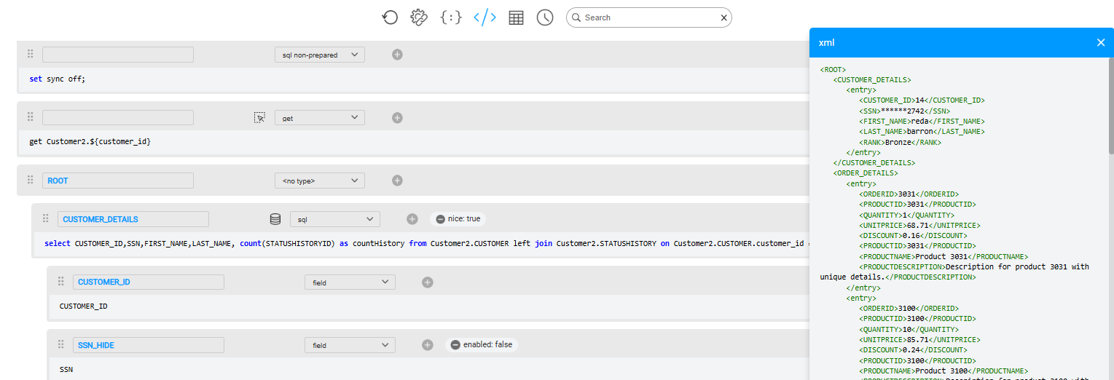
What is Graphit?
Graphit Terminology
Node: Represents an output element or a functional element within the system.
Node Type: Specifies the method for generating and structuring the content of a node.
Node Property: Provides additional instructions to a node, such as formatting a number, specifying a database to query, or indicating whether the node is active or disabled.
Nodes
Node Type
Node Properties

Slide 5
Graphit Node Types and Properties
Graphit Node Types are organized into four logical categories
Field Nodes - Represent individual data points. Node Types: Field, Function, String, Raw
Loop Nodes - Handle arrays or repeating sections. Node Types: SQL, SQL non-prepared, Function
Structure Nodes - Manage output structure. Node Types: Condition, Group, Collect.
Execute Nodes – Execute actions like GET requests or Broadway flows. Node Types: GET, Broadway.
Graphit Node Properties define additional behavior for nodes, such as:
Formatting numbers and dates.
Specifying the database for query execution.
Modifying node output.
Each node must be assigned a specific node type, and additional properties can be used to customize its functionality. Nodes that generate output must also have a designated name.

Slide 6
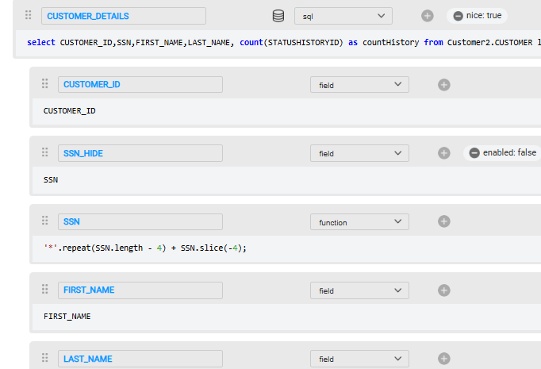
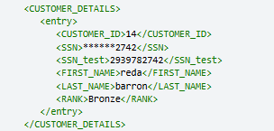
Graphit Node Types
Field - Basic node type. Defines the node as a tag in XML/JSON format.
Tag name
Output:
Tag value

Slide 7
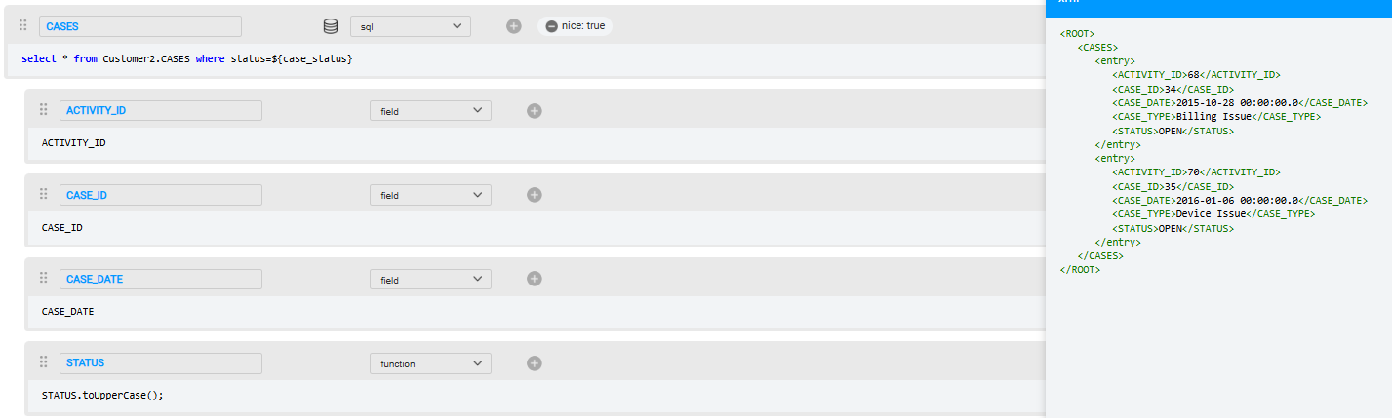
Graphit Node Types
SQL - Specifies an SQL statement / Fabric commands. Support prepared statements and binding.
The SQL output automatically added as nodes to the Graphit.
The SQL Type loops through the returned records, executing nested code for each row in the result set.
Function - JavaScript code that returns the value of an XML/JSON tag.
SQL output iterations

Slide 8
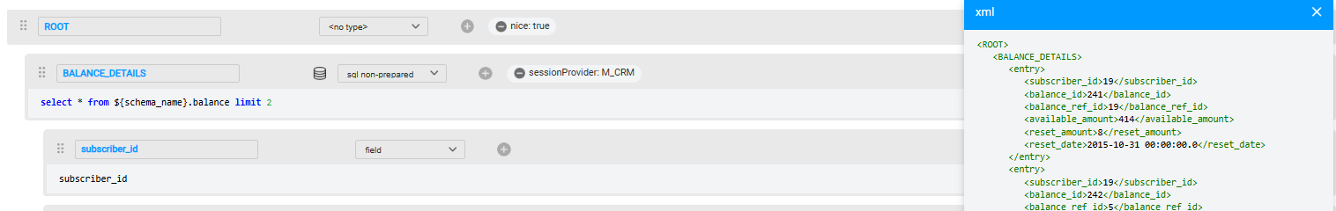
Graphit Node Types
SQL non-prepared To be used if parts of the query are dynamic (such as table name).

Slide 9
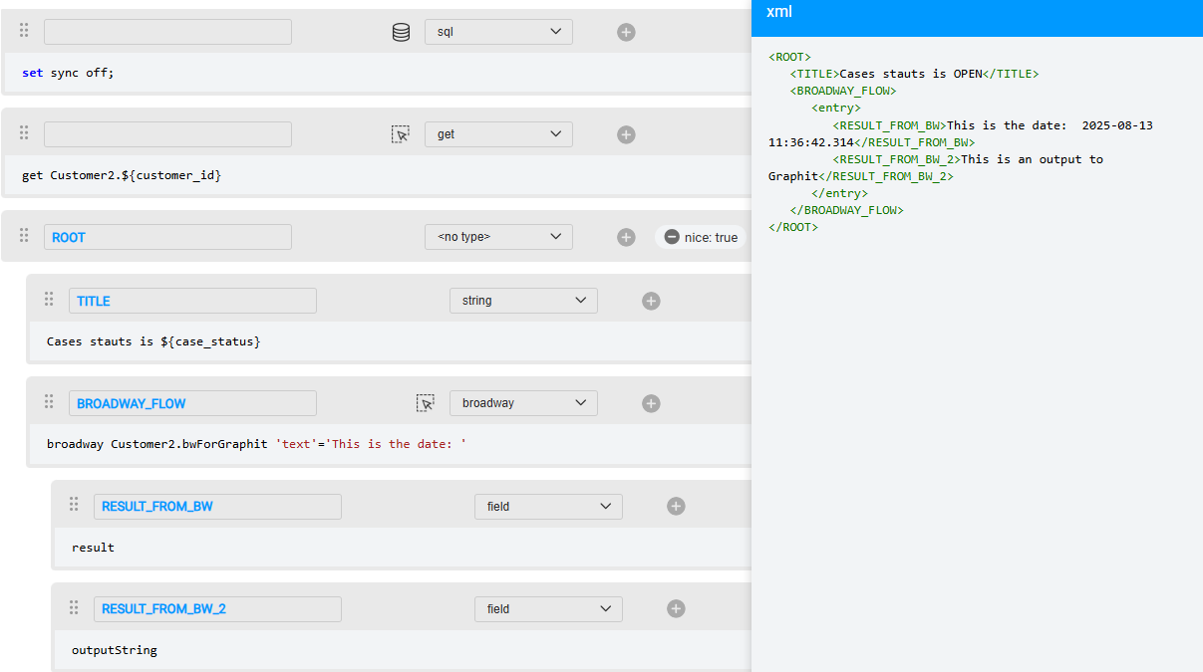
Graphit Node Types
GET - Executes a GET command on a specified LUT and IID.
String - Provides value to the tag, supporting variables like input parameters or values from previous field nodes.
Broadway - Defines a Broadway flow to be executed, The flow's output parameters automatically added as nodes to the Graphit.
BW flow input parameters
BW flow output parameters

Slide 10
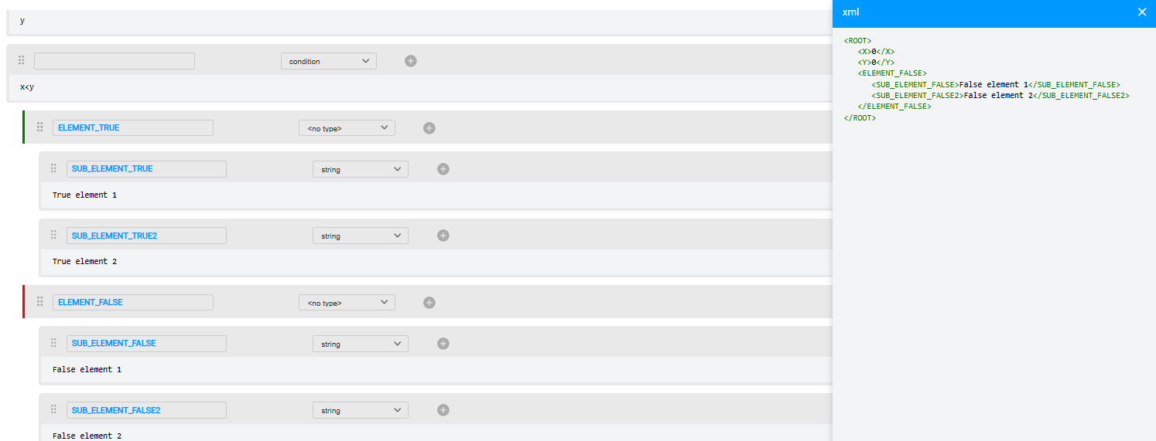
Graphit Node Types
Condition - Implements IF-ELSE functionality, where the node's content is a simple code that returns a Boolean result.
The first node after the condition represents the "true" branch.
The next sibling node represents the "false" branch.
Any child nodes under the true or false branches are included based on the evaluation of the condition.
Condition element
True element including child nodes
False element including child nodes

Slide 11
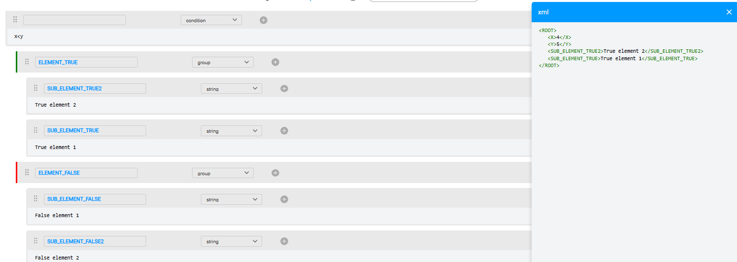
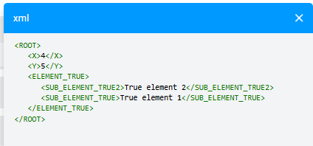
Graphit Node Types
Group - Groups several elements under a single entry tag. Used mainly with Condition nodes.
Result without Group

Slide 12
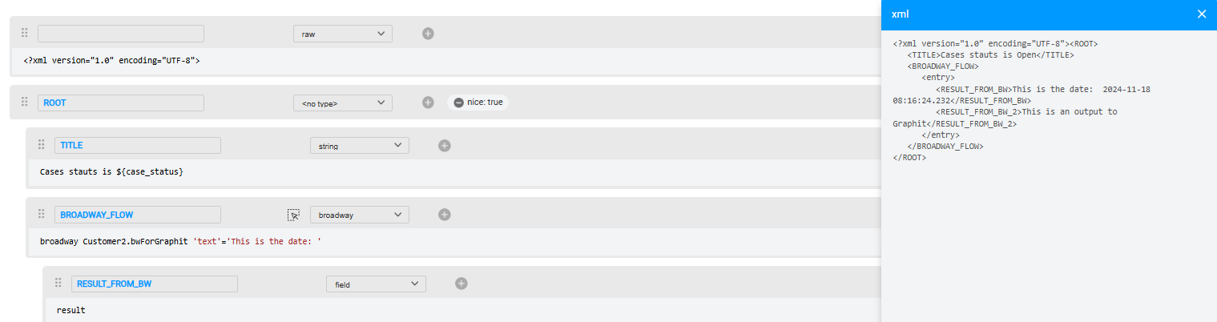
Graphit Node Types
Row - Presents data as output without any manipulation. For example, a header for an XML format.

Slide 13
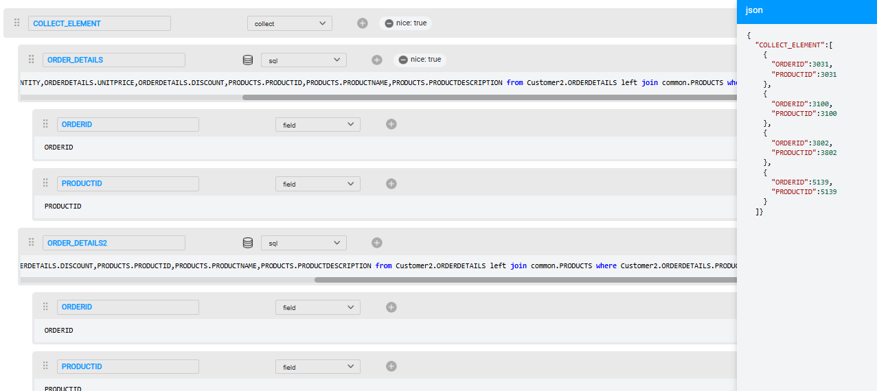
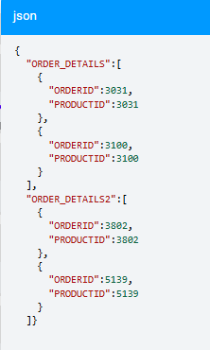
Graphit Node Types
Collect - Combines multiple datasets into a single unified array.
Result without collect

Slide 14
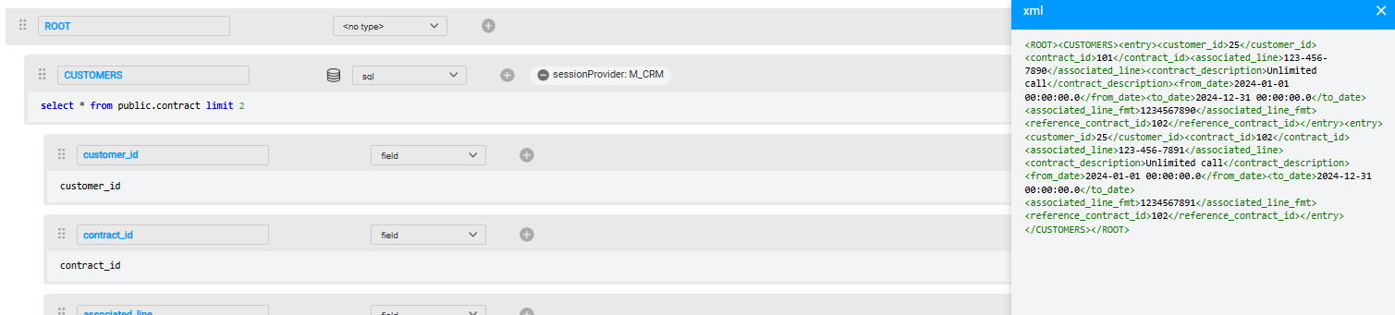
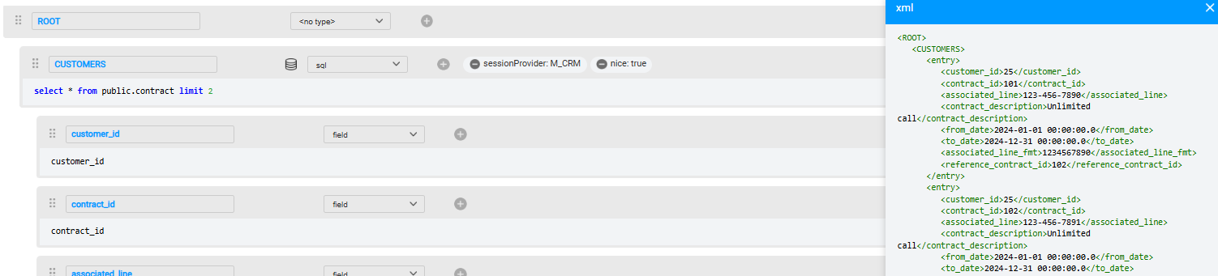
Graphit Node Properties
Session Provider – Used with SQL or Non-Prepared SQL node types to specify the interface to be used for executing a query, if not defaulting to Fabric.
Nice - Configures the layout of the output format. When set to True, each tag is printed on a new line and properly indented.

Slide 15
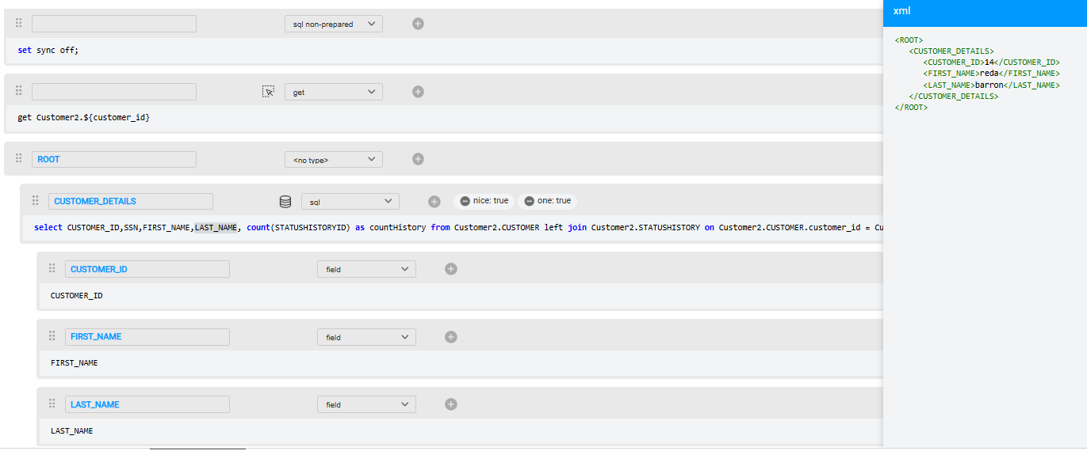
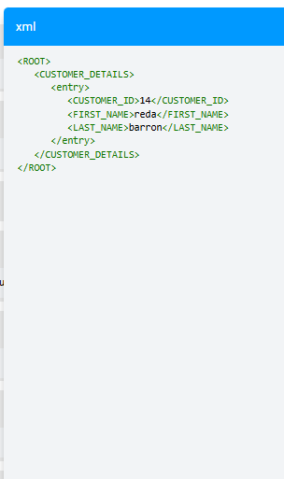
Graphit Node Properties
One – Determines whether the node is treated as a single value or an array. When set to True, the result is always a single entry, even if the underlying query returns multiple rows.
Result without ‘one’

Slide 16
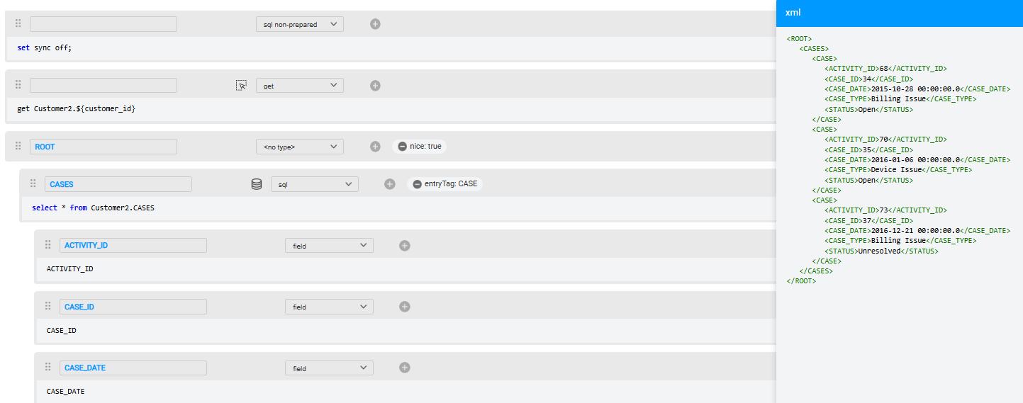
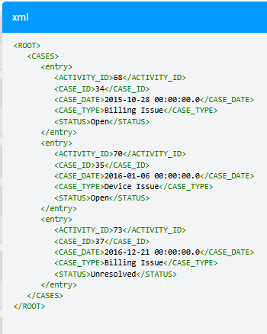
Graphit Node Properties
Entry Tag - Specifies the tag used to enclose XML array entries. If not specified or set to None, the default value <entry> is applied.
Result without ‘entryTag’

Slide 17
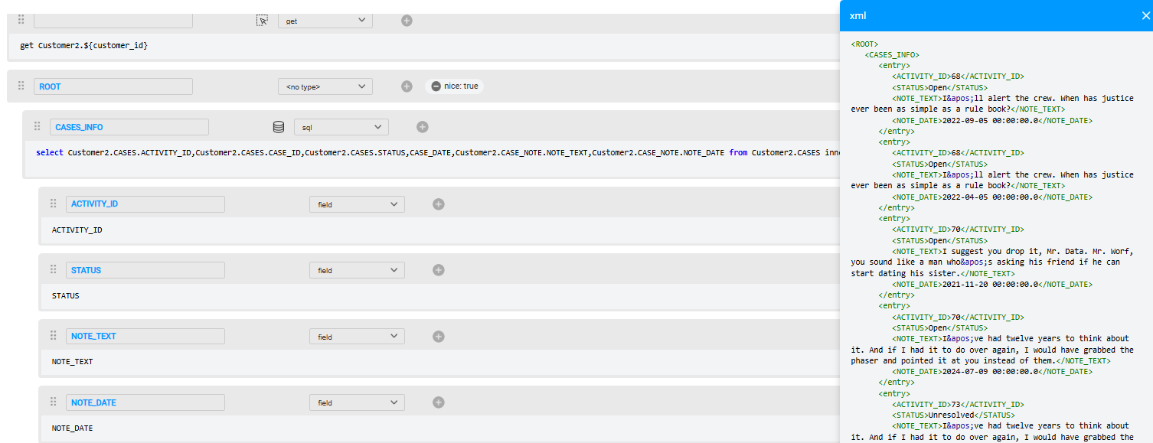
Graphit Node Properties
Keys - Advanced mechanism that replaces nested queries by joining the data on the root query and grouping it with a key. Example without keys – join query return entry per record:

Slide 18
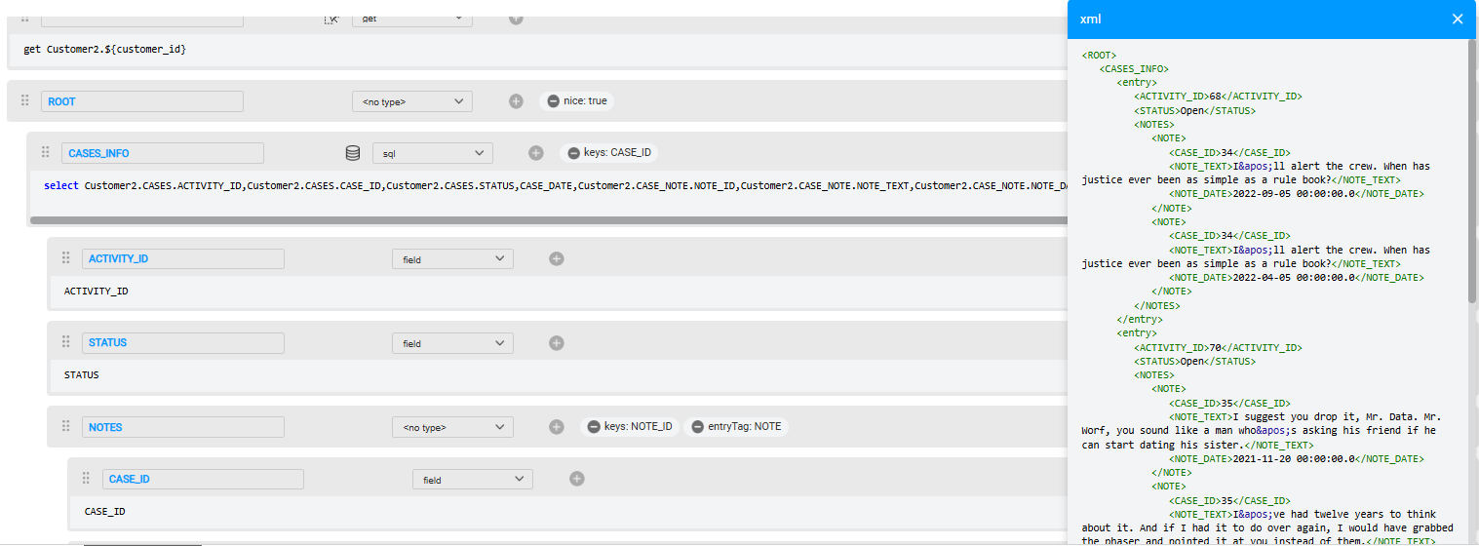
Graphit Node Properties
The Key should contain the “group by” element
Example after adding the Keys property:

Slide 19
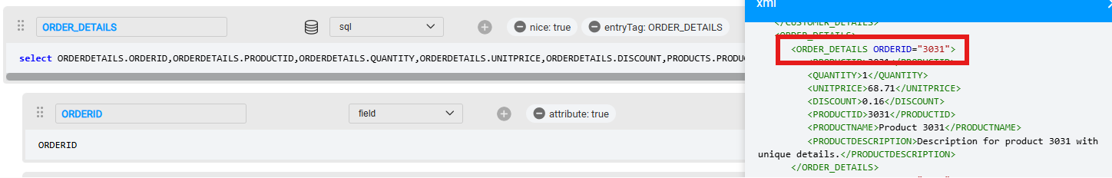
Graphit Node Properties
Attribute – to change a value from an element to an attribute

Slide 20
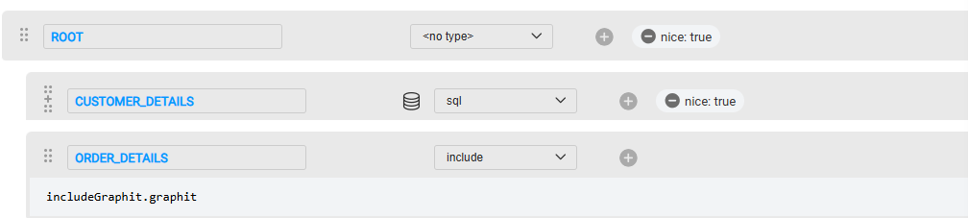
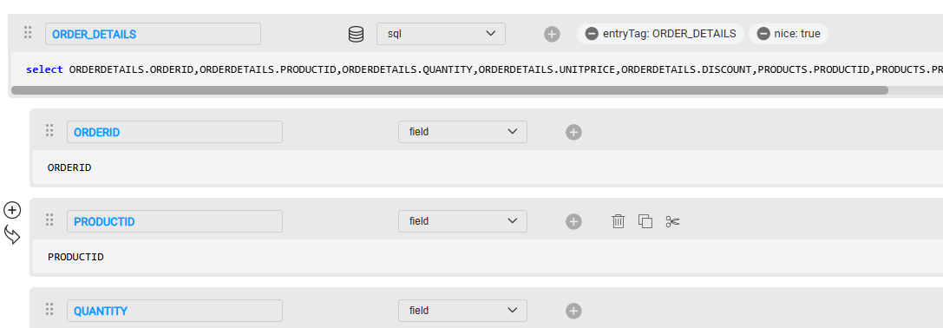
Graphit Node Properties
Include – add another Graphit file to the existing Graphit
includeGraphit.graphit
You can address any field/variables in the included graphit, as if it’s written in the outer graphit

Slide 21
Graphit Node Properties
Additional properties:
Show Empty - Defines whether empty nodes are displayed in the output. Default = True. Note that this property affects the node and its child nodes.
Show null - Defines whether null entries are displayed in the output. Default = True. Note that this property affects the node and its child nodes.
Output formats:
DatetimeFormat - Controls how date/time are formatted in the output
NumberFormat - Controls how numbers are formatted in the output
CSV - The following node properties control CSV format:
csvHeader - disables a header row
csvRow - defines the delimiter between rows in CSV format. The default value is set to the CR sign (\n).
csvCol - defines the delimiter between columns in CSV format. The default value is set to the comma character.
csvEnclose - defines the character used to enclose a value in CSV format. This is used only if the value holds a special character (csvEnclose, csvRow, csvCol).
Format – When defined, the node is evaluated and added when the output format matches the format's JSON, XML or CSV value. Note that this property only affects the node where it is defined.

Slide 22
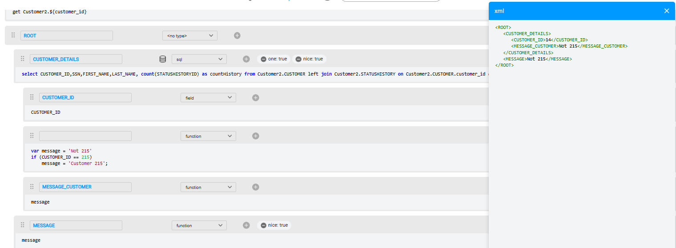
Graphit Variables
Previous Field Nodes: Variables derived from earlier field nodes.
SQL Query/Broadway Result: Data obtained from SQL queries or Broadway execution results.
Input Parameters: User-defined inputs.
Custom Variables in Function Node Type: Variables can be defined within a Function node (using JavaScript). Unlike Field nodes, these variables can be accessed outside the scope of the field node.
Define variable
Use query result as variable
Use the variable from outside the loop

Slide 23
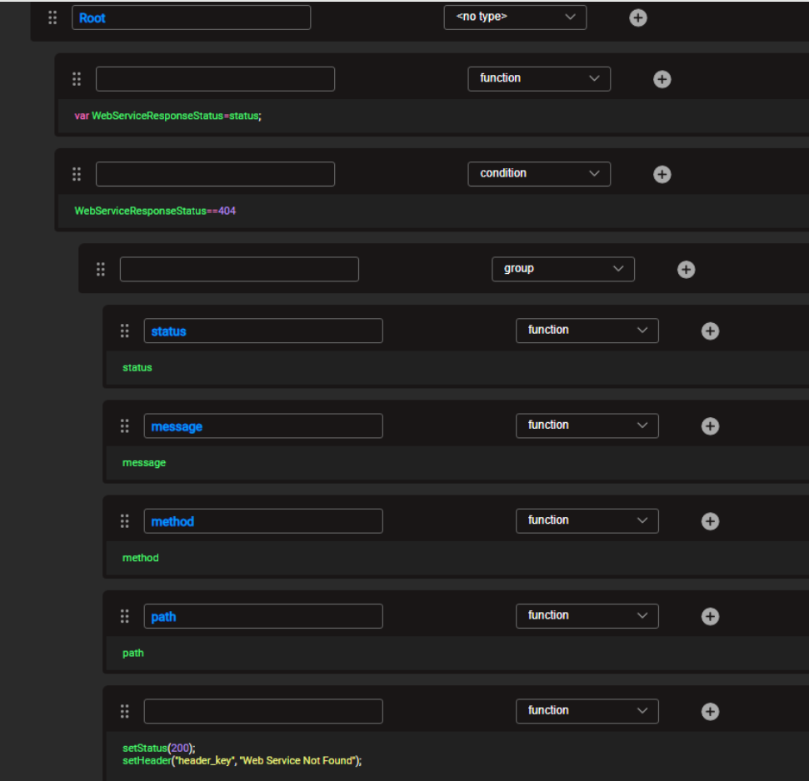
Error Handling
Error.Graphit
Executes automatically on unhandled exceptions from Fabric Web Service calls.
Not triggered if the exception is caught in the implementation.
Ensures a standardized error response in JSON or XML, matching the original request format.
The implementer has full flexibility to determine the cause of the underlying failure that triggered the process and adjust the Web Service response accordingly, including:
Status – e.g., 404 for “Page Not Found” (use setStatus to override).
Message – custom error message text.
Path – the endpoint or resource path involved.
Method – the HTTP method used (GET, POST, etc.).
Header – response headers (use getHeader / setHeader to read or modify

Slide 24

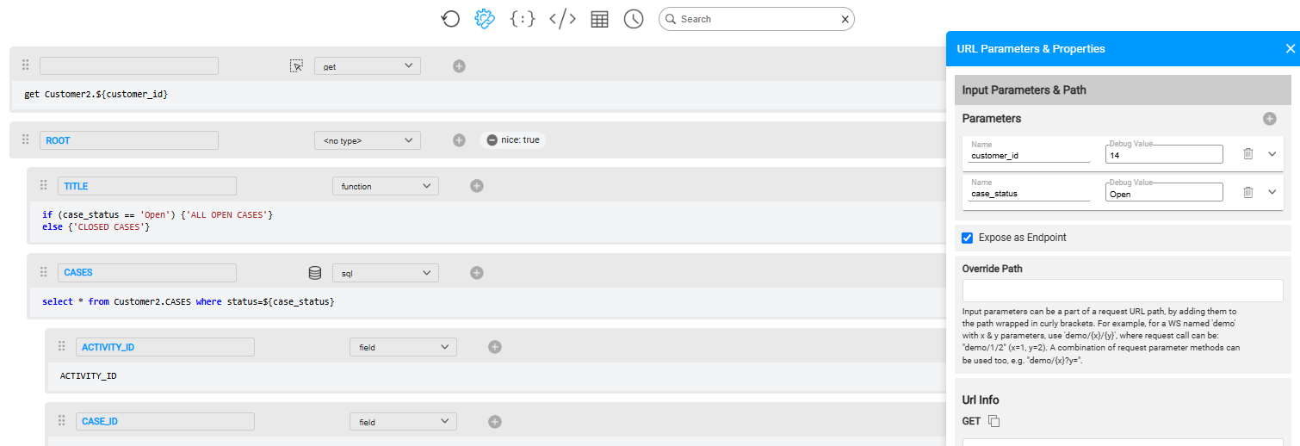
Graphit Input parameters
Use button to define parameters. Use ${param_name} syntax
Binding
Binding

Slide 25
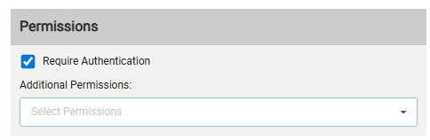
Graphit Permissions
Require Authentication
Indicates whether a web service requires authentication or not. Default is set to True.
When set to False, it will allow calling the web service by skipping the Authentication step. This mode should be carefully used; use it only when a Web Service should be accessible for everyone, without enforcing an API key, a user/password, etc.
Additional Permissions
When a web service caller lacks the necessary role-based permissions to execute certain Fabric operations used within a Graphit, the developer can enable temporary elevated access specifically for the scope of that web service.
To do so, select the required permissions in the Graphit’s properties—these will override the caller's default permissions during execution.
For the full list of available permissions, refer to: https://support.k2view.com/Academy/articles/17_fabric_credentials/01_fabric_credentials_overview.html

Slide 26
Graphit Versioning
Web Service Versioning
Versioning allows multiple versions of a web service to coexist, enabling support for different client needs. The version number is typically included in the service URL, but it is optional—if omitted, the default version is 1.
Versioning Logic
No version in URL → API returns the latest version.
Version in URL exists → API returns the specified version.
Version in URL higher than latest → API returns the latest version.
Version in URL lower than earliest → API returns an appropriate error response code.
Version in URL between two versions → API returns the lower of the two.
Implementation
Graphit: Add the version as part of the file name, e.g., a.v1.graphit.

Slide 27
Graphit Verb
Methods supported by the web service, as follows:
GET - get data.
POST - create new data based on the data provided.
PUT - update data.
DELETE - delete data.
In Graphit, the verb setting is done by incorporating it as a part of the file name. For example: "a.POST.graphit".
Note:
Only a single verb can be set.
When a verb is omitted, the web service is exposed with GET and POST verbs.

Slide 28
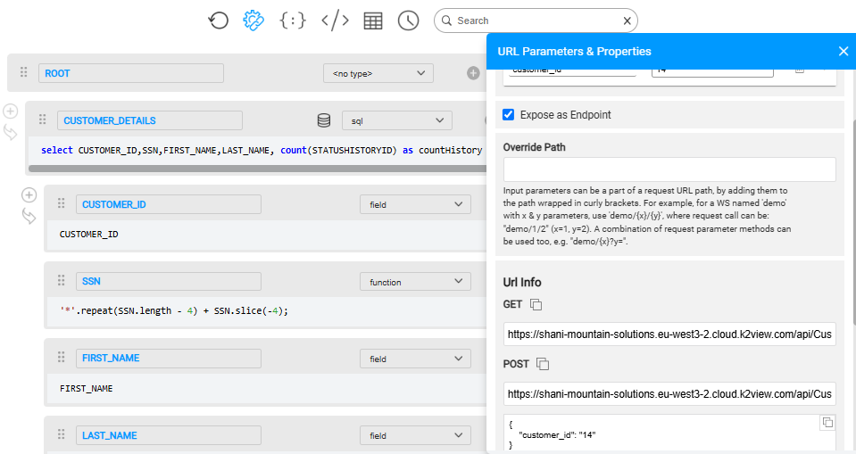
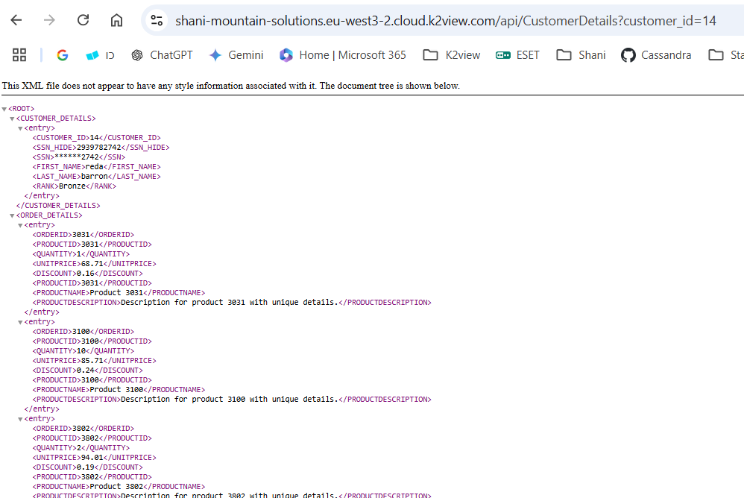
Invoke Graphit
Graphit files can be invoked either externally as Web Services or internally from other Fabric implementation components (if defined under LUT).
Web Service:
Check “Expose as Endpoint” field
Use the URLs provided in the Graphit Settings: Note: you can override the URL path using the Path parameter

Slide 29
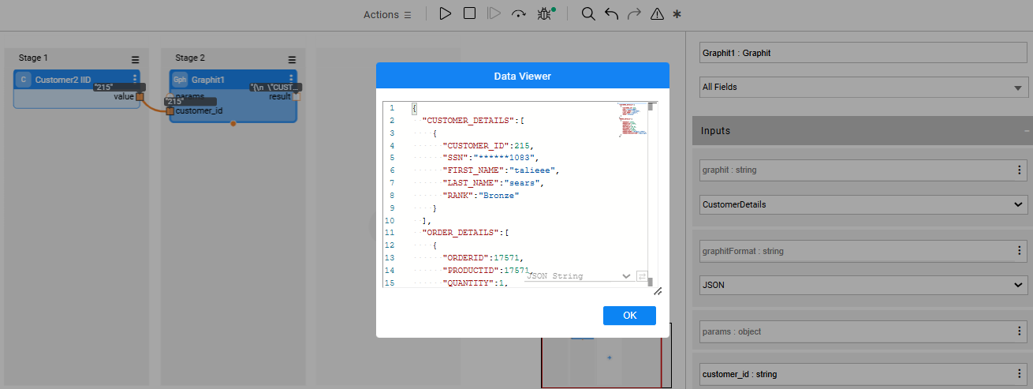
Invoke Graphit
From Fabric Implementation Components
Invoking From a Java Function
Invoking Broadway flow using Graphit Actor:
Map<String, Object> graphitParams = new HashMap<>(); graphitParams.put(“customer_id",14); return graphit("CustomerDetails.graphit", graphitParams);

Slide 30
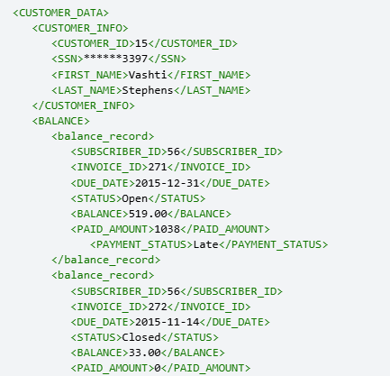
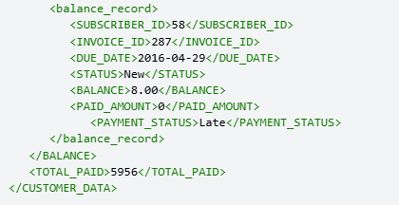
Graphit Assignment
Create the below Graphit:
Execute GET in Sync OFF for a Customer LUI
The IID should be parameter to the Graphit
Show the Customer’s data from Customer table
SSN should present only the last 4 digist. The others should be replaced with “*”
As there is only 1 record in the Customer table, make sure there is no entry tag to this record
Show the subscriber balance data from subscriber_balance table (created on course 7 – Project Functions)
For each record, add “payment_status” field and calculate the below using Broadway flow:
If balance = 0 → Show PAID status
Else - if due_date passed → show “Late”
Otherwise → show “On Time”
Each record should have <balance_record> elements wrapper
Format the due_date to show only date
Format the balance #,###.00
While iterating on the customer_balance records, sum the total paid amount
Show the total paid amount at the end of the Graphit
Create error handler graphit

