Slide 1
Tower Top Motions
Aljoscha Sander
aljoscha.sander@uni-bremen.de
28.04.2021

Slide 2
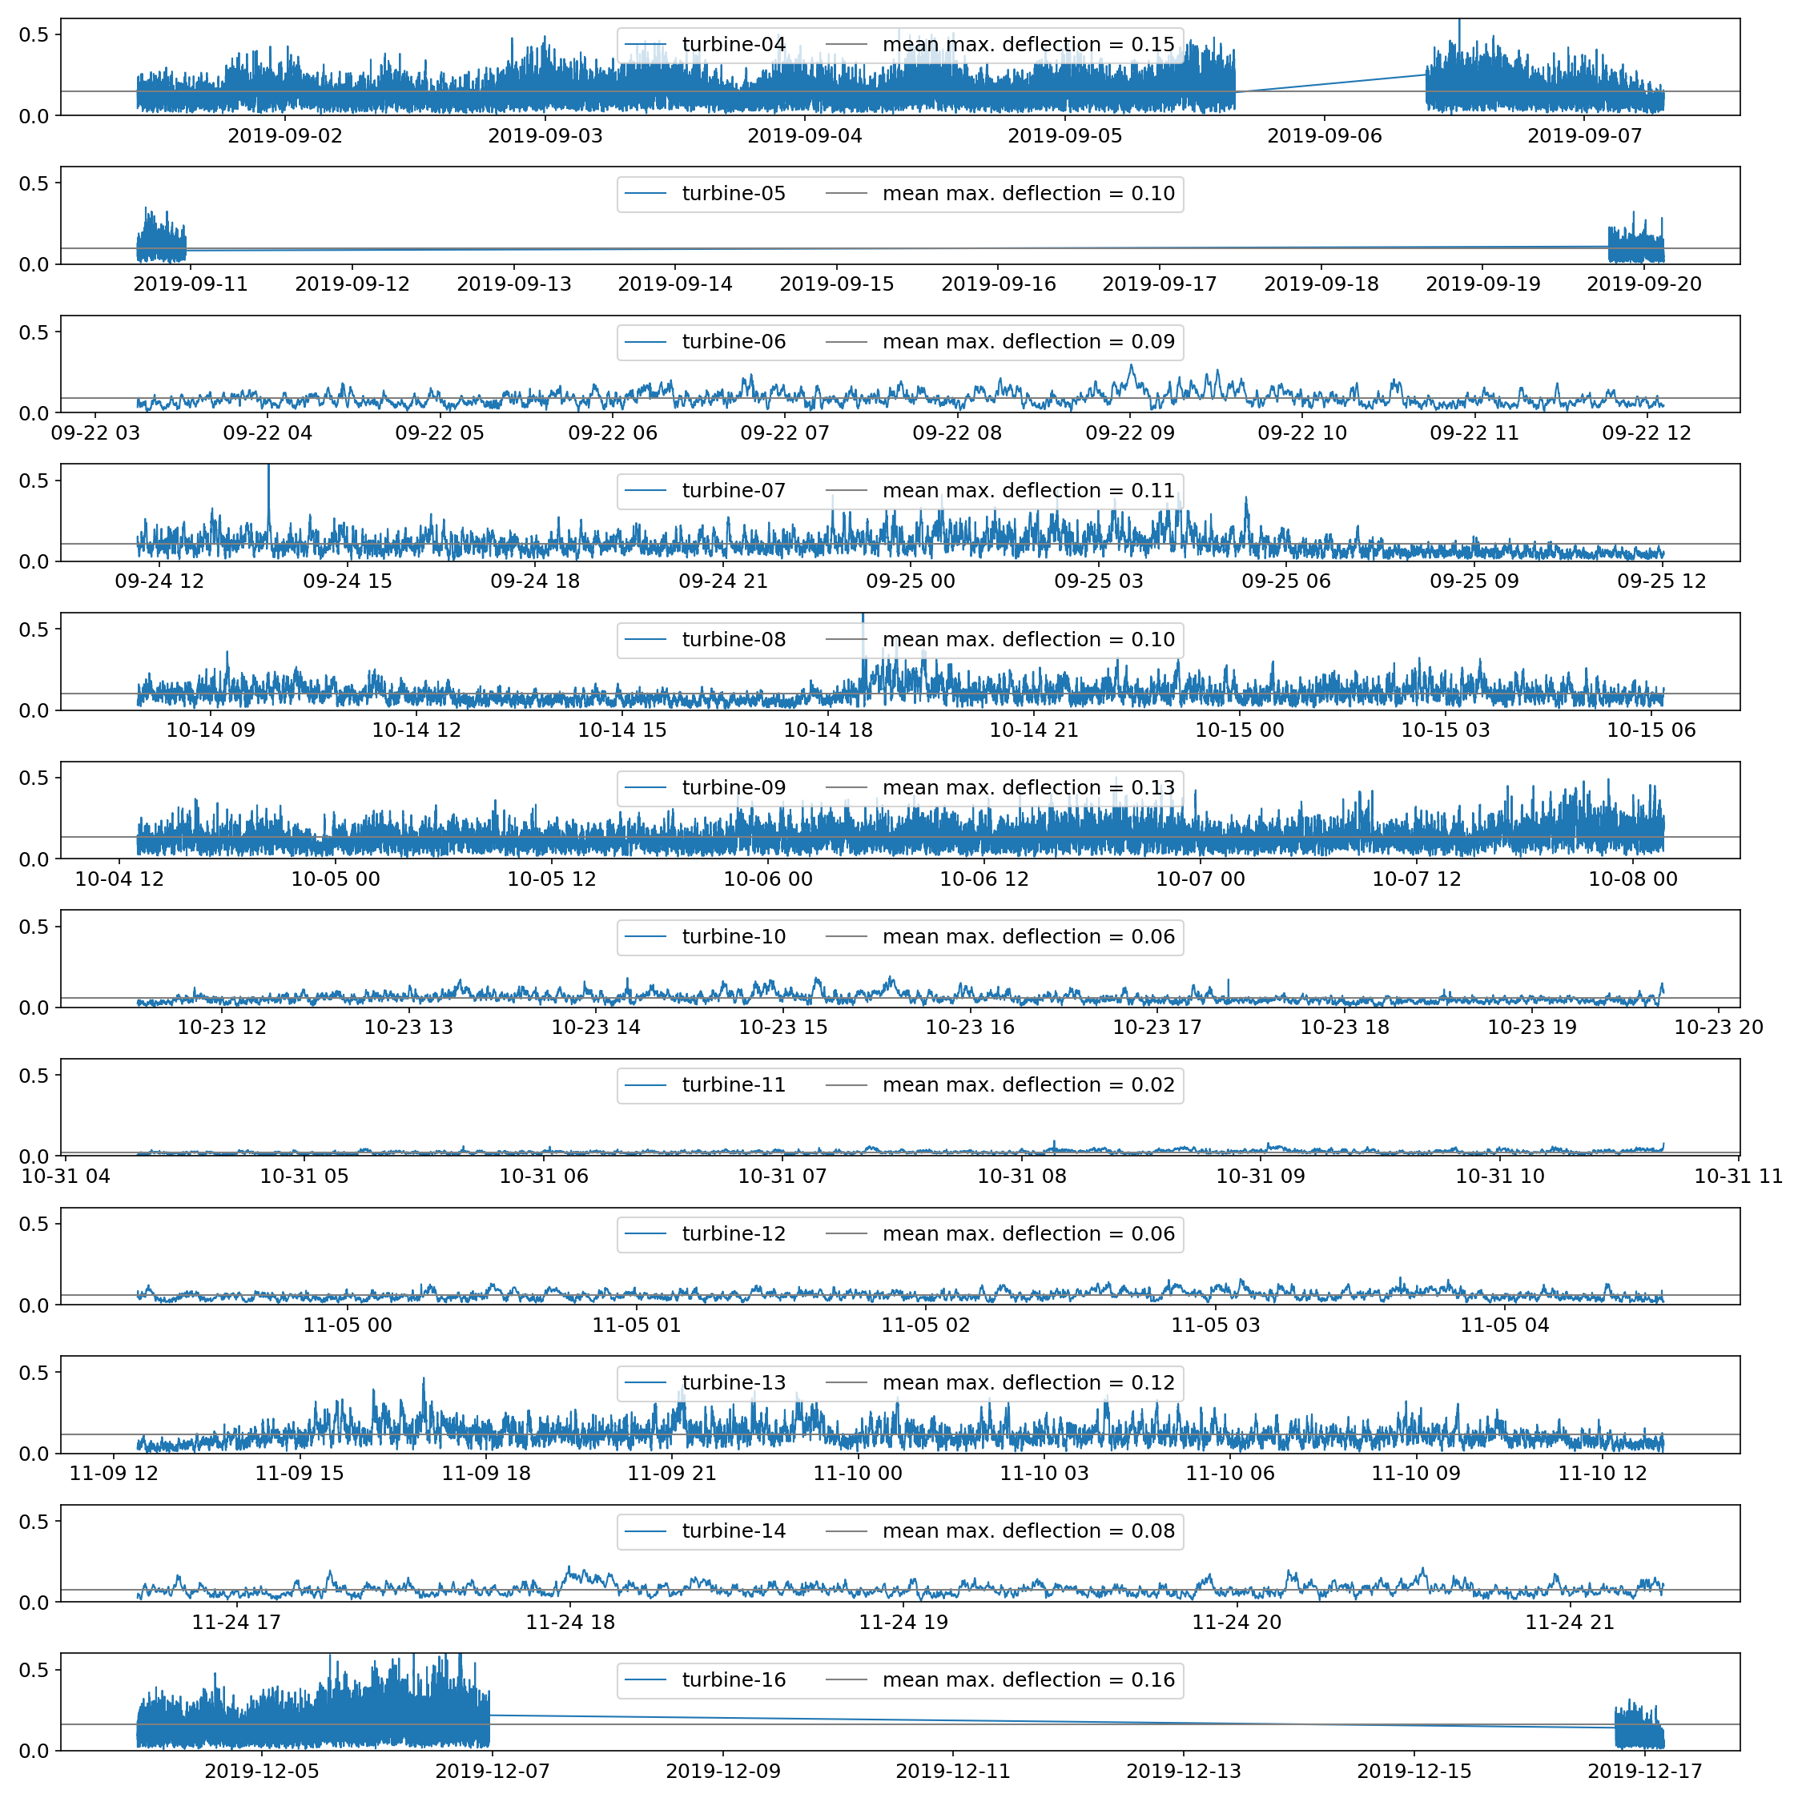
Max deflection
0 m < max. deflection < 0.6 m
Max. deflection d synonym for
semi major axis
d

Slide 3
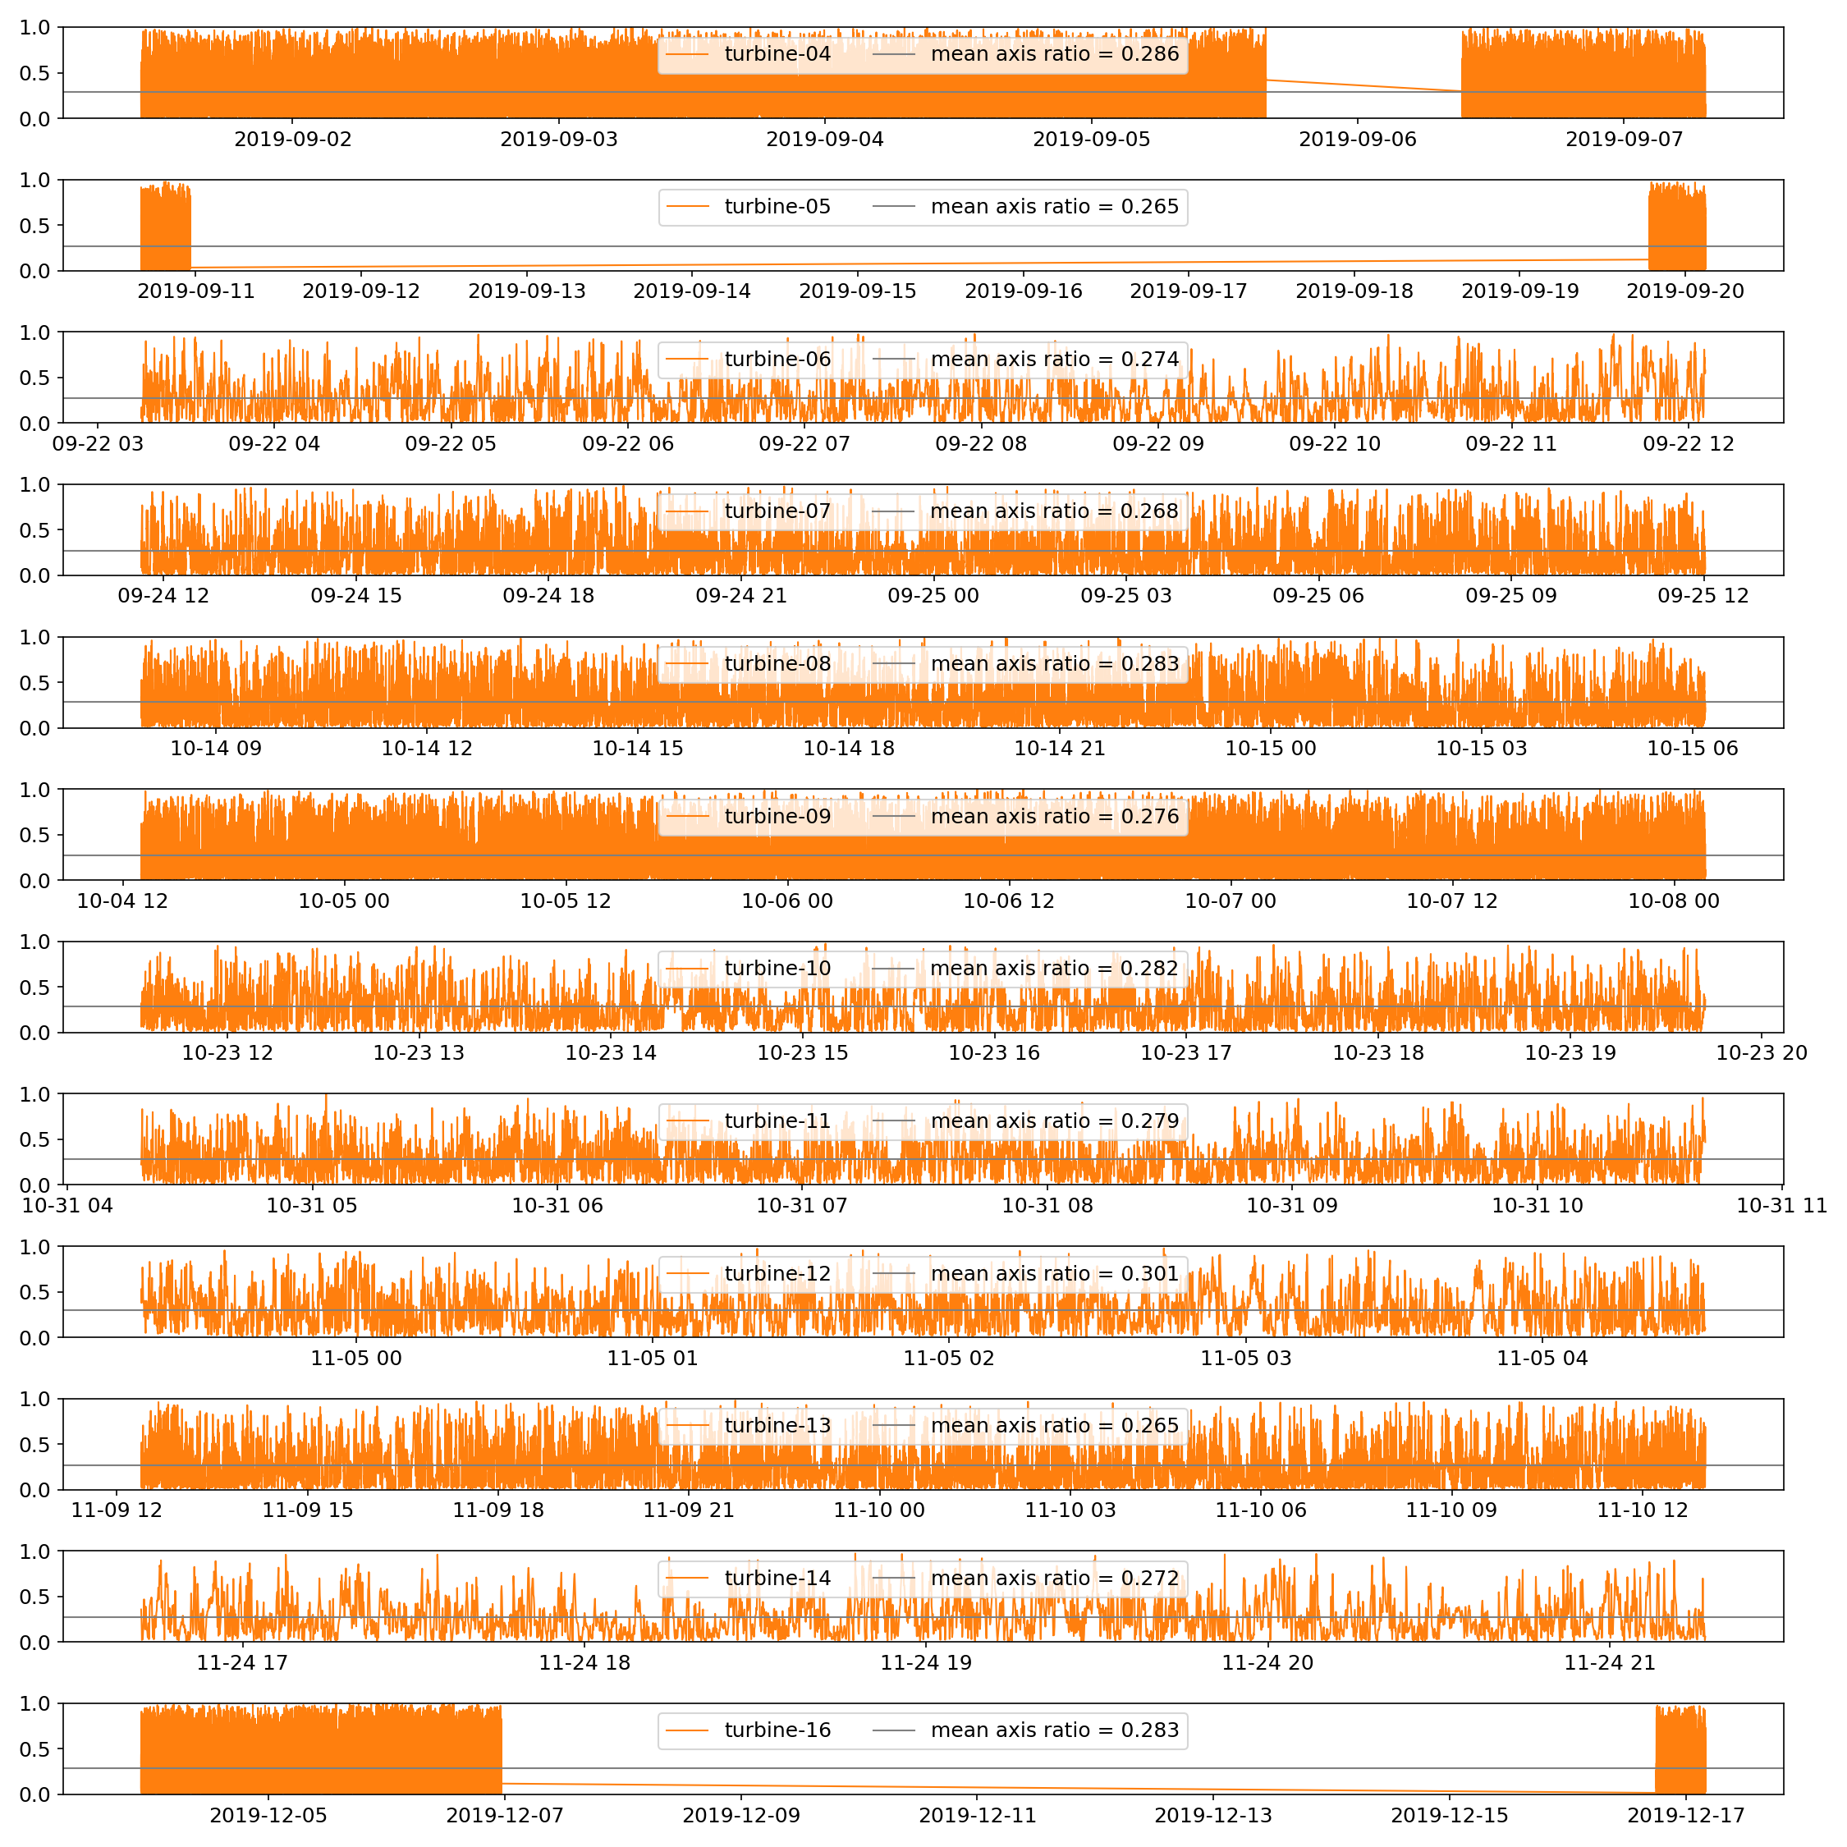
Axis ratio
0 m < max. deflection < 0.6 m
Ar = b/a

Slide 4
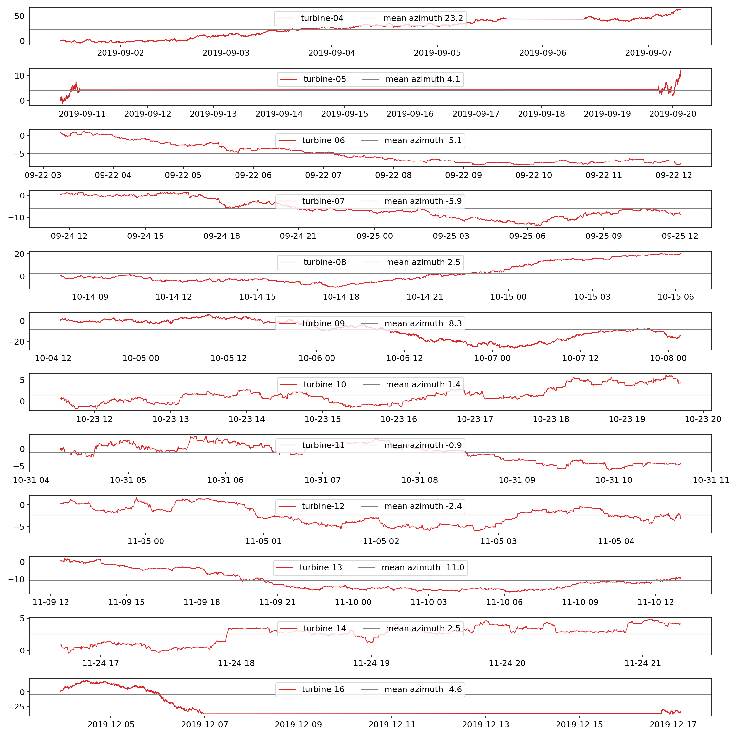
P2p angle
0 m < max. deflection < 0.6 m
Ar = b/a

Slide 5
P2p angle
0 m < max. deflection < 0.6 m
Ar = b/a

Slide 6
P2p angle
0 m < max. deflection < 0.6 m
Ar = b/a

Slide 7
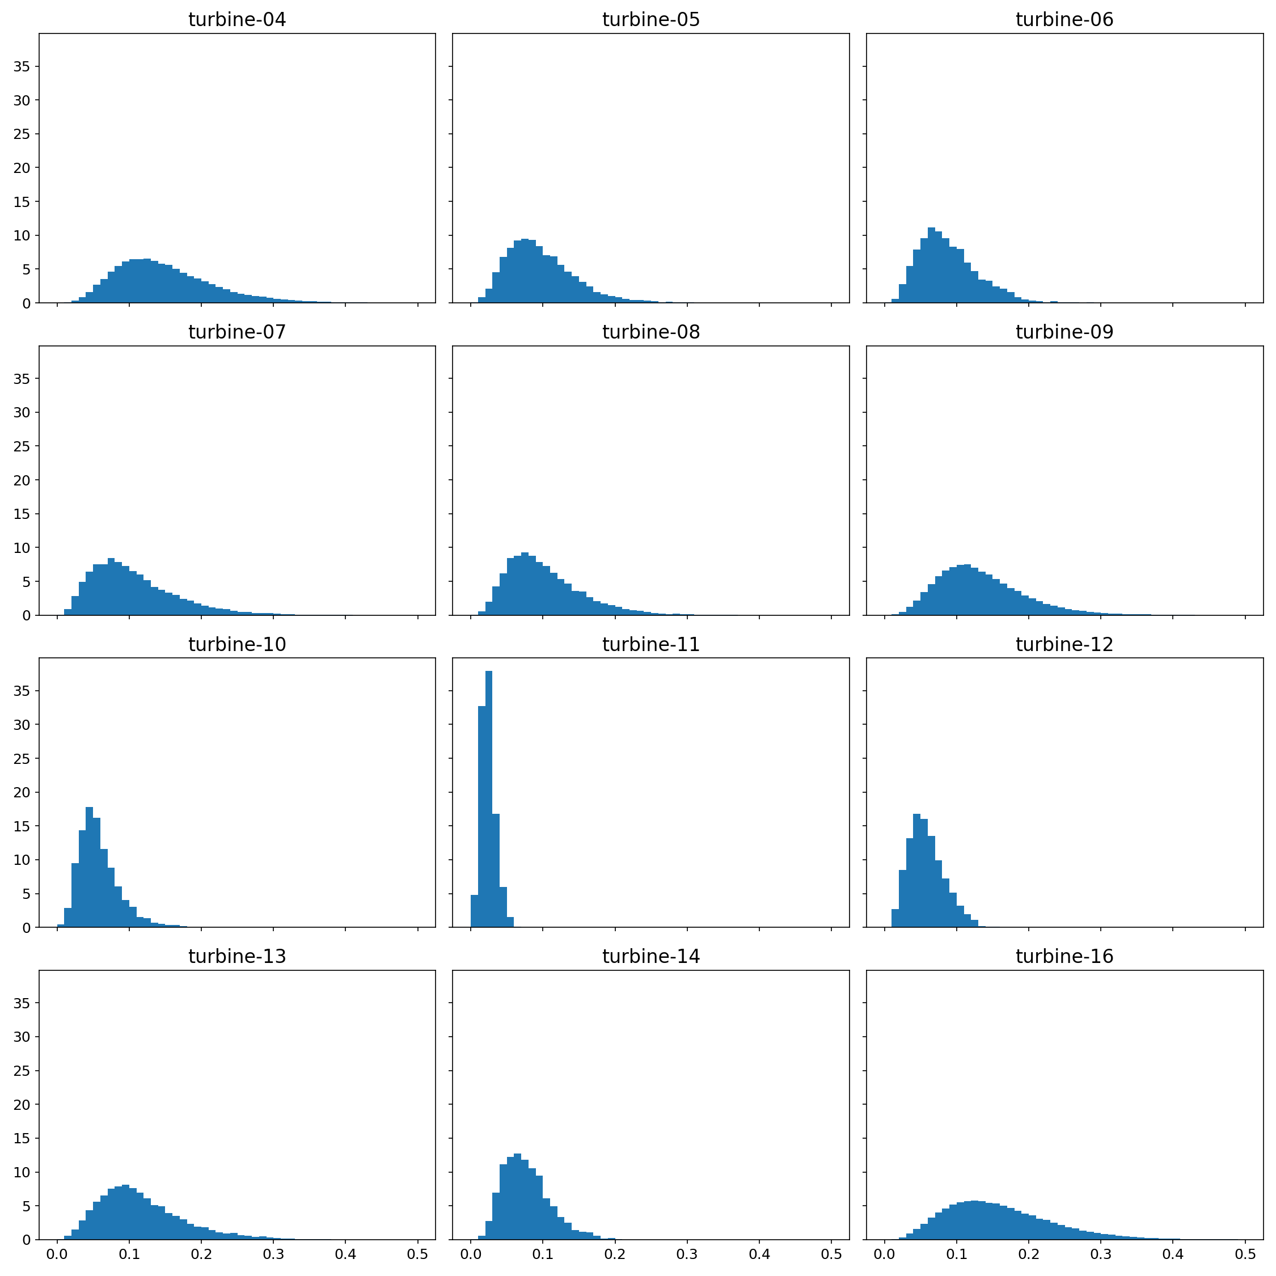
Distribution max. deflection

Slide 8
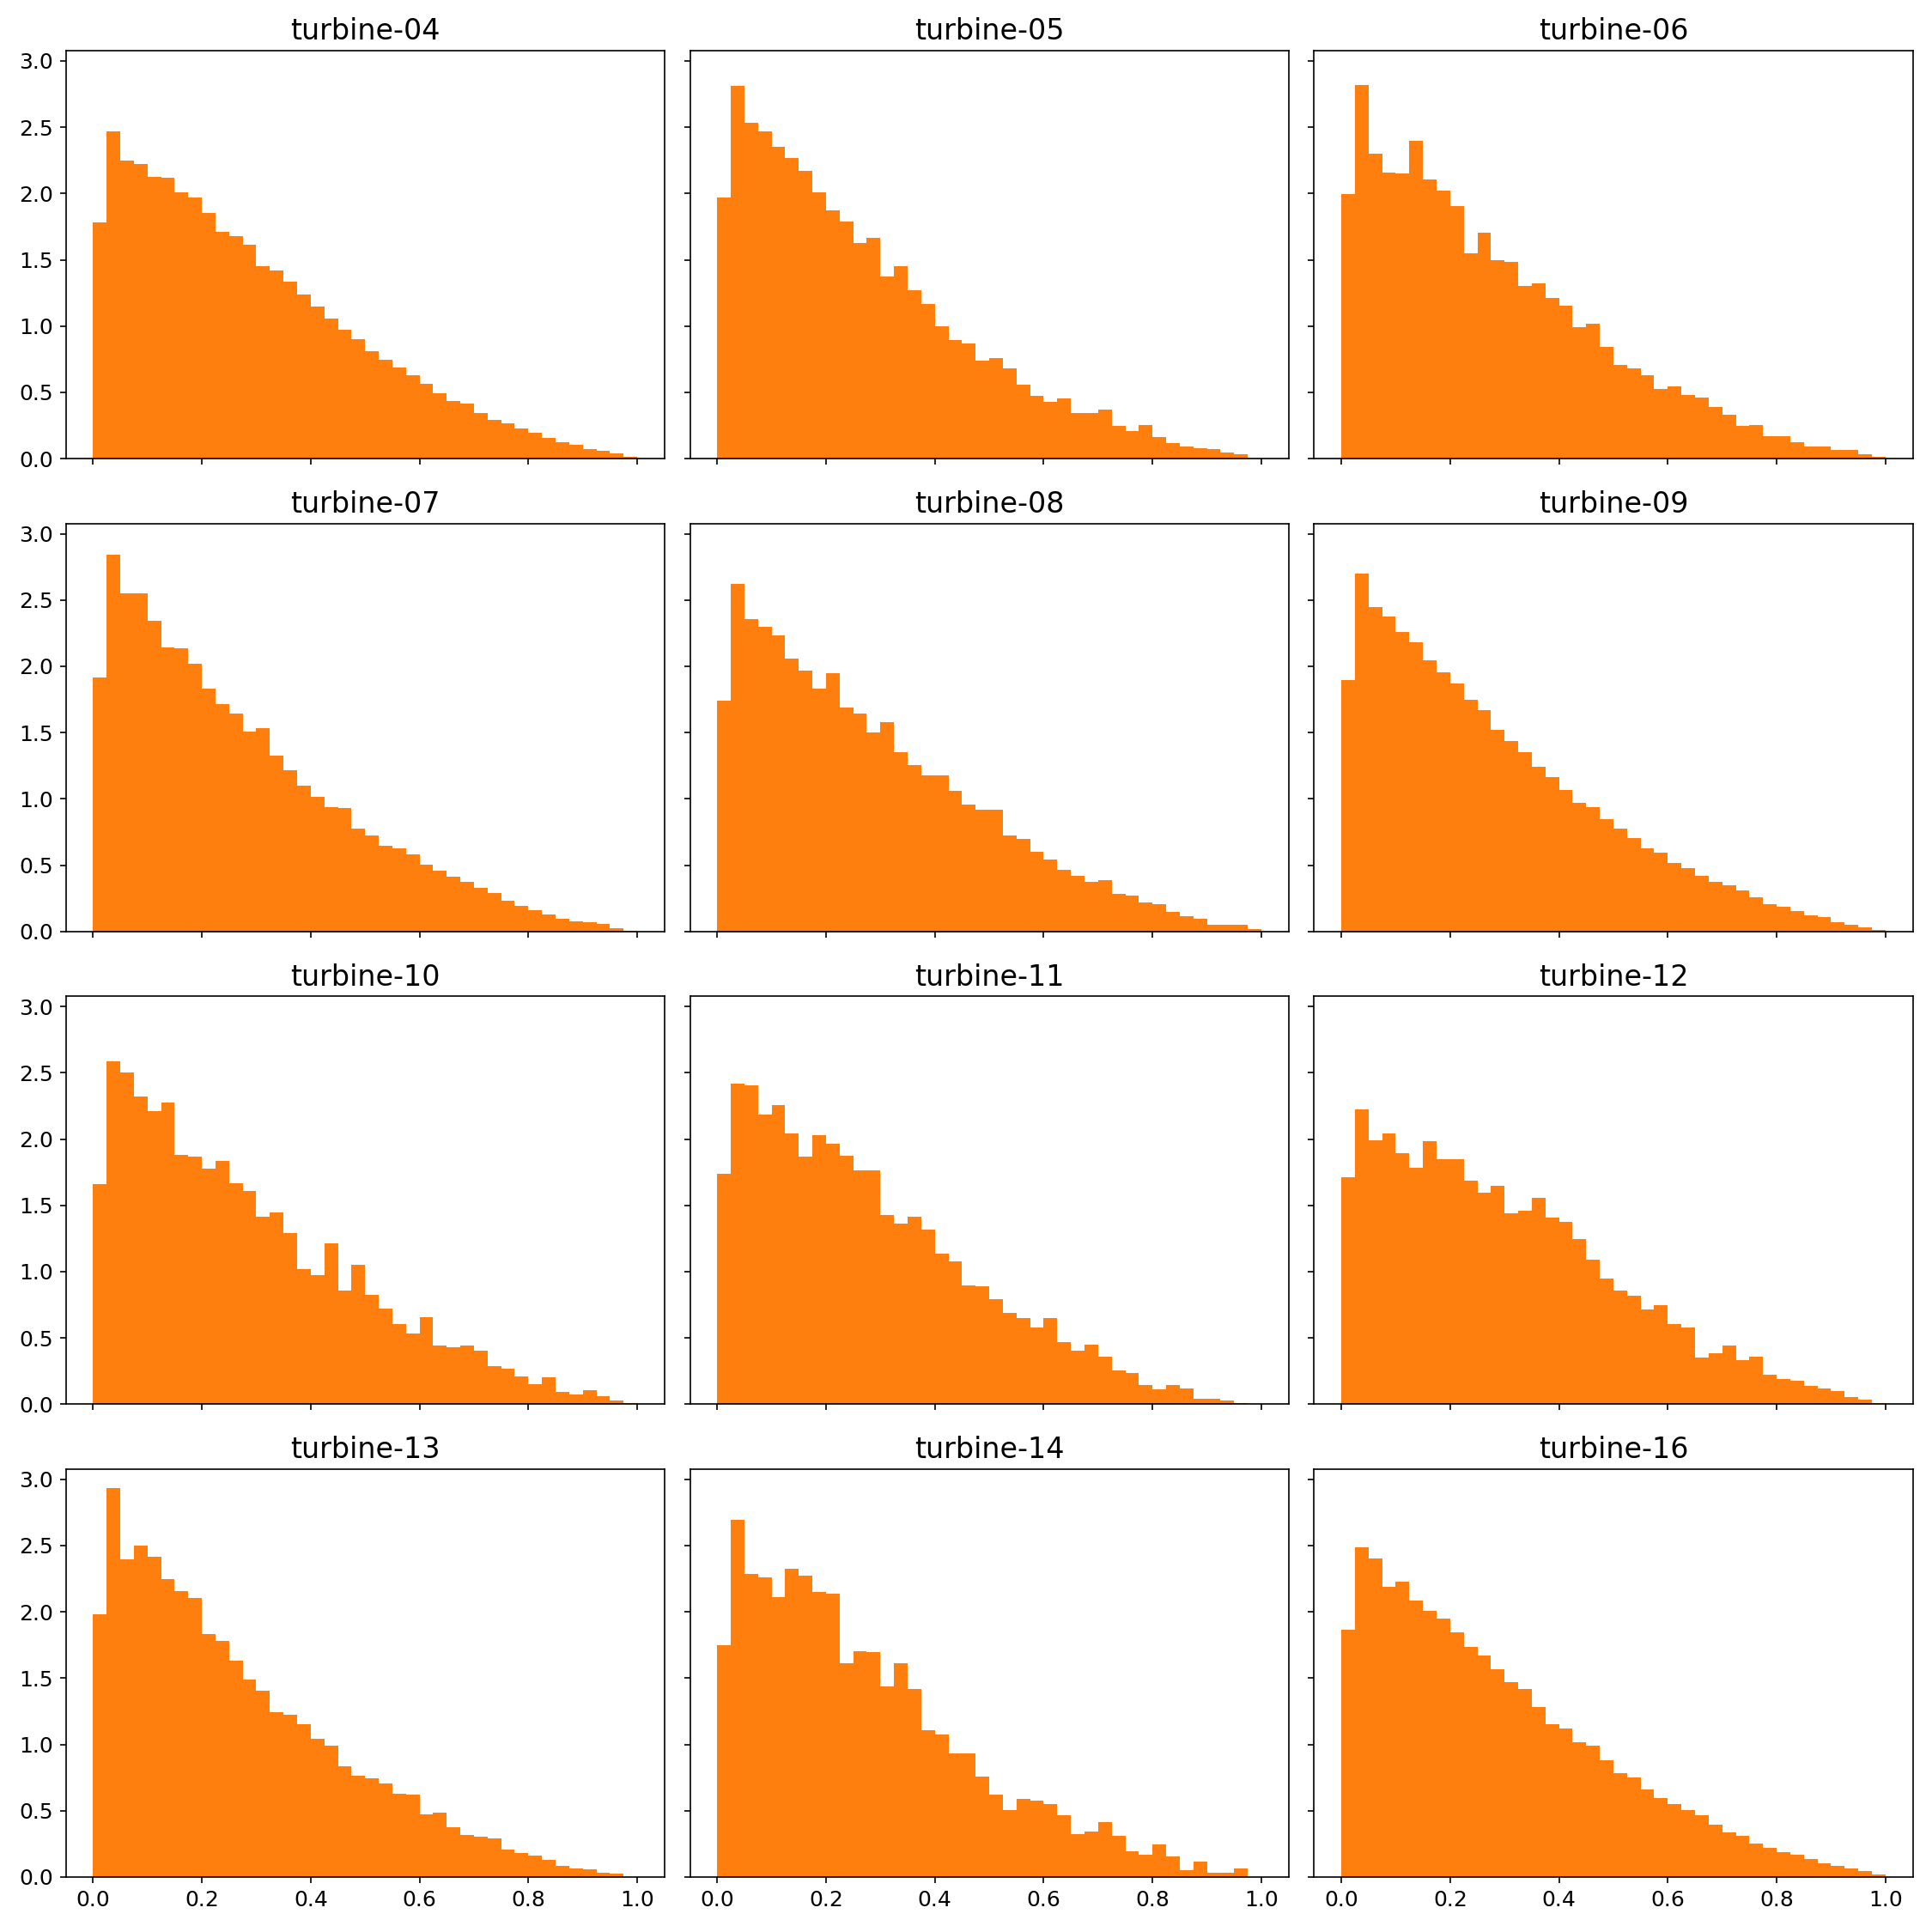
Distribution axis ratio

Slide 9
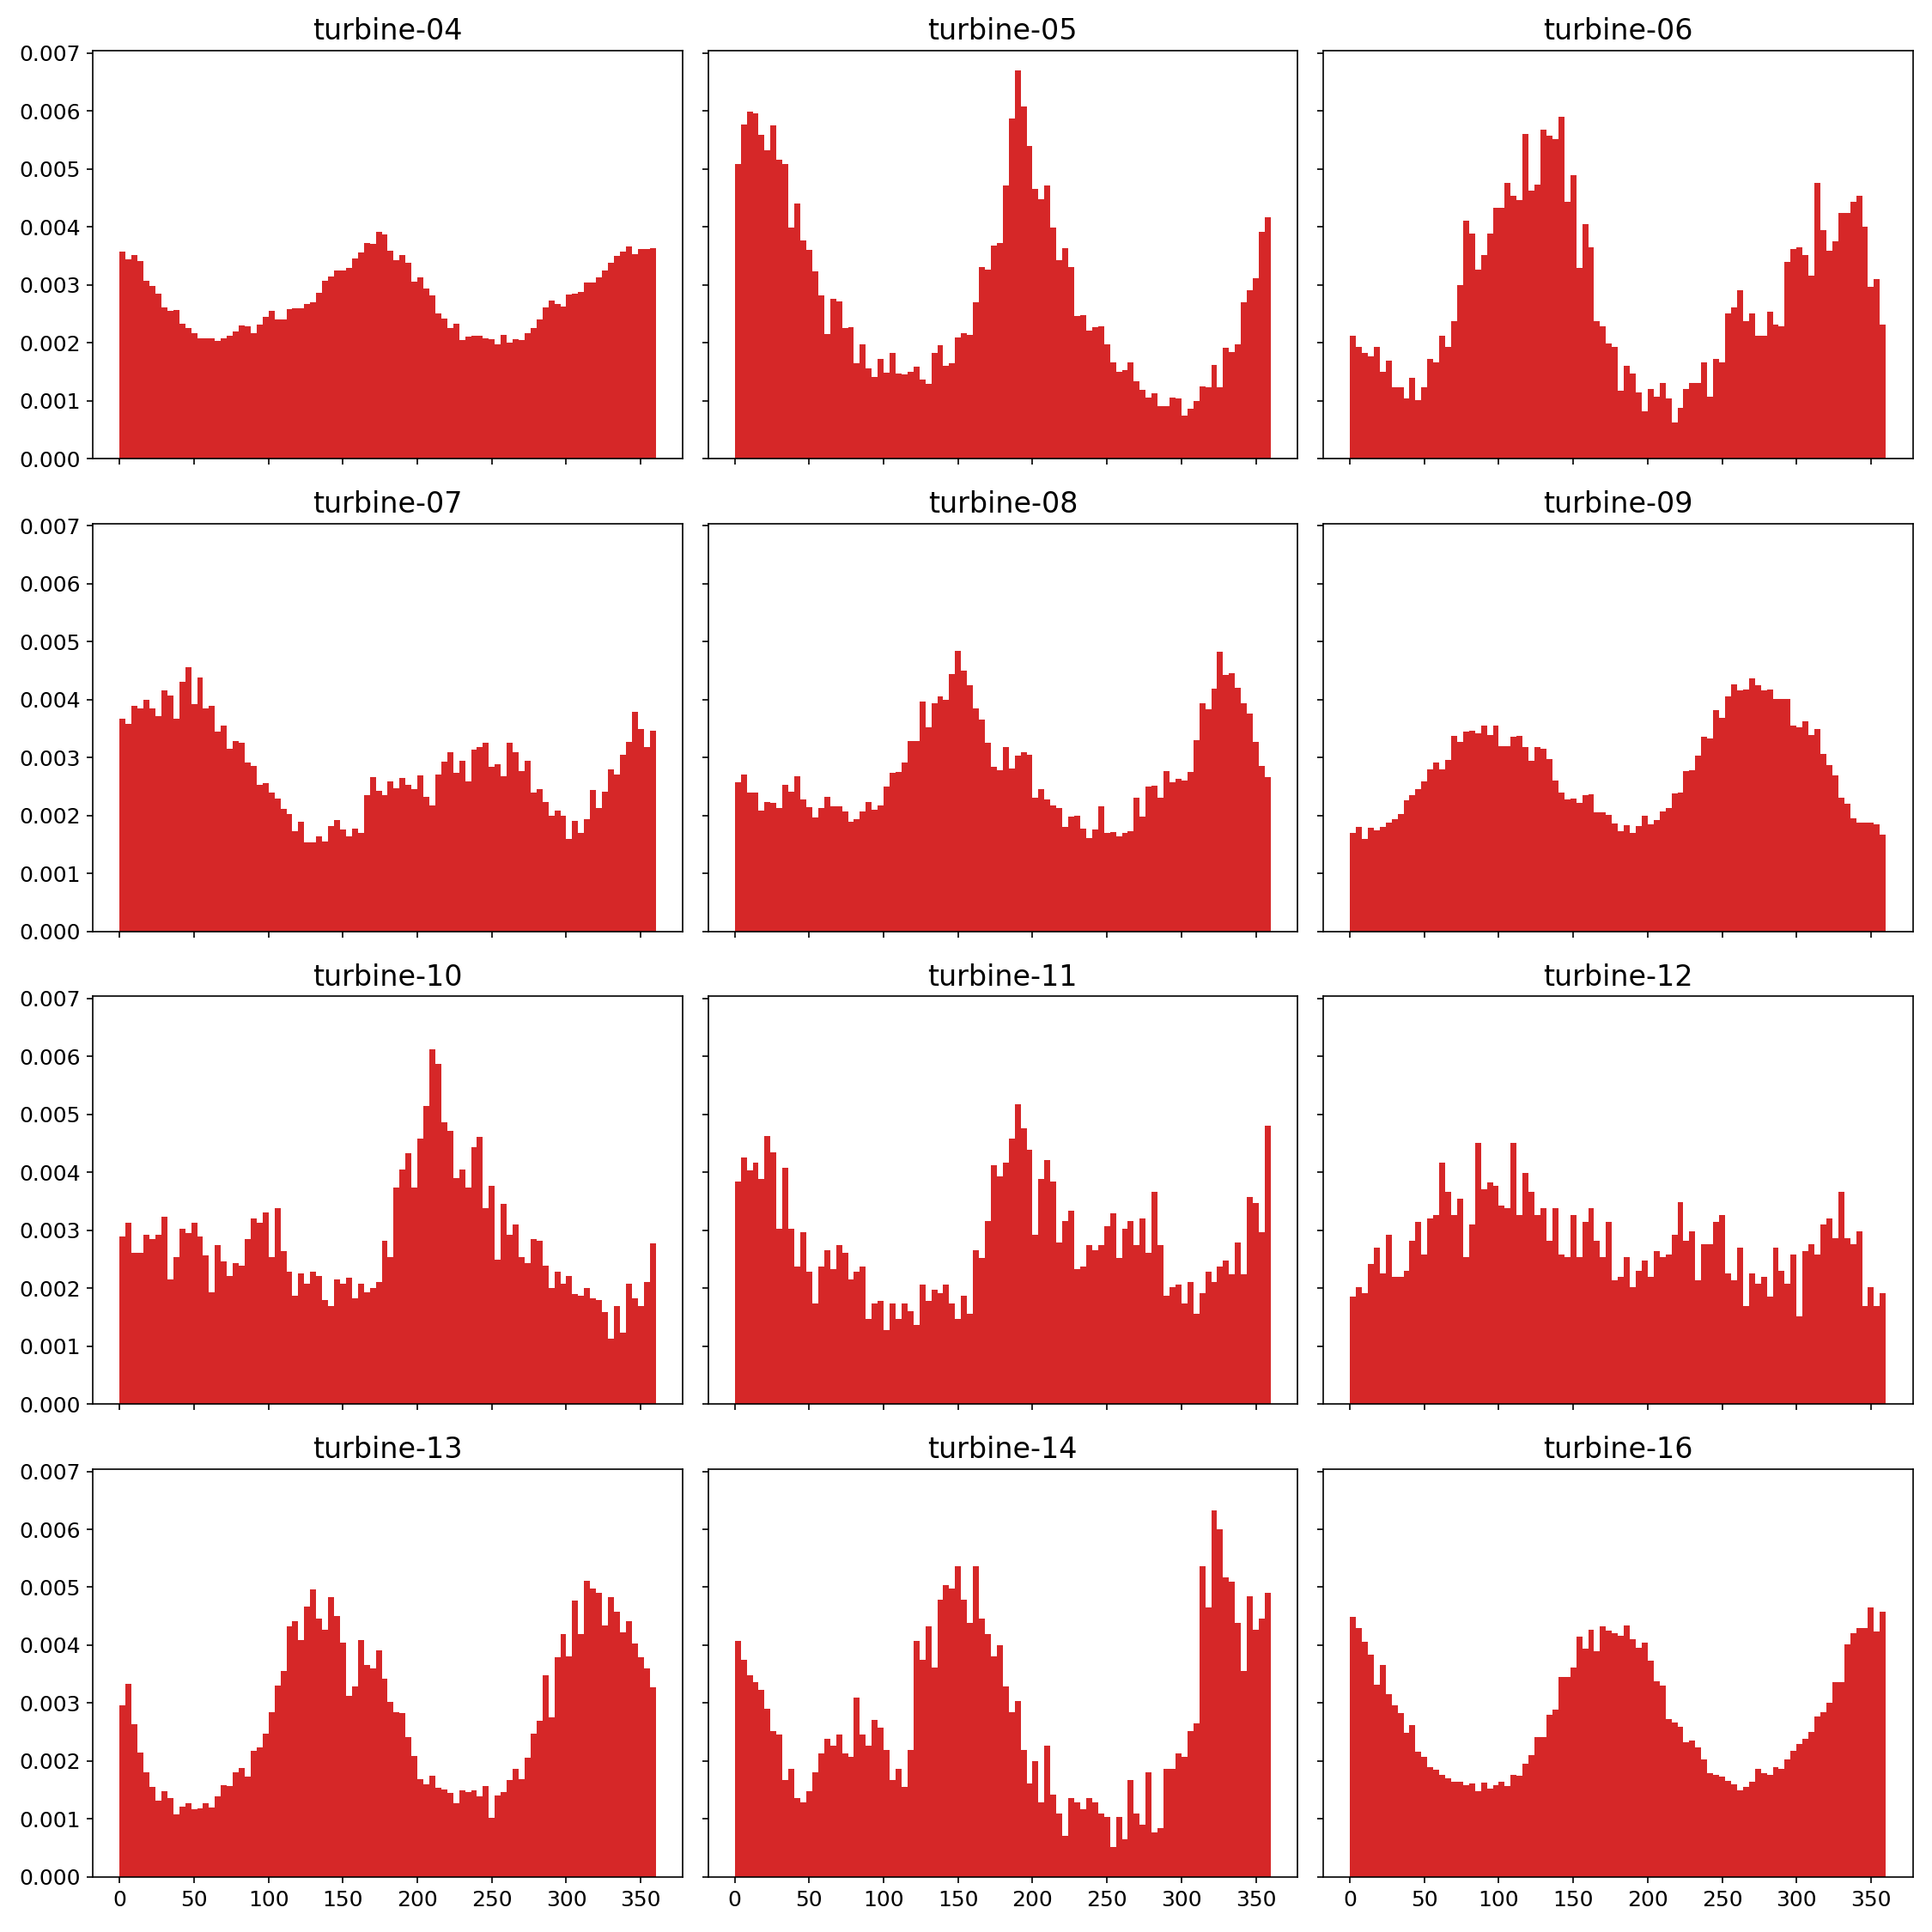
Distribution p2p angle

Slide 10
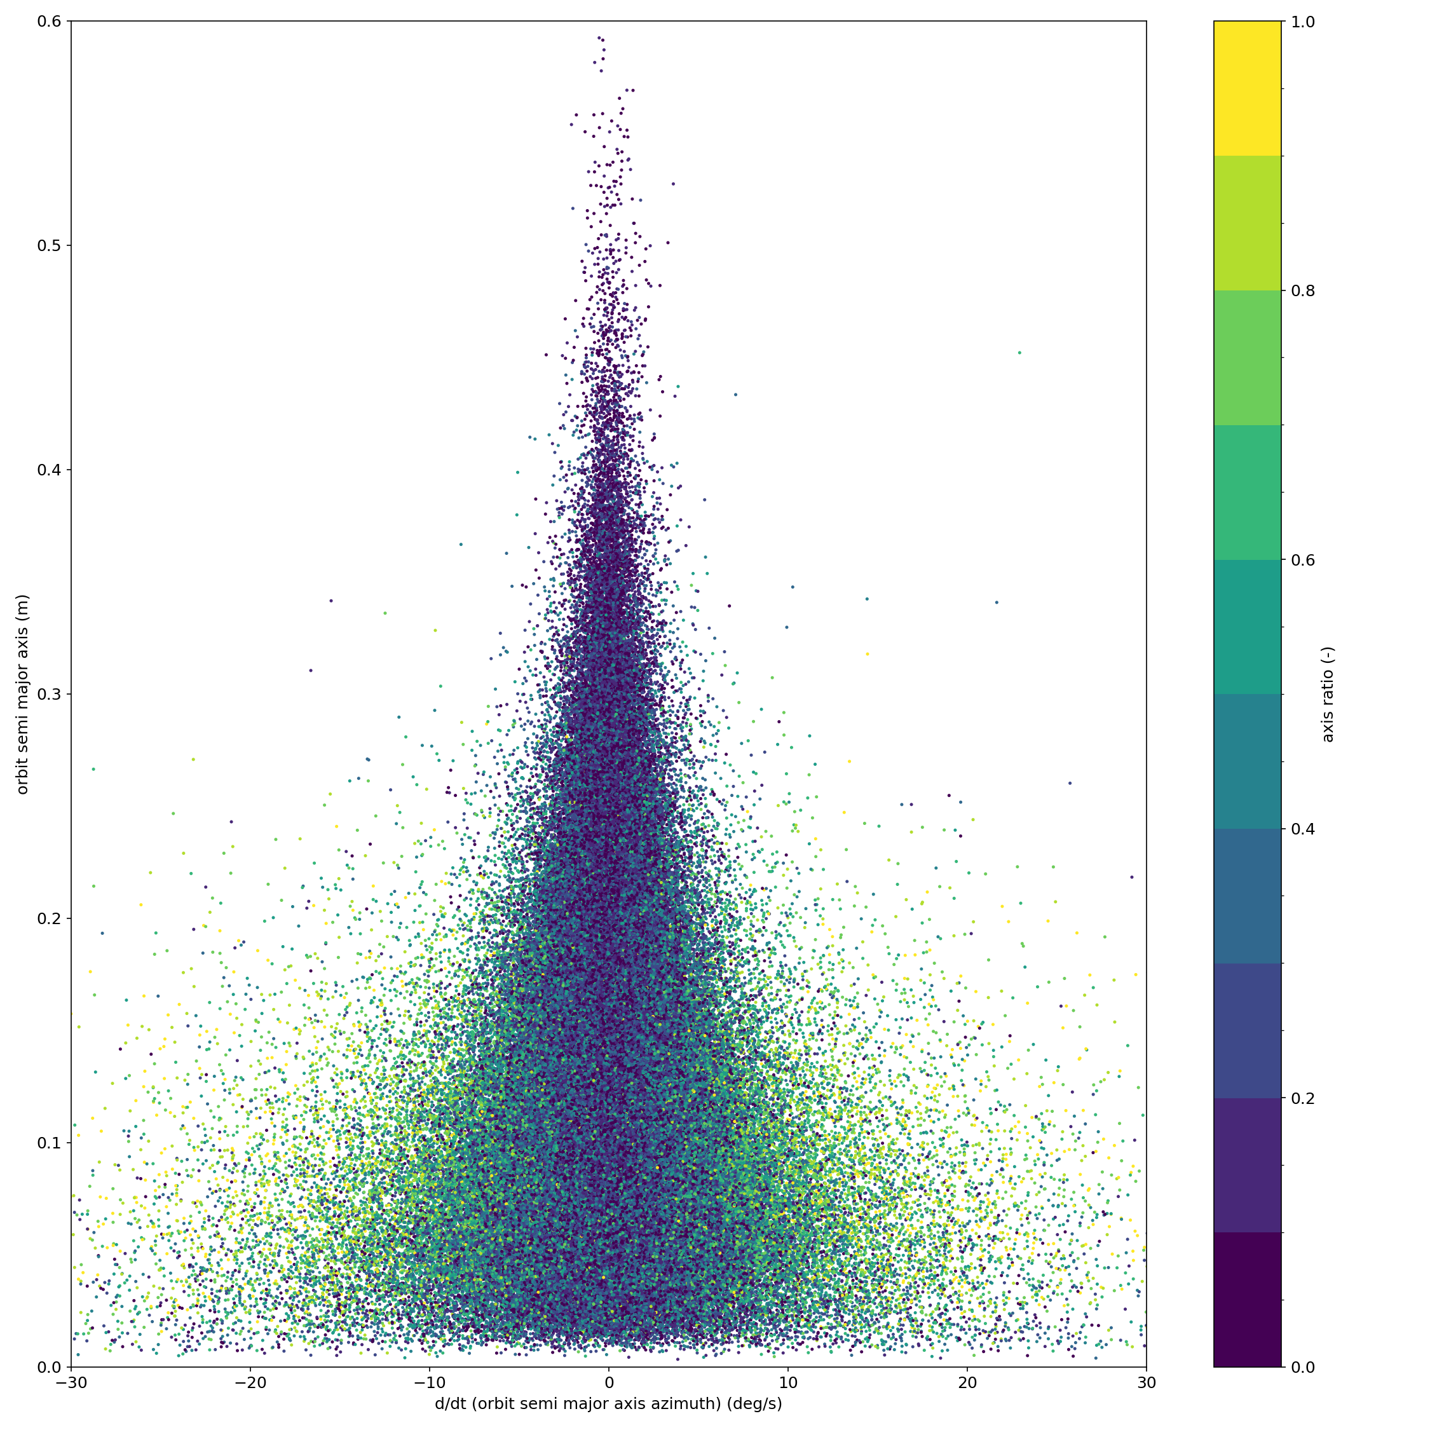
ddt p2p angle vs. max. deflection

Slide 11
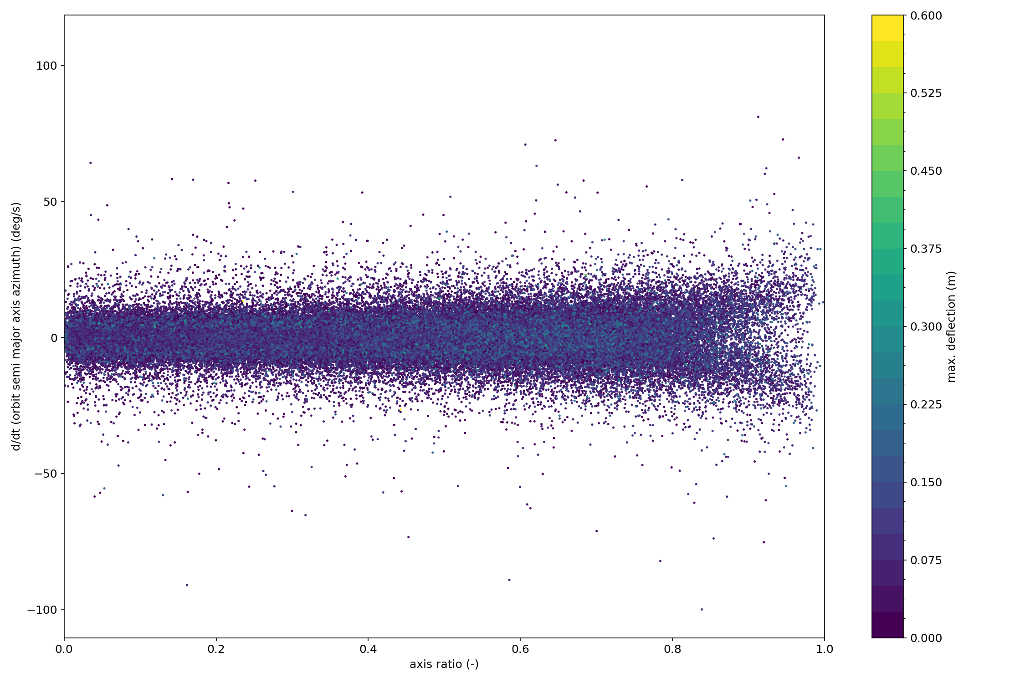
Distribution p2p angle

Slide 12
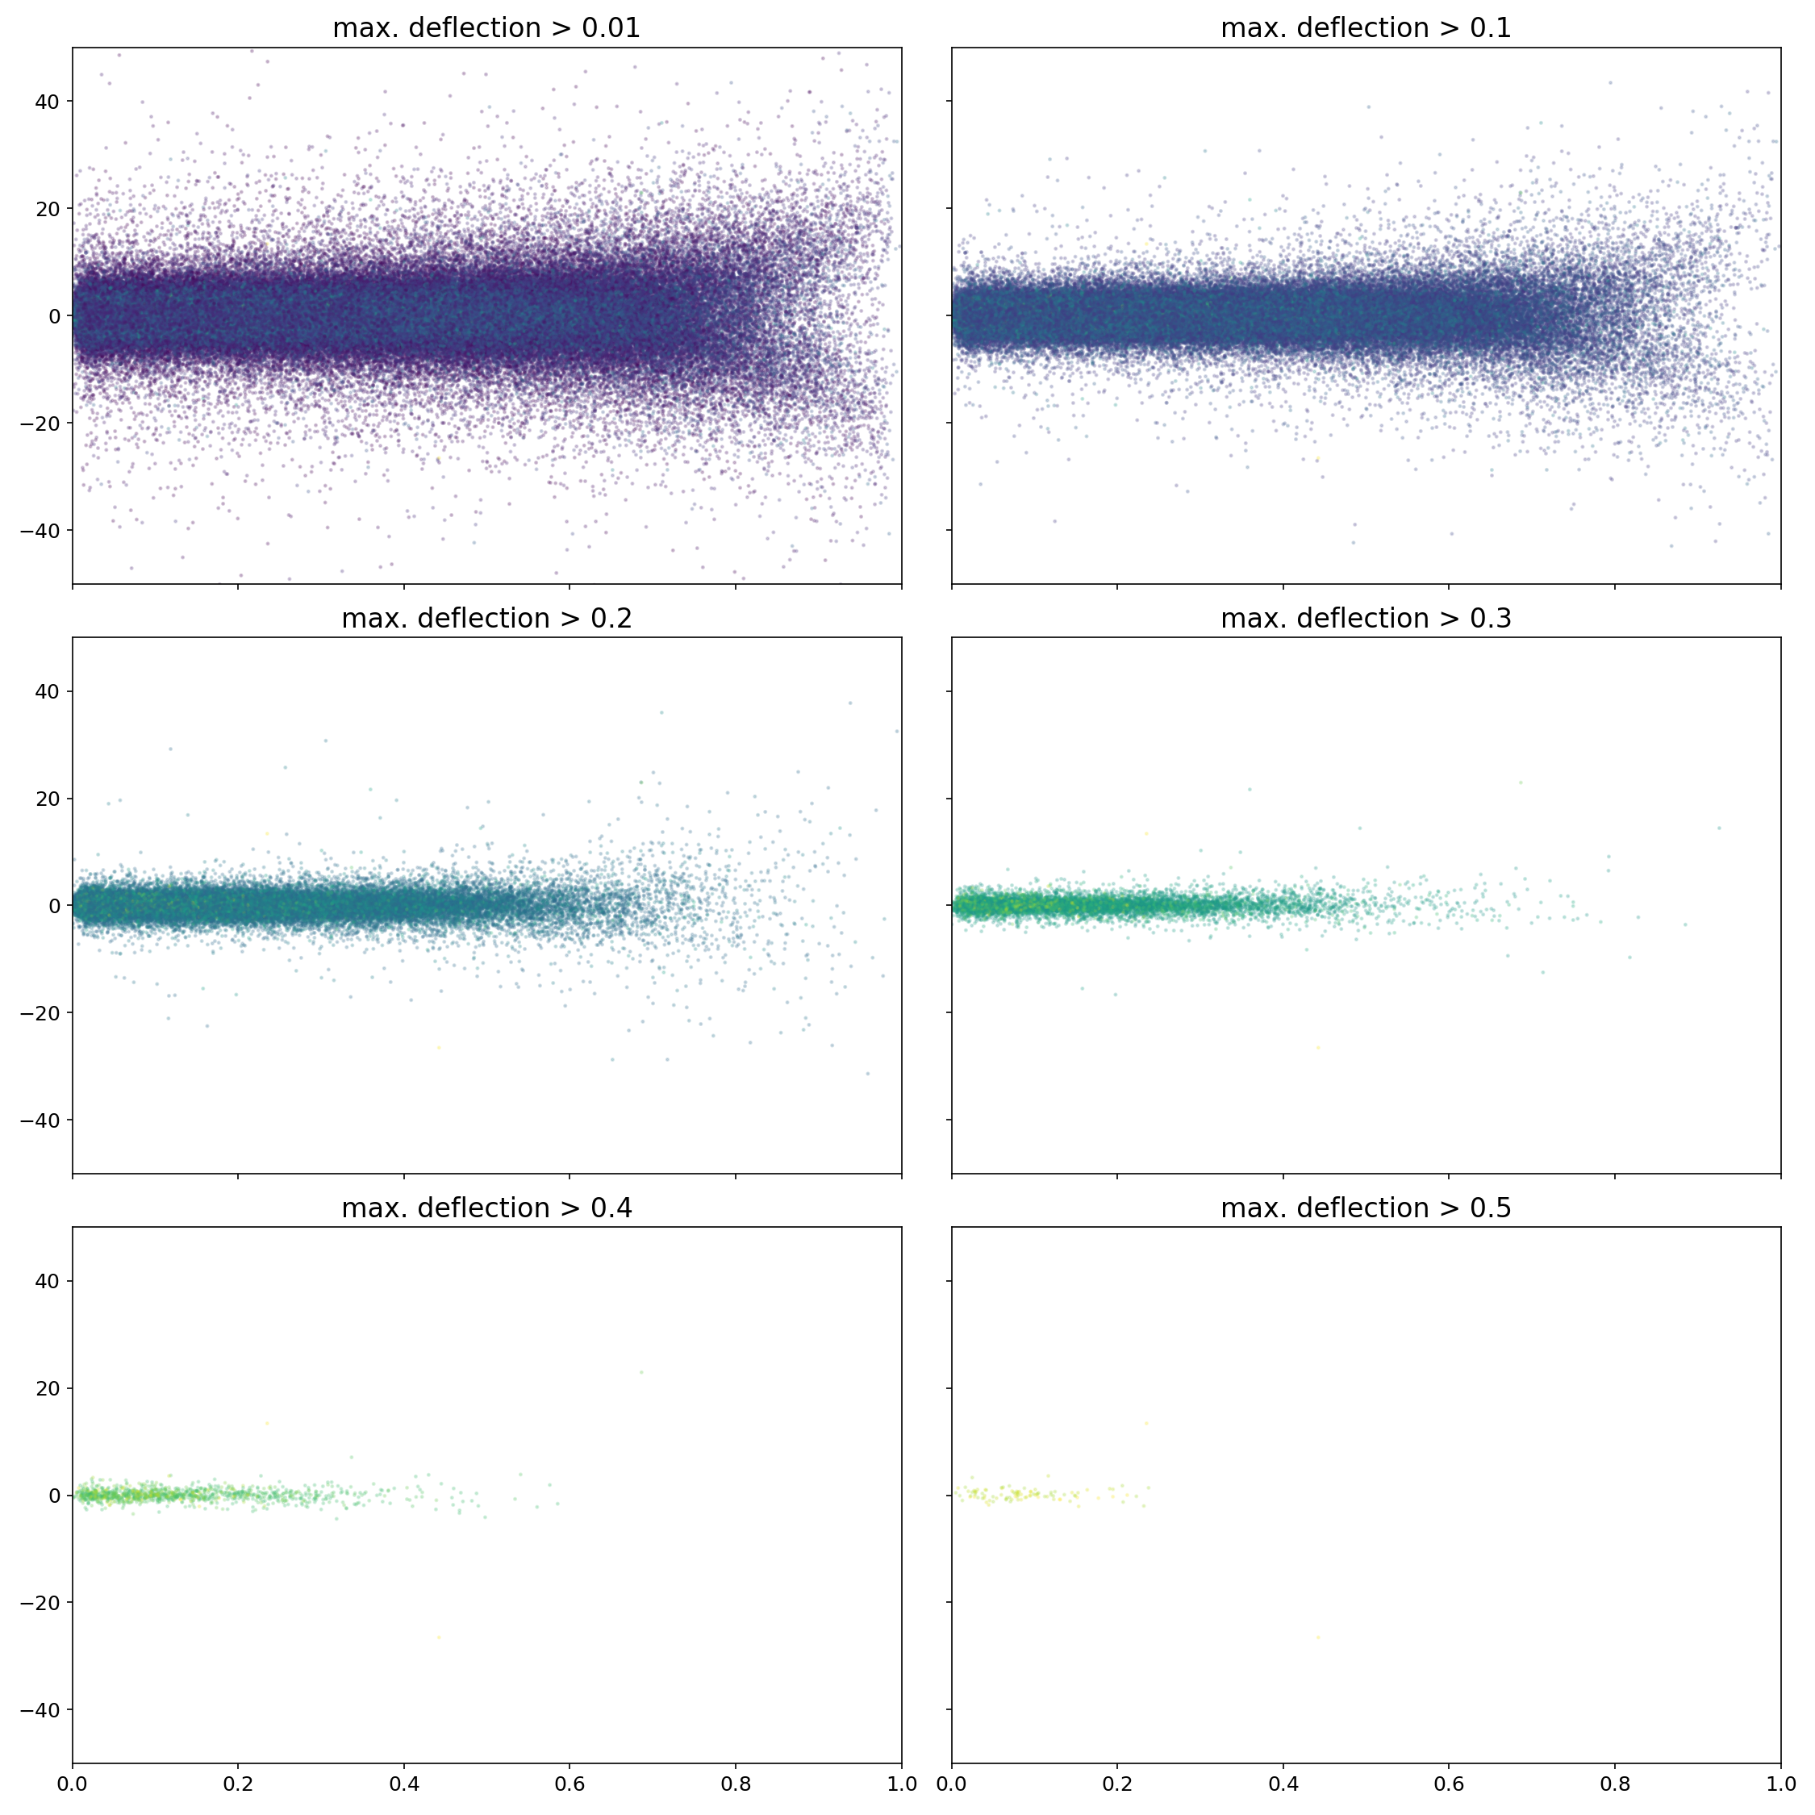
Distribution axis ratio

Slide 13
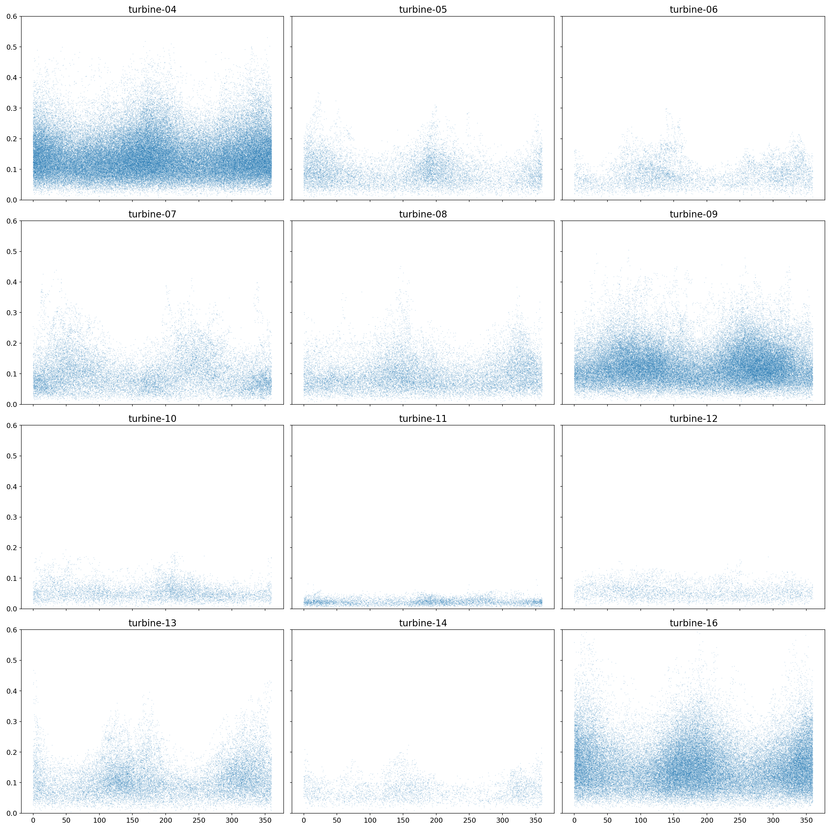
p2p angle distribution
p2p angle vs. max. deflection

