Slide 1
SNU CSE
Database : Advanced SQL
4조 : 예브게니, 윤진주, 정현호
2016. 05. 05

Slide 2
“
”
SQL Functions
Define a function
Calling a function within a query
create function dept_count(dept_name varchar(20))
returns integer
begin
declare d_count integer;
select count(*) into d_count
from instructor
where instructor.dept_name= dept_name
return d_count;
end
select dept_name, budget
from instructor
where dept _ount(dept_name) > 12;
SQL allows the definition of functions, procedures, and methods.
This function can be used in a query that returns names and budgets of all departments with
more than 12 instructors

Slide 3
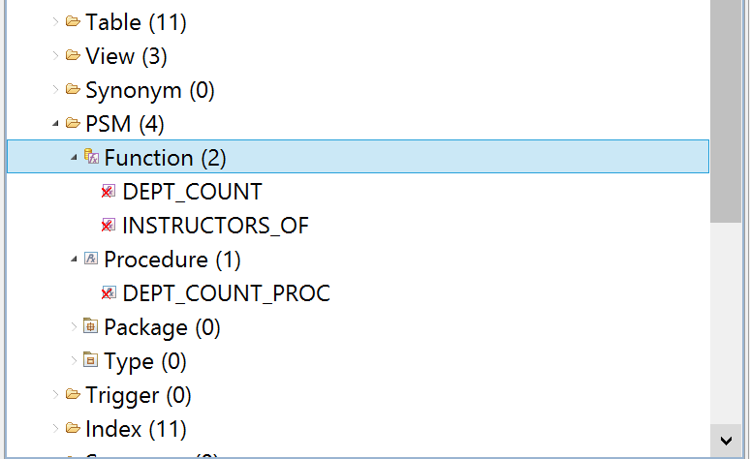
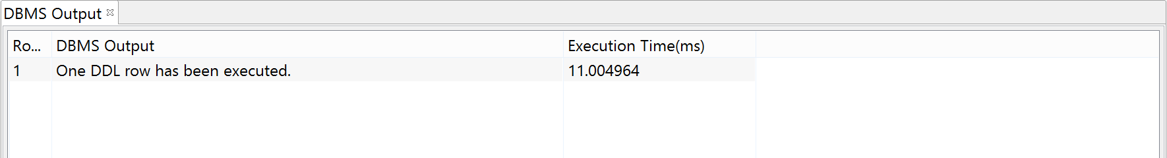
“
”
SQL Functions
create function dept_count(dept_name varchar(20))
returns integer
begin
declare d_count integer;
select count(*) into d_count
from instructor
where instructor.dept_name= dept_name
return d_count;
end
Functions in Tibero can be created
the same way as it is described in
our book

Slide 4
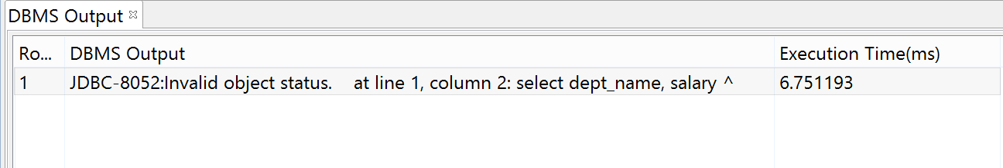

“
”
SQL Functions
create function dept_count(dept_name varchar(20))
returns integer
begin
declare d_count integer;
select count(*) into d_count
from instructor
where instructor.dept_name= dept_name
return d_count;
end
However when try to use a function in a query Tibero returns us an error

Slide 5
“
”
SQL Table Functions
Define a table function
Calling a function within a query
create function instructors of (dept_name varchar(20))
returns table (
ID varchar (5),
name varchar (20),
dept_name varchar (20),
salary numeric (8,2))
return table
(select ID, name, dept_name, salary
from instructor
where instructor.dept_name = instructor of.dept_name);
select *
from table(instructor of (’Finance’));
The SQL standard supports functions that can return tables as results
This function return all accounts owned by a given customer
Note that the function’s parameter is referenced by prefixing it with the name of the function (instructor of.dept name).
In general, however, table-valued functions can be thought of as parameterized views that
generalize the regular notion of views by allowing parameters.

Slide 6
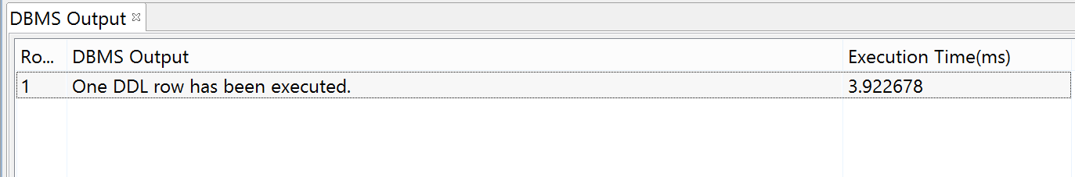
“
”
SQL Table Functions
create function instructors of (dept_name varchar(20))
returns table (
ID varchar (5),
name varchar (20),
dept_name varchar (20),
salary numeric (8,2))
return table
(select ID, name, dept_name, salary
from instructor
where instructor.dept_name = instructor of.dept_name);
Table Functions in Tibero can be created the same way as it is described in our book

Slide 7
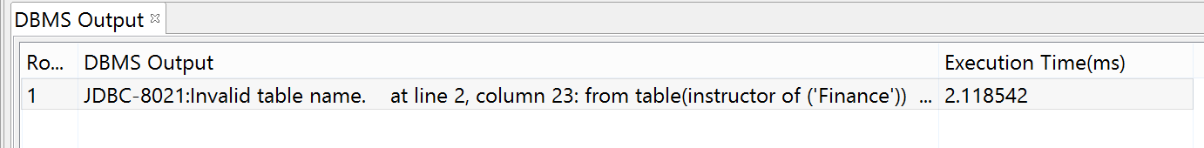
“
”
SQL Table Functions
create function instructors of (dept_name varchar(20))
returns table (
ID varchar (5),
name varchar (20),
dept_name varchar (20),
salary numeric (8,2))
return table
(select ID, name, dept_name, salary
from instructor
where instructor.dept_name = instructor of.dept_name);
However when try to use a function in a query Tibero returns us an error

Slide 8
“
”
SQL Procedures
Create procedure
Calling a statement
create procedure dept_count_proc(in dept_name varchar(20),
out d_count integer)
begin
select count(*) into d_count
from instructor
where instructor.dept_name= dept_count_proc.dept_name
end
declare d_count integer;
call dept_count_proc(’Physics’, d_count);
SQL allows the definition of procedures.
Defining them as stored procedures in the database has several advantages:
- Allows multiple applications to access the procedures
- Allows a single point of change, without changing other
parts of the application. Application code can then call the stored
procedures, instead of directly updating database relations.

Slide 9
“
”
SQL Procedures
create function dept_count(dept_name varchar(20))
returns integer
begin
declare d_count integer;
select count(*) into d_count
from instructor
where instructor.dept_name= dept_name
return d_count;
end
create procedure dept_count_proc(in dept_name varchar(20),
out d_count integer)
begin
select count(*) into d_count
from instructor
where instructor.dept_name=
dept_count_proc.dept_name
end
The dept_count function could instead be written as a procedure
SQL permits more than one procedure of the same name, so long as the number
of arguments of the procedures with the same name is different.

Slide 10
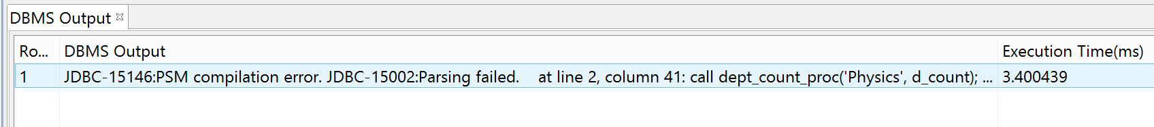
“
”
SQL Procedures
Create procedure
Calling a statement
create procedure dept_count_proc(in dept_name varchar(20),
out d_count integer)
begin
select count(*) into d_count
from instructor
where instructor.dept_name= dept_count_proc.dept_name
end
declare d_count integer;
call dept_count_proc(’Physics’, d_count);
Calling a procedure in Tibero gives us a compilation error

Slide 11
”
“
SQL Procedural Constructs
While and repeat statements
For loop
while boolean expression do
sequence of statements;
end while
repeat
sequence of statements;
until boolean expression
end repeat
declare n integer default 0;
for r as
select budget from department
where dept name = ‘Music‘
do
set n = n− r.budget
end for
A compound statement is of the form begin . . . end, and it may contain multiple SQL statements between the begin and the end.
SQL:1999 supports the while statements and the repeat statements
for loop that permits iteration over all results of a query

Slide 12

“
SQL Procedural Constructs
”
create function registerStudent(
in s_id varchar(5),
in s_courseid varchar(8),
in s_secid varchar(8),
in s_semester varchar(6),
in s_year numeric(4,0),
out errorMsg varchar(100)
returns integer
begin
declare currEnrol int;
select count(*) into currEnrol
from takes
where course_id=s_courseid and sec_id=s_secid
and semester=s_semester and year=s_year;
declare limit int;
select capcity into limit
from classroom natural join section
where course_id=s_course_id and sec_id=s_secid
and semester=s_semester and year=s_year;
if(corrEnrol < limit)
begin
insert into takes values
(s_id, s_courseid, s_secid, s_semester, s_year, null);
return (0);
end
set errorMsg='Enrollment limit reached for course' || s_course_id || 'section' || s.secid;
return (-1);
Example procedure : Register a student after ensuring classroom capacity is not exceeded
-> Returns 0 on success and -1 if capacity is exceeded
The function is created well in Tibero. But it’s not working
OK

Slide 13
“
”
Exception Handling mechanism
declare out_of_classroom_seats condition
declare exit handler for out_of_classroom_seats
Begin
…
Some code
…
If (자리가 더 없으면) then signal out_of_classroom_seats
Else continue
end
Declare ~ condition, signal : This Syntax is not supported by Tibero
(-> Declare exception name Exception,
Raise exception name in Tibero)
Handler for : This Syntax doesn’t exist in Tibero
(-> When ~ then in Tibero)
Referenced by Tibero 5.1 menual

Slide 14
“
”
Exception Handling mechanism in Tibero
DECLARE a NUMBER := 5; b NUMBER := 0;
BEGIN
a := a / b;
EXCEPTION
WHEN OTHERS THEN
handle_numeric_error(b);
END;
System Exception Definition in Tibero 5.1 Manual
In Tibero, We can do exception handling by using System defined exception ,user defined exception, exception handling routine
We executed example in Tibero 5.1 Manual but an error occurred

Slide 15


“
”
Functions/Procedures written in External PL
create procedure dept_count_proc(in dept_name varchar(20), out count integer)
language C
external name '/usr/avi/bin/dept_count_proc'
create function dept_count(dept_name varchar(20))
returns integer
language C
external name '/usr/avi/bin/dept_count'
We can make function and procedure outside of SQL and call in SQL
It was executed but it may not work
OK

Slide 16
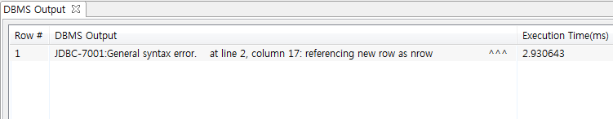
“
”
Triggers : Trigger Example
SQL> create trigger timeslot_check1 after insert on section
referencing new row as nrow
for each row
when (nrow.time_slot_id not in (
select time_slot_id
from time_slot))
begin
rollback
end;
Since the syntax of SQL statements in Tibero is slightly different from that of our textbook, a general syntax error occurs.
More information on the next slide

Slide 17
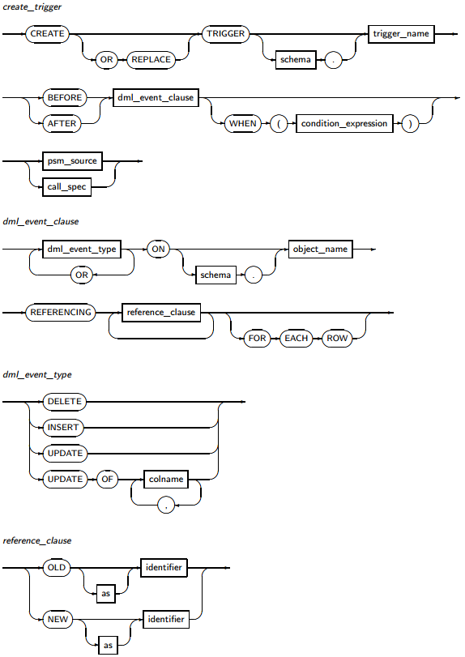
“
”
Triggers : Trigger Example
The syntax of SQL statements in Tibero is shown on the left side.
It’s from Tibero RDBMS SQL Reference Guide
We have to rewrite the query in below format:
CREATE TRIGGER trigger_name
AFTER INSERT ON schema
REFERENCING NEW as identifier
Replace NEW row with NEW (erase row)
FOR EACH ROW
WHEN ( condition_expression )
psm_source;

Slide 18
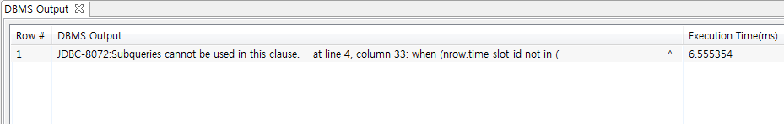
“
”
Triggers : Trigger Example
SQL> create trigger timeslot_check1 after insert on section
referencing new as nrow
for each row
when (nrow.time_slot_id not in (
select time_slot_id
from time_slot))
begin
rollback
end;
A different error occurs, despite modifying the statement to comply with Tibero SQL syntax.
In Tibero, subqueries cannot be used in when statement.
How can we solve this problem?

Slide 19
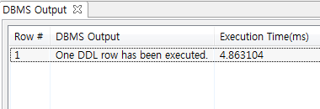
“
”
Triggers : Trigger Example
SQL> create trigger timeslot_check1 after insert on section
referencing new as nrow
for each row
begin
case when (nrow.time_slot_id not in (
select time_slot_id
from time_slot))
then rollback
end
end;
A different error occurs, despite modifying the statement to comply with Tibero SQL syntax.
In Tibero, subqueries cannot be used in when statement.
How can we solve this problem?
We can check the condition with case statement!
OK

Slide 20
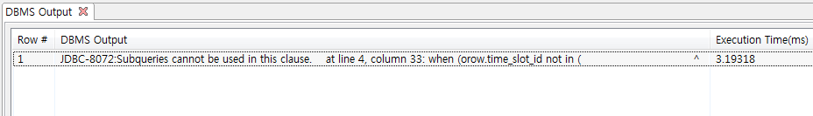
“
”
Triggers : Trigger Example
SQL> create trigger timeslot_check2 after delete on time_slot
referencing old as orow
for each row
when (orow.time_slot_id not in (
select time_slot_id
from time_slot)
and orow.time_slot_id in (
select time_slot_id
from section))
begin
rollback
end;
The same error regarding subqueries in with statement occurs.
Then, let’s fix it with case statement!

Slide 21
“
”
Triggers : Trigger Example
SQL> create trigger timeslot_check2 after delete on time_slot
referencing old as orow
for each row
begin
case when (orow.time_slot_id not in (
select time_slot_id
from time_slot)
and orow.time_slot_id in (
select time_slot_id
from section))
then rollback
end
end;
The same error regarding subqueries in with statement occurs.
Then, let’s fix it with case statement!
OK

Slide 22
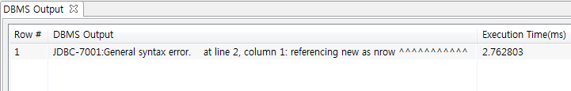
“
”
Triggers : Triggering Events and Actions in SQL
SQL> create trigger setnull_trigger before update of takes
referencing new as nrow
for each row
when (nrow.grade = ' ')
begin atomic
set nrow.grade = null
end;
A weird syntax error occurs.
It seems that the syntax completely complies with the syntax in Tibero SQL document, but it’s not working.
Then, what is the problem?

Slide 23
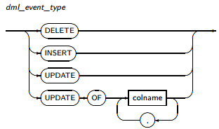
“
”
Revisited : Tibero RDBMS SQL Reference
There is UPDATE OF clause supported in CREATE TRIGGER statement
However, the argument given to UPDATE OF statement is ‘colname’, not ‘schema’!
We have to use UPDATE (ON), instead of UPDATE OF, to pass ‘schema’ as an argument.

Slide 24
“
”
Triggers : Triggering Events and Actions in SQL
SQL> create trigger setnull_trigger before update on takes
referencing new as nrow
for each row
when (nrow.grade = ' ')
begin atomic
set nrow.grade = null
end;
A weird syntax error occurs.
It seems that the syntax completely complies with the syntax in Tibero SQL document, but it’s not working.
Then, what is the problem?
Replace ‘of’ with ‘on’!
Now it’s working fine!
OK

Slide 25
“
”
Triggers : Trigger to Maintain credits_earned value
SQL> create trigger credits_earned after update of takes on (grade)
referencing new as nrow
referencing old as orow
for each row
when (nrow.grade <> 'F' and nrow.grade is not null
and (orow.grade = 'F' or orow.grade is null))
begin atomic
update student
set tot_cred = tot_cred +
(select credits
from course
where course.course_id = nrow.course_id)
where student.id = nrow.id;
end;
There are 2 problems in this SQL statement.
update on vs update of
Duplicate of referencing clause

Slide 26
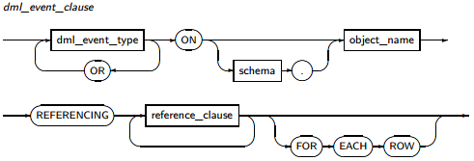
“
”
Revisited : Tibero RDBMS SQL Reference
We have to comply with Tibero’s SQL syntax by replacing ‘update of takes on (grade)’ with ‘update of grade on takes’.
Also, duplicate of REFERENCING clause is not the part of Tibero’s syntax. Instead, we can use REFERENCING once, and repeat <reference_clause> as much as we need.
So we have to replace
‘referencing new as nrow / referencing old as orow’ with
‘referencing new as nrow / old as orow’.

Slide 27
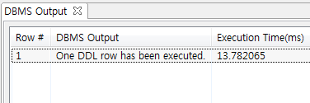
“
”
Triggers : Trigger to Maintain credits_earned value
SQL> create trigger credits_earned after update of grade on takes
referencing new as nrow
old as orow
for each row
when (nrow.grade <> 'F' and nrow.grade is not null
and (orow.grade = 'F' or orow.grade is null))
begin atomic
update student
set tot_cred = tot_cred +
(select credits
from course
where course.course_id = nrow.course_id)
where student.id = nrow.id;
end;
OK
After modifying the statement, it works just fine!

Slide 28
Compile Time Errors

Slide 29
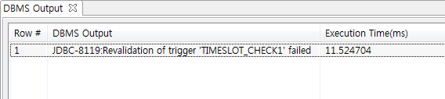
“
”
Triggers : Trigger Example
SQL> alter trigger timeslot_check1 enable;
insert into section
values ('BIO-101', 2, 'Fall', '2009', 'Painter', 514, 'Z');
How can we check whether trigger is working properly or not?
Let’s insert some values into section
A tuple whose time_slot_id value is ‘Z’, which is not in the table time_slot
It raises an error: Revalidation failed.

Slide 30
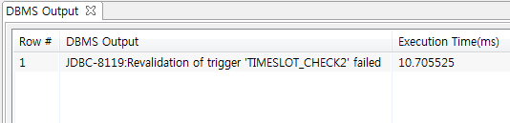
“
”
Triggers : Trigger Example
SQL> alter trigger timeslot_check2 enable;
delete from time_slot where time_slot_id = ‘H’;
Let’s delete a tuple from time_slot!
A tuple whose time_slot_id value is ‘H’, which is still referenced by a course with course_id ‘CS-101’
It raises an error: Revalidation failed.

Slide 31
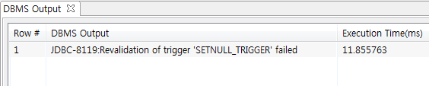
“
”
Triggers : Triggering Events and Actions in SQL
SQL> alter trigger setnull_trigger enable;
update takes set grade = ' ' where ID = '00128';
Let’s update a value in takes, and see the result.
It raises an error: Revalidation failed.

Slide 32
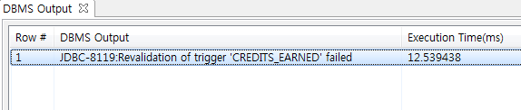
“
”
Triggers : Trigger to Maintain credits_earned value
SQL> alter trigger credits_earned enable;
update takes set grade = ‘B-’ where ID = ‘00128’;
Let’s update a value in takes, and see the result.
It raises an error: Revalidation failed.

Slide 33
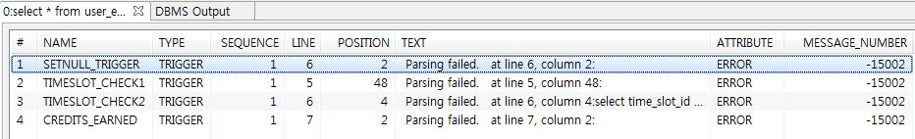
“
”
Compile issue in Tibero
SQL> select * from user_errors where type = 'TRIGGER';
What happened to those 4 triggers? They apparently have no problem at all!
We can browse errors regarding triggers by using the statement above.
All of them have parsing errors at compile time!
However, there is no problem in where those error messages point to.
So, it is assumed that parsing/compiling feature in Tibero has some problem.

